Slide 1


M6
MODULE 6 · 2:55–3:40
Documentation & Artifact Generation
Point the agent at the code and get a full suite — PRD, HLD, LLD, an architecture diagram, and a user guide — grounded in what’s really there.
August 05–08, 2026 · The Leela Bhartiya City, Bengaluru
Human × AI

Slide 2

“
Docs that write themselves — and stay true to the code.
Generated from the real codebase, not from imagination — and regenerated whenever the code changes, so they never go stale.
August 05–08, 2026 · The Leela Bhartiya City, Bengaluru
Human ×AI

Slide 3
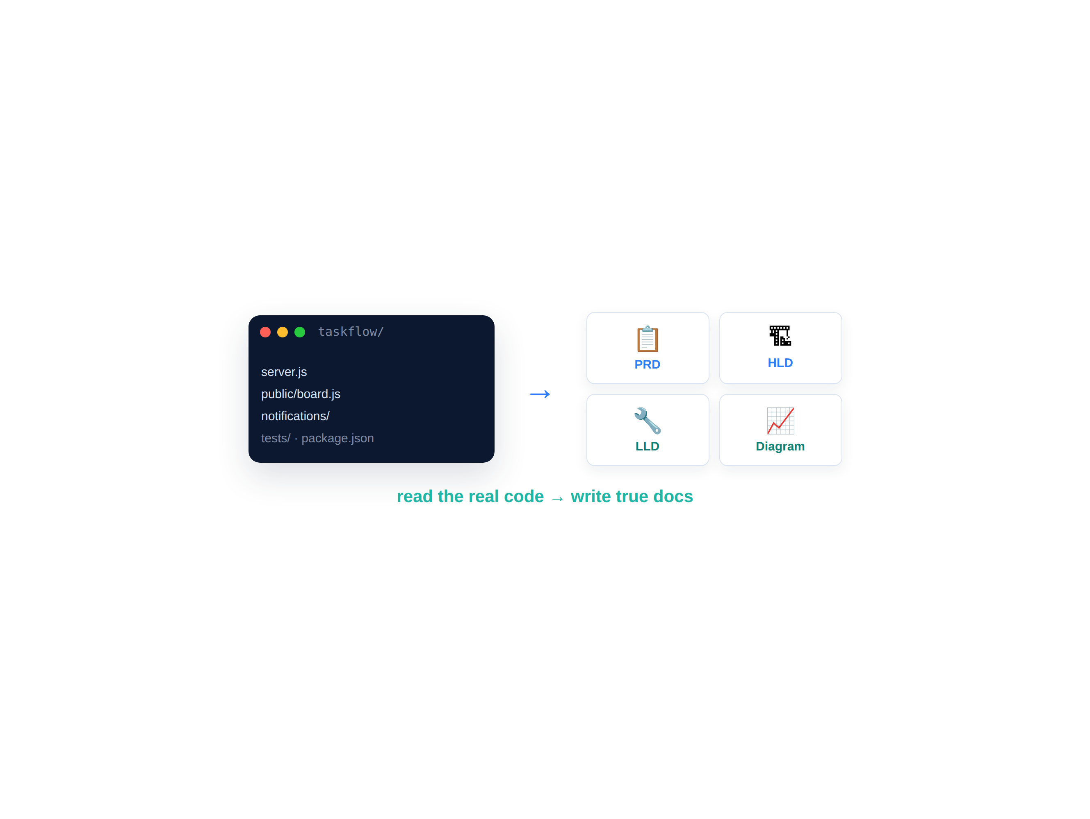


Docs from the code — not from imagination
Point the agent at the real repo; the docs describe what’s actually there.
Hand-written docs drift the moment code changes. Generating from the codebase grounds every doc in reality — and lets you regenerate on every change.
Read the repo, then write — no guessing
Every claim traces back to real code
Regenerate on change → no drift
Keep them alive in CI (that’s M7)
D A T A H A C K S U M M I T 2 0 2 6

Slide 4
PRDs in minutes — by interview
Don’t fill a blank template alone — let the agent interview you.
Interview-style prompting The agent asks the questions a good PM would; you just answer.
1 pg
From a conversation to a spec It turns your answers into a structured, testable PRD.
PRD — decision-ready
Retrofit for existing apps Point it at TaskFlow; it reverse-engineers the PRD from the code.
min
One page, decision-ready Problem, users, goals, scope, success metrics — no fluff.
to draft — not days
D A T A H A C K S U M M I T 2 0 2 6

Slide 5
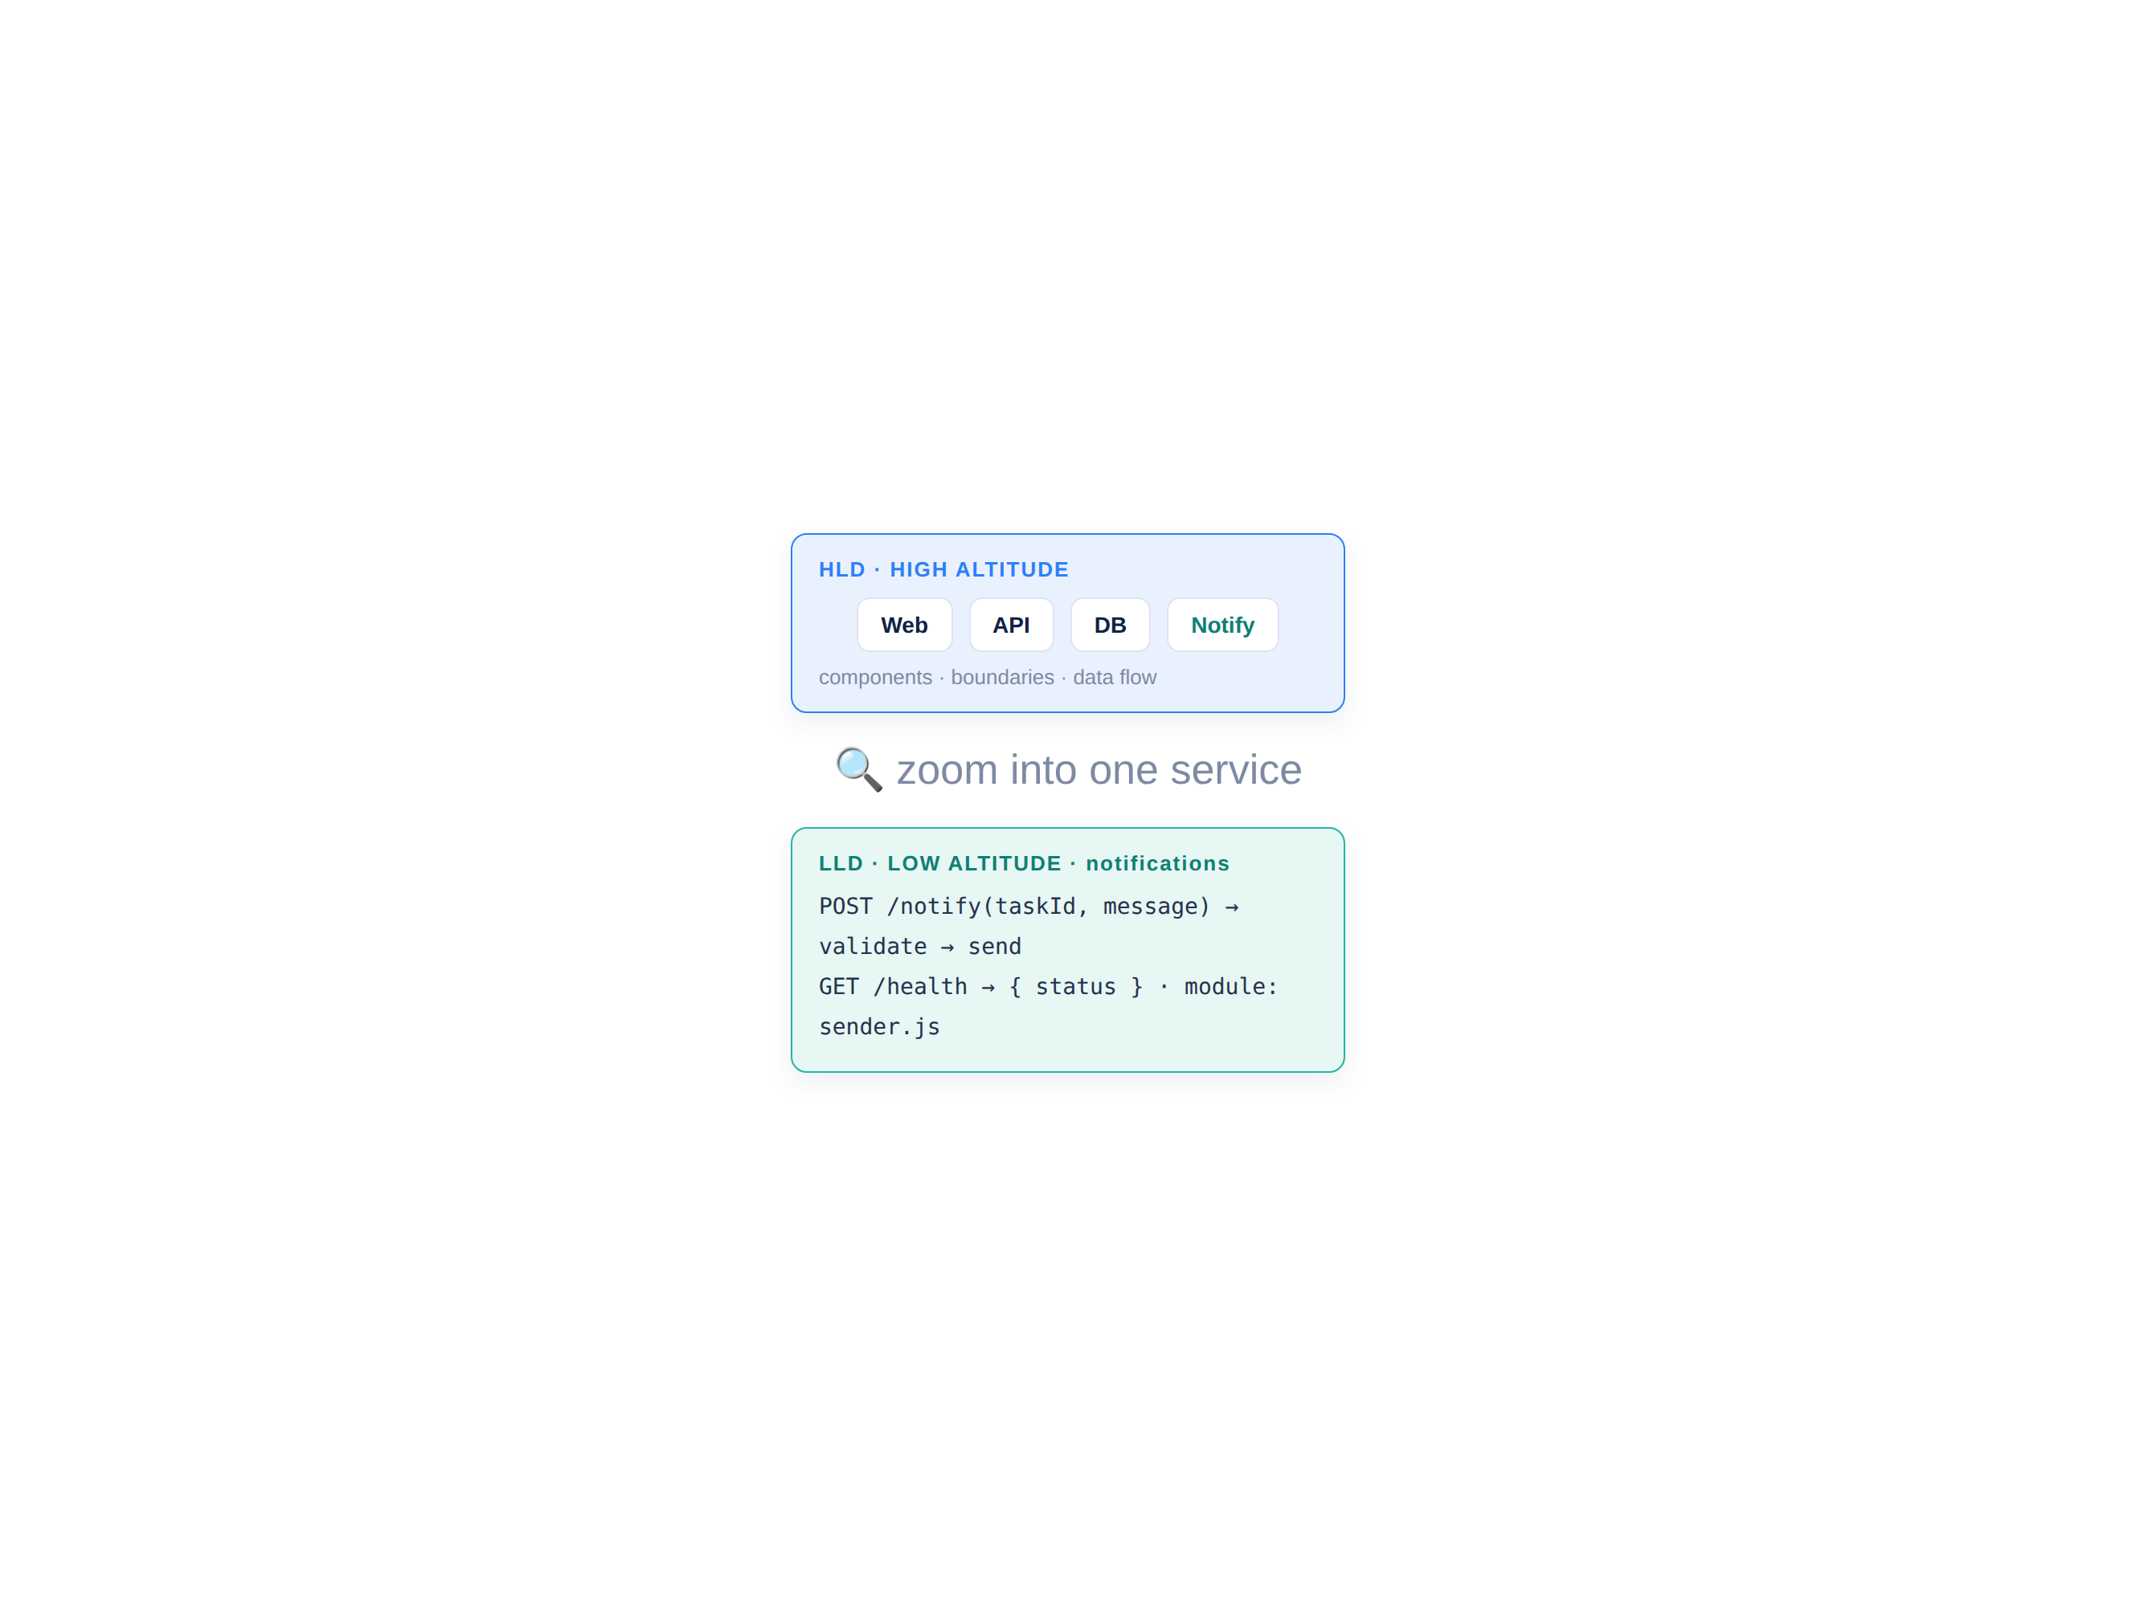
HLD & LLD — grounded in the codebase
Two altitudes of design — both read from the actual system.
The HLD tells the architecture story — components, data flow, choices. The LLD zooms into one service: its modules, functions and contracts. Both generated from code.
HLD: components, boundaries, data flow
LLD: one service, module by module
Read from code — not from memory
A design a new hire can actually follow
D A T A H A C K S U M M I T 2 0 2 6

Slide 6
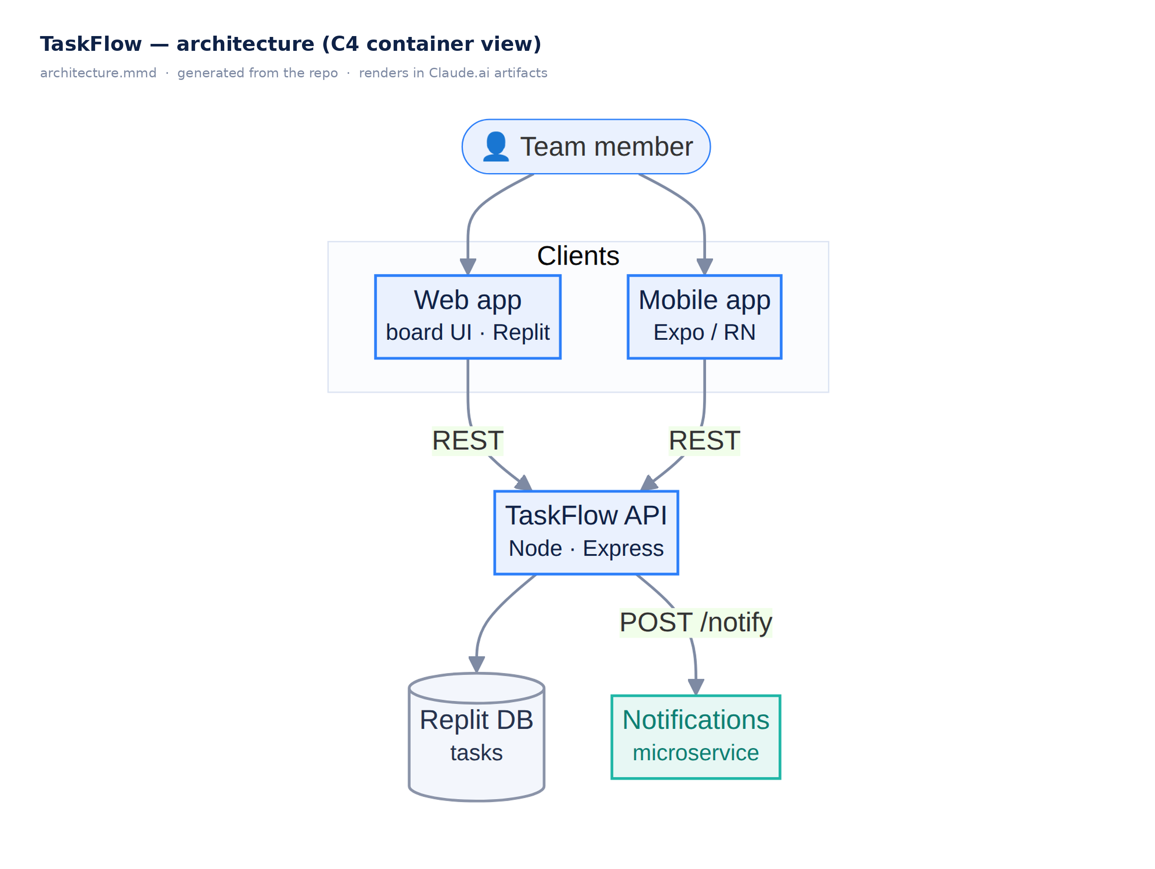
Architecture diagrams that reflect the real system
Diagrams as code — generated, versioned, regenerated on change.
Mermaid renders live in Claude.ai artifacts, GitHub and VS Code; C4 is the model, PlantUML/Structurizr the heavier tool. Text source means the diagram tracks the system.
Mermaid: text → diagram, renders everywhere
C4: context → container → component
PlantUML / Structurizr for formal C4
Regenerate from code — no stale boxes
D A T A H A C K S U M M I T 2 0 2 6

Slide 7
User guides & docs at scale
Docs for every audience — generated, and kept alive.
Non-technical user guides Plain-language how-tos from the same codebase — written for real users.
5
Docs-from-code READMEs, API docs and onboarding guides generated from the source.
doc types, one source of truth
Changelogs & release notes Summarized from commits and PRs — your M5 conventions apply.
CI
Keep docs alive in CI Regenerate on every merge so docs never lag the code (M7).
keeps every doc current
D A T A H A C K S U M M I T 2 0 2 6

Slide 8




The Build #5 pipeline — the whole suite
01
02
03
04
Point
Generate
Diagram
Peer-review
Aim Claude Code at your TaskFlow repos (web + service).
PRD, HLD, LLD and a user guide — all from the code.
An architecture diagram in Mermaid — render it live.
Score a neighbour’s PRD against the quality rubric.
A doc suite that used to take a team days — grounded in your real code, in 25 minutes.
D A T A H A C K S U M M I T 2 0 2 6

Slide 9
Module 6 — your files & the flow
File | What it is | When you use it
Build5_Lab_Guide.md | Step-by-step Build #5 | ① Follow during the lab
PRD_Quality_Rubric.md | Scoring rubric for peer review | ② Use to review a neighbour’s PRD
Doc_Generation_Prompt_Pack.md | Prompts for PRD/HLD/LLD/diagram/guide | Keep open while generating
examples/ (PRD · HLD · LLD · | A full TaskFlow doc suite — | “What good looks like” — compare
diagram · user-guide) | ready-made reference examples | your output against these
D A T A H A C K S U M M I T 2 0 2 6

Slide 10
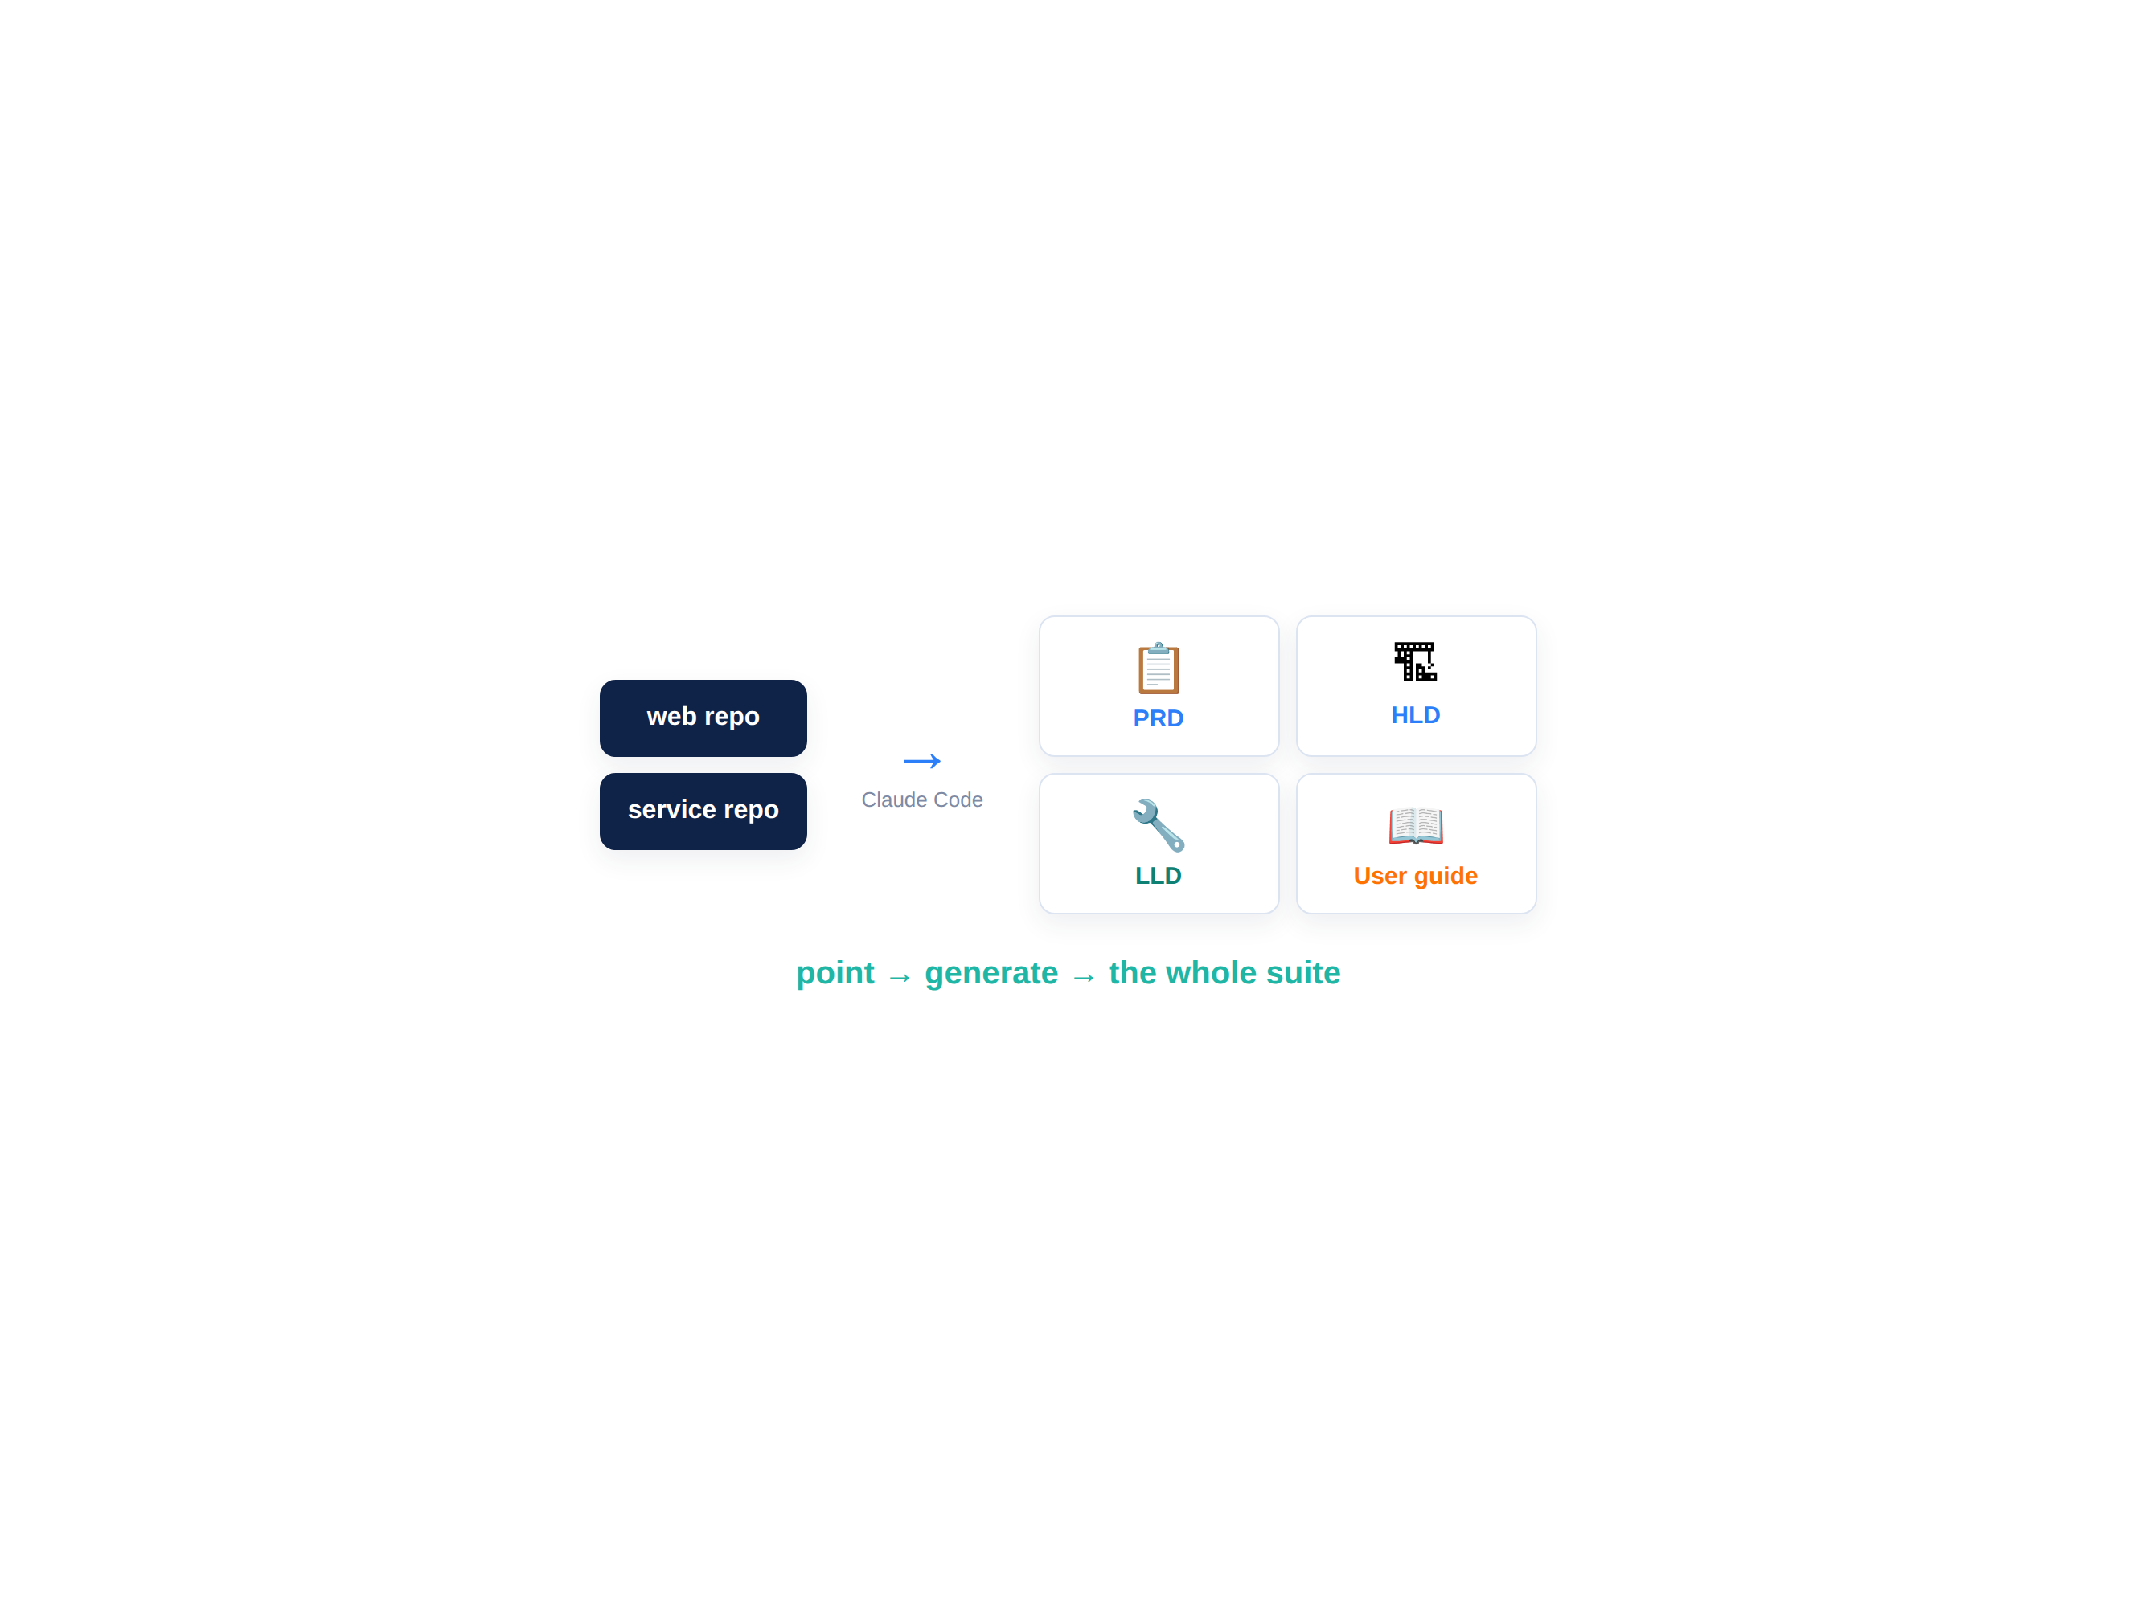
BUILD #5 — the full doc suite
Your task — 25 minutes
Generate five docs from your real code, then peer-review a PRD.
1-page PRD — retrofit from the code
HLD with a Mermaid architecture diagram
LLD for the notifications service
A non-technical user guide + peer review
Your files: Build5_Lab_Guide.md · PRD_Quality_Rubric.md · Doc_Generation_Prompt_Pack.md
D A T A H A C K S U M M I T 2 0 2 6

Slide 11
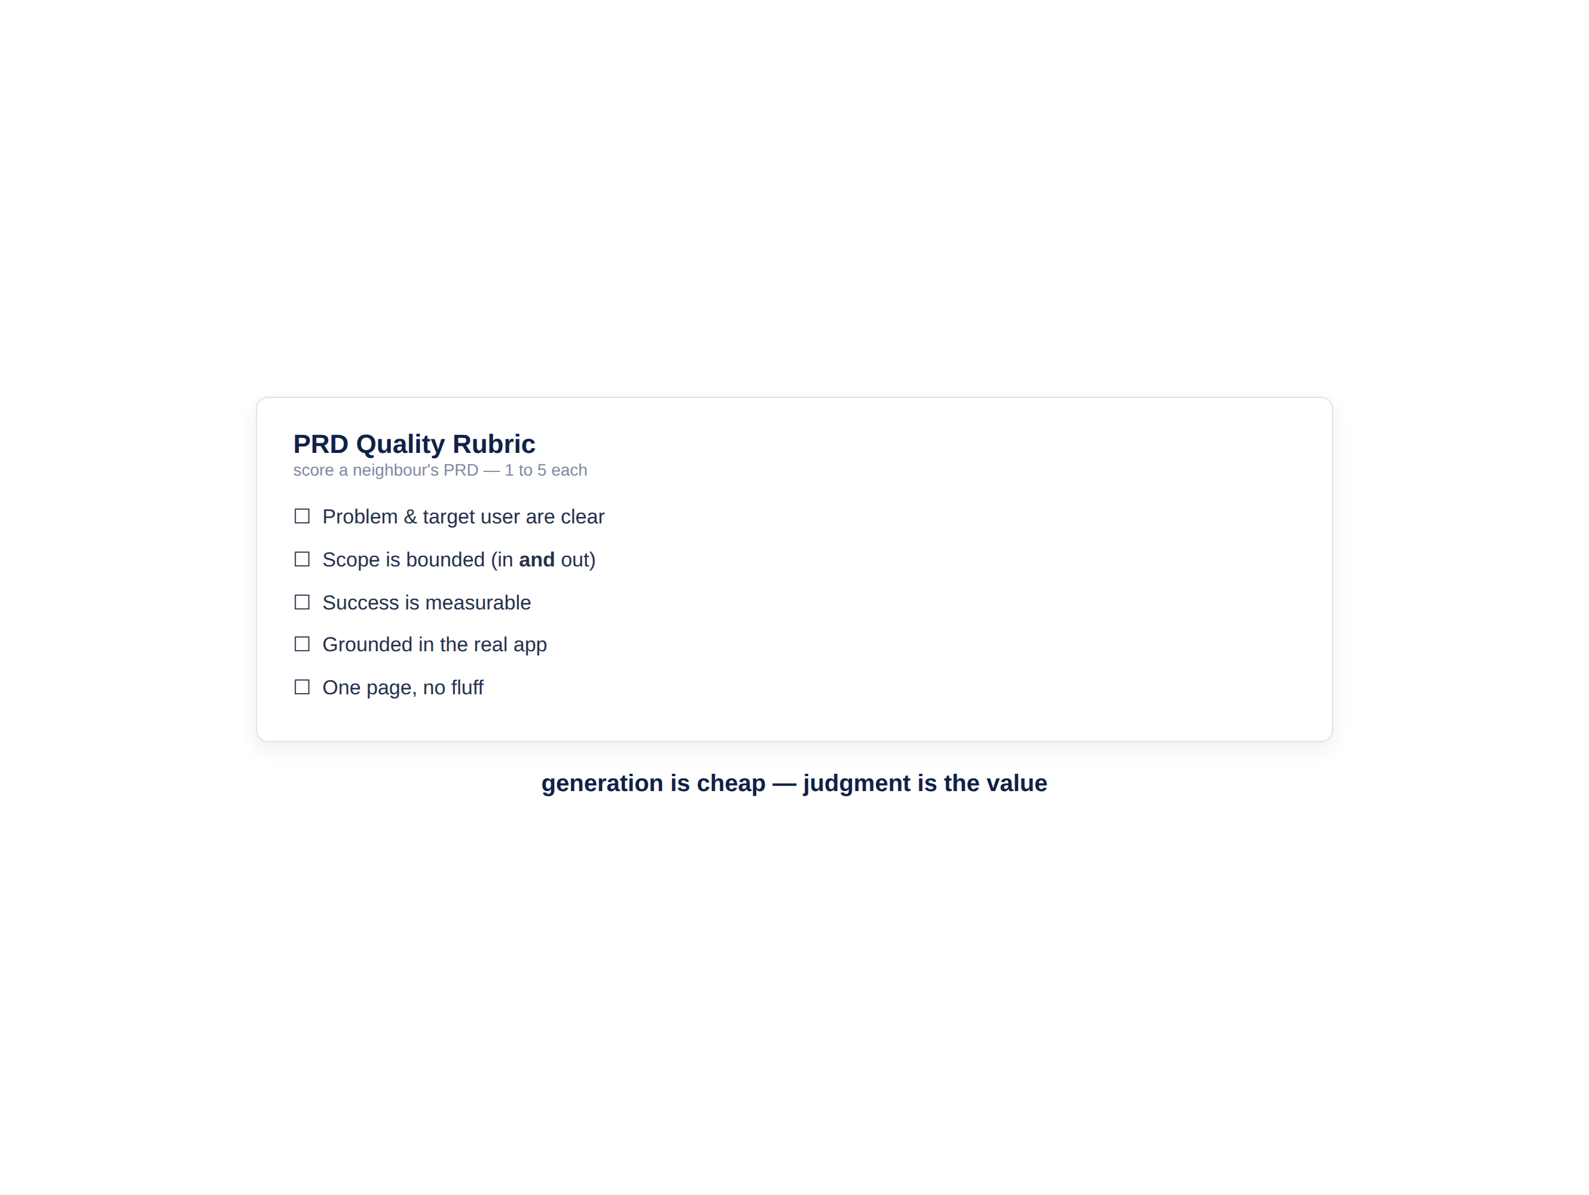
Peer review — score it against a rubric
AI drafts fast; a human rubric keeps the quality honest.
Swap PRDs with a neighbour and score theirs: is the problem clear, the scope bounded, success measurable? Generation is cheap — your judgment is the value.
Is the problem & target user clear?
Is the scope bounded — in and out?
Is success measurable?
Is it grounded in the real app?
D A T A H A C K S U M M I T 2 0 2 6

Slide 12
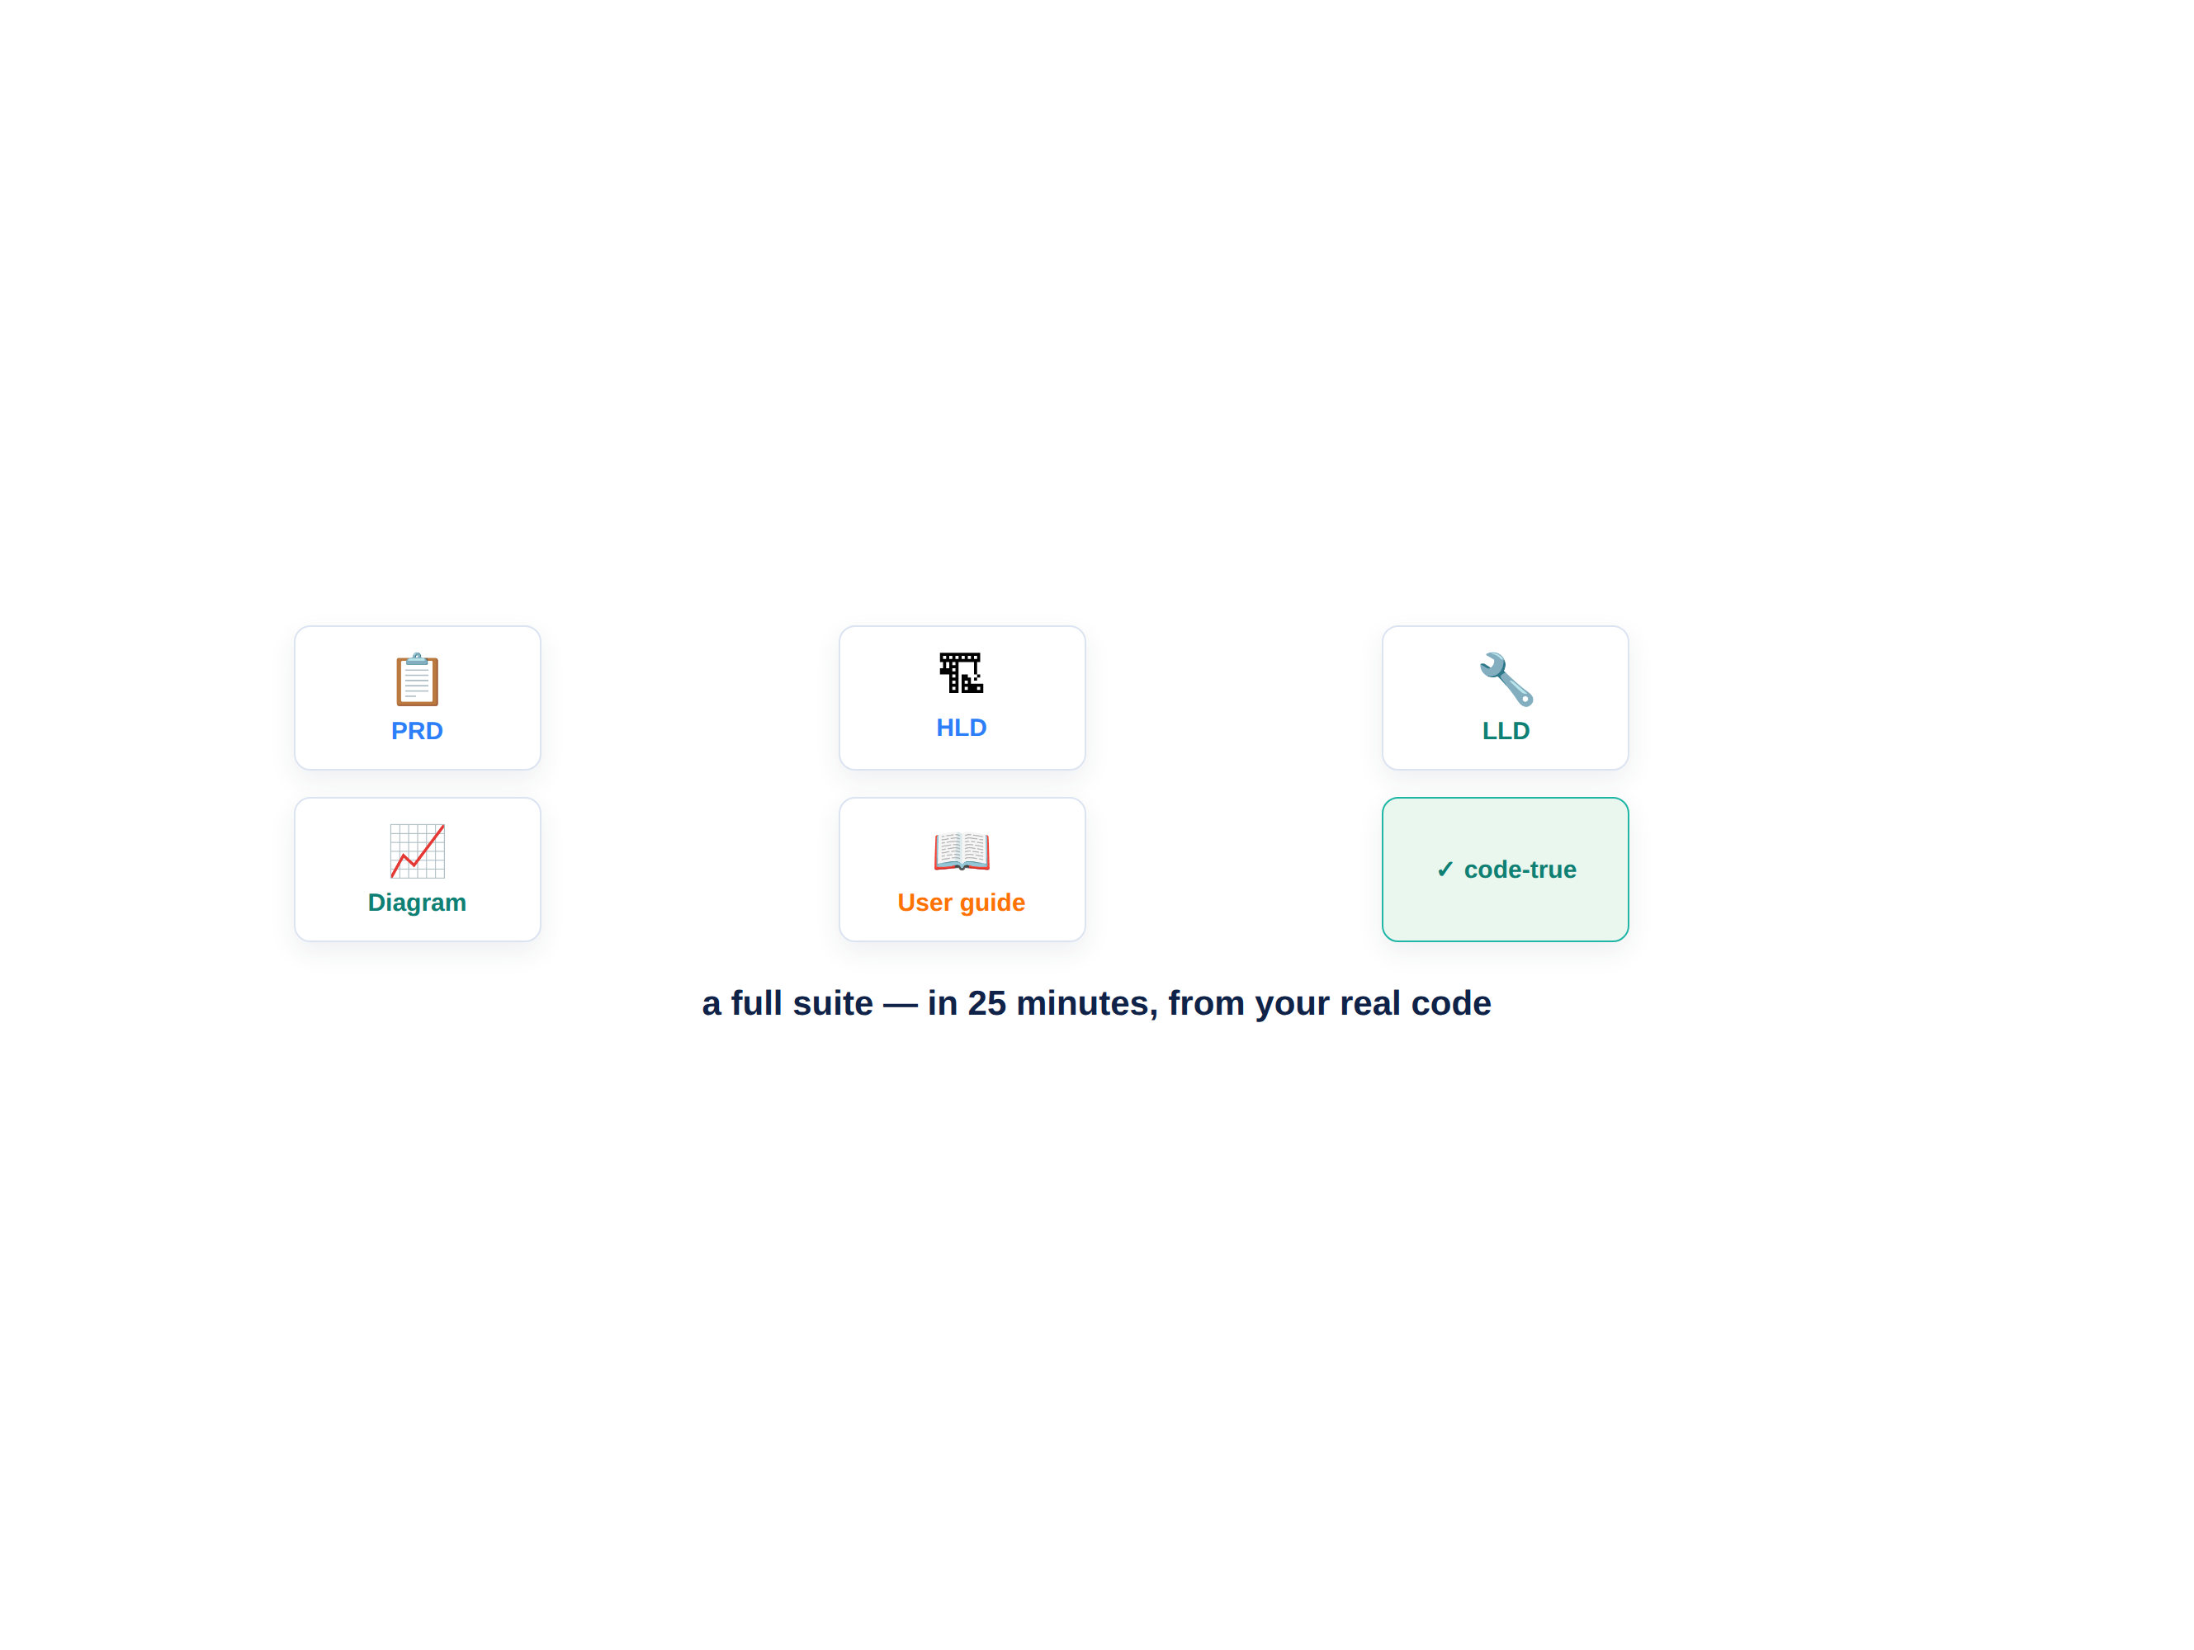
What you just generated
A complete, code-true documentation suite for TaskFlow.
In 25 minutes you produced what usually takes a team days — every document grounded in the code you built, accurate today and regenerable tomorrow.
A 1-page PRD (retrofit from the code)
An HLD with an architecture diagram
An LLD for the notifications service
A non-technical user guide
D A T A H A C K S U M M I T 2 0 2 6

Slide 13
Debrief — documentation is no longer the bottleneck
The thing teams always skip is now the cheapest thing to produce.
Grounded, not guessed Every doc traces back to the real codebase — accurate, not imagined.
days→min
Every audience covered PM, architect, engineer and end-user — all from one source.
for a full documentation suite
Alive, not stale Regenerate on change; keep it current in CI (next module).
5
Judgment is your value The agent drafts; you review against a rubric. Next: bug triage → fix → CI.
docs generated from one repo
D A T A H A C K S U M M I T 2 0 2 6

Slide 14
The doc suite — one repo, five documents
Doc | Who it’s for / what it answers | How to generate it
PRD | PM · why + what, in one page | “Interview me, then write a 1-page PRD for TaskFlow.”
HLD | Architect · how it fits together | “Write an HLD from this repo + a Mermaid diagram.”
LLD | Engineer · one service in detail | “Write an LLD for the notifications service.”
Diagram | Everyone · the shape of the system | “Generate a Mermaid C4 container diagram from the code.”
User guide | End-user · how to use it | “Write a plain-language user guide for TaskFlow.”
D A T A H A C K S U M M I T 2 0 2 6

