Slide 1


M7
MODULE 7 · 3:40–4:35
Enterprise Workflows & CI/CD Automation
Close the loop: triage a bug, fix it test-first, and ship it through a pipeline that lints, tests and reviews with AI — automatically, on every pull request.
August 05–08, 2026 · The Leela Bhartiya City, Bengaluru
Human × AI

Slide 2

“
The agent doesn’t stop at your laptop.
It triages the bug, writes the fix test-first, and reviews the pull request inside your pipeline — on every push, without you.
August 05–08, 2026 · The Leela Bhartiya City, Bengaluru
Human ×AI

Slide 3
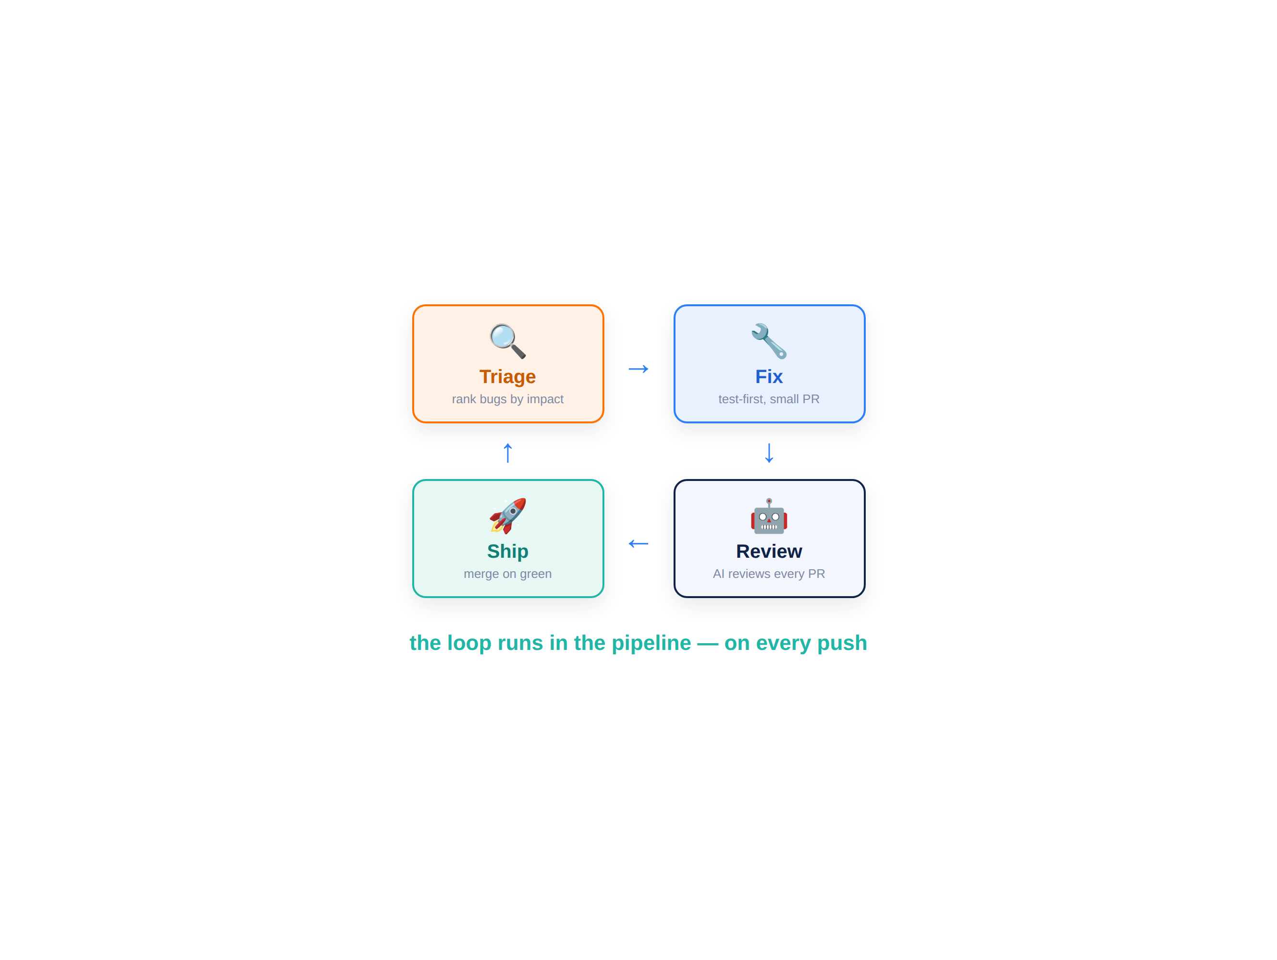


From your laptop to the pipeline — the enterprise loop
The same agent that builds now triages, fixes, reviews and ships.
Every bug now runs one loop: triage by impact, fix test-first, review in CI, ship on green — then it repeats on the next issue. Humans stay on the approval path.
Triage: rank incoming bugs by impact
Fix: reproduce, then fix test-first
Review: AI reviews every PR in CI
Ship: lint + tests + review gate the merge
D A T A H A C K S U M M I T 2 0 2 6

Slide 4
Bug triage — from backlog to ranked in minutes
Point the agent at your issues; it classifies, dedupes and ranks them.
Pulls in every open issue GitHub / Jira via M5’s MCP wiring — it reads them all.
3
Ranks by real impact Severity × blast radius × effort — not newest-first.
bugs ranked in one pass
One PR per fix Small, revertible changes — never one giant commit.
min
Triage in minutes What was a grooming meeting is now a two-minute pass.
to triage — not a meeting
D A T A H A C K S U M M I T 2 0 2 6

Slide 5
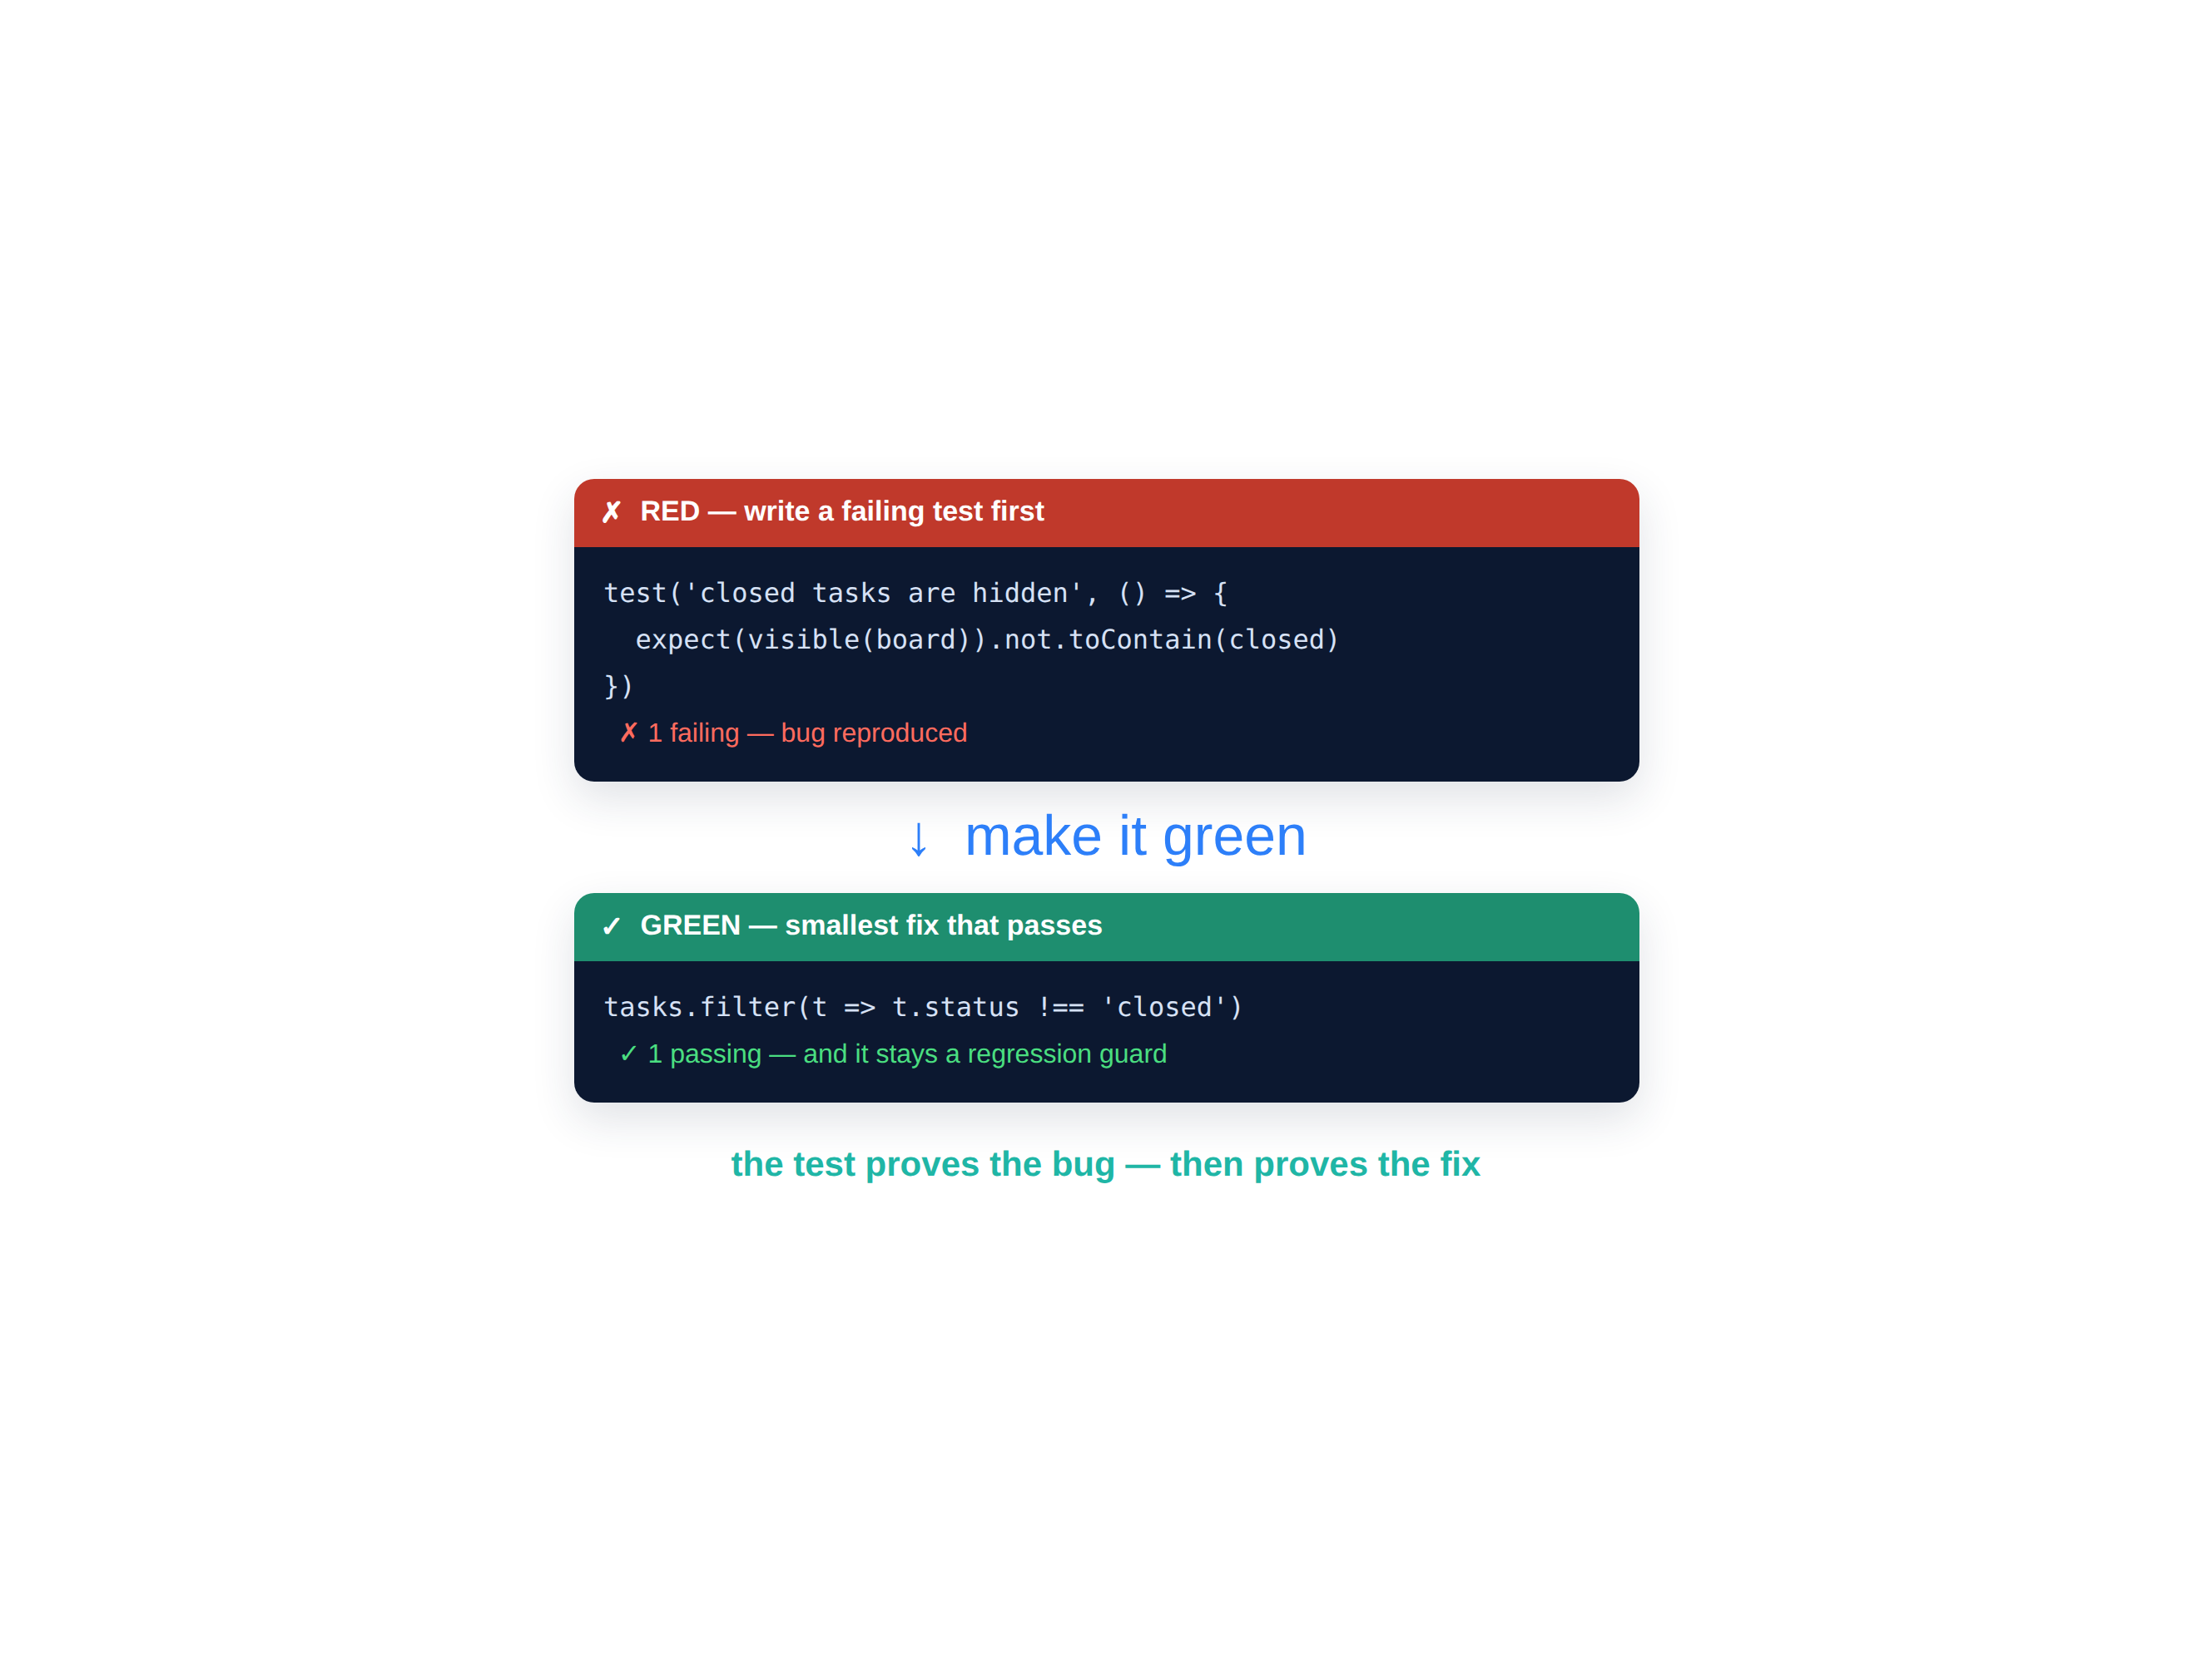
Fix it test-first — the reproduce → green loop
A failing test first proves the bug; making it pass proves the fix.
Reproduce the bug with a failing test, let the agent make it pass with the smallest change, and keep the test — it becomes a permanent regression guard. Small diffs stay reviewable.
Reproduce with a failing test first
Agent makes it green with the smallest fix
Keep the diff small and scoped
The test stays — a regression guard forever
D A T A H A C K S U M M I T 2 0 2 6

Slide 6
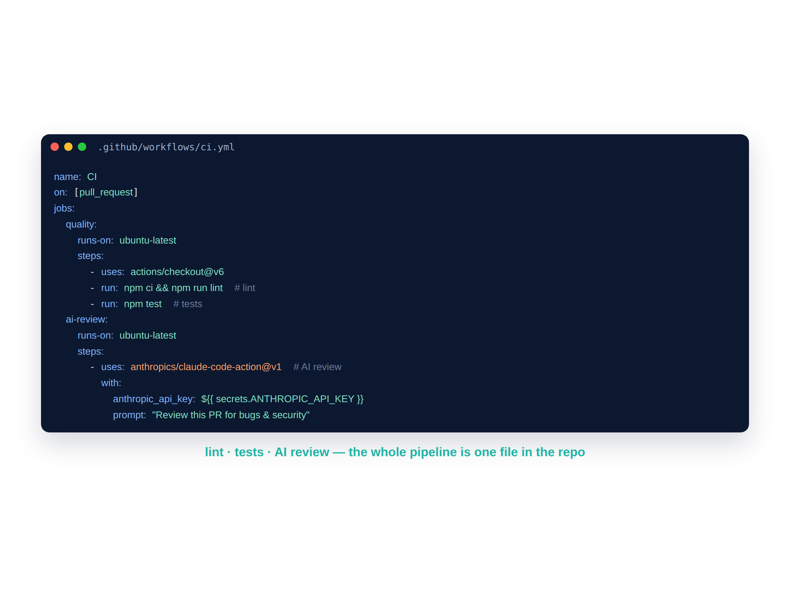
The pipeline as code — lint, test, AI review
One YAML file in the repo runs the whole quality gate on every PR.
Ask the agent to generate a GitHub Actions workflow — install, lint, test, then a headless AI review via the Claude Code Action. It lives in .github/workflows and runs on every pull request.
Runs on every pull_request — automatically
anthropics/claude-code-action@v1 for AI review
ANTHROPIC_API_KEY stored as a repo secret
The whole gate is version-controlled with the code
D A T A H A C K S U M M I T 2 0 2 6

Slide 7
AI code review — right inside the pull request
Headless review posts inline comments by severity — on every push.
Reviews every PR Reviews the diff in the context of the whole repo, on every push.
every
Severity-tagged findings Inline comments tagged by severity — bugs, not nitpicks.
PR reviewed, on every push
Logic & security, not style Catches logic errors and security issues humans skim past.
you
Humans stay in control You still approve or reject — humans stay on the merge path.
stay the decision-maker
D A T A H A C K S U M M I T 2 0 2 6

Slide 8




The Build #6 pipeline — triage → fix → ship
01
02
03
04
Triage
Fix
Pipeline
Watch it run
Seed 3 bugs, then rank them by impact via the GitHub MCP.
Fix the top bug test-first — a failing test, then make it green.
Generate the CI: lint + tests + AI review on every PR.
Open a PR and watch the checks — including @claude — run.
From a bug report to a reviewed, tested, merged fix — the whole enterprise loop in ~30 minutes.
D A T A H A C K S U M M I T 2 0 2 6

Slide 9
Module 7 — your files & the flow
File | What it is | When you use it
Build6_Lab_Guide.md | Step-by-step Build #6 | ① Follow during the lab
seed-bugs.md | 3 seeded TaskFlow bugs to triage | ② Paste as issues, then triage
ci.yml | Reference GitHub Actions pipeline | Copy into .github/workflows/
CICD_Cheatsheet.md · plus | triggers, jobs & the AI step | keep open while wiring CI
examples/ (fix · tests · review) | a worked TaskFlow reference set | compare against your own work
D A T A H A C K S U M M I T 2 0 2 6

Slide 10
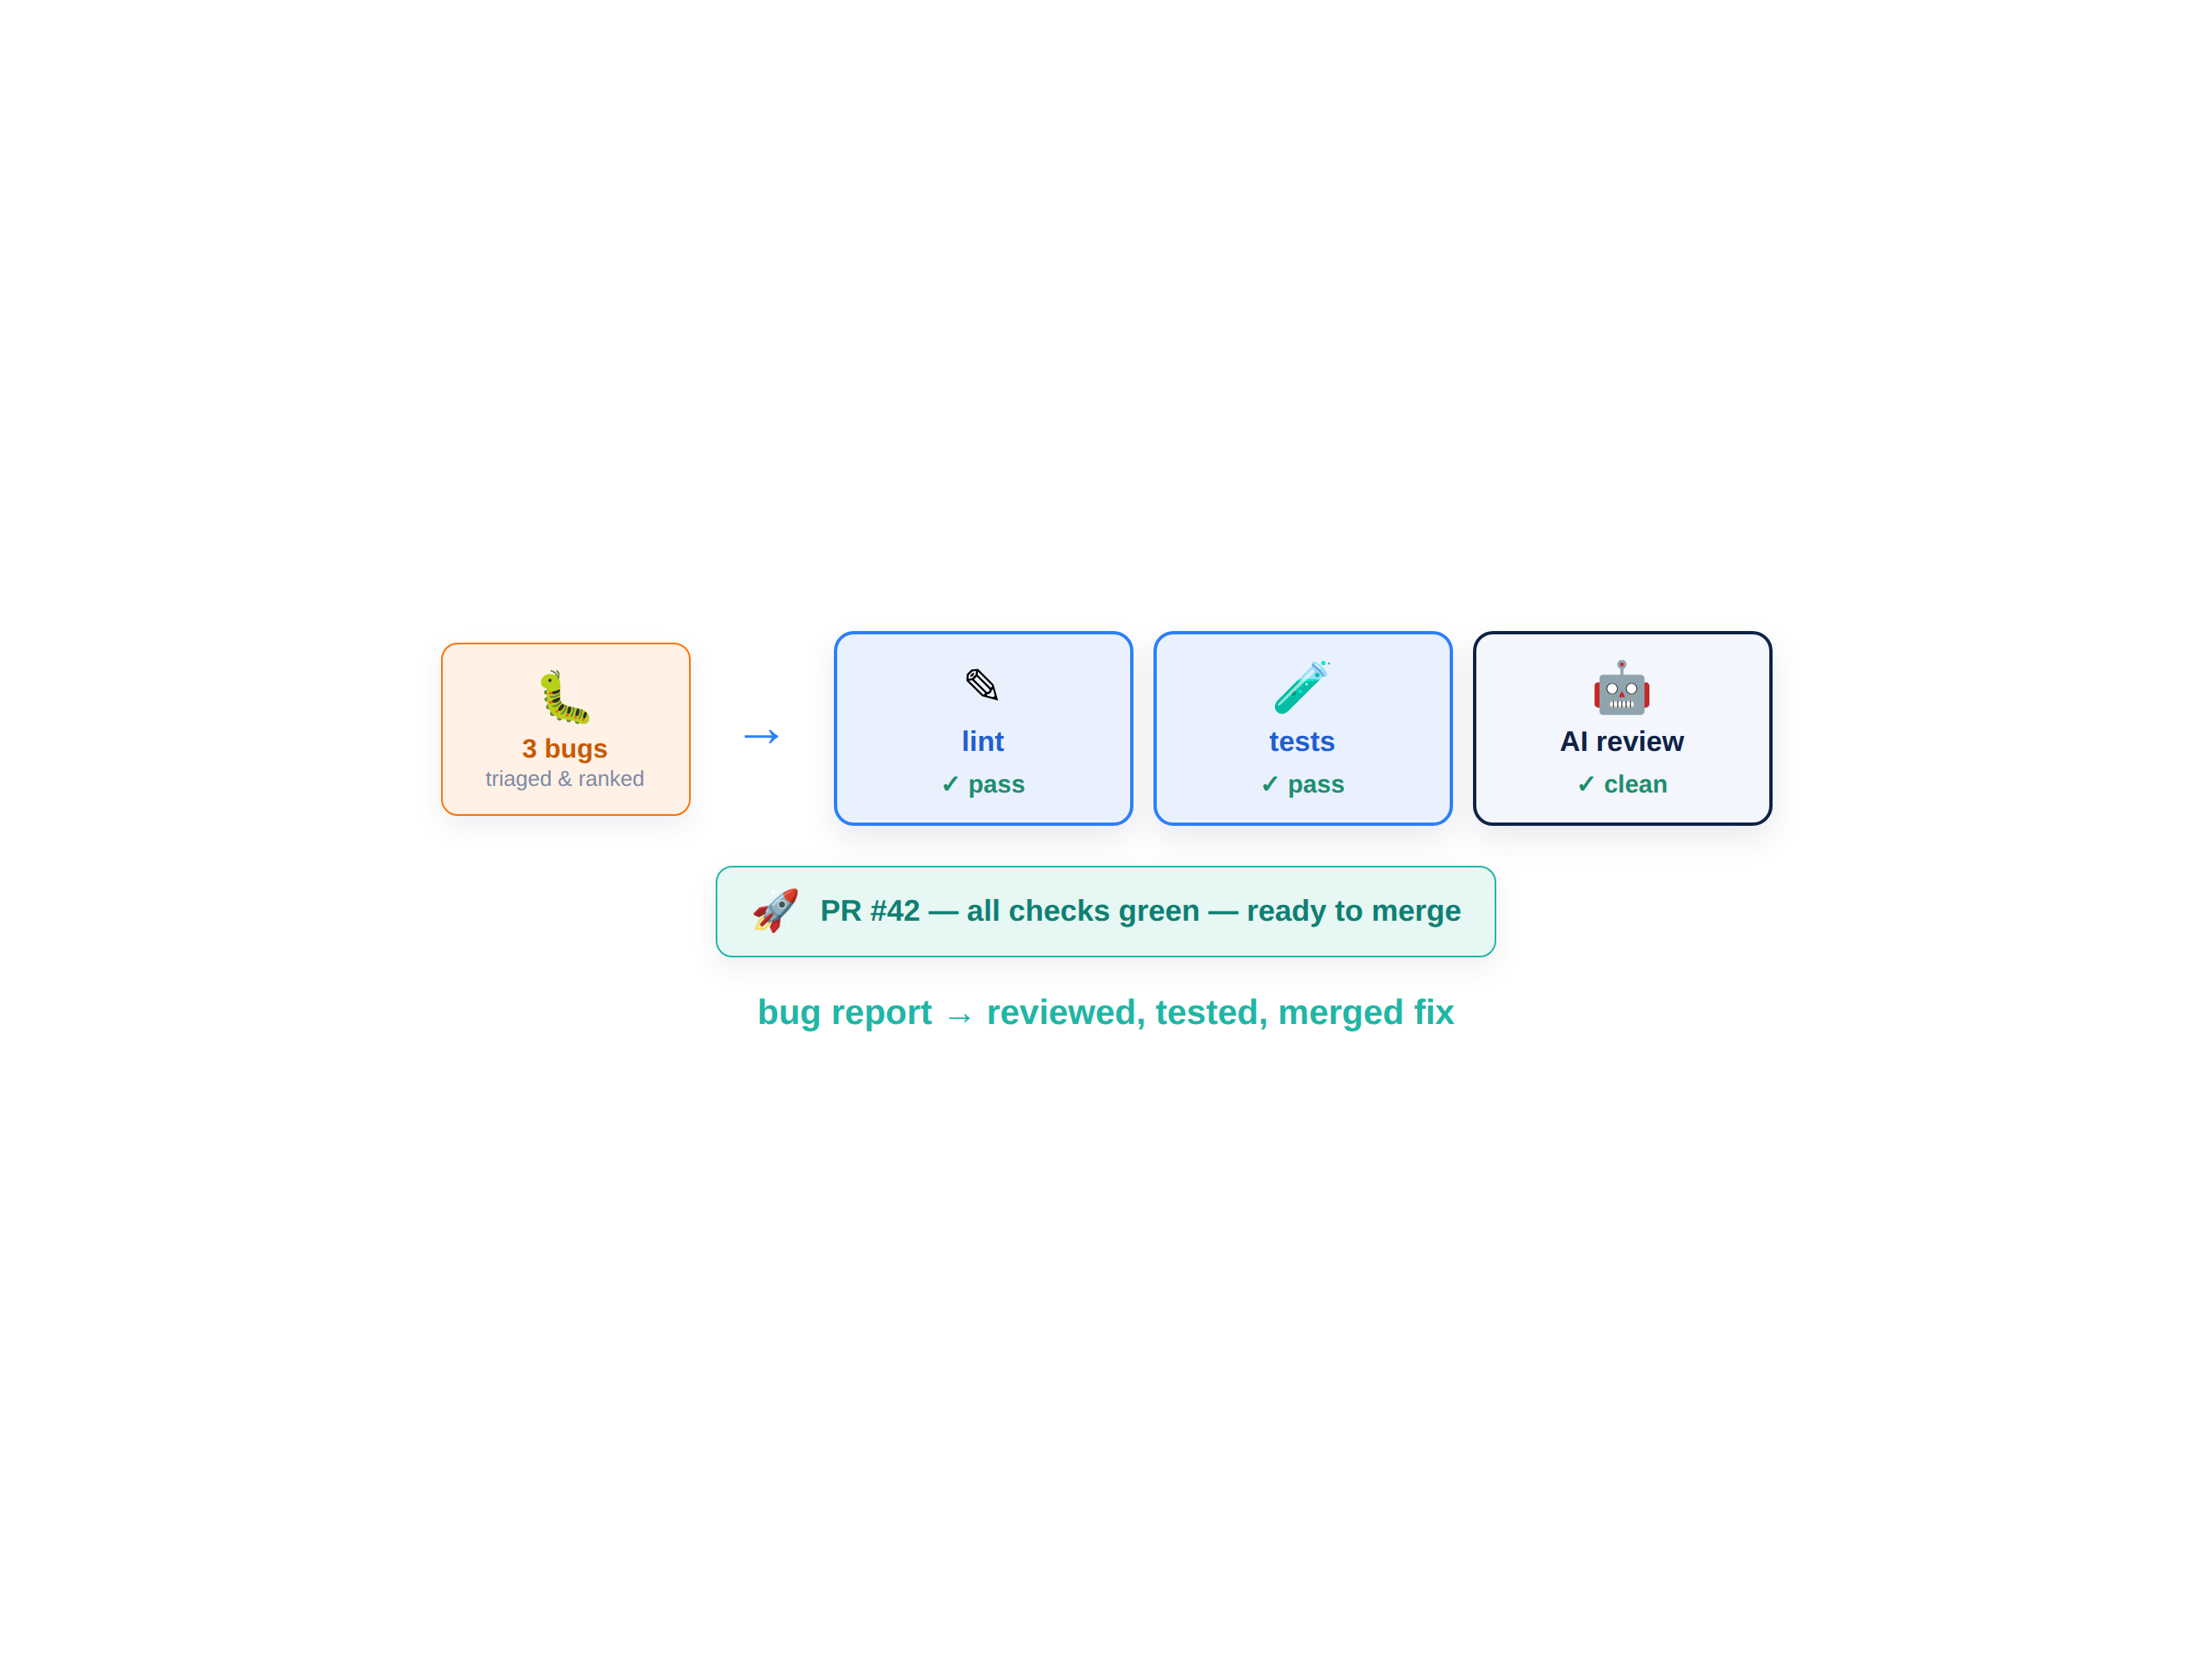
BUILD #6 — triage, fix, ship
Your task — 30 minutes
Triage 3 bugs, fix the top one test-first, then ship it through CI with AI review.
Triage 3 seeded bugs via the GitHub MCP
Fix the top bug test-first (red → green)
Add lint + tests + AI review in CI
Open a PR & watch @claude review it
Your files: Build6_Lab_Guide.md · seed-bugs.md · ci.yml
D A T A H A C K S U M M I T 2 0 2 6

Slide 11
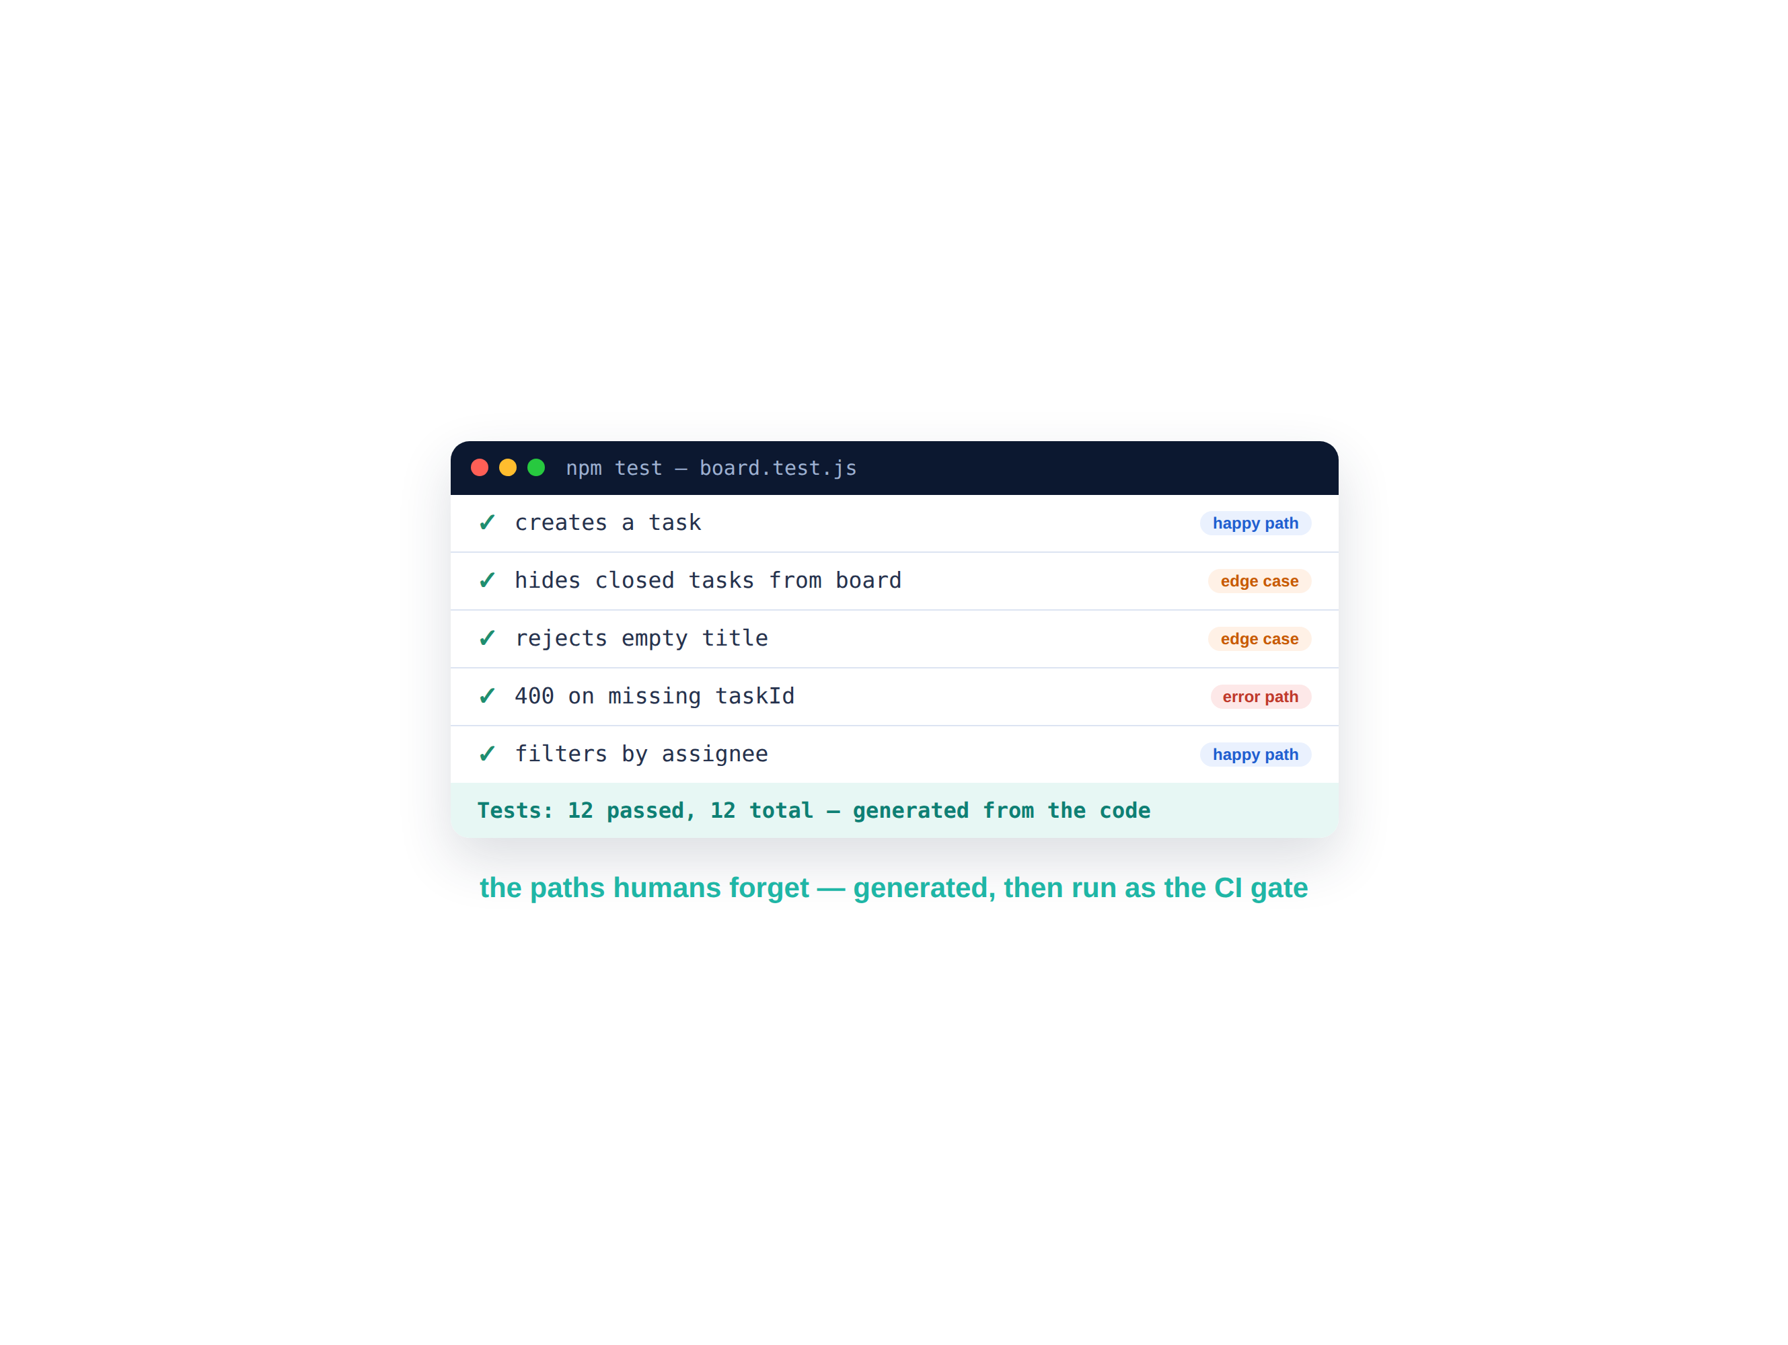
Test generation — the paths humans forget
Generate unit and edge-case tests from the code; they become the CI gate.
The agent writes happy-path, edge-case and error-path tests straight from the code — the cases people skip under deadline. Run them in CI and every future change must pass. QA professionals become AI test directors.
Unit + edge-case tests, generated from code
Covers the paths humans forget
The suite becomes the CI gate
QA shifts from writing to directing
D A T A H A C K S U M M I T 2 0 2 6

Slide 12
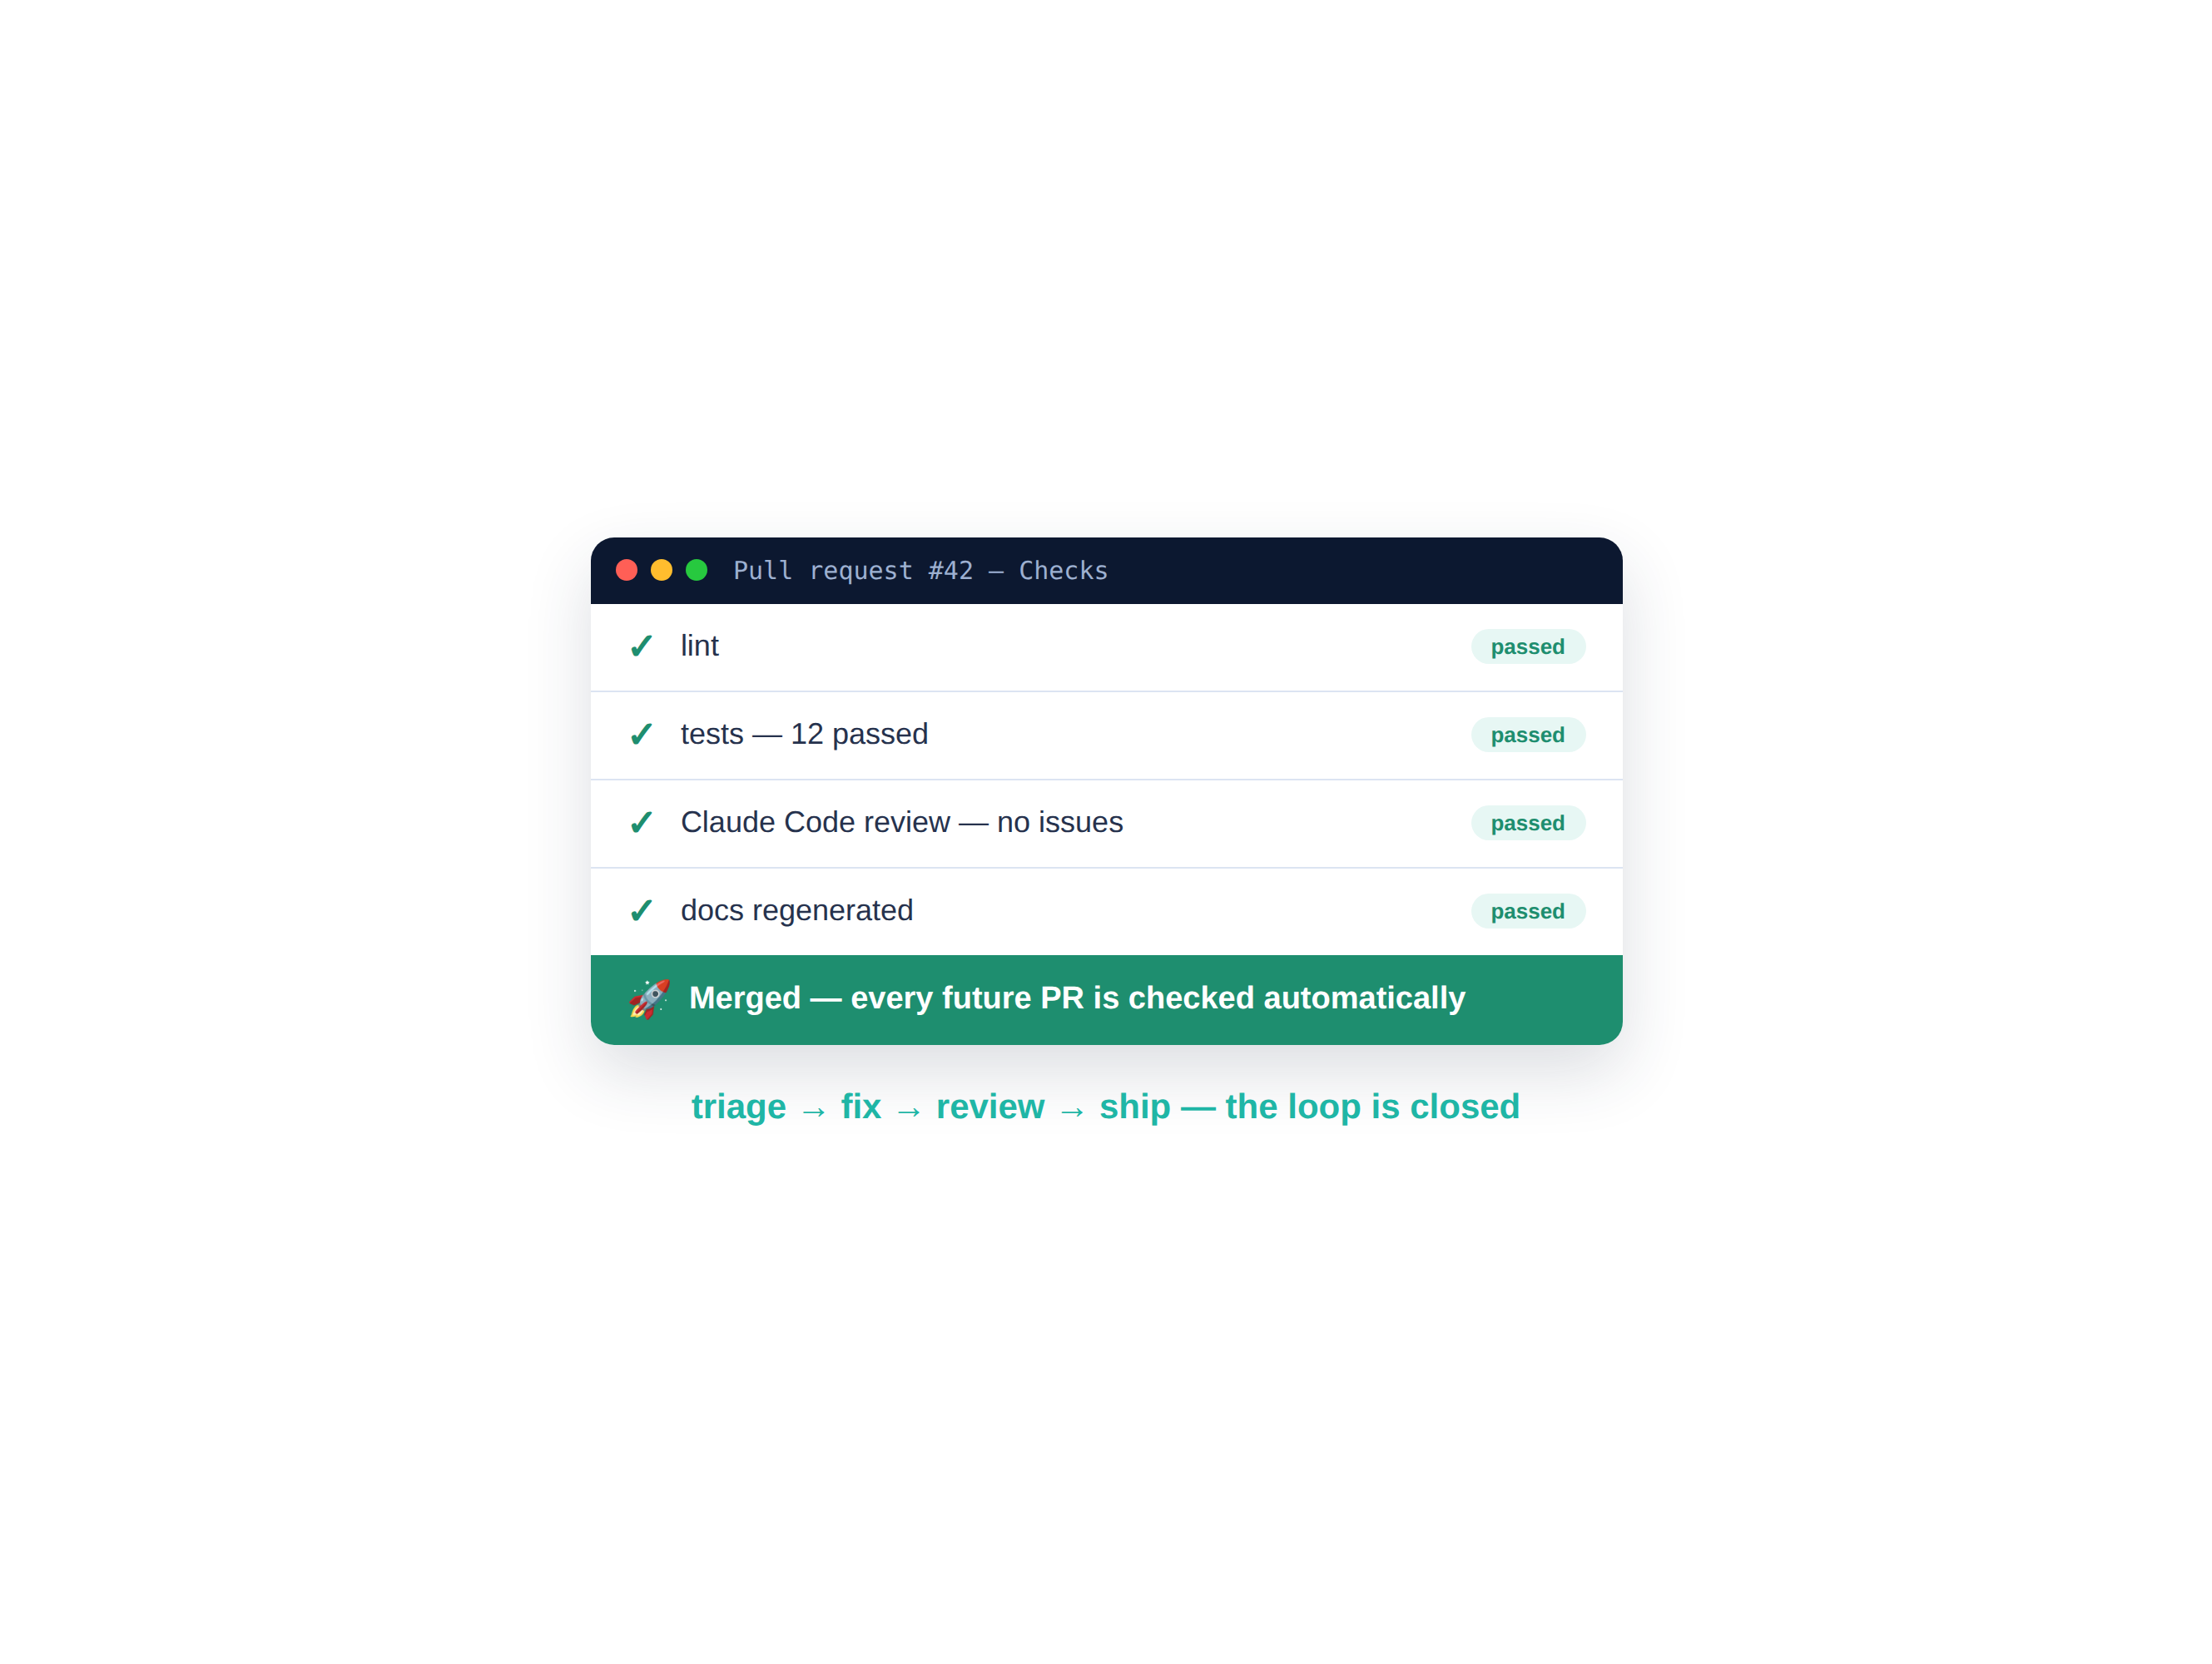
What you just built — the loop is closed
A triaged bug, a test-first fix, and a pipeline that guards every future PR.
In 30 minutes you ran the full enterprise loop — and left behind a CI pipeline that lints, tests and AI-reviews every pull request from now on, with humans on the approval path.
A triaged, prioritized bug list
A test-first fix in a small PR
A CI pipeline: lint + tests + AI review
Every future PR reviewed automatically
D A T A H A C K S U M M I T 2 0 2 6

Slide 13
Debrief — the loop runs without you
Triage, fixing, review and shipping — now a pipeline, not a person’s afternoon.
Triage that never sleeps The agent ranks incoming bugs by impact — no more newest-first firefighting.
0 min
Fixes that stay fixed Test-first fixes leave a regression guard behind every time.
of extra effort on the next PR
Review on every push AI reviews land as inline comments before a human ever looks.
3
You own the approvals Machines gate quality; humans make the call to merge. Next: showcase & your 100x roadmap.
checks gate every merge
D A T A H A C K S U M M I T 2 0 2 6

Slide 14
The CI/CD toolkit — trigger → what runs → when
Stage | What it does | How you wire it
Triage | Rank & route incoming bugs | GitHub MCP: “list open issues, rank by impact.”
Fix | Reproduce, then fix test-first | “Write a failing test for this bug, then make it pass.”
Lint + test | Quality gate on every PR | GitHub Actions: npm run lint && npm test
AI review | Headless review posts inline comments | uses: anthropics/claude-code-action@v1
Ship | Merge when all checks are green | Branch protection: require CI + review to pass
D A T A H A C K S U M M I T 2 0 2 6

