Slide 1
GIT

Slide 2
What is GIT
Distributed version control
Coordinates work between multiple developers
Who made what changes and when
Revert back at any time
Local and Remote repos

Slide 3
Concepts of GIT
Keep track of code history
Take snapshots of your files
You decide when to take snapshot by making a commit
You can visit any snapshot at any time
You can stage files before commiting

Slide 4
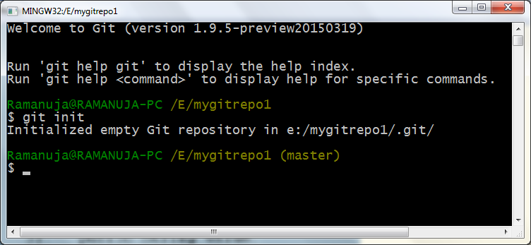
Create a Local Repo
Create the folder “mygitrepo1”
Right click and select git bash

Slide 5
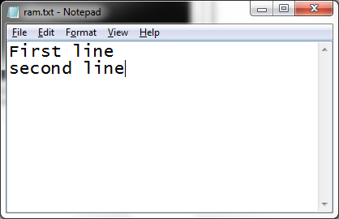
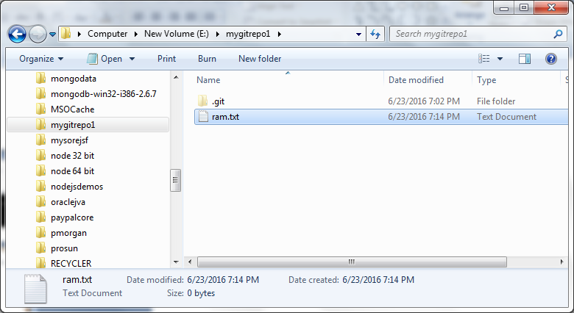
Create text document

Slide 6
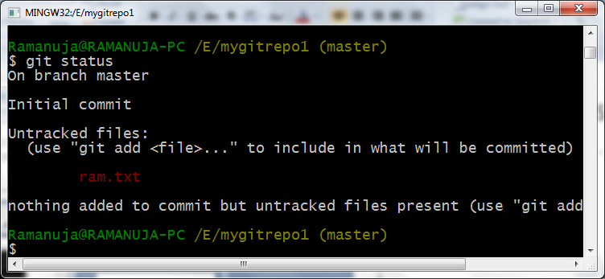
git status
It displays the status of the file
untracked, staging, tracked

Slide 7
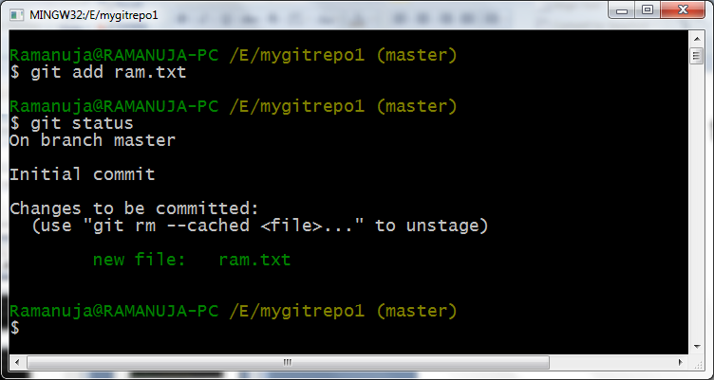
Adding file to the staging area
git add ram.txt

Slide 8
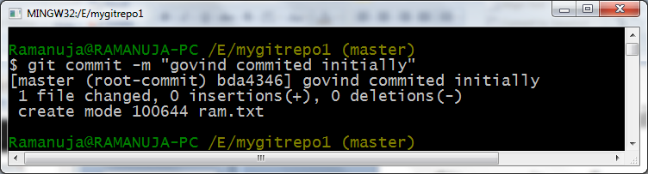
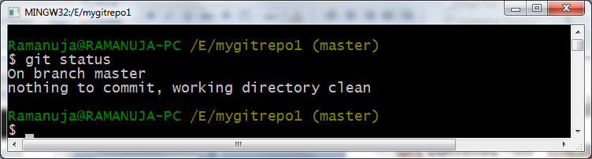
Commit to repo
Git commit –m “messge”

Slide 9
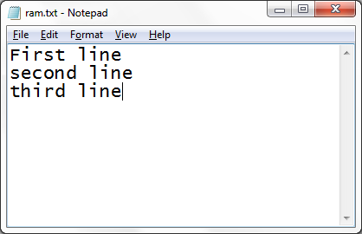
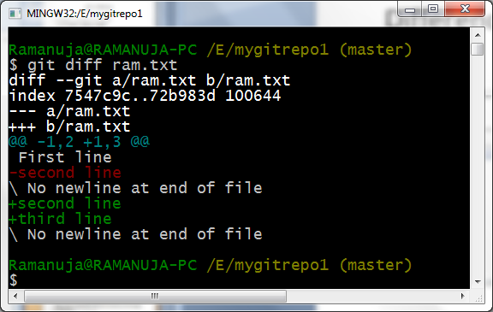
Difference between modified and latest commit
Open the file ram.txt and add third line and save the changes
Git diff ram.txt

Slide 10
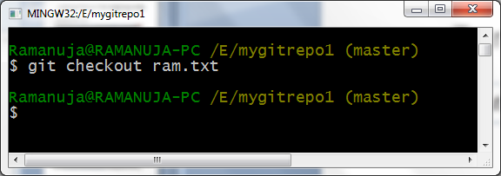
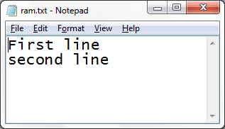
To revert the changes
git checkout ram.txt
Modified file get reverted

Slide 11
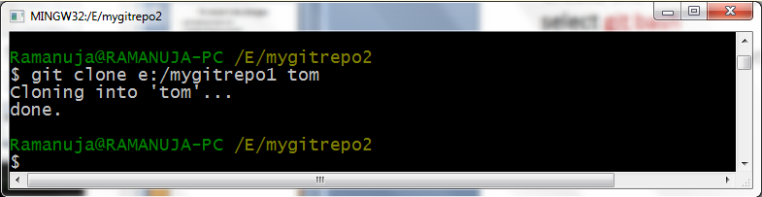
Cloning local repo
Create the folder mygitrepo2 and right click and select git bash
git clone e:/mygitrepo1 tom
Change the folder to tom
cd tom

Slide 12
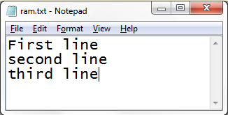
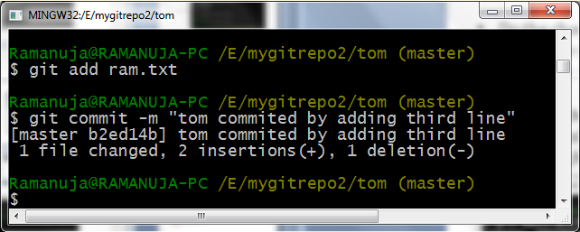
Git pull
Do the changes in ram.txt of tom repo
Add in the staging area
Commit in the tom repo

Slide 13
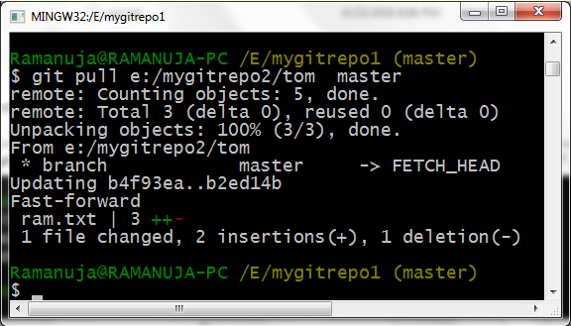
git pull
How the changes done by tom is available to repo1
Go to repo1 window
git pull e:/mygitrepo2/tom master

Slide 14
Working with remote repo
https://github.com/
Create an account and login

Slide 15
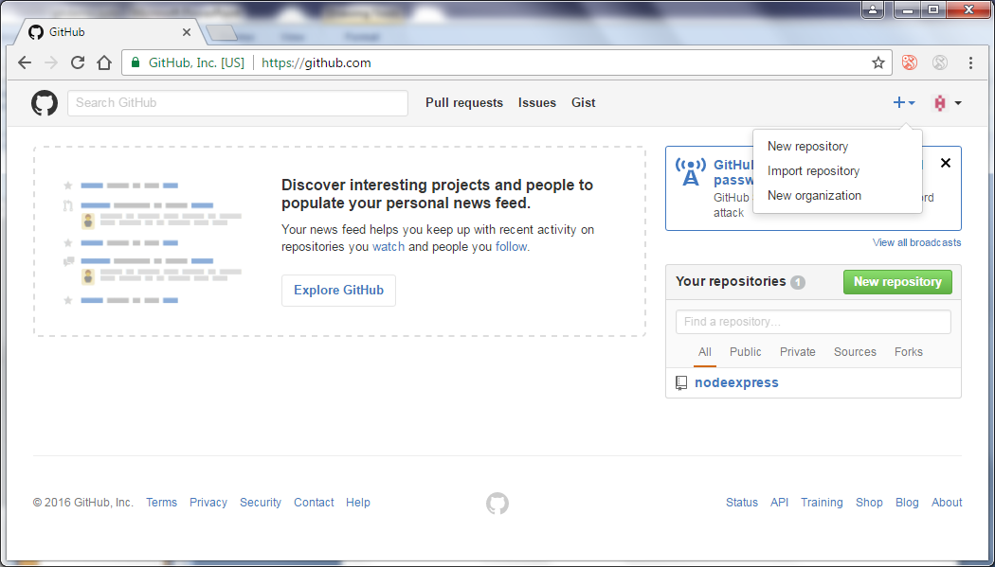
Creating a remote repo

Slide 16
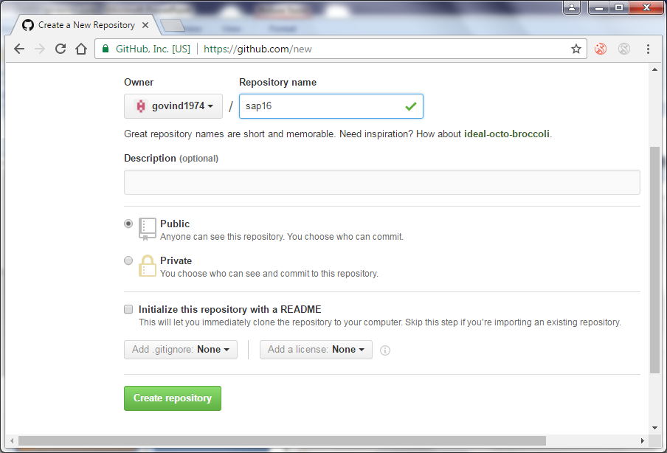

Slide 17
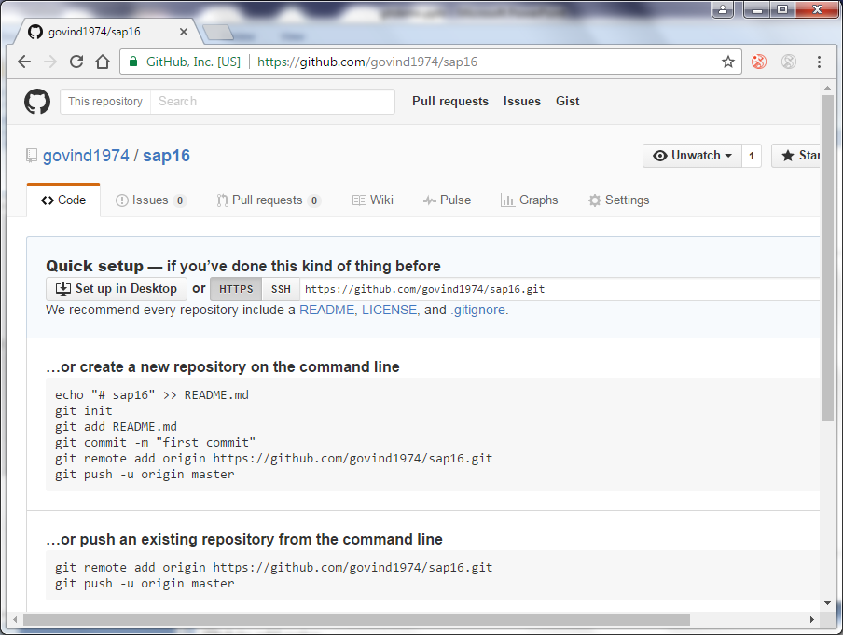

Slide 18
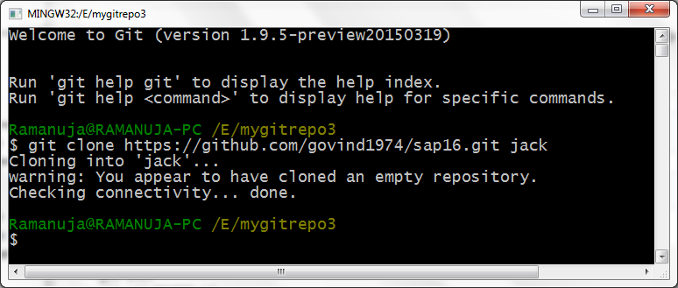
Cloning a remote repo
Create a folder in local system mygitrepo3 and rightclick and select git bash
After cloning change the folder to jack
cd jack

Slide 19
Create a doc and push to remote
Create a doc myfile.txt
Add it to staging area
Commit to local repo
Push it in to remote repo
git push origin master
Pull changes from remote rep
git pull origin master

Slide 20
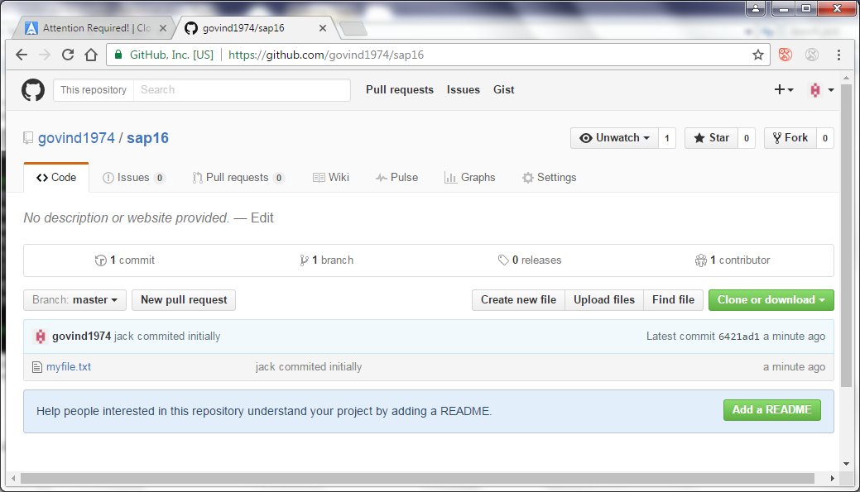

Slide 21
Conflict and merge
There are two local repo cloned from remote
remote
1.Push to remote repo
2.Pull from remote repo
jack
jill
First line
Second line
First line
Second line

Slide 22
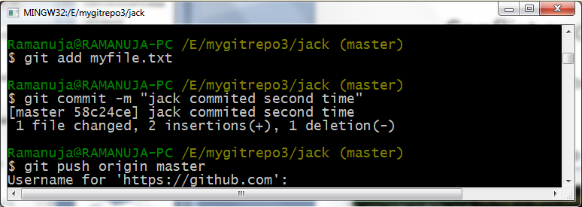
Conflict and merge
Jack changes the doc myfile.txt
Add it in to staging area
Commit into local repo
Jack pushes into remote repo

Slide 23
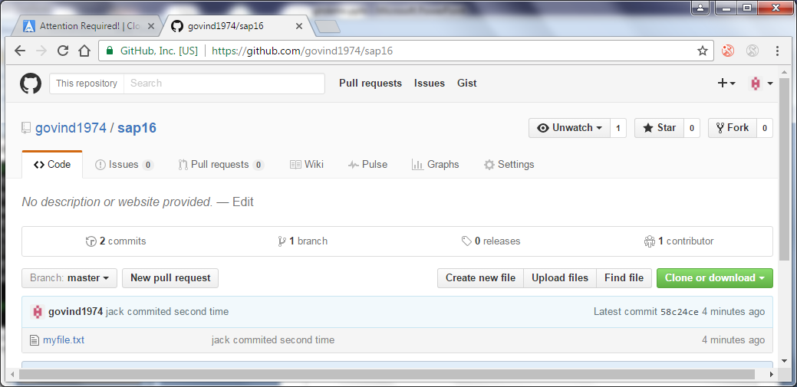

Slide 24
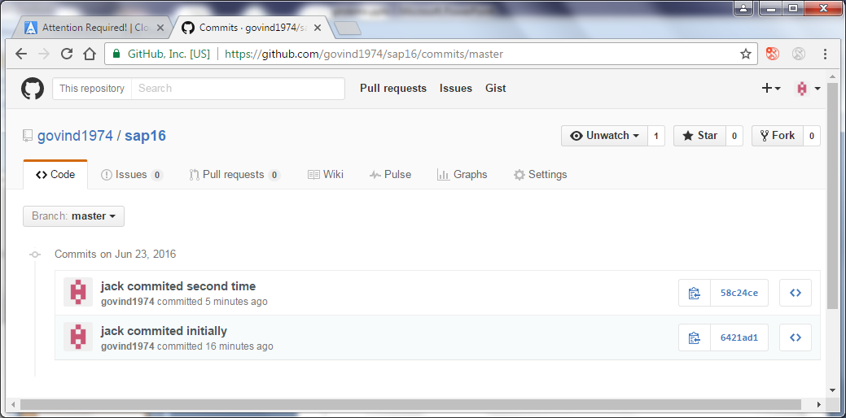

Slide 25
Conflict and merge
Without knowing the changes done by jack, jill changes the doc and commits in local repo
Jill try to push it into remote repo
Error raised that failed to push
Because the latest version in remote is 2 and you are working in revison1 and trying to push
remote
1.Jack changes the doc and Push to remote repo
2.Jill works in revison 1, commits in local repo and try to push and it is failed
jack
jill
First line
Second line
Third line
First line
Second line
Fourth line

Slide 26
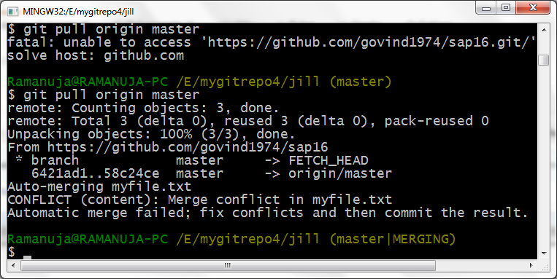
Conflict and merge
Jill pulls the latest changes
git pull origin master
Merges the document automatically but conflict raises

Slide 27
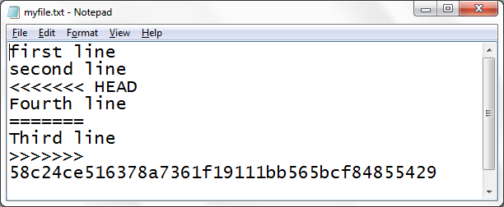
Conflict file
Remove the <<<<<<HEAD
Remove ========
Remove >>>>>>>>
Remove number
Save it
Add and commit
Push it to remote

Slide 28
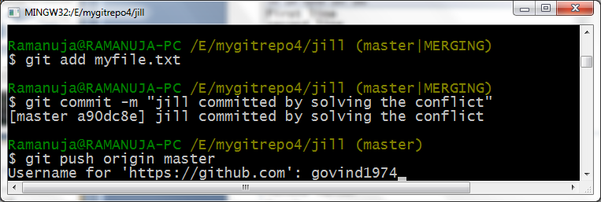
Conflict and merge

Slide 29
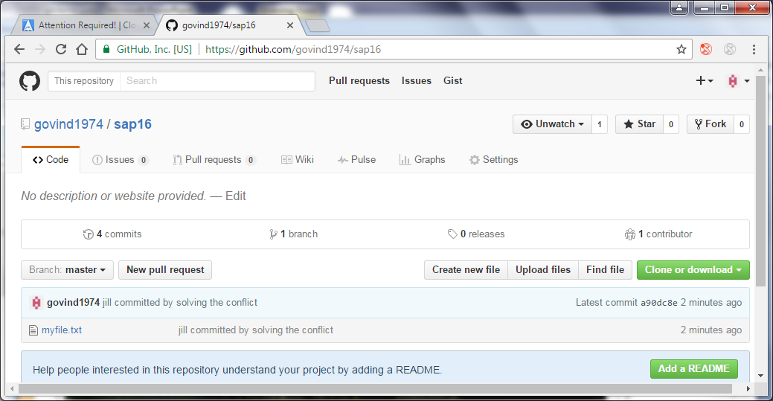
Conflict and merge

Slide 30
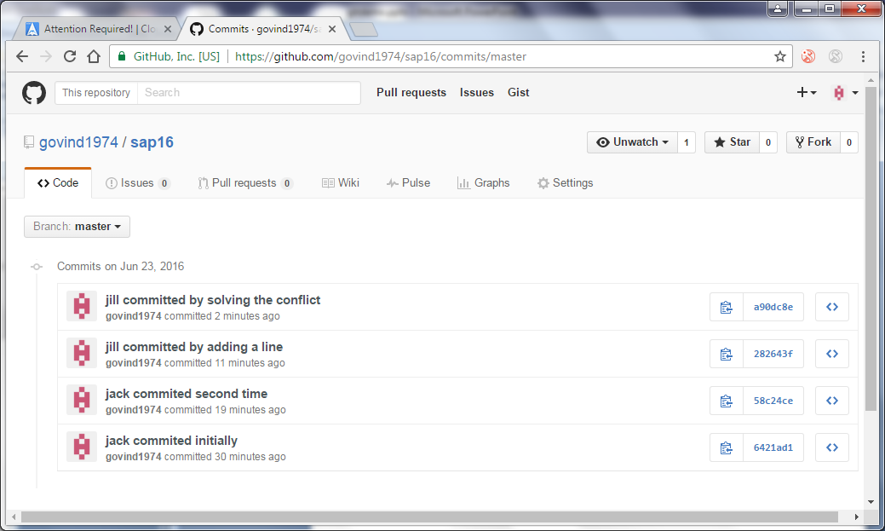
Conflict and merge

Slide 31
Create branch
To list the branch
git branch –list
To list the branches in remote repo
git branch –list -r
To create a branch
git branch bname
To switch from one branch to another branch
git checkout bname

Slide 32
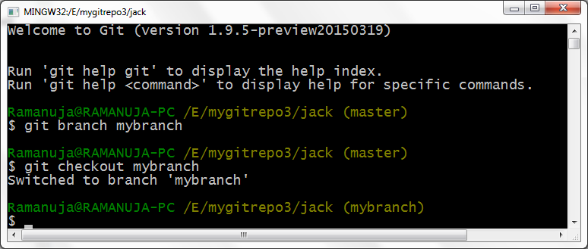
Create a branch and switch to branch

Slide 33
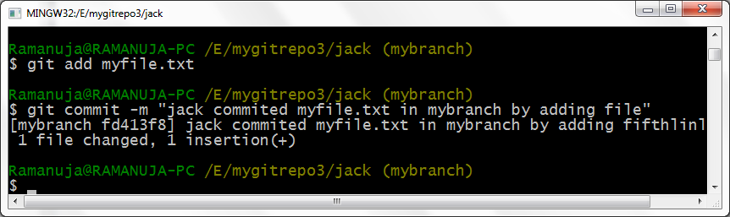
Handling branch
Do the changes “myfile.txt” in the branch “mybranch”
Add and commit
Switch it to master

Slide 34
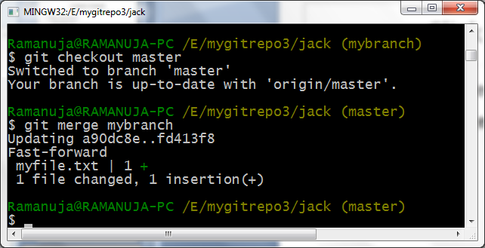
Merge branch to master
Switch it to master
Merge the changes to master done in branch
Push it to remo repo

Slide 35
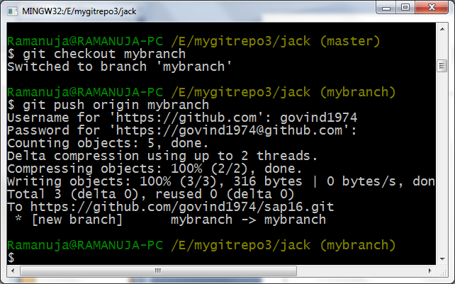
Push from branch to remote
git push origin mybranch

Slide 36
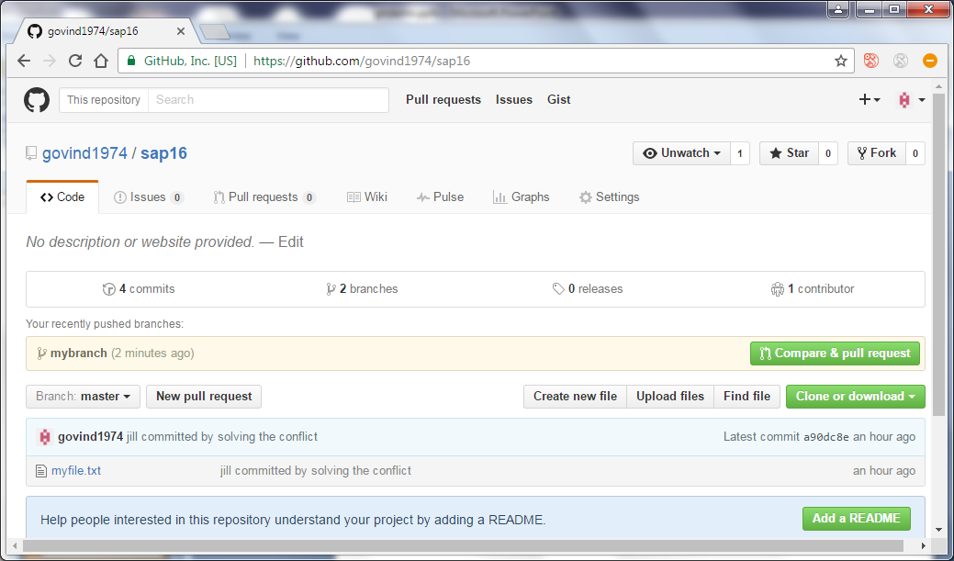

Slide 37
