Slide 1
Objectives
Understand the Exception handling mechanism.
Understand the difference between an error and exception.
Why Exception handling is important?
Understand different types of exception.
Understand how to funnel exceptions.
How to write custom exception classes and the need for it?

Slide 2
Exception
Exception is a java object
If it is thrown to JVM, your application abnormally stops

Slide 3
Effective Exception?
Effective exception handling will make your programs more robust and easier to debug. They help answer these three questions:
What went wrong?
Answered by the type of exception thrown.
Where did it go wrong?
Answered by exception stack trace.
Why did it go wrong?
Answered by exception message

Slide 4
Why Exception Handling
If an Exception is thrown from a method and it is not handled, your program abnormally terminates.
To avoid this, catch the exception
So that, your program continues the execution smoothly

Slide 5
Exception class hierarchy
Throwable
Error
Exception
...
RuntimeException
SQLException
IOException
...
ArithmeticException
InterruptedException
...
NullPointerException
...
Unchecked Exceptions
Checked Exceptions
Notes:
In java it is possible to define two catergories of Exceptions and Errors.
JVM Exceptions: - These are exceptions/errors that are exclusively or logically thrown by the JVM. Examples : NullPointerException, ArrayIndexOutOfBoundsException, ClassCastException,
Programmatic exceptions . These exceptions are thrown explicitly by the application or the API programmers Examples: IllegalArgumentException, IllegalStateException.

Slide 6
Exception Hierarchy
Object
throwable
Exception
SqlException
IOEXception
RuntimeException
FileNotFoundException
Null pointer Exzception
ArithmeticException

Slide 7
Checked Exceptions
Checked exceptions are used for problems predictable at design time.
The compiler enforces handling of these exceptions.
Software components either have to catch those exceptions, or declare that they are not catching it.
If the method is declared saying that it is not catching then the calling code is aware that there is something to be done about potential problem.
Examples : SQLException, IOException, ClassNotFoundException
Note: Checked exceptions are part of the method signature if the method is not handling the exception and therefore integral part of the contract the class or interface has with the clients.
,if

Slide 8
Un Checked Exceptions
All exceptions inherited from RuntimeException.
They are not checked by the compiler
Runtime exceptions usually occur due to a bug in a code.
Because they are unpredictable and could be anywhere in the application code, the compiler does not enforce their handling.
Examples: ArithmeticException, NullPointerException,..
“Runtime Exceptions represent problems that are the result of a programming problem, and as such, the API client code cannot reasonably be expected to recover from them or handle them in anyway”
Notes:
Sun VM specification: “In the Java programming language, throwing an exception results in an immediate nonlocal transfer of control from the point where the exception was thrown. This transfer of control may abruptly complete, one by one, multiple statements, constructor invocations, static and field initializer evaluations, and method invocations. The process continues until a catch clause is found that handles the thrown value. If no such clause can be found, the current thread exits”.
“Exceptions are expensive and should be used exceptionally. Do not use exception handling constructs if it can be avoided”
Example:
How to handle null pointer scenario:
Use:
public void addEmployee(Employee employee) {
if( employee != null ) {
// insert into the persistent layer
}
}
Instead of :
public void addEmployee(Employee employee) {
try {
// insert into the persistent layer
} catch(NullPointerException ex) {
// log the exceptions
}
}

Slide 9



Special case of Runtime Exception
Don’t try to catch Runtime Exception, mostly they represent a bug in a code.
For Ex:
NullPointerException is avoided by checking
an object is null and invoke the methods on it.
ArrayIndexOutOfBoundException is avoided
by checking the length of an array
ArithmeticException is avoided by checking
denominator is greater than zero
If you try to catch,
The code gets too messy
Since it is an object, it occupies heap space and object graph size is also big.

Slide 10
Checked vs Unchecked Exception
Checked | Unchecked
It is checked by the compiler. So the exception must be handled at compile time | It is not checked by compiler. So it is not required to handle
It is not the sub class of RuntimeException | It is the subclass of RuntimeException
If method is throwing checked exception then exception must be declared | It is not required to declare exception, if RTE is thrown by the method

Slide 11
Deal an Exception
If a method throws an Exception, There are two ways to deal it
Handling the Exception
Propagate the Exception
Handling an Exception
using try… catch.. finally block
Propagating an Exception
It is done by throwing an Exception using throw and throws keyword
Throwing an exception to calling method
Because if Exception is thrown to JVM, the program abnormally terminates.

Slide 12
Exception handling constructs
Five constructs are used in exception handling:
try – a block surrounding program statements to monitor for exceptions
catch – together with try, catches specific kinds of exceptions and handles them in some way
finally – specifies any code that absolutely must be executed whether or not an exception occurs
throw – used to throw a specific exception from the program explicitly
throws – specifies which exceptions a given method can throw (duck)
Notes:
Catch or Propagate Exceptions?
You might be wondering whether you should catch or propate exceptions thrown in your program. It depends on the situation. In many applications you can't really do much about the exception but tell the user that the requested action failed. In these applications you can usually catch all or most exceptions centrally in one of the first methods in the call stack. You may still have to deal with the exception while propagating it though (using finally clauses). For instance, if an error occurs in the database connection in a web application, you may still have to close the database connection in a finally clause, even if you can't do anything else than tell the user that the action failed. How you end up handling exceptions also depends on whether you choose checked or unchecked exceptions for your application.

Slide 13
try block and Exception Handler
try block
The code that cause an exception surround in a try block
try block can have either catch or finally block, even both
try block with finally and without catch block is legal , but that does not make sense.
One try block can have any number of catch blocks;
try block can be nested
catch block
Catch block is the Exception handler
If an exception arises in try block implicitly or explicitly, that exception is caught by catch block

Slide 14
The try, catch and finally block
try {
/*
* some codes to test here
*/
} catch (SQLException sx) {
/*
* handle Exception1 here
*/
} catch (IOException ix) {
/*
* handle Exception2 here
*/
} catch (Exception ex) {
/*
* handle Exception3 here
*/
} finally {
/*
* always execute codes here
*/
}
try block encloses the context where a possible exception can be thrown
each catch() block is an exception handler and can appear several times
An optional finally block is always executed before exiting the try statement.

Slide 15
stream
os
fr
FileReader fr = new FileReader();
When it reaches end of block
Only the ref dies
But stream is not idle
it is busy with OS
This object is not ready for GC
Thus it becomes memory leakage

Slide 16
finally block
finally block is executed, if try or catch block executes successfully or not
One try block has only one finally block
Must not have return statement in finally block
Dont throw exception from finally block
If a try or catch block returns value, then finally block gets executed and returns a value to calling method
If a catch block throws an exception then finally block gets executed and then throws the exception to the calling method
finally block will never execute only, if System.exit(0) is encountered in try or catch block.

Slide 17
Performing clean up with finally
If a stream or connection is opened in try block, And an exception arises in between the try block where will you close the stream or connection?
If you are failing to do , It becomes memory leakage
otherwise, You have to close the stream in all catch blocks, this becomes code redundant
the best thing, you can have clean up code to be placed in the finally block because it gets mandatory executed

Slide 18
Exception Matching
try {
/*
* some codes to test here
*/
} catch (SQLException sx) {
/*
* handle Exception1 here
*/
} catch (IOException ix) {
/*
* handle Exception2 here
*/
} catch (Exception ex) {
/*
* handle Exception3 here
*/
} finally {
/*
* always execute codes here
*/
}
Analyze the Exception Hierarchy, if there are multiple catch blocks.
Catch blocks must be ordered from most specifc exception (subclass type) to generic exception(super class)
Subtype to super type

Slide 19
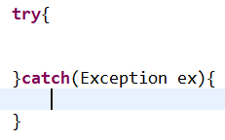
Catching Any Exception
Any type of exception can be caught using Exception object
It is a bad practice to handle it
What type of exception occurred in different scenario will be missing
How to react to the exception raised in different scenario
Ex

Slide 20
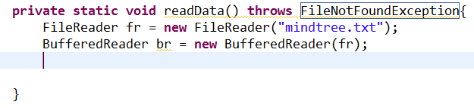
throws – Declaring an Exception
throws keyword is used to declare the exception for the method
Declaring an exception means that the method can throw the exceptions possibly
If a code can arise an checked exception or throwing an exception explicitly then declare the exception using throws keyword
If you are not handling it using try.. Catch block , then declare the exception
Specify to the compiler that the method is ducking the exception and the exception should be caught by the calling code
Use throws specifier to duck the checked type of exception
FileNotFoundException will arise because of the FileReader constructor

Slide 21
throw – Throwing an exception
Exception can be thrown explicitly using throw keyword
Ex throw new Exception(“age must be 18 and 58”);
No need to declare exception using throws keyword , if RuntimeException is thrown
throw and throws will be useful when the exceptions are funelled.
Funnelling an exception
An exception is caught and throwing an app specific exception

Slide 22
Errors
Error is a java object that cannot recover and they generally deals with hardware issues such as heap space, stack etc.
For Ex OutOfMemoryError cannot be handled because there is no enough space
Errors represent critical errors that should not occur and that the application is not expected to recover from.
Errors are typically generated from mistakes in program logic or design and should be rectified through correction of design or code
Examples: OutOfMemoryError, StackOverFlowError, UnsatisfiedLinkerError,…

Slide 23
Important methods of Throwable class
String getMessage( ) String getLocalizedMessage( )
Gets the detail message, or a message adjusted for this particular locale.
void printStackTrace( ) void printStackTrace(PrintStream) void printStackTrace(PrintWriter)
Prints the Throwable and the Throwable’s call stack trace. The call stack shows the sequence of method calls that brought you to the point at which the exception was thrown

Slide 24
Creating Own Exception
User defined checked exception are created by extending the class Exception
User defined unchecked exception are created by extending the class RuntimeException
App specific exception is thrown based on app criteria
Example:
Company creates an employee if age is between 18 and 50
Otherwise it throws application exception - InvalidAgeException
Funnel the exception
To display custom message for end user
Developer needs to know what went wrong

Slide 25
Funnel the exception
Catch the actual exception
wrap the actual exception with custom message in to user defined exception
Having custom message and actual exception
Custom message
End user to understand
Actual exception
Developer to understand

Slide 26
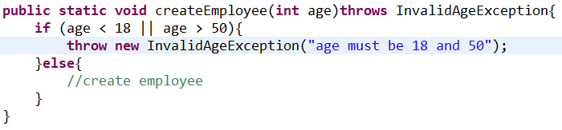
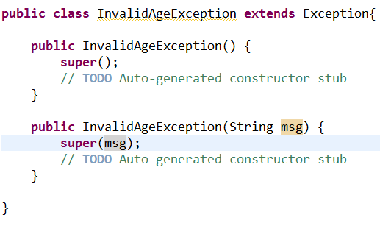
Creating Own Exception – Example1

Slide 27
Inner class
Better organization of code
Highly complicated
Are classified in to
Regular inner class
Static Nested class
Anonymous Inner class

Slide 28
Inner class
car
If car and engine are two seperate class3
Engine class cannot access the private members of Car class
has
Engine

Slide 29
Regular Inner class
Can access all static and instance members including private
How will you create an instance for inner class
inner class instance is created using outer class ref.new
Car car = new Car();
Car.Engine engine = car.new Engine();

Slide 30
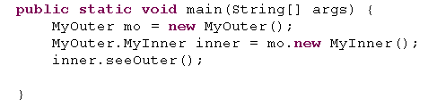
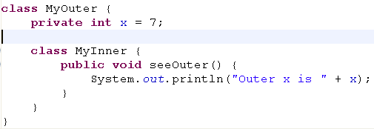
Regular Inner class
A "regular" inner class is declared inside the curly braces of another class, but
outside any method or other code block.
And if you compile it,
%javac MyOuter.java
you'll end up with two class files:
MyOuter.class
MyOuter$MyInner.class
Get a reference to outer class and instantiate inner class

Slide 31
Nested class
Inner class is marked static
Can access only static members of outer class
Ex write comparators as a static inner class

Slide 32
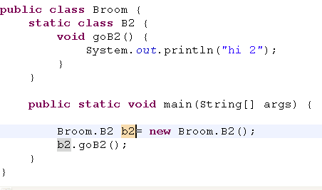

Static nested class
Static nested classes are inner classes marked with the static modifier
Instantiating a static nested class requires using both the outer and nested class names

Slide 33
Anonymous inner class – interface type
The class does not have class type
At Compile time, creates a anonymous class and implement the method
At RT, Creates an instance and refer to interface type
Syntax
Interface ref = new interface(){ };
When it finds new interface(){} It creates annonymous class
Client$1
At RT, creates an instance for Anonymous class and ref to interface
It can be used locally
When to go for Anonymous inner class
If your interfcae have only one method and having many implementations
This makes code precise and simple

