Slide 1
JDK8 streams

Slide 2
What is stream
Stream is a sequence to objects from the source
Source can be an array, collection or I/O
Stream is used to process data from source
Operations performed on a stream does not modify it's source
Designed for lamdas
It is from java.util.stream package
Characteristics of stream
Supports aggregation
Results can be pipelined
Internal iteration
Internal iteration
provides several features such as sequential and parallel execution, filtering based on the given criteria, mapping etc.

Slide 3
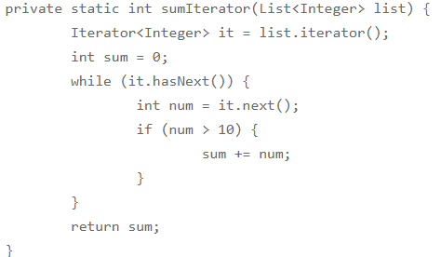
Why JDK8 Stream
external iteration - client program is handling the algorithm to iterate over the list.
The program is sequential in nature, there is no way we can do this in parallel easily.
There is a lot of code to do even a simple task.

Slide 4
Collection vs stream
Collection | Stream
Collection is in-memory data structure to hold objects | It does not have storage and represent sequece of object from source
Same Collection can be accessed for multiple times | Same stream cannot be accessed for multiple times
 | Stream is lazy (code is executed when required)
Support indexed access | Do not support indexed access
Does not support parallazible | Can be parallazibale
External iteration | Internal iteration

Slide 5
Types of stream
Sequential stream
Stream()
Parallel stream
parallelStream()

Slide 6
Intermediate operations
It returns the stream after processing
Filter(Predicate)
Map(Function)
Sorted()
flatMap(Function)

Slide 7
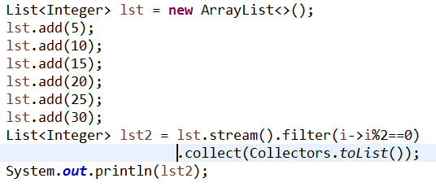
filter
Filter(Predicate) -> returns the stream that matches the given predicate

Slide 8
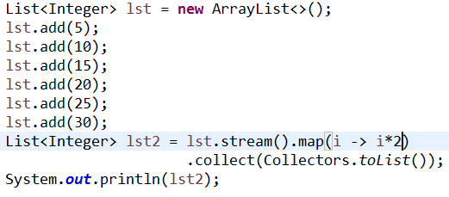
map
Map(Function)
Returns a stream consisting of the results of applying the given function to the elements

Slide 9
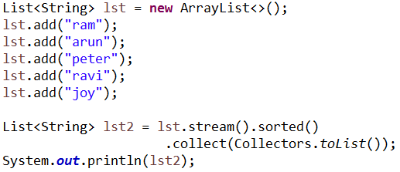
sorted
sorted()
Sorts the comparable elements in the stream
Sorted(comparator)
Sorts the data in the stream using comparator

Slide 10
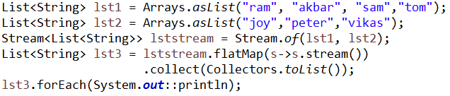
flatMap(Function)
Converts from type of stream to another type
Flattens the input stream of streams
Converts stream of list to stream of string

Slide 11
Terminal operations
Stops accessing the stream
reduce()
findFirst()
findAny()
Stops the stream if any element is found
collect()
match()
forEach()
count()
Returns no of elements in the stream

Slide 12
collect() & toArray()
Convert stream to collection
collect(collectors.toList);
collect(collectors.toMap);
collect(collectors.toSet);
Data processed by the stream is collected to a list, map or set

Slide 13
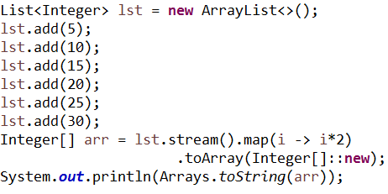
Convert stream to an array
Convert stream to an array
toArray() -- collects the data to an object array
toArray(type[]::new)—collects the data to the given array type

Slide 14

reduce(Integer, BinaryOperator)
We can use reduce() to perform a reduction on the elements of the stream, using an associative accumulation function, and return an reduced value

Slide 15

forEach(Consumer)
Iterates over the stream
Performs an action for each element in the stream

Slide 16
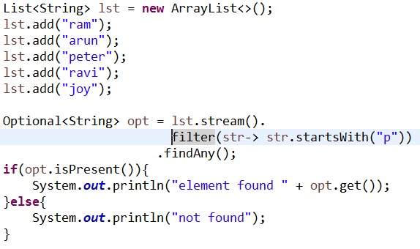
findFirst() & findAny()
findAny() - Returns optional if any element is found in the stream otherwise returns empty stream
findFirst() - Returns optional if first element is found in the stream otherwise returns empty stream

Slide 17
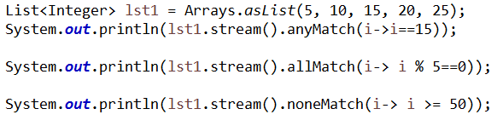
anyMatch(), allMatch(), noneMatch()
anyMatch(Predicate) | returns boolean, if any of the elements matches the given predicate
allMatch(Predicate) | returns boolean, if any of the elements matches the given predicate
noneMatch(Predicate) | Return boolean, if none of the element matches the given predicate

Slide 18
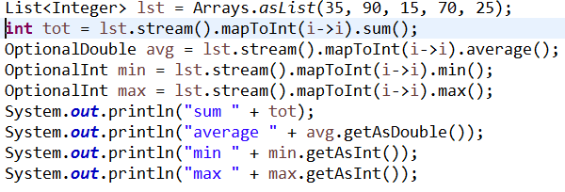
Numeric Streams
Streams API provides Streams to work with numbers. Following are the Numeric streams supported by Streams api.
IntStream
LongStream
DoubleStream

Slide 19
Built in functional interfaces
Function and BiFunction: Function represents a function that takes one type of argument and returns another type of argument
map(Function), flatMap(Function), toArray(Function), mapToInt(Function), flatMapToInt(Function), reduce(<T>, BiFunction)
Predicate and BiPredicate: It represents a predicate against which elements of the stream are tested. This is used to filter elements from the java stream.
filter(), allMatch(), anyMatch(), noneMatch()

Slide 20
Built in functional interfaces
Consumer and BiConsumer: It represents an operation that accepts a single input argument and returns no result.
void forEach(Consumer<? super T> action)
Supplier: Supplier represent an operation through which we can generate new values in the stream.
Collect(Supplier)

