Slide 1
Java 8

Slide 2
Java SE- 8
Java 8 release is the greatest thing in the Java world since Java 5
Its initial version was released on 18 March 2014.
It brings new features to the Java

Slide 3
Java 8 – Significant New Features
There are dozens of features added to Java 8, the most significant ones are
Lambda expression − Adds functional processing capability to Java.
Streams – proces sequece of objects from source to be aggregated, filtered or pipelined
Method references − Referencing functions by their names instead of invoking them directly. Using functions as parameter.
Default method − Interface to have default method implementation.
Date Time API − Improved date time API.
Nashorn, JavaScript Engine − A Java-based engine to execute JavaScript code.

Slide 4
Benefits of Lambda Expression
To enable functional programming
To make the code simple and precice
Support parallel processing
Does not create .class file
Make use of new API

Slide 5
Functional Programming
Java always remained Object first language.
  Cannot have stand alone function in Java world.
There is no way of passing a method as argument or returning a method body
Functions are first class citizens in a functional programming language.
  They exists on their own.
  Can assign them to a variable and pass them as arguments to other functions.
JavaScript is one of the best example of an FP language.
Functional Interfaces with Lambda expression adds that missing link of functional programming

Slide 6
Functional Interfaces
An interface with only one method. is known as a "functional interface.“
@FunctionalInterface
  Used to enforce the intent of the interface
  Existing interfaces are annotated with @FunctionalInterface
Functional Interfaces are used with lambda expressions.

Slide 7
Functional Interface
Has Only one abstract method
Valid even without @FunctionalInterface annotation
Can add one or more default methods
  default methods have an implementation,

Slide 8
Lambda Expressions
Anonymous inner classes provide a clear and concise way to represent one method interface
Lambda Expression is an anonymous function, method without name
A lambda expression is like a method, it provides a list of formal parameters and a body
  provides a way to represent functional interface using an expression.
  expression are composed of three parts.
Argument List (int x, int y) Arrow Token -> Body x + y

Slide 9
Functional Interface
  @FunctionalInterface
  public interface Example {
  public void show();
  }
  public static void main(String[] args) {
  Example1 obj =
  ( ()->{ System.out.println("Hello World ! "); } );
  obj.show();
  }

Slide 10
Structure of Lambda Expressions
  @FunctionalInterface
  public interface Example {
  public void show(String message);
  }
Single Expression Body
  Body is simply evaluated and returned.
Example obj=(msg)->{System.out.println(msg);};
  obj.show("Hello India");
Example obj2=(String msg)->{System.out.println(msg);};
  obj2.show("Hello India");

Slide 11
Lambda Expression
  interface Calculator{
  public Double calculate(Double d);
  }
  public static void main(String[] args) {
  Calculator calc1=(Double d)->{return d * 45.00;};
  System.out.println(calc1.calculate(new Double(100)));
  Calculator calc2=(d)->{return d * 55.00;};
  }
Body is evaluated like a method body
Return statement returns control to the caller of the anonymous method.
The type of the return value will be inferred by compiler.

Slide 12
Effectively Final
A Lambda expression can use an assigned local variable from its enclosing space
The Restriction
  It can only use local variable whose value doesn't change.
  They capture values, not variables.
Effectively Final.
  An effectively final variable is one whose value does not change after it is first assigned.
There is no need to explicitly declare such a variable as final, although doing so would not be an error.
If there is an attempt to change such a variable, compiler will throw an error.

Slide 13
Method References
Method references help to point to existing methods by their names.
A method reference is described using :: (double colon) symbol.
A method reference can be used to point the following types of methods −
  Static methods
  Instance methods
  Constructors using new operator (TreeSet::new)
Lambdas expressions, method references make the language constructs look compact and concise
It is a short hand notation for lamda expression

Slide 14
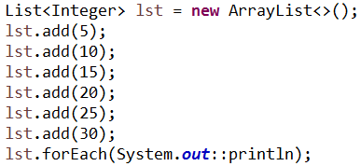
Method reference

Slide 15
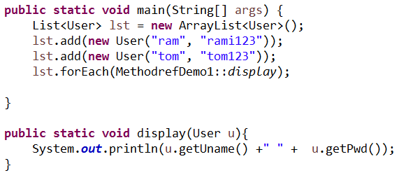
Method references

Slide 16
Why Date/Time Api (joda Api)
Immutability
  All the classes are immutable and it is thread safe(multi thread environment)
Seperation of concerns
  Defines classes seperately
    date – LocalDate
    time - LocalTime
    Datetime – LocalDateTime
Utility operations
  Are available for fomat, parse, plus, minus in all the date/time classes
zonedDateTime
  Handling zoned date time is easy

Slide 17

Date/Time Api
LocalDate.now() | Displays current date
LocalTime.now() | Displays current time
LocalDateTime.now() | Displays current date and time

Slide 18
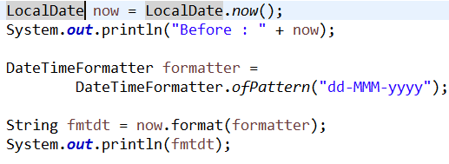
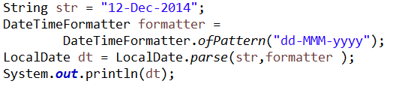
Date/time Api – Formatting and Parsing
Format() – formats the date to string using DateFormatter
parse() – parses the string into date

Slide 19
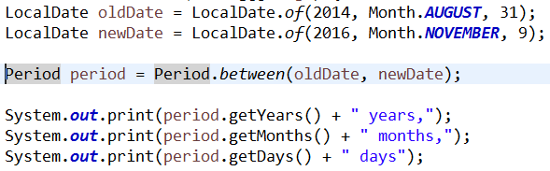
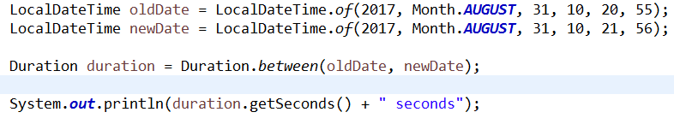
Period & Duration
Period – can determine year, month and days between two dates
Duration – can determine seconds and nanoseconds between two dates

Slide 20
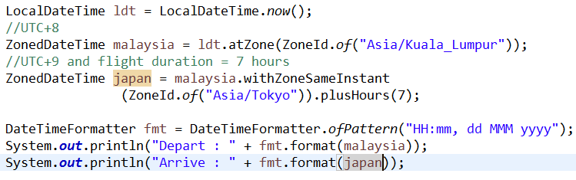
ZonedDateTime – represents time zone
a complete date-time with time-zone and resolved offset from UTC/Greenwich
atZone(zoneid) → returns zoned date and time for the given zone id
withZoneSameInstant(zoneid)→ returns the different zoned date and time for the current zone
ZoneId.getAvailableZoneIds() → returns available zoneids in a set

Slide 21


Time stamp & conversion
Instant Api
  Instant dt = Instant.now()
  Represents the time stamp
Conversion between date/time
Convert java.util.Date to Instant
Convert intant of specific zone to LocalDate

Slide 22
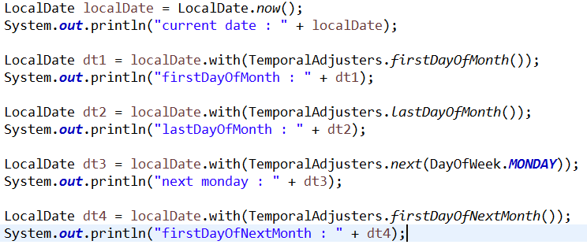
Temporal Adjusters
This Api is used to find first day of the month, last day of the month, first day of the next month, last day of next month, next date of the coming week day etc

