Slide 1
OOP

Slide 2
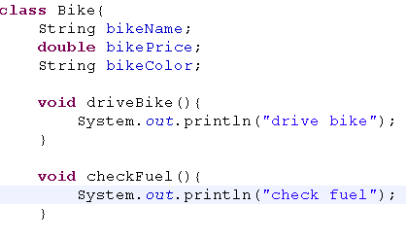
Class
Object state and behavior are defined in the class
Classes are user-defined data types.
It is a blueprint from which individual objects are created.
Once a class has been defined,
we can create any number of objects belonging to that class.
state
behaviour

Slide 3
Objects
An object is an instance of a class.
  Everything in Java is an object.
  “State” of an object is called an “instance variable”.
  “Behavior” of an object is known as “method”.
Heap space
Car car = new Car();
Car()
x1022
car
x1022
stack
New operator creates a new object dynamically at run time

Slide 4
Object creation
Instance creating using new keyword
This retuns the object ref
  type var = new type();
  CalculatorService calc = new CalculatorService();
You cannot acces obj ref programatically

Slide 5
Access instance members
Access an object members
  Instance members are accessed using instance ref following dot(.) and member
calc.val1=first;

Slide 6
Class components
State are the instance variable
Constructor special way of initializing instance variable
      Without it, none of the objects are created
Method behaviour of an object
Instance block
Static var
Static method
Static block

Slide 7
Static contract instance
Static methods/block cannot access the instance methods directly
  Create an instance
Instance method can access static methods directly

Slide 8
Object base size
Base size of an object is 8 bytes
Two int locations
  Class reference in method area
  Object lock status
CR
OLC

Slide 9

Method Area
doAdd()
doMul()
Heap space
val1
val2
cr
OLS
x1022
calc

Slide 10
OOP achieves
Extensibility, maintainability and reusability

Slide 11
OOP principles
Abstraction
Encapsulation
Polymorphism
inheritance

Slide 12
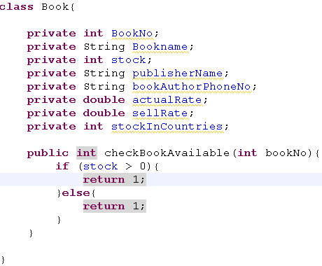
Data hiding
Data (fields) are not accessed by other classes
0

Slide 13
Diff between DataHiding and Encapsulation
It completely hides the data to the client
Forces the user to use an interface to access data

Slide 14
Encapsulation
Wraps code and data together is called encapsulation
Why Encapsulation?
  To avoid unwanted data which is not suitable to real world
  When the characteristics of state changes, it must not affect other codes

Slide 15
Encapsulation achieves
Maintainable and data secure

Slide 16
How will you do Encapsulation
Make all the fields private
Provide setters and getters
TightEncapsulation
  Make all the fields private
  Provide only getters
    Aceives immutable class

Slide 17
Setter and getter
Setter
  Set the data to instance variable
  To write business rule to validate the data
Getter
  Get the data from instance var

Slide 18
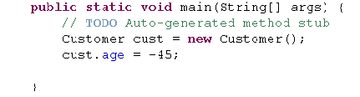
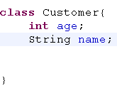
Why Encapsulation – case 1
Client code
If the fields are accessed directly by other classes, Data handling will be tedious
Age field cannot be negative in this case
Owener code should be able to handle these cases
Owner code

Slide 19
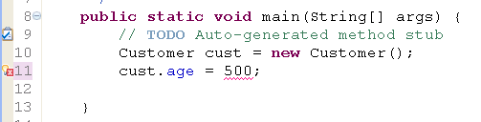
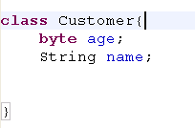
Why Encapsulation – case 2
When the owner tries to change the characteristics of a field in his code, client codes are all affected
In this case age value 500 cannot fit in to byte value

Slide 20
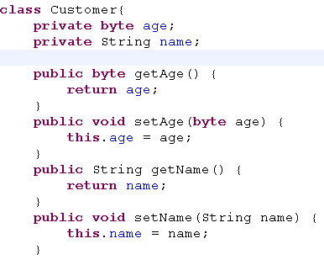
How to avoid these cases?
Encapsulation - Encapsulate the fields, is the better way
Achieving Encapsulation
How will you do the encapsulation?
Make all the fields private
Client should access these fields through getter and setter method

Slide 21

What is encapsulation
Owner code
Client code
cust.getAge();
setAge()
getAge()
age
Means wraps the data and code together as a single unit
Generally setters are called mutuators, getters are called accessors
Tight encapsulation is the good encapsulation(client should able to use accessors but not mutuators)
Encapsulation makes code maintaiable

Slide 22
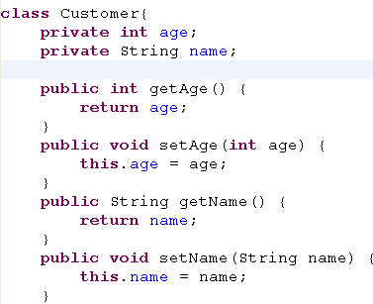

Encapsulation – the solution
In some situations, client need to use mutuators to assign fields
Consider the previous cases,
If a owner tries to change the characteristics as byte, then client code affects
What is the solution?
If the customer age is set to maximum of 30 years for a particluar loan scheme then the owner can provide the mutuators like this to assign to a byte field

Slide 23
Overloading
In java , we have
  Method overloading
  Constructor overloading
Method overloading
  Two or more methods having same name with different signature
Signature
  Includes method name and argument list
  Arguments must differ from type and number

Slide 24

Overloading
Java supports method overloading
More than one method name having same name with different parameters
JVM decides to call the method based on signatures
In java , wait method is overloaded

Slide 25
When to use overloading
Overloading ?
Providing the client to attain same task with different types of input.
Attain same task with additional arg that behaves with addl benefit.

Slide 26
Overloading
Overloading Achieves
  Maintainability
Methods are invoked based on the signature
All the methods must do the same job
Overloading occurs in stand alone class and also in inheritance
Return types can be different

Slide 27
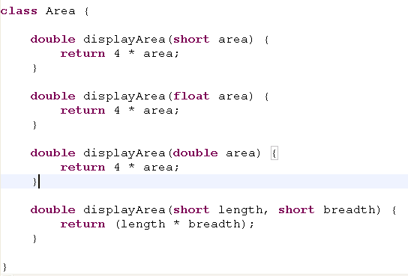
Overloading - Scenario
Area of a rectangle
Area of a square
In this case, single parameter- area of a square
Two parameter – area of a rectangle
Owner provides the client to access method displayArea() with different parameter type as input
Overloading involves in both single class or inheritance

Slide 28
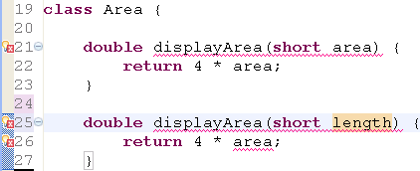
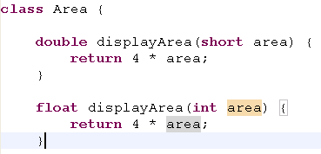
Overloading - legal
Eventhough argument names are different but they are same type
Illegal
Even if return types are different , they are legal
Overloading takes care for method names and its parameters, but not return types

Slide 29
Has – a - relationship
relies on instance var
Tightly coupled between two classes
class Car{
Wheel wheel = new Wheel();
}
has
class Wheel {
}

Slide 30



Is-a-Relation ship
Object
Inheritance achieves is-a-relationship
99% inheritance in java because all the built-in objects and user objects are inherited from Object class
Vehicle
Car
Bike

Slide 31
Inheritance
By default all the classes are the sub class of Object class
  If the class does not have explicit super class
99% inheritance is achieved

Slide 32
Object class
It is the root class in Inheritance hierarchy
Methods of Object class
  hashcode(), equals(),toString()
  getClass()
  Notify(), notifyAll()
  3 forms of wait()
Overide
  hashcode(), equals() and toString()

Slide 33
Inheritance
Subclass has its own state and behaviour plus non private members of super class
Inheritance achieves
  Reusbility and extensibility is achieved
If a class does not extend explicit super class then that class will be the direct sublass of Object class

Slide 34
Extend Explicit super class
A sub class can be created by extending super class explicitly
  Class Car extends Vehicle{
  }
In java, A class can extend only one direct super class
Java supports multi level inheritance but not multiple inheritance

Slide 35
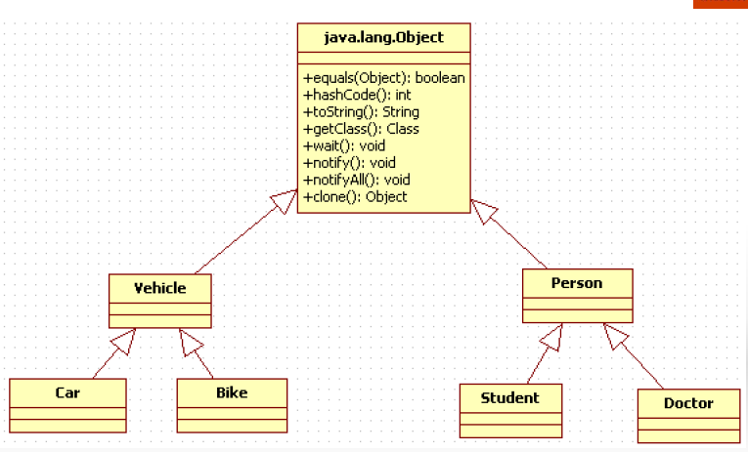

Slide 36
When to go for inheritance
When the new system has existing features of old system with extra features.

Slide 37
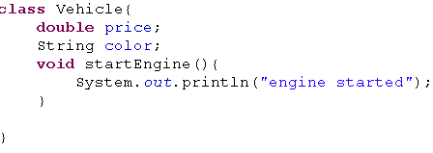
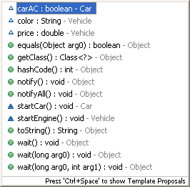
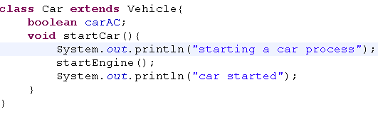
Code reuse
Two most common reasons to use inheritance are
To promote code reuse
To use polymorphism

Slide 38
== vs equals()
Objects are compared using obj identity
By deafult, Objects are compared using obj identity
this method can be overridden to compare based on content

