Slide 1
Constructor and Access specifier

Slide 2
Constructor
Constructor is a code that is invoked while creating an instance
What code can we write in constructor?
  The code to initialize instance variable

Slide 3
Default constructor
If no constructor is explicitly defined, then compiler supplies the default constructor with no arg
What happens if you write the constructor explicitly?
  Compiler stops supplying the constructor

Slide 4
Default constructor
class Car{
int modelId = 1224;
String ModelName = "hyndai accent";
String color = "green";
}
If no constructor is defined,
Jvm defines the default constructor with no args
If you define a constructor with no args explicitly then it is called ?
A constructor is a set of instructions designed to initialize an instance.
The name of the constructor must always be the same as the class name.
Constructors are not methods. They do not have return values and are not inherited.
By default class modifier will be the constructor modifier

Slide 5
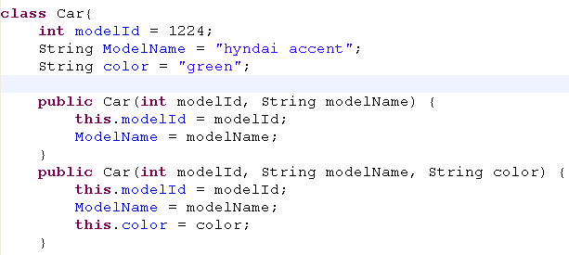

Default constructor
Default constructor is stopped supplied by your JVM
IF you explicitly define the constructor
In this case , you should define the constructor with no args
Generally defining a constructor with no args explicitly is a best practice

Slide 6
Rules for writing a constructor
Class name must be the constructor name
constructor not have return type
Constructor has only access specifier but not non access specifier.
What happens if it is having return type?
  It will treat as a method and not as a constrctor

Slide 7
Parameterized constructor
For Immutable class
Setting the data to an instance while creating an instance

Slide 8
this() or super()
Compiler rewrites super() in the first line of constructor code, If this() or super() is not explicitly defined
this() or super() must be in the first line
. And they cannot come together.

Slide 9
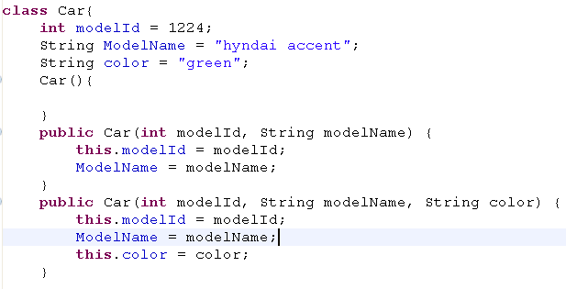
Constructor overloading
3 constructors
It calls the constructor with no args
Car car = new Car();

Slide 10
this() vs super()
How a constructor calls another constructor?
  This() invokes the constructor with in the class
  Super() invokes the constructor from super class
Generally when a constructor is invoked?
  using new keyword(creating an instance)

Slide 11
This() or super()
This()
  One constructor is invoked another constructor with in the class
    This is done using this()
    Constructor chaining
Super()
  Constructor is invoking a constructor in super class
    This is done by super()
    In Inheritance, constructors are chained
One constructor cannot call another constructor using constructor name

Slide 12

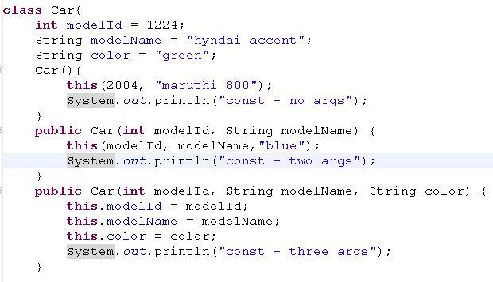
Constrctor chaining
this keyword must be as first statement
this() constructor calls the another constructor with in the class
Car()
Car(int modelId, String modelName)
Car(int modelId, String modelName, String color)

Slide 13
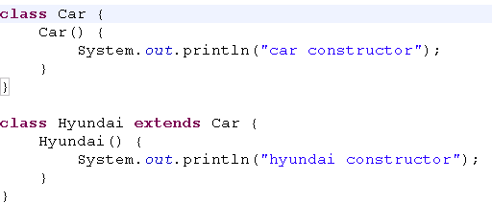


Constructor - inheritance
Client code
object
Car calls object constructor
Hyundai call car constructor

Slide 14
Constructor - What happens?
Jvm implicitly adds super() keyword as the first line, if this() or super() keyword is not given explicitly
If explicitly defined, this() or super() can be defined, but not both
Car() {
super();
System.out.println("car constructor");
}
Hyundai() {
super();
System.out.println("hyundai constructor");
}

Slide 15
Violation
Constrctor can call methods
Methods cannot invoke constructor

Slide 16
Constructor in inheritance
If a constructor with one arg is invoked in sub class, then which constructor be invoked in super class?
  If there is no super() or this() defined explicitly, then empty arg constructor is called in super class

Slide 17
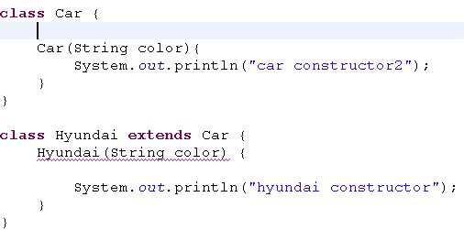
Constructor – super()
Car(String color){
super();
System.out.println("car constructor2");
}
Jvm rewrires the constructor
Hyundai(String color) {
super();
System.out.println("hyundai constructor");
}
When hyundai constructor tries to invoke super class constructor but fails, due to constructor’s absence
Best practice – always define a constructor with no args

Slide 18


Constructor – super()
How will you invoke the constructor with arguments in super class?
        Use super() keyword
Calls the super class constructor having one arg

Slide 19
Access Specifiers
They deal the restriction access
They are 4 access level but there are 3 access specifier..
Access level
  Private, default, protected, public
Access specifiers are:
  public, protected and private.
For default level, there is no specifier(keyword)
You can have only ONE access modifier.
If NO access modifier is used, then default access level is assigned.

Slide 20
Access specifiers allowed
Top level class
public or default
Constructor
All 4 levels
Static/instance Methods
All 4 levels
Static/instance var
All 4 levels

Slide 21
Access modifiers
There are 3 access modifiers but there are 4 access control levels
Static / instance Method access
Top level Class Access
public
protected
default
private
Constructor
Static / instance Variable access

Slide 22
private
Accessing level
  Members are accessed with in the class
Inheritance
  private members are not inherited
Constructor
  Can create a instance with in the class
  Cannot subclass

Slide 23
Com.pack1
  Car.java
  ClientA
  Ford.java(Sub class of Car)
Com.pack2
  ClientB
  Bmw.java(subclass of car)

Slide 24
Default (package private)
Accessing level
  Members are accessed with in the package
Inheritance
  Members are inherited with in the package
Constructor
  Instance is created with in the package
  Can be subclassed with in the package

Slide 25
protected
Accessing
  Members are accessed with in the package
Inheritance
  Members are inherited to its sub class in any package
Constructor
  Can create instance with in the package
  Can subclass in any package

Slide 26
public
Accessing
  Public members are accessed any package
Inheritance
  Inherited to any subclass of any package
Constructor
  Instance created any package
  Can subclass in any package

Slide 27

Subclasses and Method Privacy
Java specifies that methods may not be overridden to be more private.
legal overridden method access

Slide 28


Slide 29
private
The least generous access modifier is private .
Top-level (that is, not inner) classes may not be declared private.
A private variable or method is accessed only within that class.
Private cons cannot be subclassed
If cons is private, instance is created with in class
Private memebers are not inherited
Package A
Package B
Class A
classB
Class E
Class F
Class C
Class D
Class G
Class H

Slide 30
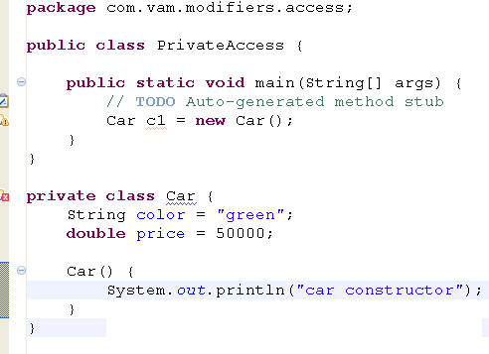
Class modifiers
Class access modifiers can be public or default access
Non – access modifiers can be final and abstract

Slide 31
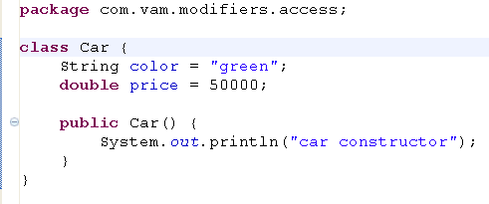
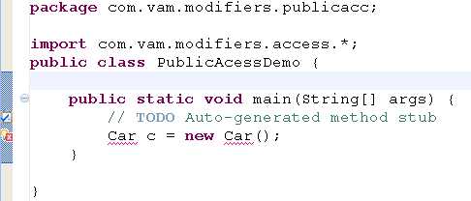
narrowing class access modifier

Slide 32
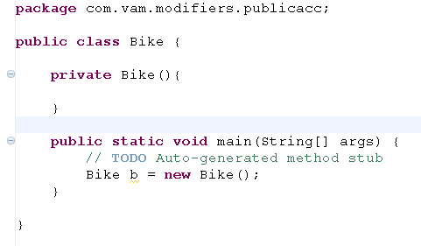
Constructor modifier
Acceesed by same class
If your constructor is private, Who can access
All 4 access level modifier is applicable
Non-accessmodifiers are not applicable
If you try to create an instance outside the class, it results compile time error

Slide 33
Default access level
Default accesss modifier is used at class, method and variable level
Members can be accessed in all the classes with in the package
Default constructor cannot be subclassed in other package
If constructor is default then instance can be created with in package
Default members are inherited to its subclass in same package
Package A
Package B
Class A
classB
Class E
Class F
Class C
Class D
Class G
Class H

Slide 34
protected
Protected modifier is applied to method and variable level
Members can be accessed by all the classes with in the package + inherited to subclasses resided in any package.
Protected constructor – can be subclassed in any package
Protected constructor – instance can be created with in package
Package A
Package B
Class A
classB
Class E
Class F
Class C
Class D
Class G
Class H

Slide 35
public
The most generous access modifier is public
Public access modifier is applied at class, method and variable level
Class, method and variable level are accessed in all the classes of any package within the application
Package A
Package B
Class A
classB
Class E
Class F
Class C
Class D
Class G
Class H

Slide 36
Subclasses and Method Privacy
Java specifies that methods may not be overridden to be more private.
legal overridden method access

