Slide 1
IO

Slide 2
Objectives
Understanding which streams to use for character-based and byte-based streams.
Read from a text file and write to a text file.
Understand wrapper stream classes for providing additional higher level functionality.
Understand how to read the data from keyboard using stream classes.

Slide 3


What is a Stream?
A stream represents a flow of data, or a channel of communication with a writer at one end and a reader at the other.
All fundamental I/O in java is based on streams.
Source/dest can be file, console, network

Slide 4
Byte Vs Character streams
In java , there are two types of streams
Byte stream
Byte stream reads or writes 8 bit of any data such as character, image, audio, video etc. at a time
It is derived from InputStream and OutputStream abstract class hierarchy
Character stream
Character stream reads or writes 16 bit at a time that represents only character.
This stream was introduced later in JDK 1.1
It is derived from Reader and Writer abstract class hierarchy
Translate character stream to byte stream and vice versa
Read or write a line of text
It is faster than byte stream

Slide 5
Character Streams
Character stream is derived from Reader and Writer abstract class hierarchy
Character stream reads or writes 16 bit unicode characters at a time
This stream was introduced later in JDK 1.1
Translate byte stream to character stream and vice versa
Read or write a line of text

Slide 6
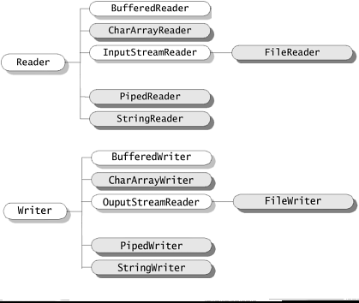
Character Stream Hierarchy
OutputStreamWriter
Notes:
The Java platform stores character values using Unicode conventions.
Character stream I/O automatically translates this internal format to and from the local character set.
All character stream classes are descended from Reader and Writer.

Slide 7
Writer class methods
write(int b) Writes the single character to the output stream..
write(char[] b) Writes an array of characters to the character writer stream.
flush() – flushes the stream
close() closes the character writer stream to free up system resources
OutputStream
+ write (int )
+ write (byte[ ] data)
+flush()
+ close ( )

Slide 8
Writer class - FileWriter
FileWriter
Writes a character to a file
FileWriter(file/String)
FileWriter(file/String, boolean append)
Ex: new FileWriter(“abc.txt”, true);
If append is false, It replaces an existing file otherwise it appends to an existing file.
If a new line character has to be written then include ‘\n’ as part of the string
“welcome to mindtree\n”

Slide 9
FileWriter
Str= ram\nraj\nravi
FR
stream
r
FileWriter writes only one char at a time
If you have tow write 100 chars then 100 time it hits the file
It is very much costlier
Dont use FileWriter directly to write
Instead use BufferedWriter
Xch1.txt

Slide 10
BufferedWriter
Maintains an internal buffer of default size 8192 bytes(8kb) and it is configurable
Data in the buffer is flushed to a underlying stream such as file, console output etc, at a time
Buffer is flushed, when the buffer is full or flush() / close() is invoked.
BufferedWriter(writer)
BufferedWriter(writer, buffersize)
The second option in the constructor configures the buffer size.
newLine() includes a new line character to the underlying stream.
No of hits to a file is reduced

Slide 11
Buffer, size is 8KB
Ram is great
Inspiring innvation
2
1
3
BW
FW
file
stream

Slide 12
PrintWriter
As of JDK5 , It handles the file directly
PrintWriter(File/string/writer);
new PrintWriter(“abc.txt”);
It maintains an internal buffer to write chunk of characters to a file at a time
println() writes the text including new line character
It writes formatted text using printf()
printf(“%s salary is %f”, name, salary);

Slide 13
Reader class methods
read() reads a single character. It returns the number of bytes read, or -1 if end-of-file has been reached.
read(char[]), which takes the character array, reads an array of characters and returns -1 ,if the end-of-file has been reached.
skip(long), skips a specified number of characters.
close() closes the stream to free up system resources
InputStream
+ int : read ()
+ int : read (char[] data)
+ long: skip (long lng)
+ void : close ( )

Slide 14
Reader class
FileReader
It reads a character from file
Syntax: new FileReader(File/string);
BufferedReader
It reads the data from the file to an internal buffer at a time, which is 8192 bytes by default and it is configurable
new BufferedReader(reader);
new BufferedReader(reader, buffersize);
new BufferedReader(new FileReader(“abc.txt”), 1024 *10);
The above syntax is used for configuring buffer size.
readLine() method reads a line from internal buffer,

Slide 15
BufferedReader
String
2
Buffer, size is 8KB
Reads until buffer is full
Reads line by line from buffer to String var
1
br
FR

Slide 16
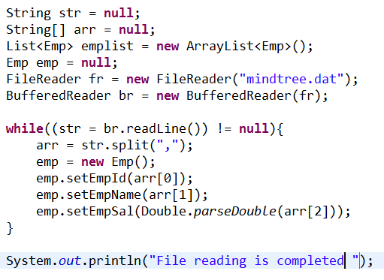

Reading from file
Reads the data from CSV file and binds to a List that contains Emp objects
Mindtree.dat

Slide 17

Converting Streams
Character stream is capable of converting from byte stream to character stream vice versa
InputStreamReader and OutputStreamwriter are the bridge between char and byte streams.
InputStreamReader
Converts byte stream to character stream
Syntax : new InputStreamReader(bytestream);
Ex:
Reads a line from input stream (System.in) , converts in to char stream and carries to buffer reader

Slide 18

Converting Streams
OutputStreamWriter
Converts character stream to byte stream
Syntax: new OutputStreamWriter(bytestream);
Ex:
It flushes the data from the bufferedWriter , converts into byte stream and sends to standard output (console output)

Slide 19
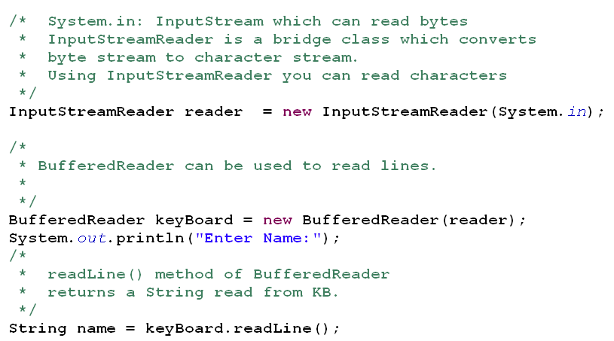
Converting Streams - Reading from Keyboard.
Notes:
Refer Character Streams. URL: http://goo.gl/D5q11

Slide 20
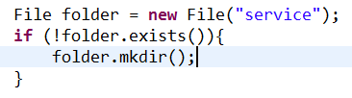
File
File object is used for creating a file or folder
File file = new File(filename);
The above syntax creates a file object but does not create a file physically
To create a file
File is created physically when File object is passed in the constructor of FileWriter, PrintWriter, FileOutputStream object .
FileWriter(file), FileOutputStream(file), PrintWriter(file)
To find file length : file.length()
To create a folder: file.mkdir();
To check the file/folder exist
file.exists()

Slide 21
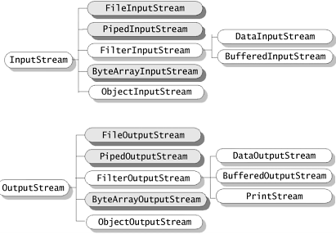
Byte streams hierarchy
Notes:
InputStream is an abstract base class for reading bytes.
OuputStream is an abstract blasé class for writing bytes.

Slide 22

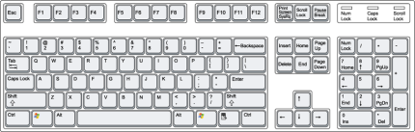
Input Stream and Output Stream
In Java there are different streams for reading and writing.
Use Output Stream to write data from an application.
Use Input Stream to read data into an application.
read( )
write()
100
110
77
105
105
77
Program
110
84
100
OutputStream
(System.out)
77
InputStream
(System.in)

Slide 23
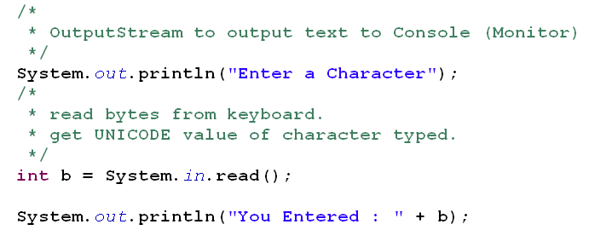

Console I/O – Reading and writing standard IO
System.out : out is an object of type PrintStream for outputting data to console.
System.in : in is an object of type InputStream which allows reading of raw bytes from keyboard.
Output Screen:
Notes:
Refer: ConsoleIOExample.java

Slide 24
InputStream class methods
read() reads a single byte. It returns the number of bytes read, or -1 if end-of-file has been reached.
read(byte[]), which takes the byte array, reads an array of bytes and returns a -1 if the end-of-file has been reached.
skip(long), skips a specified number of bytes of input and returns the number of bytes actually skipped.
available() returns the number of bytes that can be read without blocking.
close() closes the input stream to free up system resources
InputStream
+ int : read ()
+ int : read (byte[ ] data)
+ long: skip (long lng)
+ int: available ( )
+ void : close ( )

Slide 25
FileInputStream
A FileInputStream obtains input bytes from a file in a file system.
FileInputStream is meant for reading streams of raw bytes such as image data.
If you are trying to open the file which does not exist, or if you are opening a directory rather than a regular file, or for some other reason cannot be opened for reading FileInputStream throws FileNotFoundException.
read( )
77
105
File
Program
110
84
100
MindTree Ltd. ….
77
FileInputStream

Slide 26
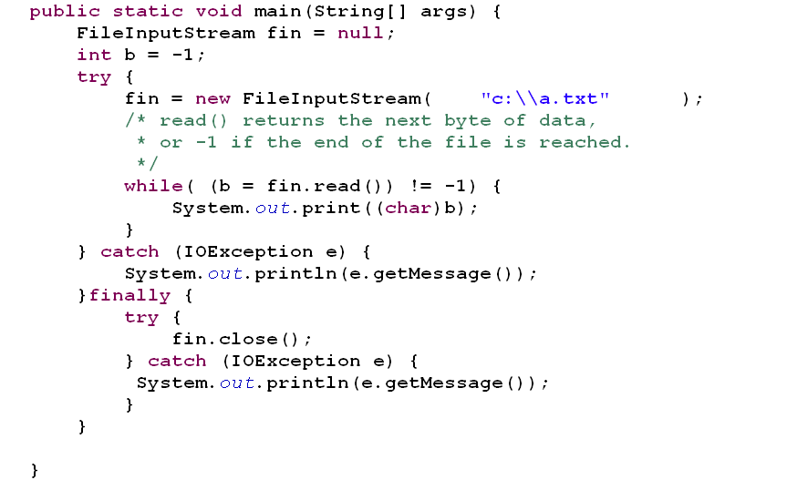
Code Snippet: using FileInputStream to read text file.
“FILE NAME”

Slide 27
OutputStream class
write(int b) Writes the specified byte to the output stream..
write(byte[] b) Writes b.length bytes from the specified byte array to this output stream.
close() closes the output stream to free up system resources
OutputStream
+ write (int )
+ write (byte[ ] data)
+ close ( )

Slide 28
FileOutputStream
A file output stream is an output stream for writing data to a File.
FileOutputStream is meant for writing streams of raw bytes such as image data.
write(100)
100
110
File
Program
105
77
Mind
FileOutputStream

Slide 29
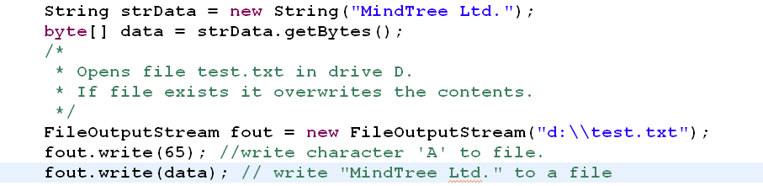
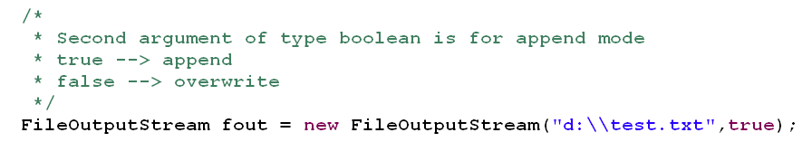
Using FileOutputStream to write data to file
“FILE NAME”
“FILE NAME”
“FILE NAME”

Slide 30
BufferedInputStream and BufferedOutputStream
Reads/writes a buffer of data from /to a underlying stream such as a file/network/console

Slide 31
Serialization
Serialization
Sending an object over a stream
It is done by using ObjectOutputStream
Class marked Serializable
State of an instance is sent over a stream
Deseralization
Getting an object from stream
Binding an instance state from stream to an object
It is done by using ObjectInputStream
Ex: RMI, EJB projects

Slide 32
Static var
Cannot be serialized
Instance var
Can be serialized
Transient
Applied to instance var
Transient field ignore serialization

Slide 33
Has - a
Has a relation ship
Car has a wheel
Class Car implements Serializable{
Whel w = new Wheel();
}
The members of car class must be serializable

Slide 34
Is a
If super class is Serializable then all its sub classes are also serializable
class Nokia1100 implements Serializable{
}
class NokiaLumia extends Nokia1100{
}

