Slide 2
JDBC
It is an ApI to intreact with DB
Jdbc api is from java.sql package
Sun java provides JDBC API,
As Interfaces
Implementation is vendor specific
This API is a wrapper for vendor specific API

Slide 3
Seven Basic Steps in Using JDBC
1. Load the driver
2. Define the Connection URL
3. Establish the Connection
4. Create a Statement object
5. Bind parameters to Statement
6. Execute a query
7. Process the results
8. Close the connection

Slide 4
Driver
Driver is a java class provided by vendor and it is responsible for
Is responsible for doing entire JDBC operations
Establishing connection to DB
parse the query
Send SQL statements
Receiving resultset from DB

Slide 5
Step 1: Load the driver
try {
Class.forName("oracle.jdbc.driver.OracleDriver");
} catch (ClassNotFoundException cnfe) {
System.out.println("Error loading driver: " cnfe);
}
Handle ClassNotFoundException

Slide 6
Step2: Define a DB URL
Jdbc:mysql://localhost: 3306/test
dbname
protocol
vendor
ipaddr
Port no
Default port no for Mysql is 3306
Default port no for oracle is 1521

Slide 7
Step3: Get a Connection
DriverManager.getConnection(url, uname, pwd)
It gets a connection from DB and creates the connection instance
It invokes the driver
driver
1. Request DB for connection
2. Db accepts to give connection
Db
Conn
3. Driver creates a connection instance and connected to DB

Slide 8
Connection conn = DriverManger.getConnection(url, uname, pass)
conn
Db
heap
stack
conn

Slide 9
Step4: Creating Statement
PreparedStatement is created using
conn.prepareStatement(sql)
It contains SQL (query/DML) statements
It is also Parameterized query statement
It is also pre compiled statement
It gas IN parameters

Slide 10
Pre compiled Statement
Statement gets executed in DB using 4 phases
Reads the query
Parses the query
Create execution plan
Hits the DB

Slide 11
Pre compiled statement
Select * from product where category= ‘computer’
Select * from product where category= ‘mobile’
The above queries are same but the value passed is different
If same query to executed for multiple times for different parameter
Use prepsredStatement
only for the first time
It undergoes all 4 phases
It caches the parsed query and query plan
For subsequent times
It gets parsed query and query plan from cache
Hits the DB
PreparedStatement performance is high

Slide 12
Step 5: Binding parmeters to query
Using
St.setXXX(parameteridx, value)
St.setInt(1, 1002)
St.setString(2,’computer’)
setXXX() of prepared statement instance

Slide 13
Step6: Execute the SQL
st.executeQuery()
Execute Sql select queries and returns the result from DB as ResultSet java object
St.executeUpdate()
Execute DML(insert/ update/delete)
Returns no of rows updated as int

Slide 14
Step 7: Iterate the ResultSet
Go to a row and access columns
rs.next()
Returns true if there is a row found and points to a current row
While(rs.next()){
rs.getInt(“pid”);
}
Get a column in a row
Rs.getXXX(colname/colidx)
Ex: rs.getInt(“pid”)
Rs.getDouble(“price”);

Slide 15
Step 8: Close connection
Conn.close();
Disconnecting the connection from DB
close() of connection instance
conn
The local ref var conn will die when it reaches end of method
Connection Instance is busy with DB and it is not ready to GC
So close the connection
conn

Slide 16
Close a connection
If connection is not closed properly
Memory leakage in your app
Db cannot accept any more connection from aother applications
Scalability becomes low in DB server side

Slide 17
Best Practice
Open a connection locally
Close a connection locally

Slide 18
Why Connection instance must not be static/instance ref?
Connection instance is synchronized
Create a connection for each demand and close it immediately after job is over
Provide connection instance for each demand, to improve performance
conn
db
conn
t1
t2

Slide 19
Dont return ResultSet to calling method
Connection has to be kept opened to iterate ResultSet

Slide 20
SimpledateFormat
SimpleDateFormat sdf = new SimpleDateFormat(pattern)
dd - date
MM - month
MMM - month in 3 chars
yyyy - year
hh - hours
mm - mins
Ss – secs
Sdf.format(dt)
Converts date into String
Sdf.parse(str)
Converts string into date

Slide 21
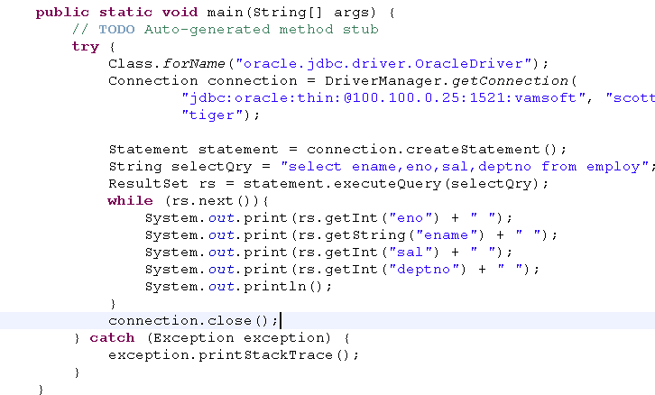
Jdbc - Demo
Load the driver
Establish connection
Create statement
Execute query
Process results
Close connection

Slide 22
ResultSetMetaData
It is obtained from Result set
It contains metadata about your result set
Column name
Column type
Column scale
Column precission
No of colums in result set

Slide 23
ResultSet
Contains rows rows fetched from DB and metadata returned from DB
It maintains the cursor
Three types of ResultSet
Forward result set, Scrollable result set, updatable result set.

Slide 24
Forward Result set
Can iterate only in forward direction
conn.prepareStatement(qry);
The above statement returns forward result set.

Slide 25

Scrollable ResultSet
Can iterate in both direction
Only for readable purpose
Add two more arg
TYPE_SCROLL_INSENSITIVE - Changes done by others are not known
CONCUR_READ_ONLY – retrieved only for readable purpose

Slide 26
Scrollable/updatable RS methods
Rs.first() | Returns first row
Rs.last() | Returns last row
Rs.next() | Returns next row
Rs.last() | Returns last row
Rs.beforeFirst() | Cursor moves to before of first row
Rs.afterLast() | Cursor moves to after last row

Slide 27
Scrollable/updatable RS methods
Rs.absolute(n) | Moves to nth row
Rs.relative(n) | From current row, it forwards to n rows

Slide 28
Count no of rows from RS
Rs.last();// go to last row
Int r = Rs.getRow();// get row number

Slide 29
Callable Statement
Used to invoke a stored procedure
Has IN and OUT parameters
Create a Callable Statement
CallableStatement st = conn.prepraeCall(“{call p1}”)
Bind In paarmeters
Out parameters must be registered
After executing the Sp, callable statement maintains OUT parameter internally
Get the data from Callable Statement
st.getXXX(parameter idx)
getXXX() of Callable Statement

Slide 30
Transaction
BY default, Jdbc is using auto commit transaction
If you have 3 sql statements , then it is use 3 TXns
Now I want to make all 3 sql statements to send in single TX
After obtaining connection
Set conn.SetAutoCommit(false);
At the end of try block
Commit the tx, using conn.commit()
If any sql statement goes wrong, It should roll back
Rollback the Tx in catch block, using conn.rollback();

