Slide 2
Overriding, Static

Slide 3
Overriding
Occurs only in inheritance
Methods in super class and sub class having same method name, signature and return type
Sub class method overrides super class method
Only instance methods

Slide 4
When to use overriding?
When the new system has improved version of existing behavior
Run time polymorphism

Slide 5
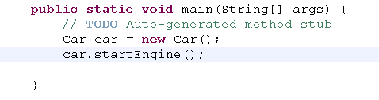
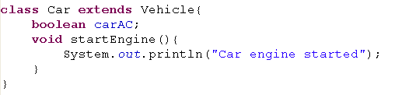

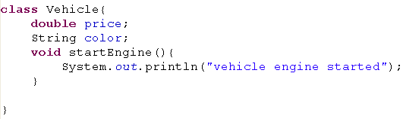
Overriding
Client code
startEngine() of car method overrides startEngine() of vehicle
Overridden mehod
output

Slide 6
Overriding
What happens if signatures are different?
Compiles fine and it is Overloading
What happens if return type is different?
Compile – time error except covariant types

Slide 7

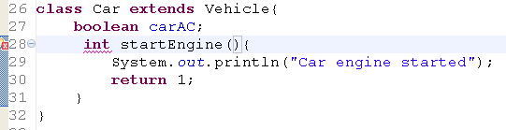
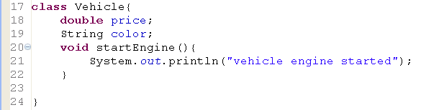
Overridden - restrictions
Legal, because it is not overriding,
It is overloading
Cannot override because return types are different

Slide 8
Access specifier in overriding
Overridden method access modifier must be same access level or widening access level

Slide 9
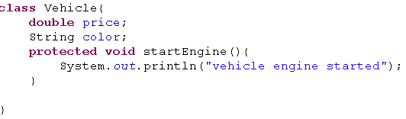
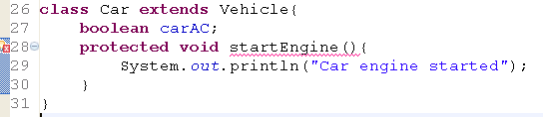
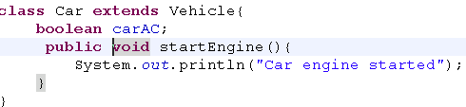
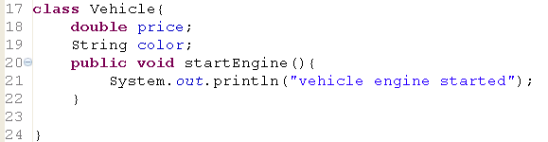
Access modifiers - overriding
Illegal
legal
Less Generous
More Generous/
Widened scope

Slide 10
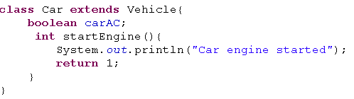
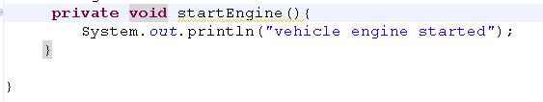
Overriding – private method
Why there is no error
Actually , Overriding does not takes place
Because super class method is private

Slide 11
Exception Hierarchy
Object
throwable
Exception
IOEXception
RuntimeException
FileNotFoundException
Null pointer Exzception
ArithmeticException

Slide 12
Exceptions in Overriding
Can a sub class declares checked exception, If super class method does not declares exception
No
If super class declares exception then sub class
May or may not declare exception
If it declares, then declare same checked exception or most specific exception.(subclass of that exception)

Slide 13
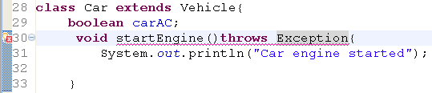
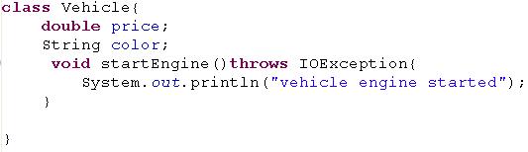
Exceptions in Overriding
Exception
IOException
Overridden method must throw same checked Exception or most specific exception

Slide 14
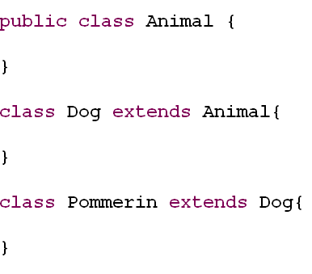
Covariant return type
Return type can be different , if only a return type is covariant
Method must return same return type or its subclass
Class Base{
public Dog getAnimal(){
return null;
}
}
Class SubA extends Base{
public ________ getAnimal(){
return null;
}
}

Slide 15

Accessing super class method
Provide an additional method in sub class

Slide 16
final
Final class
Prevents inheritance
Final method
Prevents overriding
Final var
Constant var
Local variable is having only one modifier, that is final

Slide 17
Prevent overriding
Final methods in super class cannot be overridden in sub class

Slide 18
Immutable class created
2 ways
Tight encapsulation
Make all the fields final
Prevent inheritance
2 ways
Making constructors private
Mark the class final

Slide 19
Static var
Static var are shared to any no of instances of same or different type
Count no of instances created
Calculate total sales, average
Gwnwrate an Id
Public static
Global variables
Public static final
Global constant

Slide 20
Static modifier
It applies to variables, methods, static initializer.
A static feature belongs to a class
not an instance of the class.(One copy per class)
Static member is allocated once when class is loaded, the initialization also happens at class-load time.
class Car{
static int price = 5;
}
Int p = Car.price

Slide 21

Static variables
They are not declared inside any methods or constructors
Class variables (belong to a class)
class Car{
static double price = 50000;
int noOfPass = 3;
}
Car c1 = new Car();
Car.price = 6000;
c1.noOfPass = 2;
System.out.println(c1.noOfPass + “” + Car.price);
Car c2 = new Car();
Car.price = 7000;
c2.noOfPass = 5;
System.out.println(c2.noOfPass + “” + Car.price);
System.out.println(Car.price);

Slide 22
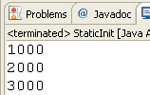
Static variable
They are shared to all instances of that class
It is alive till jvm shuts down
Behaved as Global variables
Ex – auto generating Ids, total sales of all salesperson, average sales etc
SalesPerson p1 = new SalesPerson(1000);
System.out.println(SalesPerson.sales);
SalesPerson p2 = new SalesPerson(1000);
System.out.println(SalesPerson.sales);
SalesPerson p3 = new SalesPerson(1000);
System.out.println(SalesPerson.sales);
class SalesPerson{
static int sales;
SalesPerson(int tmpSales){
sales += tmpSales;
}
}

Slide 23
Static Method
Methods get loaded during class time
Lifespan – alive till your jvm die
Utility functionalities moved in static method
Formatting, validation, conversion, logger
Singleton, Factory codes in static method

Slide 24
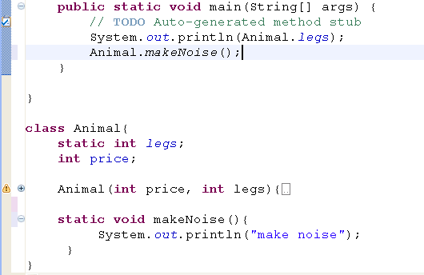
Accesing static Method
Static variables and methods are accessed before any instance is created

Slide 25
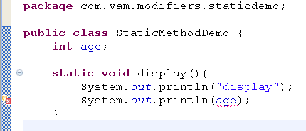
Static method access
Instance members cannot be accessed directly in static method or static block.
StaticMethodDemo sd = new StaticMethodDemo
System.out.println(sd.age);

Slide 26
static block
The main purpose to use static initializer is to ensure some codes to be executed mandatory once
Static block is loaded and executed during class time
What codes does the static block contain
Loading the class programatically
Initializing static final variable

Slide 27
Instance Block
Instance initializer is loaded and executed whenever the object is created
Redundant codes in overloaded constructors can be moved to instance Block

Slide 28
Restrictions on modifier
private and abstract cannot come together
abstract and final cannot come together
static and transient cannot come together
None of the non – access modifier come together with abstract

Slide 29
Scopes of a variable
There are 3 scopes of a variable
static
local
instance
They are declared inside the method
They die when the method completes its execution
Reside in java stack
Not initialized by default
They are declared in the general area of the class
They live until the jvm shuts down
Reside in method area
Initializes by default
They are declared in the general area of the class
They live until the instance is alive
Reside in heap space
Initialize values by deafuly

Slide 30
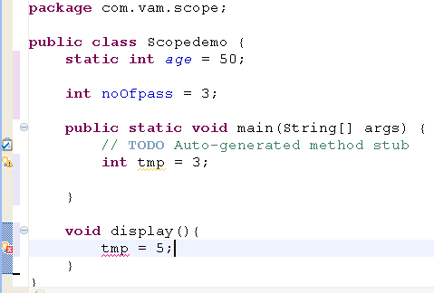
Scope of a local variable

Slide 31
Jvm flow
Class is loaded – Static variables loaded in method area and initializes default values
Static method gets loaded and available at RT
Static block gets loaded and executed
Constructor, inst method and inst block gets loaded and available when obj gets referenced

Slide 32
Instance creation flow
When instance is created
JVM invokes the constructor and if necessary calls the explicit super class constructor
Jvm determines the super class is object class then object creation process is started
Instance variable is loaded and initialized default values
Instance methods are referenced
Instance block is executed
Code in the constructor fires

