Slide 1
Junit5.x
Unit Testing

Slide 2
Junit 5.x
JUnit is a framework for writing tests
  JUnit helps the programmer:
    define and execute tests and test suites
    formalize requirements and clarify architecture
    write and debug code
    integrate code and always be ready to release a working version
JUnit 5 = JUnit Platform + JUnit Jupiter + JUnit Vintage

Slide 3
JUnit - A Testing Framework
Open source for automated tests
Can write repeatable tests.
Can write parameterized test
3.<number>
Notes:
XP Extreme Programming
Junit ist seit 1998 zum De-facto-Standard für Java Entwicklertests geworden und ist in den meisten IDEs integriert.

Slide 4
Testing phases
Unit Testing
  on individual units of source code (mostly methods)
Integration Testing
  on groups of individual software modules
System testing
  on a complete end-to-end system

Slide 5
What is unit testing?
Unit
  A Method , a class, a package, or a subsystem.
Can Test :
  an entire object
  part of an object – a method or some interacting methods
  interaction between several objects
Helps discover failures in the logic and improve the quality of their code.
Used to ensure that the code work as expected in case of future changes.

Slide 6
JUnit
Widely used in industry and can be used as stand alone or within an IDE such as Eclipse.
Features:
  Assertions for testing expected results.
  Test features for sharing common test data.
  Test suites for easily organizing and running tests.
  Graphical and textual test runners.

Slide 7
JUnit 5.x
Annotations for marking methods as tests
Annotations for marking methods that setting up and cleaning up test data (“fixtures”)
methods for making assertions
textual and graphical tools for running tests
3.<number>
Notes:
Das einfachste Framework der Welt ist einfacher geworden.
Die Architekur wurde grundlegend geaendert - benutzt Annotations von Java 1.5.
Annotations sind die neue Ausdrucksmittel von Metaprogramming.
Dieses Sprachkonstrukt wird verwendet um Methode als Test-Methode zu markieren.

Slide 8
When to Write Test
During Development
To add new functionality
When adding new features,
During Debugging
While a defect is discovered in code to demonstrates the defect.
write unit tests to thoroughly test a single class
write tests as develop (even before you implement)
write tests for every new piece of functionality
Notes:
Bei Test-getriebener Entwicklung wird - wie der Name schon sagt - die Entwicklung durch automatisierte Tests getrieben, indem neuer Code nur dann geschrieben wird, wenn ein automatisierter Test fehlgeschlagen hat. Die Entwickler müssen Tests schreiben, bevor sie die Implementierung schreiben.

Slide 9
CORRECT -JUNIT
Conformance
  does the value conform to expected format?
Ordering
  does value is in expected ordered?
Range
  does value is in expected range?
Reference
  does code reference anything external which is not in direct control of the code itself?
Existence
  does the value exists? (null, non-null, present or absent in Collection)
Cardinality
  Are there exactly enough values?
Time (absolute and relative)
  Is everything happening in order? At the right time? In time?

Slide 10
Annotations
@Test – mark a method as test
@BeforeAll – run once before all tests
@AfterAll – run once after all tests
@BeforeEach – called before every testX()
@AfterEach – called after every testX()
Can have as many @Before and @After methods
  Order of execution is not predefined.

Slide 11
Annotation
@Disabled
  Ignores testing the method
@DisplayName
  Sets the name for the test or the class
@Tag
  sets the tag name for the test or class
@IncludeTag/@ExcludeTag
  Filters the test by tag name
@RunWith(JUnitPlatform.class)
  It uses junit5 jupiter engine to test the methods
The below annotation is used for test suite
  @SelectClasses
  @SelectPackages

Slide 12
Assertions
methods
fail(msg) | triggers a failure named msg
assertTrue( boolean, msg) | Test passes if condition is true
assertEquals(v1, v2) | Test passes if two value or object is equal. It uses equals() to check based on the ref and the content
assertNull(object , msg) | Test passes if object is null
assertNonNull(object,msg) | Test passes if object is not null
assertSame(obj, obj) | Test passes, if two object references are same
assertThrows(exception, executable) | test passes if executable code is throwing exception
assertTimeout(duration, executable)→ test | Test passes if it executes with in given duration
assertNotEquals(v1,v2) | Test passes, if two values are not equal
assertArrayEquals(arr, arr) | Test passes, if two array contents are equal

Slide 13
Assumptions
JUnit 5 Assumptions class provides static methods to support conditional test execution based on assumptions.
A failed assumption results in a test being aborted.
Assumptions are typically used whenever it does not make sense to continue execution of a given test method.
In test report, these test will be marked as passed.

Slide 14
Assumptions
methods
assumeTrue(condition) | Assertion is continued , if assumption is valid
assumeFalse(condition)
assumingThat(condition, executable) | Executable is executed, if assumption condition is valid

Slide 15
Writing a JUnit test class, I
  Start by importing these JUnit 4 classes:
import org.junit.jupiter.api.*
import static org.junit.jupiter.api.Assertions..*; // note static import
  Declare your test class in the usual way
public class MyProgramTest {
  Declare an instance of the class being tested
  You can declare other variables, but don’t give them initial values here
public class MyProgramTest {
MyProgram program;
int someVariable;

Slide 16
Writing a JUnit test class, II2
  Define a method (or several methods) to be executed before each test
  Initialize your variables in this method, so that each test starts with a fresh set of values
@BeforeEach
public void setUp() {
program = new MyProgram();
someVariable = 1000;
}
  You can define one or more methods to be executed after each test
  Typically such methods release resources, such as files
  Usually there is no need to bother with this method
@AfterEach
public void tearDown() {
}

Slide 17
A simple example
Suppose you have a class Arithmetic with methods int multiply(int x, int y), and boolean isPositive(int x)
import org.junit.jupiter.api*;
import static org.junit.jupiter.api,Assertions.*;
public class ArithmeticTest {
}
@Test
public void testMultiply() {
assertEquals(4, Arithmetic.multiply(2, 2));
assertEquals(-15, Arithmetic.multiply(3, -5));
}
@Test
public void testIsPositive() {
assertTrue(Arithmetic.isPositive(5));
assertFalse(Arithmetic.isPositive(-5));
assertFalse(Arithmetic.isPositive(0));
}

Slide 18
Assert methods I
Within a test,
  Call the method being tested and get the actual result
  Assert what the correct result should be with one of the assert methods
  These steps can be repeated as many times as necessary
An assert method is a JUnit method that performs a test, and throws an AssertionError if the test fails
  JUnit catches these Errors and shows you the result
static void assertTrue(boolean test)
static void assertTrue(String message, boolean test)
  Throws an AssertionErrorif the test fails
  The optional message is included in the Error
static void assertFalse(boolean test)
static void assertFalse(String message, boolean test)
  Throws an AssertionErrorif the test fails

Slide 19
Example: Counter class
For the sake of example, we will create and test a trivial “counter” class
  The constructor will create a counter and set it to zero
  The increment method will add one to the counter and return the new value
  The decrement method will subtract one from the counter and return the new value
We write the test methods before we write the code
  This has the advantages described earlier
  However, we usually write the method stubs first, and let the IDE generate the test method stubs
Don’t be alarmed if, in this simple example, the JUnit tests are more code than the class itself

Slide 20
JUnit tests for Counter
public class CounterTest {
Counter counter1; // declare a Counter here
@BeforeEach
void setUp() {
counter1 = new Counter(); // initialize the Counter here
}
@Test
public void testIncrement() {
assertTrue(counter1.increment() == 1);
assertTrue(counter1.increment() == 2);
}
@Test
public void testDecrement() {
assertTrue(counter1.decrement() == -1);
}
}
Note that each test begins with a brand new counter
This means you don’t have to worry about the order in which the tests are run

Slide 21
The Counter class itself
public class Counter {
int count = 0;
public int increment() {
return count += 1;
}
public int decrement() {
return count -= 1;
}
public int getCount() {
return count;
}
}
Is JUnit testing overkill for this little class?
The Extreme Programming view is: If it isn’t tested, it doesn’t work
You are not likely to have many classes this trivial in a real program, so writing JUnit tests for those few trivial classes is no big deal
Often even XP programmers don’t bother writing tests for simple getter methods such as getCount()
We only used assertTrue in this example, but there are additional assert methods

Slide 22
Warning: equals
You can compare primitives with ==
Java has a method x.equals(y), for comparing objects
  This method works great for Strings and a few other Java classes
  For objects of classes that you create, you have to define equals
assertEquals(expected, actual) uses == or equals
To define equals for your own objects, define exactly this method:
public boolean equals(Object obj) { ... }
  The argument must be of type Object, which isn’t what you want, so you must cast it to the correct type (say, Person):
  public boolean equals(Object something) {
  Person p = (Person)something;
  return this.name == p.name; // test whatever you like here
  }
We’ll talk much more about equals later

Slide 23
Assert methods II
assertEquals(expected, actual)
assertEquals(expected, actual, String message)
  expected and actual must be both objects or the same primitive type
  For objects, uses your equals method, if you have defined it properly, as described on the previous slide
assertSame(Object expected, Object actual)
assertSame(Object expected, Object actual, String message)
  Asserts that two arguments refer to the same object
assertNotSame(Object expected, Object actual)
assertNotSame(Object expected, Object actual, String message)
  Asserts that two objects do not refer to the same object

Slide 24
Assert methods III
assertNull(Object object)
assertNull(String message, Object object)
  Asserts that the object is null (undefined)
assertNotNull(Object object)
assertNotNull(String message, Object object)
  Asserts that the object is null
fail()
fail(String message)
  Causes the test to fail and throw an AssertionFailedError
  Useful as a result of a complex test, when the other assert methods aren’t quite what you want

Slide 25
Writing a JUnit test class, III
This page is really only for expensive setup, such as when you need to connect to a database to do your testing
  If you wish, you can declare one method to be executed just once, when the class is first loaded
@BeforeAll
public static void setUpClass() throws Exception {
// one-time initialization code
}
  If you wish, you can declare one method to be executed just once, to do cleanup after all the tests have been completed
@AfterAll
public static void tearDownClass() throws Exception {
// one-time cleanup code
}

Slide 26
Test-Driven Development (TDD)
It is difficult to add JUnit tests to an existing program
  The program probably wasn’t written with testing in mind
It’s actually better to write the tests before writing the code you want to test
This seems backward, but it really does work better:
  When tests are written first, you have a clearer idea what to do when you write the methods
  Because the tests are written first, the methods are necessarily written to be testable
  Writing tests first encourages you to write simpler, single-purpose methods
  Because the methods will be called from more than one environment (the “real” one, plus your test class), they tend to be more independent of the environment

Slide 27
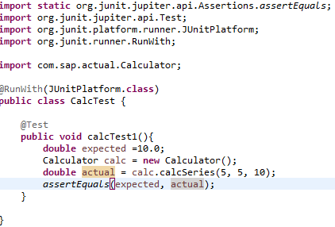
Test code

Slide 28
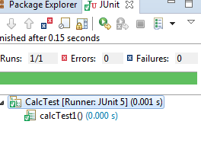
Run junit test case

Slide 29
Ignoring a test
In this we expect that this testing method will be ignored and won’t be executed.
  The @Disabled annotation says to not run a test
@Disabled(“Code is Pending")
@Test
public void add() {
assertEquals(4, program.sum(2, 2));
}
  You shouldn’t use @Ignore without a very good reason!

Slide 30

Testing exception
assertThrows(exception, executable)
  Test passes if executable is throwing the given exception
Parameters
  Exception – represents the expected exception class
  Executable refers to lamda expression

Slide 31
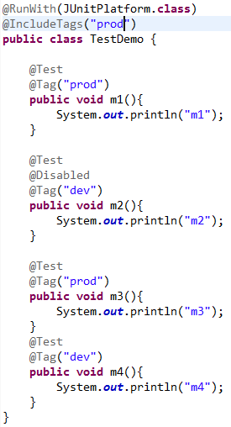
Tagging and Filtering
@Tag
  is used to tag a test or a class
@IncludeTag/@ExcludeTag
  it filters the test by tag name

Slide 32
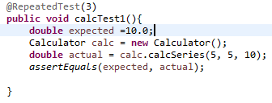
@RepeatedTest
Repeats the test for given no of times

Slide 33
Unit Test as Safety Net
Automated unit tests can provide a safety net
  Can continually enhance your applications,
  Need not be afraid of the code currently working on.
  Can Quickly verify functionality to code with confidence – and empower make improvements
  Create solutions that are more maintainable and have a longer lifetime
  A much higher return on investment.

Slide 34
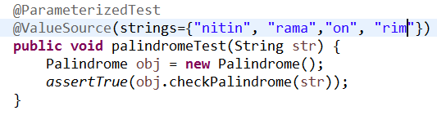
@ParamerizedTest
To run the same test for different arguments
@ValueSource
  Represents an array of data to be passed to test method

Slide 35
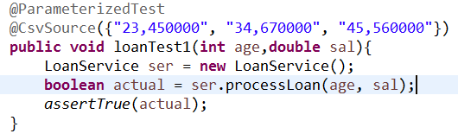
@CsvSource
Represents string array containing comma seperated values

Slide 36
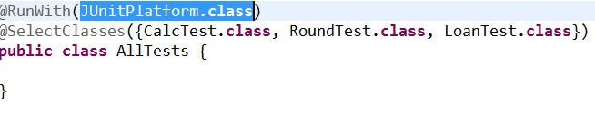
Test suite
A test suite is a collection of some test cases from different classes that can be run all together
The class must be annotated with @RunWith(JUnitPlatform.class) along with @SelectClasses / @SelectPackages
@SelectClasses – represents the classes to test.
@SuitePackages – represents the packages to test

Slide 37
Once more, in pictures
test suite
test runner
another unit test
test case (for one method)
A unit test tests the methods in a single class
A test case tests (insofar as possible) a single method
  You can have multiple test cases for a single method
A test suite combines unit tests
The test fixture provides software support for all this
The test runner runs unit tests or an entire test suite
Integration testing (testing that it all works together) is not well supported by JUnit
another test case
another unit test
another test case
another test case
another test case
unit test (for one class)
test case (for one method)
another test case
test fixture

