Slide 1
Maven

Slide 2
What is maven
Maven is a project management and comprehension tool.
Maven provides developers a complete build lifecycle framework.
Maven uses a standard directory layout and a default build lifecycle.

Slide 3
Environment variable
Set the environment variables using system properties. M2_HOME=C:\Program Files\Apache Software Foundation\apache-maven-2.2.1
MAVEN_HOME=C:\Program Files\Apache Software Foundation\apache-maven-2.2.1

Slide 4
Configure maven
SET Environment variables
M2_HOME
JAVA_HOME
path

Slide 5
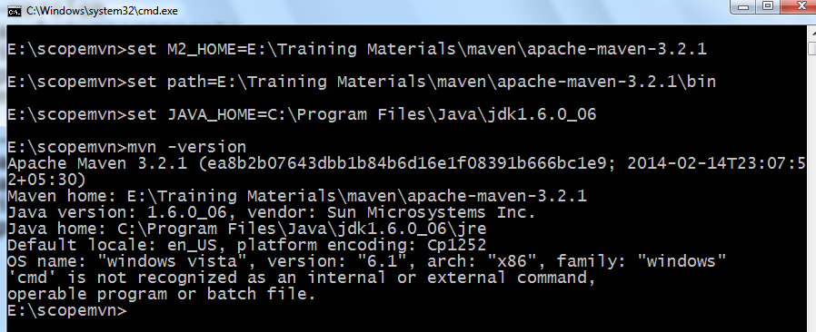

Slide 6
mvn -version
It displays the version of
Maven
Java
Os

Slide 7
POM.xml
POM stands for Project Object Model. It is fundamental Unit of Work in Maven. It is an XML file. It always resides in the base directory of the project as pom.xml.
The POM contains information about the project and various configuration detail used by Maven to build the project(s).
POM also contains the goals and plugins

Slide 8
POM.xml
<project …>
<modelVersion>4.0.0</modelVersion>
<groupId>com.companyname.project-group</groupId>
<artifactId>project</artifactId>
<version>1.0</version>
</project>

Slide 9
Pom.xml
groupId
This is an Id of project's group. This is generally unique amongst an organization or a project. For example, a banking group com.company.bank has all bank related projects.
artifactId
This is an Id of the project.This is generally name of the project. For example, consumer-banking. Along with the groupId, the artifactId defines the artifact's location within the repository.
version
This is the version of the project.Along with the groupId, It is used within an artifact's repository to separate versions from each other. For example:

Slide 10
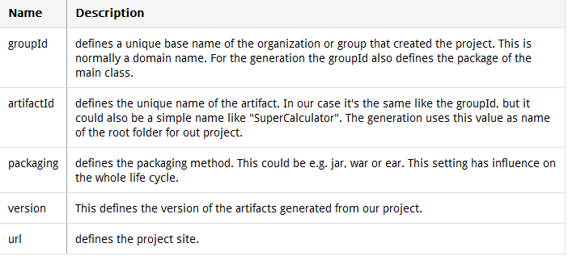
POM.xml

Slide 11
To create a maven java project
mvn archetype:generate
-DgroupId=com.scope.bank
-DartifactId=MySecondApp
-DarchetypeArtifactId=maven-archetype-quickstart
-DinteractiveMode=false

Slide 12
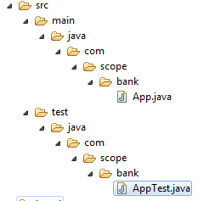
Maven folder structure

Slide 13
To create a new maven web project
mvn archetype:generate
-DgroupId=com.scope.bank
-DartifactId=MySecondApp
-DarchetypeArtifactId=maven-archetype-webapp
-DinteractiveMode=false

Slide 14
Maven LifeCycle phases
Validate
Ensure the project is correct and having necessary dependencies
Downloads the dependencies, if is is not available in the local repository
Compile
Compiles the java classes under src/main/java
Test-compile
Compiles the java classes under src/test/java
Test
Does unit testing
Packaging
Creates a jar/war file
Install
Copies the jar/war to Local repo
Deploy
Deploys the jar/war file to remote repo

Slide 15
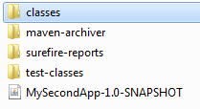
Target folder

Slide 16
mvn clean
mvn clean
It cleans target folder
Mvn clean compile
cleans target folder and builds compile goal
Mvn clean test-compile
cleans target folder and builds test-compile goal
Mvn clean test
cleans target folder and builds test goal
Mvn clean package
clean target folder and builds package goal

Slide 17
Mvn install
mvn goal/phase
Builds the project for the given goal
mvn install
it undergoes downloading dependencies
compile
test-compile
unit test
packaging into jar/war file under the target folder
Copies jar/war file also in local repo

Slide 18
Mvn package
mvn package
it undergoes downloading dependencies
compile
test-compile
unit test
packaging into jar file under the target folder

Slide 19
mvn compile
Mvn compile
it undergoes downloading dependencies
Compile all the java classes from src\main\java
Mvn test-compile
it undergoes downloading dependencies
Compile all the java classes from src\main\java
Compile all the java test classes from src\test\java

Slide 20
Mvn eclipse:eclipse
It creates two files
.project
.classpath
Import the maven project in Eclipse
This command provides maven project support to eclipse IDE

