Slide 1
SLF4J

Slide 2
What is logging and What is logged?
Logging refers to the recording of activity
Types of information logged
Program flow
Detailed information about what occurs in a method at a granular level.
Information about a specific error that has occurred in the system.
Document historical business events that have occurred.

Slide 3
Problems of System.out.println()
System.out.println() method displays the messages in the server’s console and it becomes more complicated to trace or debug an web application.
The type of messages is missing such as error, exception and information
It runs as part of the existing thread
There is no option to turn off the messages or specific type of messages
There is no option to check the messages later
SOPs are bad in performance. When we analyze deeply the sequence of calls are like println -> print -> write() + newLine() method.
Both write() and newLine() contains a synchronized block it has a little overhead and it is more the the cost of adding characters to the buffer and printing is high.

Slide 4
SLF4J
Simple Logging Facade for Java
acts as a facade for different logging frameworks (e.g. java.util.logging, logback, Log4j).
It offers a generic API making the logging independent of the actual implementation.

Slide 5
When to use SLF4J
It is used to migrate to any logger implementation
Ex : to migrate from log4j to logback

Slide 6
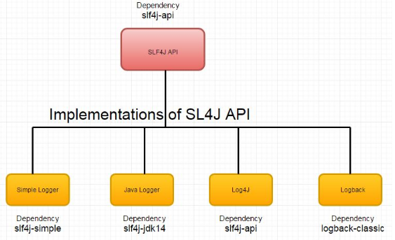
SLF4J

Slide 7
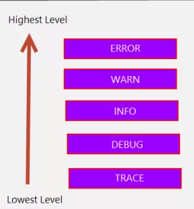
Logger level

Slide 8
logback
Logback is intended as a successor to the popular log4j project.
It was designed by Ceki Gülcü, log4j's founder.

Slide 9
Logback - Advantages
Logback offers many advantages over log4j
faster
smaller memory footprint
automatic reloading of configuration files
automatic compression of archived log files
conditional processing of configuration files and many more

Slide 10
Logback- core features
faster execution compared to log4j
native support for slf4j, which makes it easy to switch to a different logging framework, should that be necessary later on
conditional processing of the defined configuration
advanced filtering capabilities
compression of archived log files
support for setting a maximum number of archived log files
HTTP-access logging
recovery from I/O failures

Slide 11
Logback - Modules
Logback is comprised of three modules
logback-core
contains the basic logging functionality
The core module lays the groundwork for the other two modules
logback-classic
The classic module extends core.
The classic module corresponds to a significantly improved version of log4j.
Logback-classic natively implements the SLF4J API
contains additional logging improvements, such as slf4j support
logback-access.
The third module called access integrates with Servlet containers to provide HTTP-access log functionality.
provides integration with servlet containers, such as Tomcat and Jetty

Slide 12
Log4j Architecture
Architecture involves Three Components
Logger
Logger is responsible for handling the majority of log operations.
public interface Appender
Appender is responsible for writing the log messages to different destination such as console, file, db, smtp
Encoder and Layout
Encoder and Layout is responsible for formatting the log messages used by Appender.

Slide 13
Logger
Responsible for logging operations
There are two types of logger
Root logger
Custom logger

Slide 14
Logger Hierachy
Non root Logger
x.y
a.b
com.mindtree
Root logger
x
a
com
hcl
y
b

Slide 15
Root Logger
The root logger resides at the top of the logger hierarchy. It is exceptional in three ways:
• it always exists,
• its level cannot be set to null,
Invoking the class static LoggerFactory.getLogger(Logger.ROOT_LOGGER_NAME) method retrieves it.

Slide 16
Custom logger
Has a name that follows a package name in java
Ex: com.sapient,
hcl is the child logger to com and com is the child logger to root logger
Logger.getLogger(String/class name)
instantiates if logger does not exists in the given name otherwise it retrieves it
Can be set to null
Retrieved by name

Slide 17
Logger Levels
The org.apache.log4j.Level class provides following levels
Level | Description
Trace | Designates finer-grained informational events than the DEBUG , this is introduced from 1.2.12
DEBUG | Designates fine-grained informational events that are most useful to debug an application.
INFO | Designates informational messages that highlight the progress of the application at coarse-grained level.
WARN | Designates potentially harmful situation
ERROR | Designates error events that might still allow the application to continue running.

Slide 18
Logger Levels
Level | Description
ALL | The ALL Level has the lowest possible rank and is intended to turn on all logging
OFF | The OFF Level has the highest possible rank and is intended to turn off logging

Slide 19
Logger Levels – Basic selection rule
This rule is at the heart of log4j. It assumes that levels are ordered. For the standard levels, we have
TRACE < DEBUG < INFO < WARN < ERROR
Level Set At | Displays ?
Trace | Displays all levels of Log messages
Debug | Dispays all levels of log messages From DEBUG
Info | Displays from INFO, WARN, ERROR and FATAL
Warn | Displays from WARN, ERROR and FATAL
Error | Displays from ERROR and FATAL

Slide 20
Configuring Logger
Configuration
Configuring logger means assigning the logger level, defining appender and defining specific layout to appender
If no configuration is defined then it uses simple configuration(BasicConfig)
By default , it uses DEBUG level

Slide 21
Logback Configuration Files
The system will automatically pick up and use the configuration automatically.
There are three valid standard file names you can choose from:
logback-test.xml
logback.groovy
logback.xml

Slide 22

Configuring Logger

Slide 23
Appender – Hierarchy
Object
Appender
OutputStreamAppender
FileAppender
ConsoleAppender
RollingFileAppender

Slide 24
Appender
Appender objects which are primarily responsible for printing logging messages to different destinations such as consoles, files
ConsoleAppender – writes messages to the system console
FileAppender – appends messages to a file
RollingFileAppender – extends the FileAppender with the ability to roll over log files
SMTPAppender – sends log messages in an email, by default only for ERROR messages
DBAppender – adds log events to a database
SiftingAppender – separates logs based on a runtime attribute

Slide 25
Encoder
Layouts can only transform a message into String, while encoders are more flexible and can transform the message into a byte array, then write that to an OutputStream.
This means encoders have more control over when and how bytes are written.

Slide 26
Why Encoder
OutputStreamAppender and sub-classes now take an Encoder as a sub-component instead of a Layout.
In previous versions, most appenders relied on a layout to transform an event into a string and write it out using a java.io.Writer.
In previous versions of logback, users would nest a PatternLayout within FileAppender.
Since logback 0.9.19, FileAppender and sub-classes expect an encoder and no longer take a layout.

Slide 27

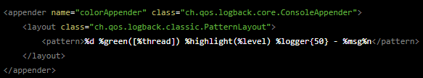
Configuring-ConsoleAppender and Encoder
Depreacted style because appender uses layout directly
Layout returns the formatted message as a string and not a byte[]

Slide 28
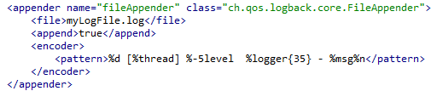
Configuring- FileAppender and Encoder

Slide 29
LayoutWrappingEncoder
many appenders relied on the Layout instances to control the format of log output
LayoutWrappingEncoder bridges the gap between encoders and layouts
. It implements the encoder interface and wraps a layout to which it delegates the work of transforming an event into string

Slide 30
PatternLayoutEncoder
It is an extension of LayoutWrappingEncoder
It is restricted to wrapping instances of PatternLayout
It uses pattern to display the messages

Slide 31
Layout
Layout is responsible to format the log message.
It knows how to format the log messages
The Appender must have have an associated encoder
Layout is wrapped by an encoder to return the formatted message as byte[]
There are three types of Layout available wrapped by encoder:
HTMLLayout formats the output as HTML table.
PatternLayout formats the output based on a pattern specified.
XMLLayout formats the output in as XML format

Slide 32
Layout
Layouts are logback components responsible for transforming an incoming event into a String.
The format() method in the Layout interface takes an object that represents an event (of any type) and returns a String.
Encoders transforms string into byte[]

Slide 33
PatternLayout
PatternLayout isdeprecated
Uses conversion pattern to format the messages
PatternLayoutEncoder is an extension of LayoutWrapping Encoder
is responsible for formatting the log messages using pattern

Slide 34
Logger Configured - Programatically
2017-12-24 19:31:43 [main] DEBUG sapient - message1
Log message
%msg%n
Logger level
%level
Logger name
%logger
Thread
%thread
%d{Yyyy:MM:dd hh:mm:ss}

Slide 35
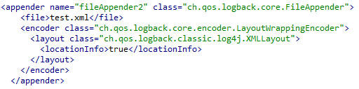
XML LAYOUT

Slide 36
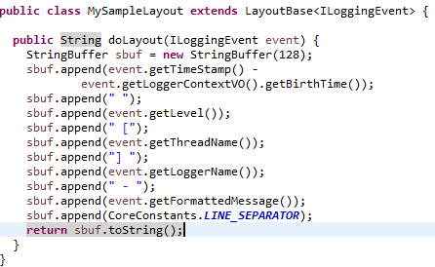
Custom Layout
Create the class that extends LayoutBase

Slide 37

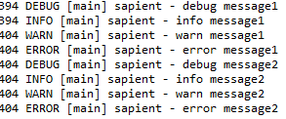
Custom Layout

Slide 38
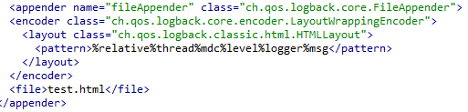
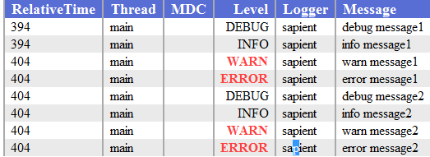
HTML LAYOUT

Slide 39
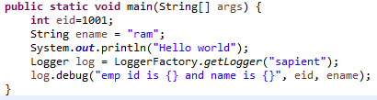
Parameterized logging
Parameters passed to log messages
log.debug("emp id is {} and name is {}", eid, ename);
Parameter to be passed

Slide 40
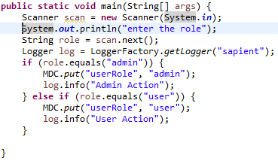
Logging Seperation
Seperates logs based on runtime attribute
It is done by Sifting Appender configured in xml
Set the runtime attribute programatically using MDC.put(key, value)

Slide 41
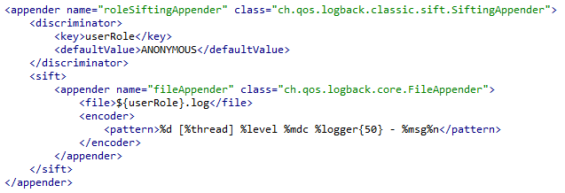
SiftingAppender
The implementation of this appender relies on creating nested appenders
using one of these for logging depending on a discriminator.
The default discriminator used is MDCBasedDiscriminator.
Mapped Diagnostic Context

Slide 42
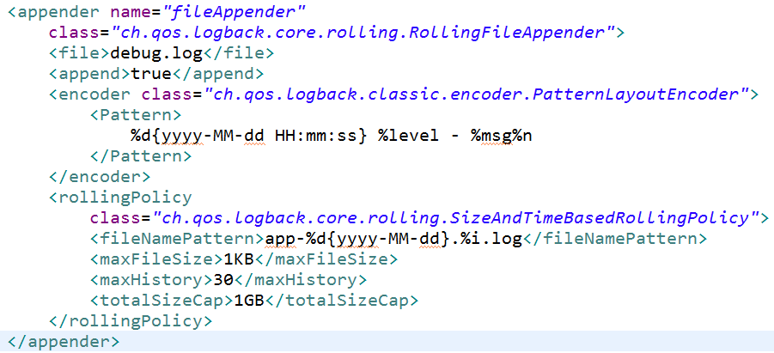
RollingFileAppender
RollingFileAppenderextends FileAppender with the capability to rollover log files.
RollingFileAppender can log to a given file named debug.log file and, once a certain condition is met, change its logging target to another file.

Slide 43
RollingFileAppender
<file> | Represents initial file name
<append> | Represents the file to be opened in append mode, By default append is true
<encoder> | Uses patternLayoutEncoder or LayoutWrappingEncoder for formatting the messages
<rollingPolicy> | Uses SizeAndTimeBasedRollingPolicy
 | <fileNamePattern> | Represents the rollback file name and also represents when to roll back
 | <maxFileSize> | It rollbacks when it reaches the maximum file size
 | <maxHistory> | Set the maximum number of archive files to keep
 | <totalSizeCap> | Represents the total size of all archive files. When it reaches it deletes the old archive file

Slide 44
FileNamePattern
yyyy-MM-dd | Rollback daily
Yyyy/MM | Rollback at beginning of each month
yyyy-ww | Rollback at beginning of each week
yyyy-MM-dd_hh | Rollback for each hour
yyyy-MM-dd_hh-mm | Rolback for every minute

