Slide 1
OOAD and UML

Slide 2
Structured vs OOP
Structured | Object oriented OOP
No data security | Data security
Non constant Data cannot be read only | Non constant Data can be read only
More than one method cannot have same name | More than one method can have same name
Code cannot be extensible | Code can be extensible
No abstraction | Abstraction is possible(hiding data and methods to other code)
Reusability and maintainability of the code is limited | Reusability and maintainability of code is high
Always tightly coupled | Loosely coupled is possible
Focused on the functions | Focused on the data and functions

Slide 3
OOA
Grady Booch has defined OOA as,
“Object-oriented analysis is a method of analysis that examines requirements from the perspective of the classes and objects found in the vocabulary of the problem domain”.

Slide 4
Primary task of OOA
Identifying objects
Organizing the objects by creating object model diagram
Defining the internals of the objects, or object attributes
Defining the behavior of the objects, i.e., object actions
Describing how the objects interact

Slide 5
OOD
Object Oriented Design (OOD) involves implementation of the conceptual model produced during object-oriented analysis.
implementing classes, constraints are identified and interfaces are designed

Slide 6
OOD
The implementation details generally include:
Restructuring the class data (if necessary),
Implementation of methods, i.e., internal data structures and algorithms,
Implementation of control, and
Implementation of associations.

Slide 7
OO Model
The object model visualizes the elements in a software application in terms of objects.

Slide 8
OO Model
The benefits of using the object model are:
It helps in faster development of software.
It is easy to maintain. Suppose a module develops an error, then a programmer can fix that particular module, while the other parts of the software are still up and running.
It enables reuse of objects, designs, and functions.
It reduces development risks, particularly in integration of complex systems.

Slide 9
Class
Object state and behavior are defined in the class
Classes are user-defined data types.
It is a blueprint from which individual objects are created.
Once a class has been defined,
we can create any number of objects belonging to that class.
state
behaviour

Slide 10
Object
Real time physical entity
An object is an instance of a class.
It contains state and behaviour
“State” of an object is called an “instance variable”.
“Behavior” of an object is known as “method”.

Slide 11
Object vs Class
Class is template
Class is purely static concept, represented by program text.
Object is instance of the class
Object is dynamic entity, occupying space in memory

Slide 12
Benefit of OO
Maintainability
Reusability
Extensibility

Slide 13
OOP Principles
Major themes
Abstraction
Encapsulation
Modularity
inheritance
Polymorphism

Slide 14
Abstraction
It hides the state and behavior of an object to other code

Slide 15
Encapsulation
Wraps code and data together is called encapsulation
Why Encapsulation?
To avoid unwanted data which is not suitable to real world
When the characteristics of state changes, it must not affect other codes

Slide 16
Encapsulation achieves
Maintainable
data secure
Read only

Slide 17
How will you do Encapsulation
Make all the fields private
Provide setters and getters
TightEncapsulation
Make all the fields private
Provide only getters
Aceives immutable class

Slide 18
Setter and getter
Setter
Set the data to instance variable
To write business rule to validate the data
Getter
Get the data from instance var

Slide 19
What is encapsulation
Owner code
Client code
cust.getAge();
setAge()
getAge()
age

Slide 20
Modularity
Modularity is the process of decomposing a problem (program) into a set of modules
so as to reduce the overall complexity of the problem.

Slide 21
Overloading
Static polymorphism is implemented using Overloading
Method overloading
Two or more methods having same name with different signature
Signature
Includes method name and argument list
Arguments must differ from type and number

Slide 22
When to use overloading Overloading ?
Providing the client to attain same task with different types of input.
Attain same task with additional arg that behaves with addl benefit.

Slide 23
Overloading
Overloading Achieves
Maintainability
Methods are invoked based on the signature
All the methods must do the same job
Overloading occurs in stand alone class and also in inheritance
Return types can be different

Slide 24
Inheritance- class hierarchy
Generalisation- ‘is a’ or ‘is a kind’ relationship
Car and vehicle
Generalisation is implemented using inheritance
Types
Single
Multilevel
Multiple
Hybrid

Slide 25
Inheritance
Subclass has its own state and behaviour plus non private members of super class
Inheritance achieves
Reusbility and extensibility is achieved
If a class does not extend explicit super class then that class will be the direct sublass of Object class

Slide 26
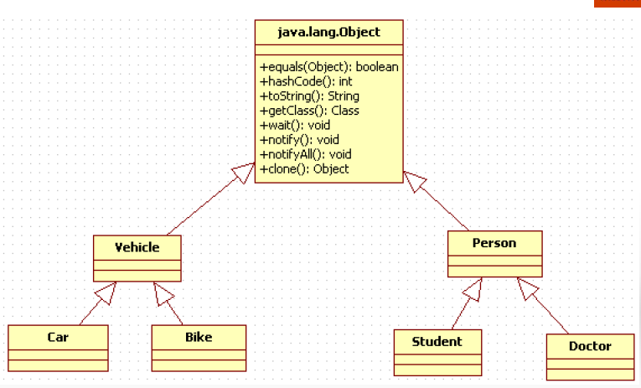

Slide 27
When to go for inheritance
When the new system has existing features of old system with extra features.
Two or more class having common state and behavior, then move the state and behavior to parent class

Slide 28
Types of relation ship
Has – a
An object will be the member in another class
Car has an Engine
Relied on instane var
Tightly coupled between two classes
Is –a
Relied on inheritance

Slide 29
Has – a - relationship
relies on instance var
Tightly coupled between two classes
class Car{
Wheel wheel = new Wheel();
}
has
class Wheel {
}

Slide 30
Is-a-Relation ship
Object
Inheritance achieves is-a-relationship
Vehicle
Car
Bike

Slide 31
Class Relationships
Class diagrams may contain the following relationships:
Association
Aggregation
Composition
Generalization
Realization
OR
OR
OR
Notes:
The next several slides will explain and define each of these relationships.

Slide 32
Association
An association is a structural relationship within which classes or objects are connected to each other. (An association between objects is called a link.)
plays
customer
Cd player

Slide 33
What Is Multiplicity?
Multiplicity is the number of instances one class relates to ONE instance of another class.
For each association, there are two multiplicity decisions to make, one for each end of the association.
For each instance of Professor, many Course may be taught.
For each instance of Course there may be either one or zero Professor as the instructor.
Professor
+ instructor
Course
0..1
0..*
Notes:
Multiplicity can be defined as:
The number of instances of one class that relate to one instance of another class.
For each role, you can specify the multiplicity of its class and how many objects of the class can be associated with one object of the other class.
Multiplicity is indicated by a text expression on the role. The expression is a comma-separated list of integer ranges.
It is important to remember that multiplicity is referring to instances of classes (objects) and their relationships. In this example, a Course Offering object can have either zero or one Professor object related to it. Conversely, a Professor object can have zero or more Course Offering objects related to it.
Multiplicity must be defined on both ends of the association.

Slide 34
Multiplicity Indicators
Unspecified
Exactly One
1
Zero or More
0..*
Zero or More
*
One or More
1..*
Zero or One (optional scalar role)
0..1
Specified Range
2..4
Multiple, Disjoint Ranges
2, 4..6
Notes:
Multiplicity is indicated by a text expression on the role.
The expression is a comma-separated list of integer ranges.
A range is indicated by an integer (the lower value), two dots, followed by another integer (the upper value).
A single integer is a valid range, and the symbol “*” indicates "many.” That is, an asterisk “*” indicates an unlimited number of objects.
The symbol “*” by itself is equivalent to “0..*” That is, it represents any number, including none. This is the default value.
An optional scalar role has the multiplicity 0..1.
The use of “N” instead of “*” is from Booch, not UML. For example, the use of “0..N” and “N” is not UML.
The multiplicity specified for a relationship is for all instances of that relationship, not simply for a particular use-case realization or for a particular point in time.

Slide 35
Association Multiplicity
Example: a Person is employed by one Company; a Company employs one or more Persons
Multiplicity represent other association like aggregation and composition
1..*
Company
Employees
1

Slide 36
Aggregation
Aggregation is a “whole-part” or “has a” relationship within which one class represents a larger thing that consists of smaller things.
Car
AC system
passengers

Slide 37
Composition
Composition is a special form of aggregation within which the parts are inseparable from the whole.
University
Department

Slide 38
Composition
Car
Chasis
Fuel system
Engine
Break system

Slide 39
Generalization
A generalization is a “kind of” or “is a” relationship between a general thing (superclass or parent) and a more specific thing (subclass or child).
Employee
Permanent Employee
Contractor Employee

Slide 40
Why Model?
Modeling achieves four aims:
Helps you to visualize a system as you want it to be.
Permits you to specify the structure or behavior of a system.
Gives you a template that guides you in constructing a system.
Documents the decisions you have made.
You build models of complex systems because you cannot comprehend such a system in its entirely.
You build models to better understand the system before you develop.
Notes:
According to Booch in The Unified Modeling Language User Guide, modeling achieves four aims:
1. Models help you to visualize a system, as you want it to be. A model helps the software team communicate the vision for the system being developed. It is difficult for a software team to have a unified vision of a system that is described only in specification and requirement documents. Models bring about understanding of the system.
2. Models permit you to specify the structure of behavior of a system. A model allows how to document system behavior and structure before coding the system.
3. Models give a template that guide you in constructing a system. A model is an invaluable tool during construction. It serves as a road map for a developer. Have you experienced a situation where a developer coded incorrect behavior because he or she was confused over the wording in a requirements document? Modeling helps alleviate that situation.
4. Models document the decisions you’ve made. Models are valuable tools in the long term because they give “hard” information on design decisions. You don’t need to rely on someone’s memory.
Sell the students on the value of visual modeling.
Clarify that you are discussing formal modeling, not modeling written on a white board or on the back of a napkin at lunch.

Slide 41
Why Model
to better understand the system and expose opportunities for simplification and reuse
to manage risk
testing physical entities before building them
reduction of complexity.
communication with customers

Slide 42
Types of model
Object model The object model represents the static structure of a system
Class diagram, package diagram
Dynamic model The dynamic model represents a behavior of system, transition of state, exchanging messages over time.
State chart diagram, activity diagram, sequence diagram, collaboration diagram, use case diagaram

Slide 43
UML
Graphical modelling language that is used to express designs.
Standardized language for creating blueprints that depict the structure and design of the software system
Is a notational language that enables the stakeholders to view the architecture of the system from various perspectives

Slide 44
UML
Language for specifiying artifacts: notations for classes, objects and interfaces
Visualizing artifacts
Constructing artifacts – forward engineering and reverse engineering
Documenting artifacts – input docs for the subsequent phases of SDLC

Slide 45
UML
UML stands for Unified Modeling Language.
This object-oriented system of notation has evolved from the work of
Grady Booch, James Rumbaugh, Ivar Jacobson, and the Rational Software Corporation.
UML is accepted by the Object Management Group (OMG) as the standard for modeling object oriented programs.

Slide 46
Types of UML diagarams
UML defines nine types of diagrams:
class
Package
use case
Sequence
Collaboration
Statechart
Activity
component,
deployment.

Slide 47
Develop a Problem Statement
Build an Object Model:
Identify object classes.
Develop a data dictionary for classes, attributes, and associations.
Add associations between classes.
Add attributes for objects and links.
Organize and simplify object classes using inheritance.
Test access paths using scenarios and iterate the above steps as necessary.
Group classes into modules, based on close coupling and related function.

Slide 48
Class Notation
Name
Attributes
Operations

Slide 49
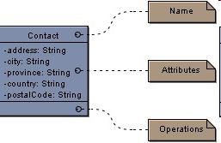
Classes
Classes are used to represent entities within the system

Slide 50
Class diagram
Classes are divided into three sections
Top : name, package and stereotype is specified
Centre : Attributes of the class are specified
Bottom : Operations that can be performed in the class

Slide 51
Attributes: Is a property of a class
The format :
visibility name:type = defaultValue
Visibility :
- Private
+ Public
# Protected
~ Package

Slide 52

Operations
Visibility name(parameters) : return type
Parameters
Direction name: type = default

Slide 53
Object Modelling – static model
The object model represents the static structure of a system
Main concepts are class, state, behavior and relation ship such as association, Aggregation, composition and generalization

Slide 54
Common Uses of Class Diagrams
to model vocabulary of the system, in terms of which abstractions are part of the system and which fall outside its boundaries
to model simple collaborations (societies of elements that work together to provide cooperative behavior)
to model logical database schema (blueprint for conceptual design of database)

Slide 55
Diff b/w Static and Dynamic Design
Static design describes object structure and object relations
Class relations
Objects at a given time
Dynamic design shows communication between objects
Similarity to class relations
can follow sequences of events

Slide 56
Object Diagrams
Object Diagrams describe the static structure of a system at a particular time. Whereas a class model describes all possible situations, an object model describes a particular situation. Object diagrams contain the following elements:
Objects, which represent particular entities. These are instances of classes.
Links, which represent particular relationships between objects. These are instances of associations.
.

Slide 57
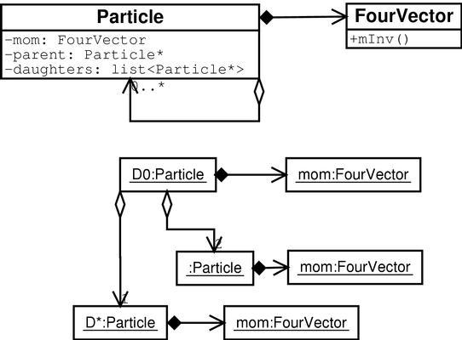
Object Diagram
Class diagram
never changes
Object diagram shows
relations at instant in time
(snapshot)
Object relations are drawn
using the class association
lines

Slide 58
Dynamic Model
The dynamic model is used to express and model the behaviour of the system over time. It includes
support for activity diagrams, state diagrams, sequence diagrams and extensions including business process modelling.
Dynamic modeling captures system behavior.

Slide 59
What Is System Behavior?
System behavior is how a system acts and reacts.
It is the outwardly visible and testable activity of a system.
System behavior is captured in use cases.
Use cases describe the system, its environment, and the relationship between the system and its environment.
Notes:
No system exists in isolation. Every system interacts with people or automated systems for some purpose. These interactions result in some sort of predictable result. This predictable result is system behavior.
Use cases are the mechanism for capturing the desired behavior for the system that is under development, but they do not specify how the behavior is to be implemented.
The UML specifies a model for communicating system behavior — the Use-Case Model.

Slide 60
Major Concepts in Use-Case Modeling
An actor represents anything that interacts with the system.
A use case is a sequence of actions a system performs that yields an observable result of value to a particular actor.
Actor
Use Case
Notes:
An actor represents a coherent set of roles that users of the system play when interacting with these use cases. Typically, an actor represents a human, a hardware device, or some other external system. In UML 2, actors should be named whenever possible.
A use case is a sequence of actions a system performs to yield an observable result that is of value to a particular actor. A use case describes what a system does, but it does not specify how it does it. Whenever space permits, put the name of the use case inside the icon.
This is a good place to remind students that in UML 2, actors are usually named and to put the name of the use case in the icon when space permits.

Slide 61
Use Case and Actor
It captures behavior of a system
What the system will do
A use case is a sequence of actions, including variants, that a system performs to yield an observable result of value to an actor.
most useful for creating scenarios
An actor is a coherent set of roles that human and/or non-human users of use cases play when interacting with those use cases.

Slide 62
Benefits of use cases
Communication
with the end users and domain experts:
Provides buy-in at an early stage of system development.
Ensures a mutual understanding of the requirements.
Identification
of system users and what the system should do:
Establishes the requirements for the system interfaces.
Verification
that all requirements have been captured:
Ensures that the development team understands the requirements.

Slide 63
Scenarios
Scenario can be created using use cases
A use case describes a set of sequences in which each sequence in the set represents one possible flow through all these variations.
Each sequence is called a scenario.
A scenario is a specific sequence of actions that illustrates behavior.

Slide 64
Simple Use Case Diagram
Do
Trade
Entry
Generate
Reports
Update
Portfolio
Info

Slide 65
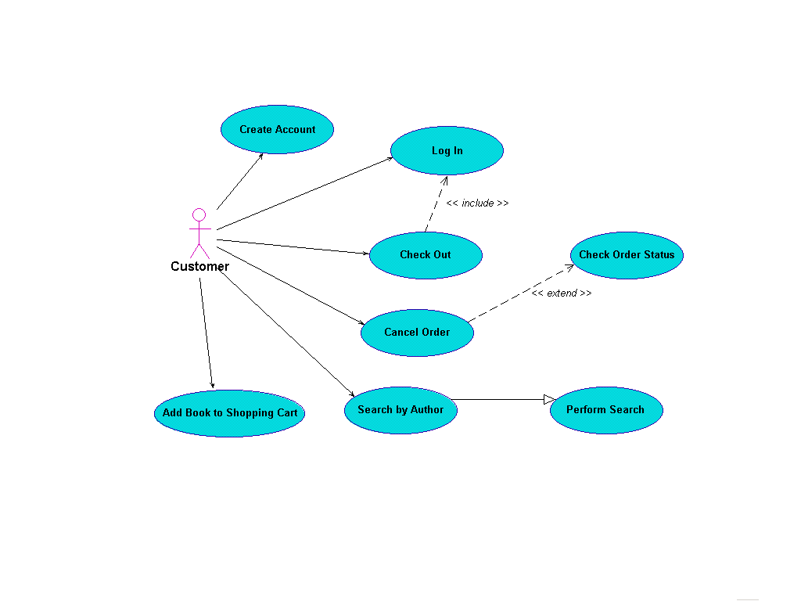

Slide 66
Interaction model
Interaction between objects
most useful for showing detailed design of procedures
Develop and evaluate various mechanisms for each scenario
Find new objects and classes
Develop the interface for each class
most useful for showing the collaboration of several objects in a single use case
Sequence diagrams.
Collaboration diagrams.

Slide 67
Interaction and Message
An interaction is a behavior that comprises a set of messages, exchanged among a set of objects, to accomplish a specific purpose.
A message is the specification of a communication between objects that conveys information, with the expectation that some kind of activity will ensue.

Slide 68
Sequence Diagram
Sequence diagrams are used to display the interaction between users, screens, objects and entities
within the system. It provides a sequential map of message passing between objects over time.
Frequently these diagrams to illustrate the use case scenario
how a user will interact with the system and what happens internally to get the work done.

Slide 69
Sequence Diagram
A sequence diagram shows:
Object lifeline,
messages between objects,
Object life activation.
Return messages
Asynchronous flow

Slide 70
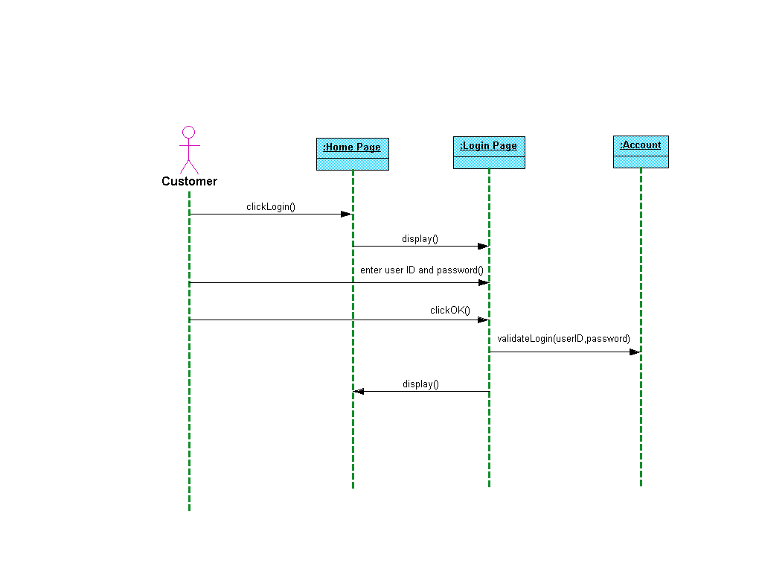
Steps in sequence diagram
Define who will initiate the interaction
Draw the first message to subsystem
Draw message to other sub sysytem
Draw return message to actor
Send/ respond to anonymous actor

Slide 71
Collaboration Diagram
A collaboration diagram is an interaction diagram
Collaboration diagrams represent interactions between objects as a series of sequenced messages.
It is organised object structure
Collaboration diagrams describe both the static structure and the dynamic behavior of a system
Sequence numbers indicate the time ordering of messages, to one or more levels.
highlights the roles each object plays in an interaction model

Slide 72
Collaboration Diagram
A collaboration diagram shows:
Objects,
links between objects,
messages between objects,
temporal ordering and nesting of these messages.

Slide 73
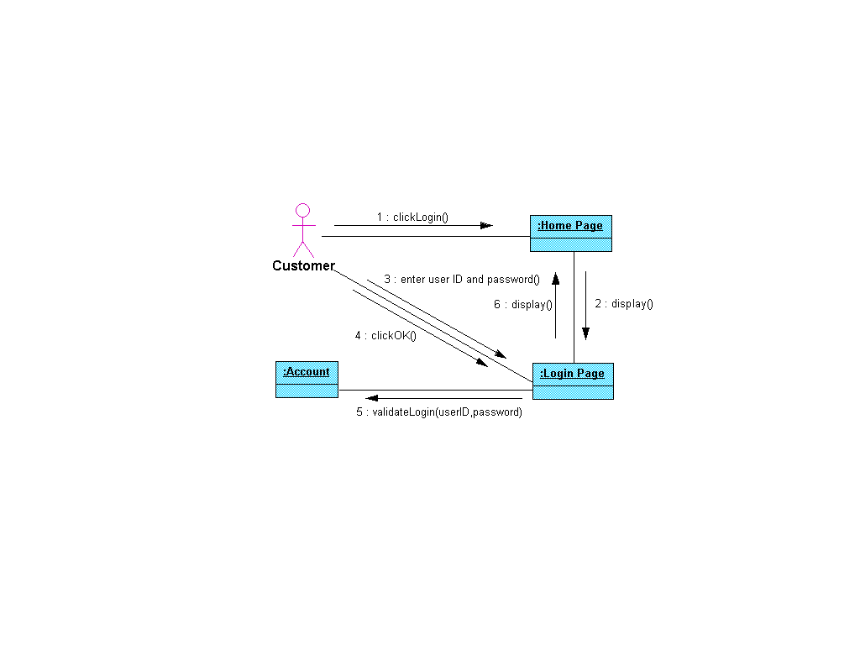

Slide 74
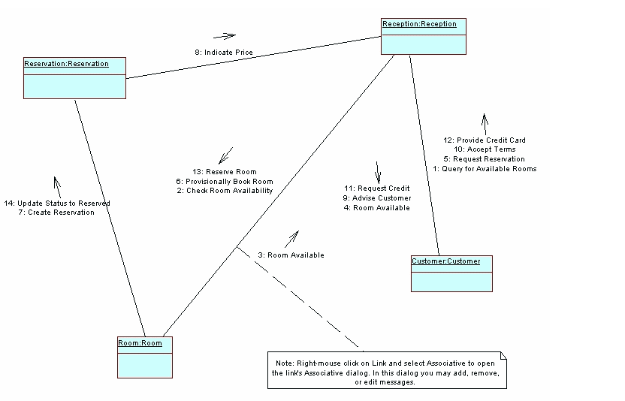
Collaboration diagram

Slide 75
Activity Diagram
Activity diagrams are used to show how different workflows in the system are constructed.
most useful for business modeling of a human organization or the workflow of a system
how they start and the possibly many decision paths that can be taken from start to finish.
control flow from one activity to another. This control flow does not include messages.

Slide 76
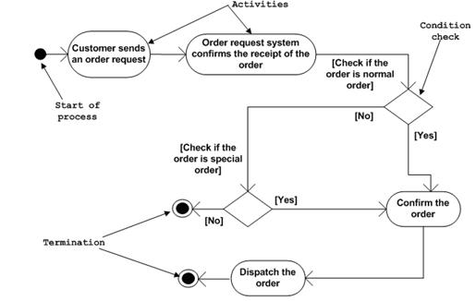
Activity diagram

Slide 77
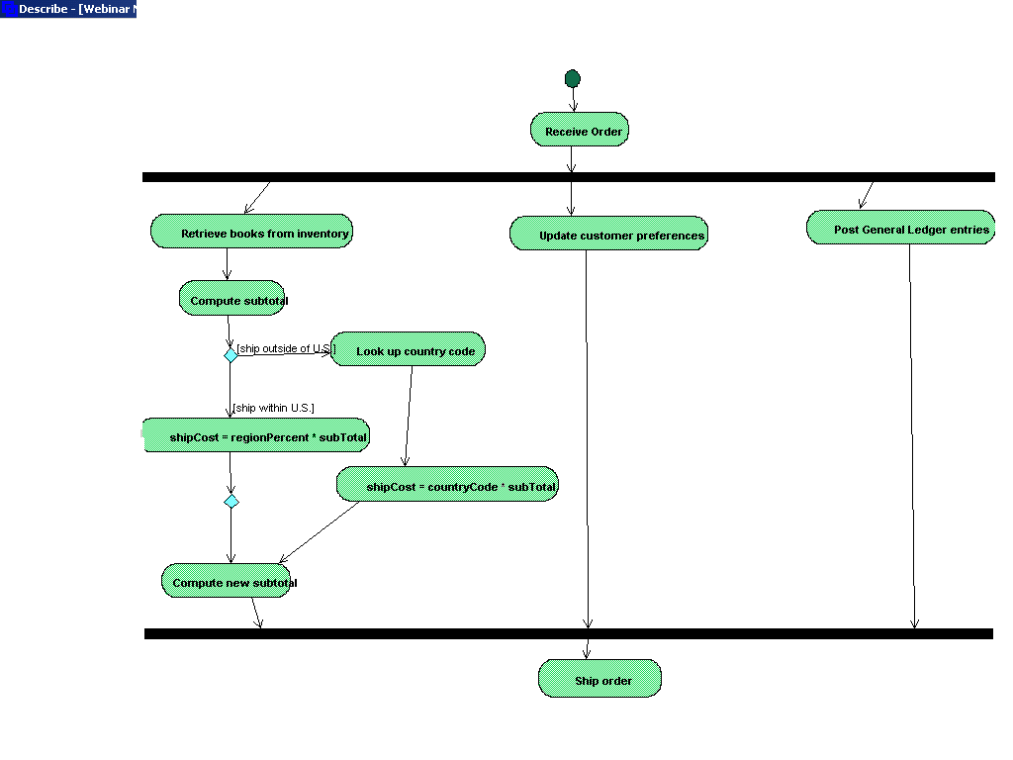
Activity Diagram

Slide 78
What is component diagram?
COMPONENT DIAGRAM:
Component diagrams illustrate the organizations and dependencies among software components.
A component may be
A source code component
A run time components
An executable component
Dependency relationship.

Slide 79
Component Diagram [for withdrawal of cash]
policy.dll
Bank
Server.exe
Branch
customer.dll
Bank.dll
Branch
Bank.exe
ATM.exe

Slide 80
Deployment diagram
Deployment diagrams depict the physical resources in a system, including nodes, components, and connections.
Shows the physical relationship between hardware and software

Slide 81
What is deployment diagram?
A deployment diagram shows the relationship among software and hardware components in the delivered system.
These diagram include nodes and connections between nodes.
Each node in deployment diagram represents some kind of computational unit, in most cases a piece of hardware.
Connection among nodes show the communication path over which the system will interact.
The connections may represent direct hardware coupling line RS-232 cable, Ethernet connection, they also may represent indirect coupling such as satellite to ground communication.

Slide 82
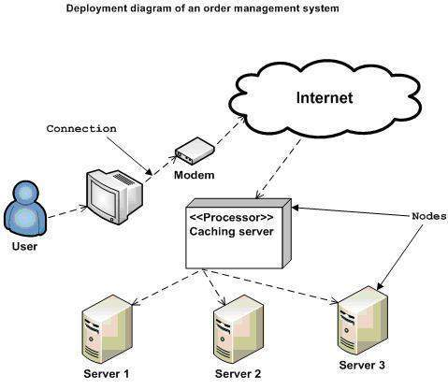
Deployment diagram

Slide 83
State Chart
State charts are used to detail the transitions or changes of state an object can go through in the system.
They show how an object moves from one state to another and the rules that govern that change.
most useful for describing events and its state
State charts typically have a start and end condition

Slide 84
5 steps in State Chart
Define state
Describe state
Draw Transition
Draw Transition triggers
Define guard conditions

Slide 85
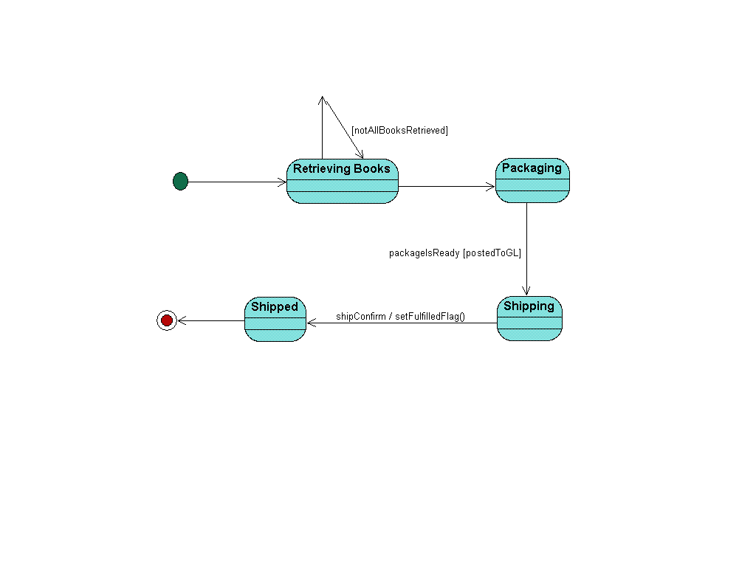

Slide 86
Package diagram
Package diagrams are a subset of class diagrams,
but developers sometimes treat them as a separate technique.
Package diagrams organize elements of a system into related groups to minimize dependencies between packages.

Slide 87
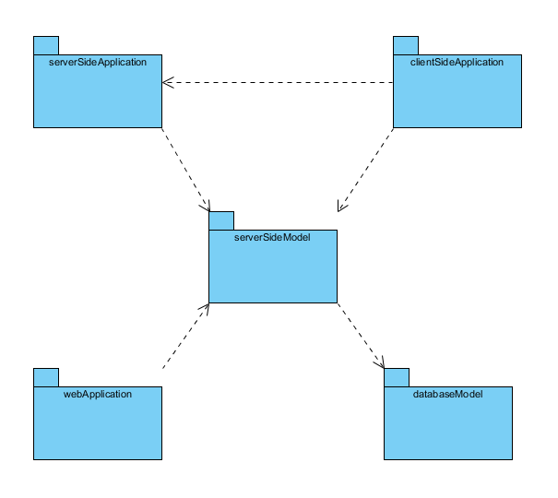
Package Diagram

