Slide 1
RDBMS

Slide 2
What is
Data
Meaningful facts, text, graphics, images, sound, video segments.
Information
Data processed to be useful in decision making.
Notes:
Examples:
Note Book
Digital Dairy

Slide 3
Why DBMS?
Controlling redundancy
Sharing of data
Restricting unauthorized access
Providing multiple interfaces
Enforcing integrity constraints
Providing backup & recovery
Potential for enforcing standards
Reduced application development time
Availability of up-to-date Information

Slide 4
Database Management System
Database Management System
It is a software to
Defining, constructing, and manipulating databases for various applications

Slide 5
Database Management System
Defining
specifying types of data and detailed description of each type
Constructing
storing the data itself on some storage medium
Manipulating:
Querying
Updating
Generating reports

Slide 6
RDBMS
RDBMS is a model in which all data is logically structured with relations
Data is stored in tables
It uses SQL to interact with DB
DDL
DMl
Query
TCL
Ex: Oracle, MySQL, MSSQL, DB2

Slide 7
RDBMS
Column(attribute)
The data having a common unique name
Row(tuple)
Collection of related columns
It is also called record
Table
Collected of rows
Each row is uniqely identified by Primary key
Database
Collection of tables , relations and constraints

Slide 8
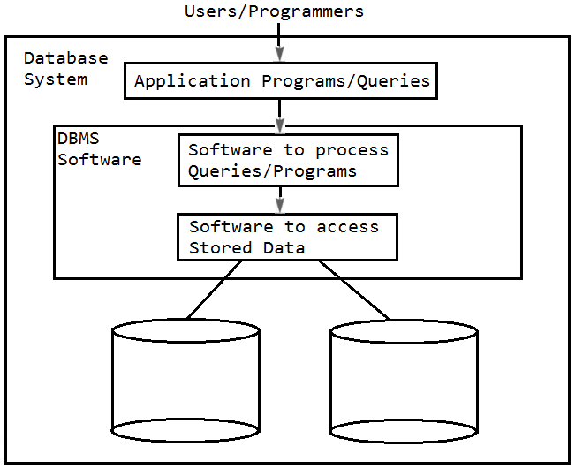
Database System Environment

Slide 9
key
Keys
Candidate Key is a set of one or more attributes that can uniquely identify a row in a given table.
Primary Key is an attribute of an entity which can uniquely identify a row in a given table
Composite Key is a primary key which is a combination of more than one attribute is called a composite primary key
Foreign Key is an attribute of an entity which refers to the domain of the primary key in the same entity or a different entity
Notes:
Keys:
Candidate Key:Any Unique Identifier for a Record.
Primary Key: The candidate key you choose to use to identify each row in a table uniquely. Only one primary key may be defined per table. The column or set of columns included in the definition of a table's PRIMARY KEY constraint. Can not contain Null values
Composite Key:A Key Made Up of More Than One Field.
Unique Key:A rule defined on a column (or set of columns) that allows only the insert or update of a row containing a unique value for the column (or set of columns).The column or set of columns included in the definition of a UNIQUE constraint A table may have more than one unique keys
Foreign Key: A rule defined on a column (or set of columns) in one table that allows the insert or update of a row only if the value for the column or set of columns (the dependent value) matches a value in a column of a related table (the referenced value). A field in one table that points to a record in a different table.

Slide 10
The Entity-Relationship Model
Conceptual Data Modeling

Slide 11
E-R Model Constituents
Entity
Person, Place, Object, Event, Concept…
Attributes
Name, Age, City, Salary…
Relationships
Student registers for a Course
Employee applies for a Leave
Notes:
2

Slide 12
Entity Relationship Modelling
Entity Relationship (ER) modelling is a design tool
•is a graphical representation of the database system
•provides a high-level conceptual data model
•supports the user’s perception of the data
•is DBMS and hardware independent
•had many variants
•is composed of entities, attributes, and relationships

Slide 13
Simple Vs composite attribute
Simple Attribute:
Can not be divided into simpler components
For example, age of a Person
Composite Attribute:
Can be split into components
Address of a Person can be split into street, location, city, state, zip
Date of birth of an Employee can be split into day, month, and year

Slide 14
Single Vs Multi-values Attributes
Single Valued:
Can take only a single value for each entity instance
For example, Salary of an employee (only one value)
Multi-valued:
Can take many values
For example, Skill-Set of an employee can be “Java, Servlet, JSP” or “C#, ASP.Net, WCF, WPF”

Slide 15
Stored Vs Derived Attributes
Stored Attribute:
Attribute that need to be stored permanently
For example, name of an employee
Derived Attribute:
Attribute that can be calculated based on other attributes
For example, years-of-service of an employee can be calculated from the date of hire and the current date

Slide 16
Regular Vs Week Entity
Regular Entity:
Entity that has its own key attribute
For example, Employee, Student, Customer etc.
Weak Entity:
Entity that depends on other entity for its existence and does not have key attribute of its own
For example, Nominee of an Insurance policy holder.

Slide 17
Relationships
A relationship type between two entity types defines the set of all associations between these entity types
Each instance of the relationship between the members of these entity types is called a relationship instance

Slide 18
Cardinality
Relationships can have different connectivity
One-To-One (1:1)
One-To-Many (1:N)
Many-To-One (N:1)
Many-To-Many (N:M)

Slide 19
Cardinality
One-To-One
One employee is given only one laptop and one laptop has only one owner
One department has only one head-of-department and each HOD heads only one department

Slide 20
Cardinality
One-To-Many
One department has many employees
Many-To-One
Many employees belong to one department

Slide 21
Cardinality
Many-To-Many
One project has many employees, and one employee has worked in many projects
One customer has purchased many products, and one product is purchased by many customers

Slide 22
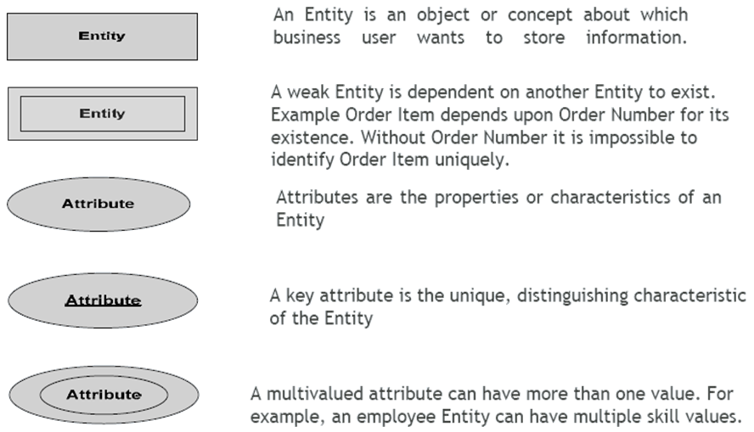
ER-Modeling - Notations

Slide 23
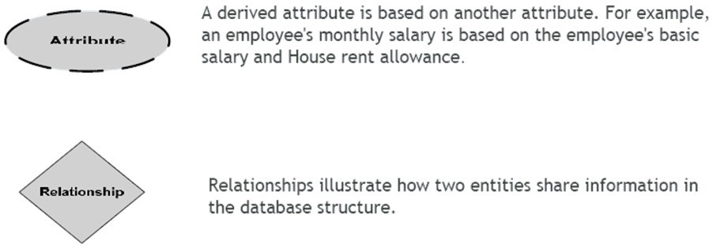
ER-Modeling - Notations

Slide 24
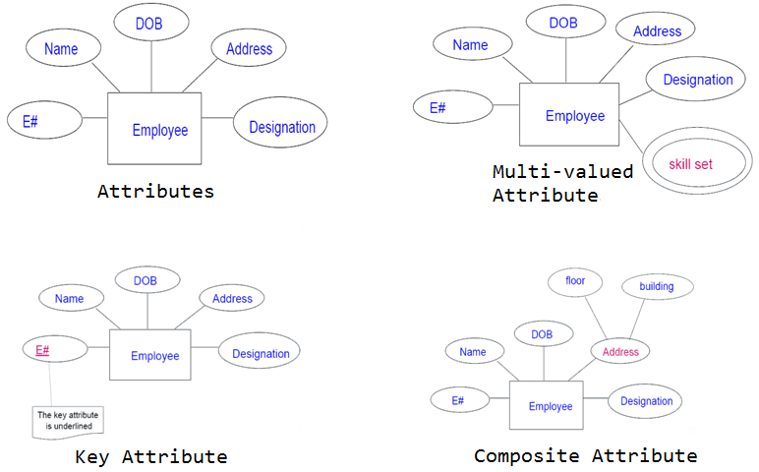
ER-Modeling - Notations

Slide 25
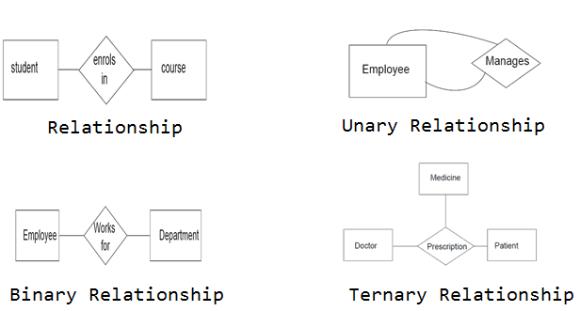
ER-Modeling - Notations

Slide 26
Transforming E-R Diagrams into Relations
Map Regular Entities to Relations
Composite attributes: Use only their simple, component attributes
Multi-valued Attribute - Becomes a separate relation with a foreign key taken from the superior entity
Map Weak Entities
Becomes a separate relation with a foreign key taken from the superior entity

Slide 27
Normalization
Transforming data from a problem into relations while ensuring data integrity and eliminating data redundancy.

Slide 28
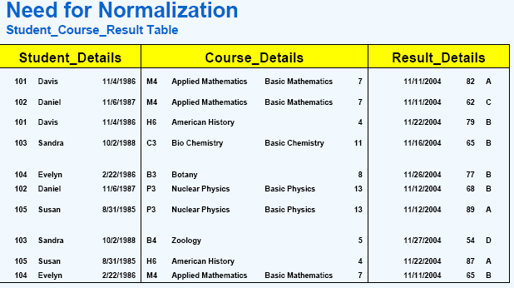
Redundancy and normalization

Slide 29
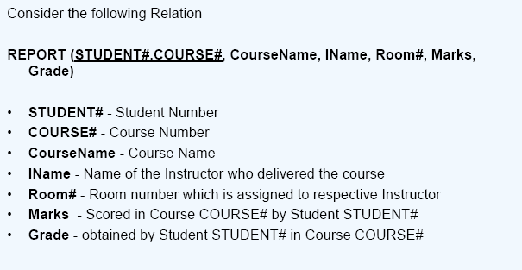
Normalization

Slide 30
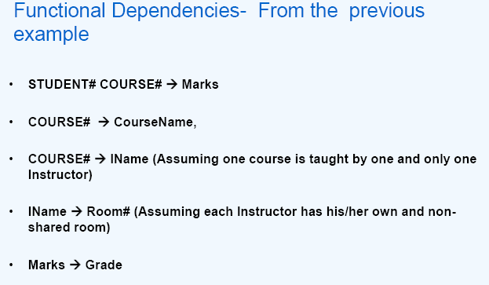
Normalization

Slide 31
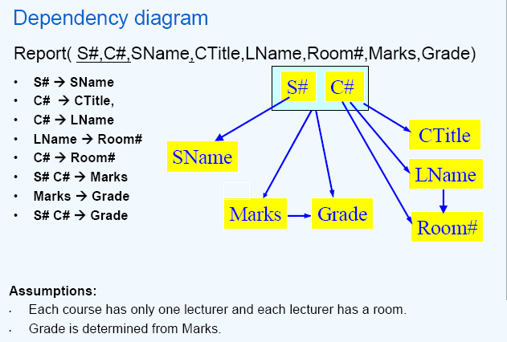
Normalization

Slide 32
Normal Forms - 1st Normal Form (1NF)
A table (relation) is in 1NF if
There are no duplicated columns in the table.
Each cell is single-valued (i.e.,there are no repeating groups or arrays).

Slide 33
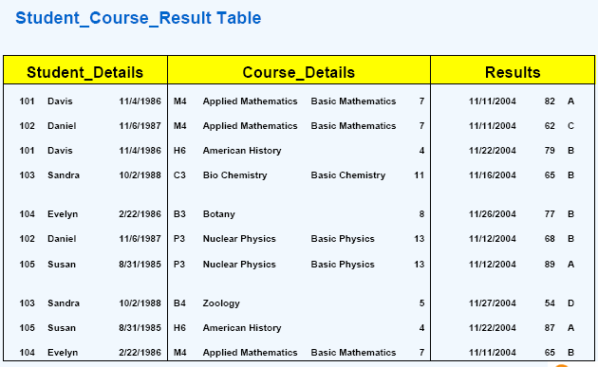
Recall

Slide 34
It must be in the 1NF
A relation is in 2NF if, and only if, it is in 1NF and every non-key attribute is fully functionally dependent on the whole key.
•Another way of saying this is that there must be no partial key dependencies (PKDs).

Slide 35
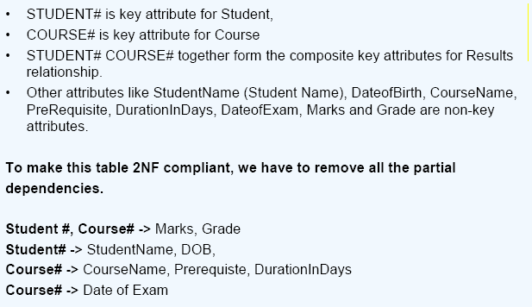
Normal Forms – 2nd Normal Form (2NF)

Slide 36
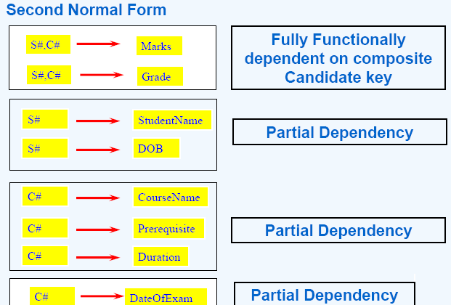
Normal Forms – 2nd Normal Form (2NF)

Slide 37
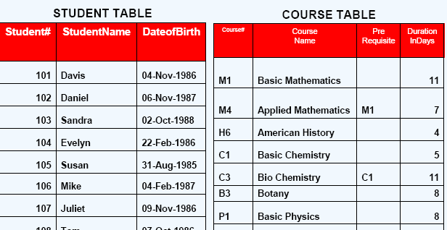
Normal Forms – 2nd Normal Form (2NF)

Slide 38
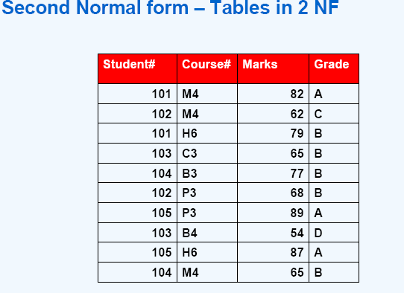
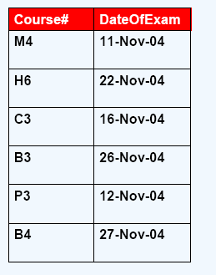
Normal Forms – 2nd Normal Form (2NF)
Student-Marks Exam-Date

Slide 39
3NF
Every column must depend directly on the primary key. Remove columns that are not dependent upon the primary key
•A relation is in 3NF if, and only if, it is in 2NF and there are no transitive functional dependencies

Slide 40
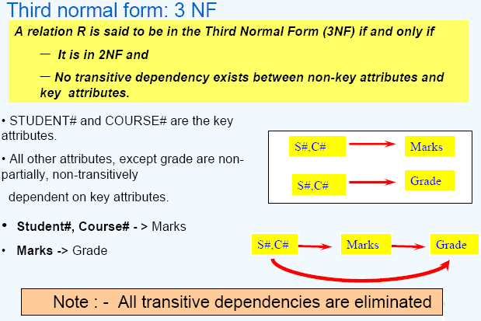
Normal Forms – 3rd Normal Form (3NF)

Slide 41
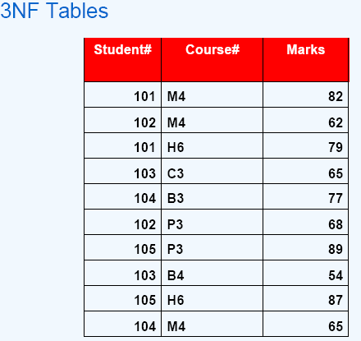
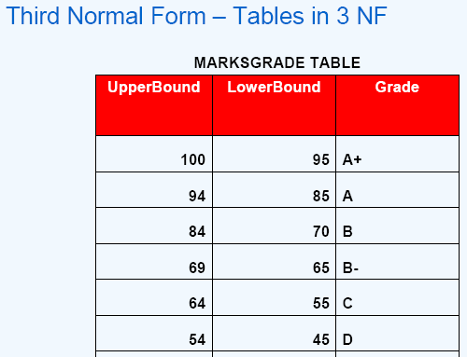
Normal Forms – 3rd Normal Form (3NF)

Slide 42
Oracle - Session 1

Slide 43
Table creation
CREATE TABLE tbl_name(col defns);
col_definition
colname datatype constraint
Constraints
Primary key
UNIQUE
NOT NULL
Foreign KEY
CHECK

Slide 44
Constraints
NOT NULL
The column cannot be null
UNIQUE
Does not allow duplicates

Slide 45
Constraints
PRIMARY KEY
It is unique and not null
FOREIGN KEY
It is the column in the child table that references the primary key column in parent table

Slide 46
Column level defn
Defined along with column defn
CREATE TABLE emp(eid NUMBER primary key);
Which constraint can be deined only at column level?
NOT NULL constraint can be defined only at column level

Slide 47
Table level column defn
Not defined part of column defn
Defined as a separate defn
CONSTRAINT [constraint_name] PRIMARY KEY (col_name)
CONSTRAINT [constraint_name] UNIQUE (col_name)
CONSTRAINT [constraint_name] FOREIGN KEY (col_name) reference_definition
CONSTRAINT [constraint name] CHECK (expr)
CREATE TABLE emp (eid NUMBER ,
ename varchar2(45),
CONSTRAINT emp_pk PRIMARY KEY(eid));

Slide 48
Altering the table structure
Alter table allows us to do the following:
Change the name of the column
Change the column type
Add a new column
Delete an existing column

Slide 49
Alter table - examples
Add a new column
ALTER TABLE questions ADD marks NUMBER;
CHANGE Column Name
ALTER TABLE questions RENAME COLUMN marks TO points;
Drop Column
ALTER TABLE emp DROP COLUMN CITY
Change Column type and size
ALTER TABLE emp MODIFY ename VARCHAR2(45);

Slide 50
DROP TABLE and TRUNCATE
DROP TABLE tblname;
drops the table
TRUNCATE tblname;
removes the data not the table structure
Once removed cannot be rolled back

Slide 51
DDL vs DML
DDL is always auto committed
Auto commit of DML is turned ON/OFF

Slide 52
INSERT
Inserts a row in the table
INSERT into tblname(col1, col2..)
VALUES(v1, v2…);
values must match the order of column defined and its type
INSERT into tblname VALUES(v1,v2,v3);
Values are matched against the order of table structure and its type

Slide 53
UPDATE & DELETE
UPDATE
Updates the row in the table
UPDATE tblname SET col1 =v1, col2=v2….
WHERE (condition)
DELETE
Deleted the row in the table
DELETE from tblname WHERE (condition)
WHERE condition is optional

