Slide 1
UNIT I
Collection Framework

Slide 2
Background:
An array can be used to store a group of elements of the same type (either primitives or objects).
Syntax:
int var-name[]; or int[] var-name;
var-name=new type [size];
Example:
int intArray[]; //declaring array
intArray=new int[20]; //allocating memory to array
Or
int[] intArray=new int[20]; //combining both statements in one
int intArray[]={2,3,4,5};//declaration, instantiation and initialization
The array, however, does not support so-called dynamic allocation - it has a fixed length which cannot be changed once allocated.
Furthermore, array is a simple linear structure.
Many applications may require more complex data structure such as linked list, stack, hash table, sets, or trees.

Slide 3
Introduction:
In version 1.2, Java provided a unified architecture, known as collection framework for representing and manipulating aggregate objects.
Definition: A collection is basically a container that encapsulates multiple objects into a single unit. (OR)
A collection, as its name implied, is simply an object that holds a collection (or a group, a container) of objects. (OR)
A collection is a set of classes and interfaces which are used for storing and manipulating groups of data as a single unit.
Example:
A list of employees,
A set of numbers,
A set of processes,
A queue of requests etc.

Slide 4
All Collection Frameworks primarily contains three parts:
Interfaces
Implementations (classes) and
Algorithms.

Slide 5
Interfaces:
These abstract data types define the functionality of collections.
All collection interfaces define a method add() that may be used to add an element to the collection.
Collection interfaces are provided in the package java.util.
Implementation:
These are classes implementing those interfaces.
Implementation classes are provided in java.util and java.util.concurrent package.

Slide 6
Algorithms:
In addition, collection framework defines a set of methods (usually static) for important operations such as searching, sorting, shuffling of objects which implement collection interfaces.
These methods behave polymorphically; i.e. work differently on different implementations.

Slide 7
BENEFITS: (Advantages)
Less Programming Effort
High Quality and Performance
Interoperability
Quick Learning
Flexible Redesign

Slide 8
Arrays vs Collections
Arrays | Collections
Arrays are fixed in size. | 1.Collections are Growable in nature. i.e., based on our requirement we can increase or decrease the size.
2.With respect to memory arrays are not recommended to use. | 2.with respect to memory collections are recommended to use.
3.With respect to performance Arrays are recommended to use. | 3.with respect to performance collections are not recommended to use.
4.Arrays can hold only homogeneous data type elements. | 4.Collections can hold both homogeneous & heterogeneous elements.
5.There is no underlying data structure for arrays and hence ready made method support is not available. | 5.Every collection class is implemented based on some standard data structure. Hence ready made method support is available For every requirement.
6.we can hold both int[] and Integer[]. (primitives and Objects types). | Collections can hold only Objects but not primitives.

Slide 9
COLLECTION INTERFACES:
Collection interfaces define behaviour of commonly used concepts and establishes relations among them.
The core collection interfaces and their hierarchy is shown in Figure 5.1: For simplicity, the major interfaces are shown here.
All core collection interfaces are generic. However, they may also be used as ordinary interfaces.

Slide 10
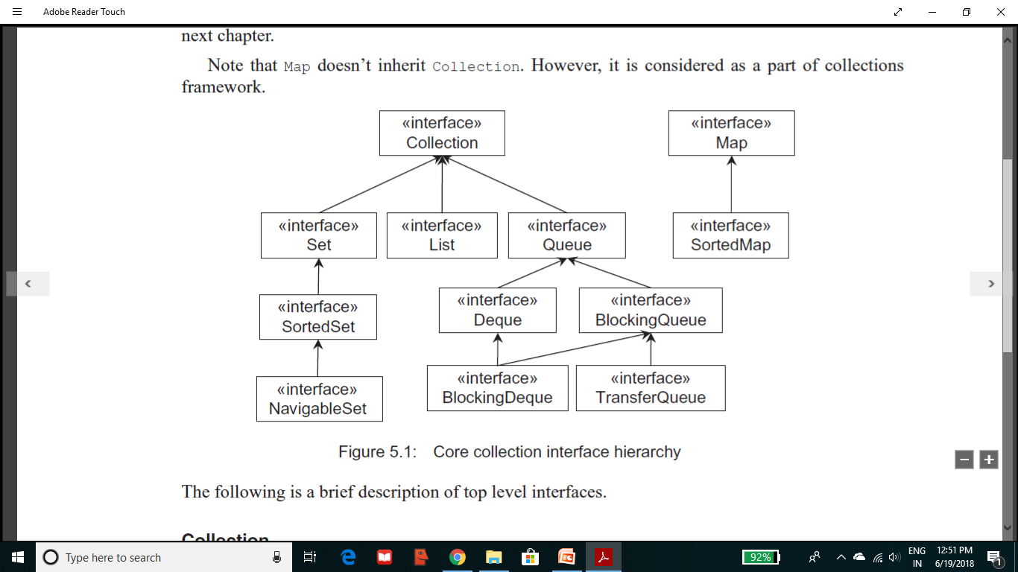

Slide 11
The following is a brief description of top level interfaces.
Collection
The root interface in the hierarchy is Collection interface.
It represents a general group of objects, called elements.
It defines primitive operations on collections such as adding[add()], removing [remove()] elements, checking existence of an element [contains()], size [size()] of collection etc.
It also provides methods for bulk operations such as addAll(), removeAll(), retainAll(), containsAll(), clear() etc.
The toArray() method acts as bridge between collections and older APIs that expect arrays on input.

Slide 12
Set
This interface models the mathematical set that contains an unordered collection of objects without any duplicates.
It contains only methods inherited from Collection.
However, since a set cannot contain duplicate elements, it does add restrictions on those methods.
Set also changes the contract of equals() and hashCode() operations so that Set objects can be compared meaningfully irrespective of their implementation.
Note that two sets are equal if they contain the same elements.

Slide 13
List
A List is an ordered collection and can contain duplicate elements.
It is like a dynamic array.
It allows us to have precise control over the elements inserted and deleted.
We can access elements by their position (integer index).
In addition to the operations inherited from Collection, List interface provides useful methods to add, remove, replace elements based on specified position and arbitrary range operations on the list.

Slide 14
Queue
This interface models queue where elements are added and removed in a specific order, typically in a first-in-first-out (FIFO) manner.
It defines additional operations for insertion, removal and inspection.
Although queues typically arrange elements in a FIFO order, other arrangements (such as LIFO) are also possible.
Every Queue implementation must specify its ordering properties.

Slide 15
Map
It represents key-value pairs.
The keys will be unique and each key can map to at most one value.
Although, it does not ensure element ordering, some implementations guarantee it.
To interoperate with other collection classes/interfaces, it provides three collection views, which allow a map's contents to be viewed as a set of keys, collection of values, or set of key-value mappings.

Slide 16
COLLECTION IMPLEMENTATION:
All collection implementations provide two constructors:
one that takes no argument and
one that takes a Collection argument.
The following sections discuss how to work with these collections.

Slide 17
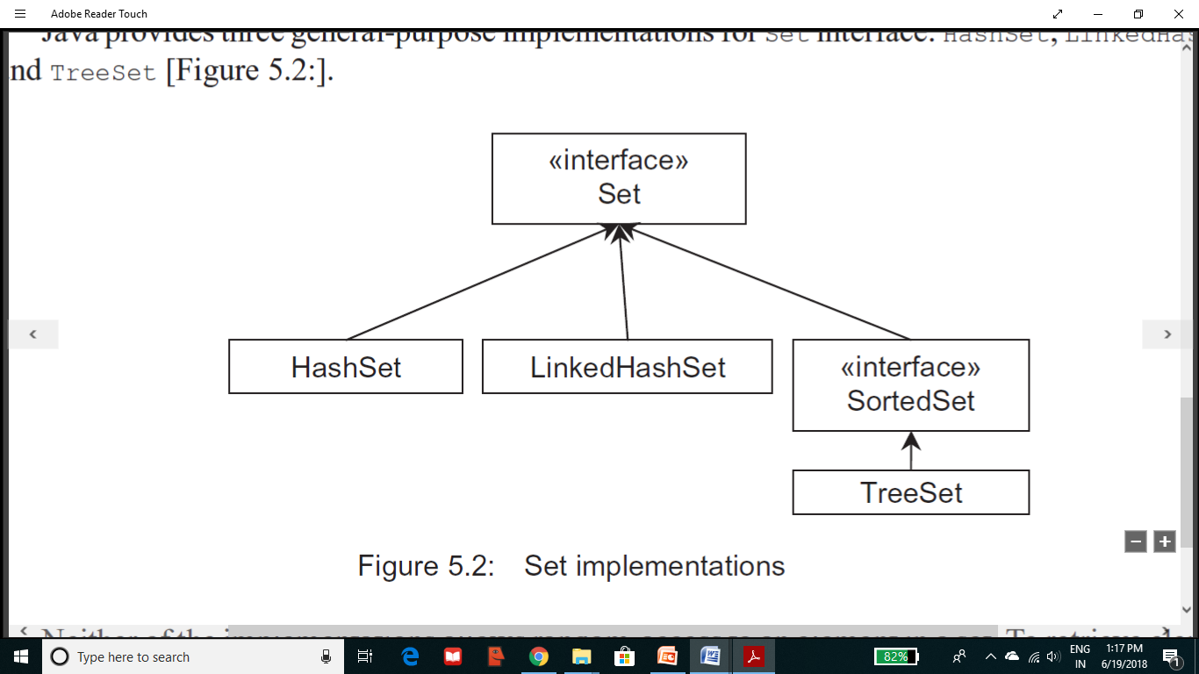
Set
Java provides three general-purpose implementations for Set interface: HashSet, LinkedHashSet and TreeSet [Figure 5.2:].
Neither of the implementations allows random-access to an element in a set.
To retrieve elements from the Set, we can either use Iterator or for-each loop.

Slide 18
1.2V
<<interface>>
Collection
1.5V
<<interface>>
Queue
1.2V
1.2V
<<interface>>
List
<<interface>>
Set
1.5V
1.5V
PriorityQueue
<<interface>>
BlockingQueue
1.2V
1.2V
1.0V
1.2V
1.2V
1.5V
ArrayList
LinkedList
Vector
HashSet
<<interface>>
SortedSet
LinkedBlockingQueue
1.0V
1.4V
1.6V
1.5V
Stack
LinkedHashSet
<<interface>>
NavigableSet
PriorityBlockingQueue
1.2V
TreeSet

Slide 19
1.2V
<<interface>>
Map
1.0V
Abstract Class
Dictionary
1.2V
1.2V
1.4V
1.0V
HashMap
WeakHashMap
IdentityHashMap
Hashtable
1.2V
<<interface>>
SortedMap
1.4V
1.0V
LinkedHashMap
Properties
1.6V
<<interface>>
NavigableMap
1.2V
TreeMap

Slide 20
Important Methods of Collection
boolean add(Object o) //To add an Object
boolean addAll(Collection c) // To add group(collection) of Objects
boolean remove(Object o) // To delete(remove) an Object
boolean removeAll(Collection c) // To remove group(collection) of Objects
boolean retainAll(Collection c) //To remove all objects except those present in c
void clear() //To remove all objects
boolean contains(Object o) //To check for an element
boolean containsAll(Collection c) //To check for group of objects
Boolean isEmpty() //To check empty or not
int size(); // To find the size
Object[] toArray(); //To convert this collection to Array
Object[] a=c.toArray();
Iterator iterator() //To get objects 1 by 1

