Slide 1
Playemos
Project Proposal Presentation
by
K M Shikha Shukla (2147153),
Sandeep Sutradhar (247130),
Sunny Dahit J (2147135),
Project Guide
Prof. Senthilnathan T
Department of Computer Science
CHRIST(Deemed to be University), Bengaluru-29

Slide 2
AGENDA
Existing System
Limitations of Existing System
Proposed System
Functional Description
Solution Architecture
Software & Hardware Requirements
Benefits of Proposed System
Plan of Work
References

Slide 3
Introduction
The project is to develop an emotion based music system which is an web based application.
It’s meant for user to minimize their effort in managing large playlists.
The proposed model will extract user’s facial expressions and features to determine the current mood of the users.
Once emotion is detected playlist of songs are suitable to the mood of the user will be presented to user.

Slide 4
1. Existing System
Spotify, Emo music, Saavn etc.
Lacks the ability to recommend songs to users based on mood.
Traditional way for creating playlists.
Don’t learn by itself.
Recommendation is determined after learning the user preferences over a period of time.

Slide 5
2. Limitations of Existing System
Does not provide personalized playlist to users automatically.
Does not recommend songs based on users emotion.
Users have to manually search for songs/music.
Not very user friendly.
Only static Image [1]
Accuracy is less and not fully implemented [2]

Slide 6
3. Proposed System
Playemos new approach to song recommendation.
Analyze the Scanned Image.
Live Mood Detection
Playlist Suggestion. [3]
This approach makes the system user friendly and easier for the user to interact with the application.
CNN, K-Means, Random Forest. SVM.

Slide 7
4. Functional Description
Login Module
User Module
Admin Module
Image recognition
Emotion detection
Playlist access
Song Suggestion
Play song
Feedback module.

Slide 8
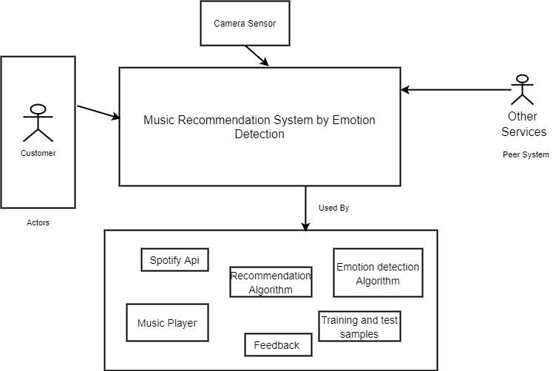
5. Solution Architecture

Slide 9
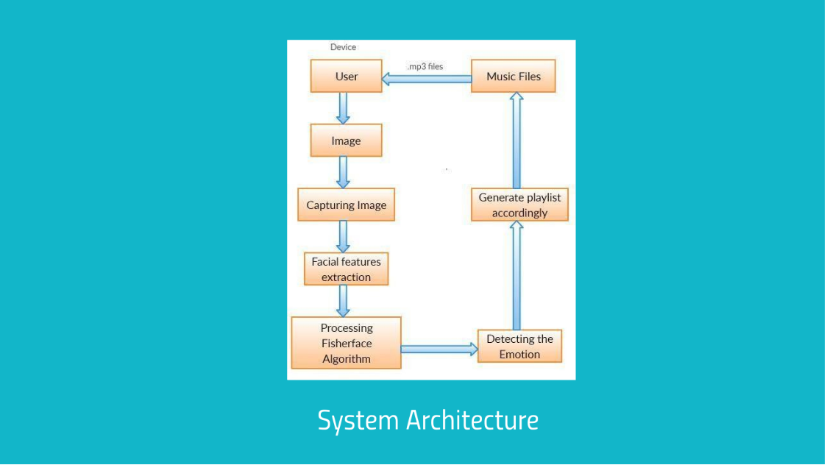
[4]

Slide 10
6. Software and Hardware Requirements
Hardware Requirements
Processor: Intel i5 processor or higher
RAM: 8 GB or higher
Disk space : 512GB HDD
Webcam

Slide 11
Software Requirements
Front End
HTML
CSS
Javascript
Back End
Python
Pycharm
JavaScript

Slide 12
7. Benefits of Proposed System
Provides emotion based music recommendations.
Makes user experience much easier than traditional approach.
Playlist is created in real time.
Better personalized experience for the user.

Slide 13
8. Plan of work
1. Set goals and objectives.
2. Establish team responsibilities.
3. Work based on task assigned.
4. Understand the usage of different algorithms.
5. Go with Agile framework.

Slide 14
Data Acquisition
Make a suitable model
Train the model
Create an Interface
Make the required change
Test the model with available data
Live data testing
Deployment of the application

Slide 15
9. References
[1] Deny John Samuvel, B. Perumal, and Muthukumaran Elangovan (2020). Music Recommendation System Based On Facial Emotion Recognition 3C Tecnología. Glosas de innovación aplicadas a la pyme. ISSN: 2254 – 4143 .262 http://doi.org/10.17993/3ctecno.2020.specialissue4.261-271.
[2] S Metilda Florence and M Uma (2020). Emotional Detection and Music Recommendation System. 3rd International Conference on Advances in Mechanical Engineering (ICAME 2020) IOP Publishing IOP Conf. Series: Materials S0cience and Engineering 912 (2020) 062007 doi:10.1088/1757-899X/912/6/062007
[3] Madhuri Athavle1, Deepali Mudale, Upasana Shrivastav, and Megha Gupta [2021]. Music Recommendation Based on Face Emotion Recognition. ISSN (Online) : 2582-7006 International Conference on Artificial Intelligence (ICAI-2021). Journal of Informatics Electrical and Electronics Engineering (JIEEE) A2Z Journals.
[4] https://prezi.com/p/ht3mxhk39pwd/emotion-based-music-recommendation-system/

