Slide 1
Playemos
Project Proposal Presentation
by
K M Shikha Shukla (2147153),
Sandeep Sutradhar (247130),
Sunny Dahit J (2147135),
Project Guide
Dr. Senthilnathan T
Department of Computer Science
CHRIST(Deemed to be University), Bengaluru-29

Slide 2
AGENDA
Module 1 : Face recognition
References

Slide 3
1. Module 1: face recognition
In this module the main aim is to train our module to detect the user face by checking for facial landmarks like the face, eyes, nose, ears, mouth, chin.
Once detecting the the landmark features the model it displays the emotion.

Slide 4
2. Steps to Execute
Login to system.
Upon successful completion.
Face recognition model automatically run the camera and detects the face.

Slide 5
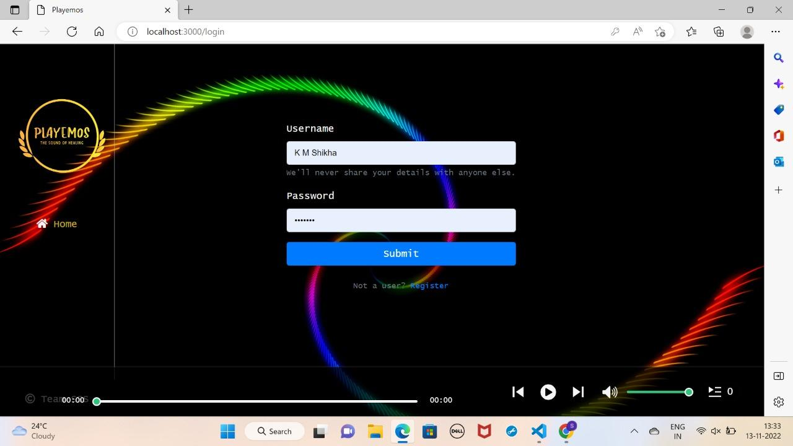
2. Login Page

Slide 6
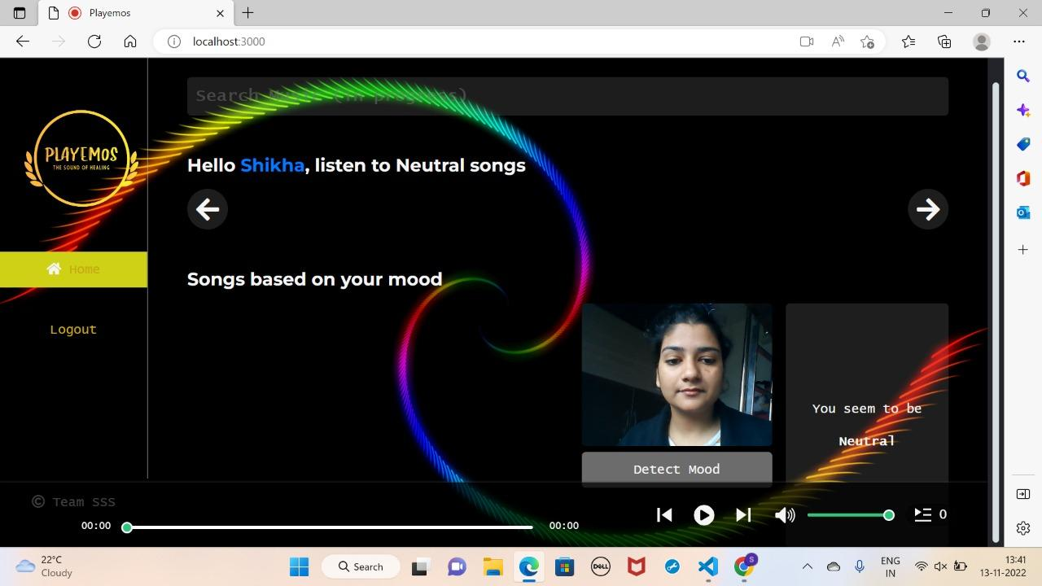

Slide 7
