Slide 1
Playemos
Project Proposal Presentation
by
K M Shikha Shukla (2147153),
Sandeep Sutradhar (247130),
Sunny Dahit J (2147135),
Project Guide
Prof. Senthilnathan T
Department of Computer Science
CHRIST(Deemed to be University), Bengaluru-29

Slide 2
AGENDA
Existing System
Limitations of Existing System
Proposed System
Functional Description
Solution Architecture
Software & Hardware Requirements
Benefits of Proposed System
Plan of Work
References

Slide 3
1. Introduction
Music plays an important role in shaping one’s emotions in different aspects of life. It is a way to express how he/she is feeling, and traditional music players or digital music service applications in a way help anyone enjoy the music on the go but they do not personalize the playlist according to the user's emotion/mood, instead there are a series of selections to be made in order to get desired songs automatically in the playlist. This often makes the user experience unpleasant and also is time-consuming. With the increasing usage of artificial intelligence and machine learning in different day-to-day applications. There is a need for music players to be smarter and have a better user experience. The project “Playemos” is to develop an Emotion Based Music recommendation system which is a web-based application meant for users to minimize their efforts in searching large playlists. This application is not targeted for a specific group or audience but for the general users as a whole.

Slide 4
1. Existing System
Spotify is one of the most popular digital music player application in the world. It is an upgrade over the traditional music player which completely depends on downloaded music in the system.
It lacks the ability to recommend songs to users based on their mood rather it has the same traditional approach to create desired playlists manually.
Recommendation is determined after learning the user preferences over a period of time.

Slide 5
2. Limitations of Existing System
Does not provide personalized playlist to users automatically.
Does not recommend songs based on users emotion.
Users have to manually search for songs/music.
Not very user friendly.

Slide 6
3. Proposed System
Playemos new approach to song recommendation, where the mood of a person is determined from his picture and based on the mood predicted song recommendations are made that best suit the mood predicted.
This approach makes the system user friendly and easier for the user to interact with the application.

Slide 7
Playemos new approach to song recommendation, where the mood of a person is determined from his picture and based on the mood predicted song recommendations are made that best suit the mood predicted.
This approach makes the system user friendly and easier for the user to interact with the application.

Slide 8
Playemos new approach to song recommendation, where the mood of a person is determined from his picture and based on the mood predicted song recommendations are made that best suit the mood predicted.
This approach makes the system user friendly and easier for the user to interact with the application.

Slide 9
4. Functional Description
Functional description defines the functionality of a system or one of its subsystems. It also depends upon the type of software, expected users and the type of system where the software is used. Functional system descriptions describe clearly about the system services in detail. The functional description contains Login modules. They are the login module, registered users’ module, normal users’ module, administrator module and server module.

Slide 10
Login Module
User Module
Admin Module

Slide 11
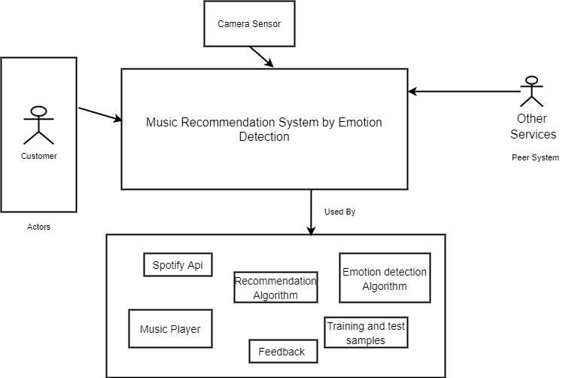
5. Solution Architecture

Slide 12
6. Software and Hardware Requirements
Hardware Requirements
Processor: Intel i5 processor or higher
RAM: 8 GB or higher
Disk space : 10GB HDD
Webcam

Slide 13
Software Requirements
Front End
HTML
CSS
Javascript
Back End
Python
Pycharm
JavaScript

Slide 14
7. Benefits of Proposed System
Provides emotion based music recommendations.
Makes user experience much easier than traditional approach.
Playlist is created in real time.
Better personalized experience for the user.

Slide 15
8. Plan of work
1. Set goals and objectives
2. Establish team responsibilities
3. Work based on task assigned
4. Understand the usage of different algorithms.

Slide 16
8. Plan of work
Data Acquisition
Make a suitable model
Train the model
Create an Interface
Make the required change
Test the model with available data
Live data testing
Deployment of the application

Slide 17
9. References
[1] Deny John Samuvel, B. Perumal, and Muthukumaran Elangovan (2020). Music Recommendation System Based On Facial Emotion Recognition 3C Tecnología. Glosas de innovación aplicadas a la pyme. ISSN: 2254 – 4143 .262 http://doi.org/10.17993/3ctecno.2020.specialissue4.261-271.
[2] S Metilda Florence and M Uma (2020). Emotional Detection and Music Recommendation System. 3rd International Conference on Advances in Mechanical Engineering (ICAME 2020)
IOP Publishing IOP Conf. Series: Materials Science and Engineering 912 (2020) 062007
doi:10.1088/1757-899X/912/6/062007
[3] Ankita Mahadik, Prof. Vijaya Bharathi Jagan, Shambhavi Milgir, Vaishali Kavathekar, and Janvi Patel [2021]. Mood-based Music Recommendation System.

