Slide 1
MCA681 – Industry Project Presentation – III
Simplify CV
Sandeep Sutradhar
Reg No - 2147130
Yasharth Singh Dr . Thirunavukkarasu.V Manager (Simplify3x Pvt. Ltd) ASSISTANT PROFESSOR
Christ (Deemed to be University)

Slide 2
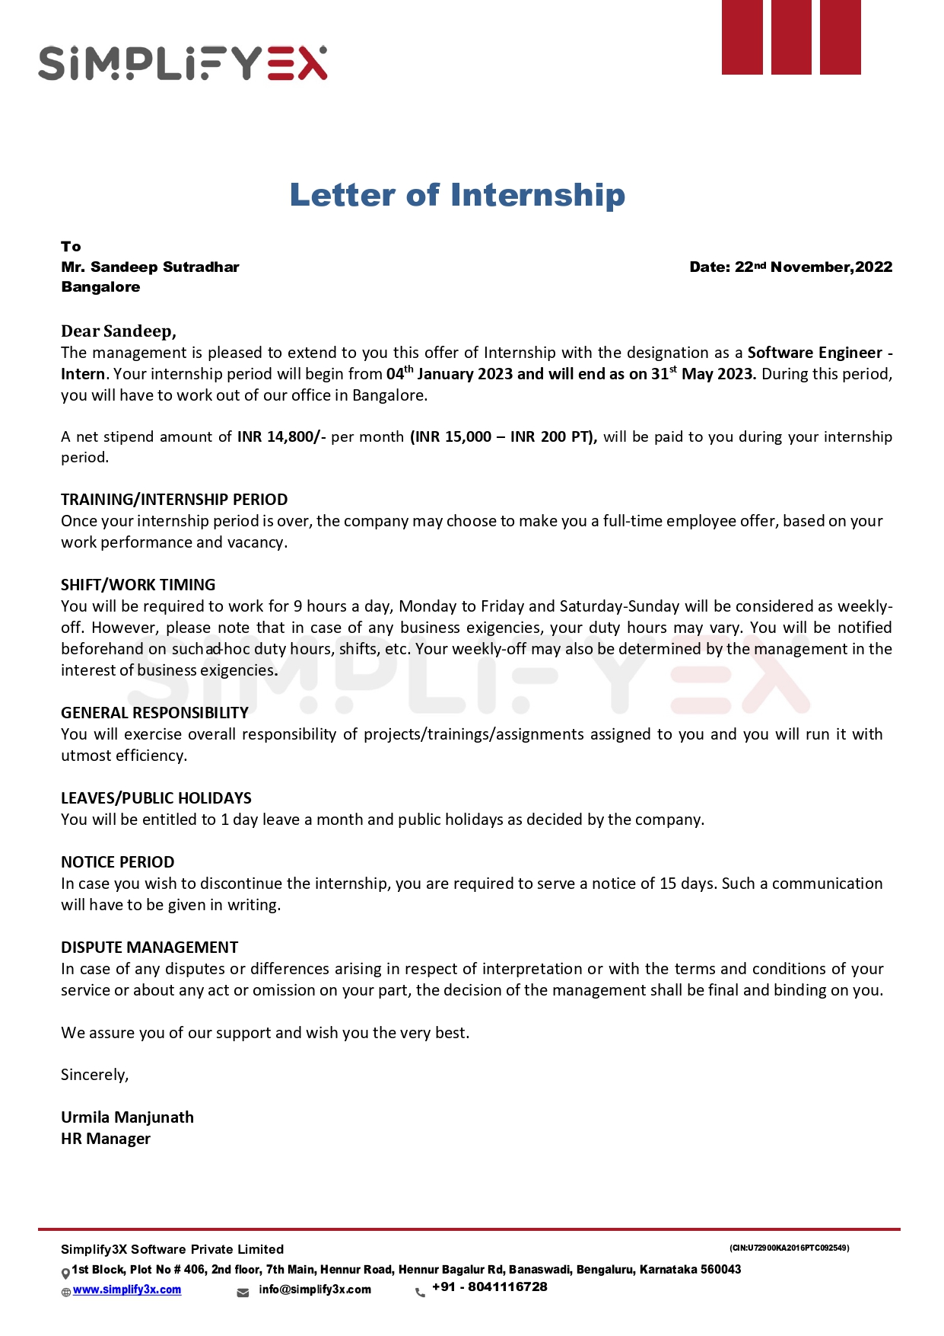
Offer Letter

Slide 3
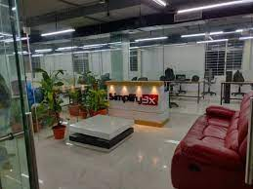
About the Organization
Simplify3x is an IT service and IT consulting company.
Established in the year 2016.
Services are intended to expedite product development and testing to increase business agility.
They offer sophisticated tech solutions to achieve performance optimization.

Slide 4
About the Project Domain
SimplifyCV is a Simplify3x home product.
Project has modules like Resume builder, assessment, recruitment, and training.
It is a product for the world to ease the recruitment process. This initiative is created to assist the company’s clients to achieve transformative results for hiring and those seeking a job.

Slide 5
It includes Pre-hiring screening, applicant skills evaluation, training, and development programs for employees/students in all areas where web application design bespoke assessments.
It holds commercial plans with various features. It allows the user not to have to do all of the work themselves, making it a quick and straightforward process of creating a resume or a cover letter for a job.

Slide 6
Recruitment Module
Recruitment software is specifically for managing all the processes, including recruitment.
The recruitment module helps make Job Descriptions, schedule assessments, and interviews, appoint a recruiter and panelist and declare the result of selection.
It also includes generating reports for students like how they have performed in different subjects in the test they have attended.

Slide 7
Different Users have different functionalities. It basically includes 6 Logins -- Admin, Obset, Recruiter, Panel, HR, and Vendor.

Slide 8
Data Set Specification (if any)
Mongo DB
API
Array of Objects Format

Slide 9
Roles and Responsibilities
As a Software Intern.
Generating Reports and enhancing User Experience.
Generate useful information from the Data.
Representing the data in a more understanding way.

Slide 10
Tasks Completed
Week 1 – Revisiting About the topics on JavaScript, and Learnt about various APIs
Week 2 – Learnt about Vue JS, Axios.
Week 3 - VUE X, Started learning about D3.JS
Week 4 – Understood the Project flow and continuing D3.js

Slide 11
Week 5 – 7 – Worked on the given data set
Week 8 Onwards – Creating the Library for All the Charts

Slide 12
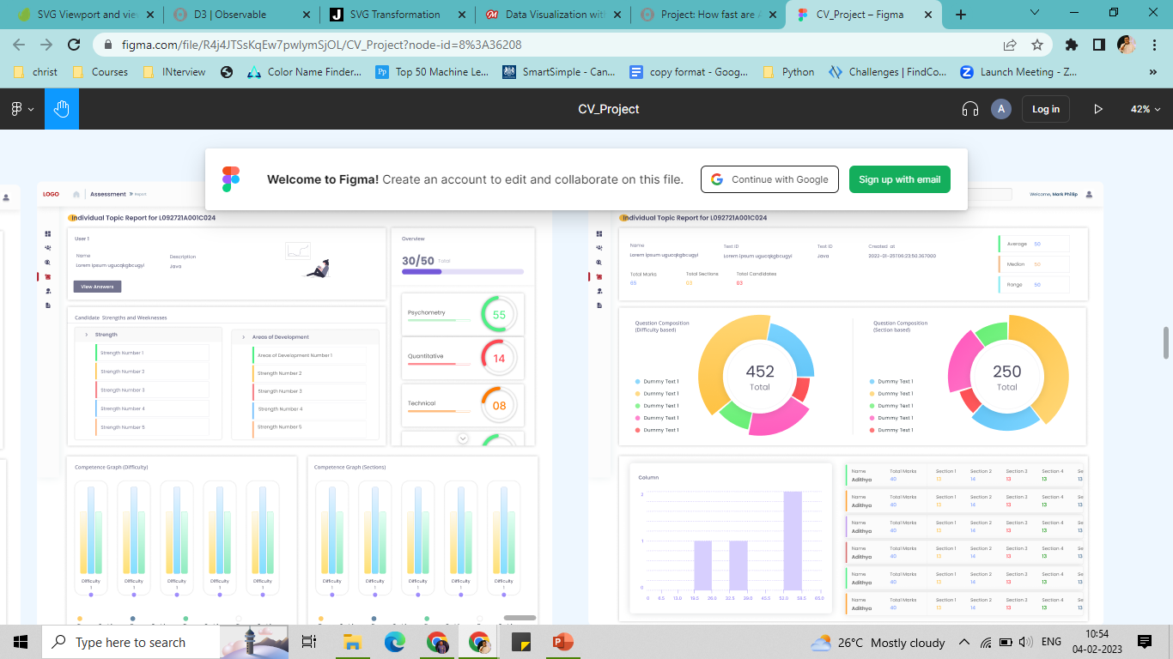
Tasks On-Going / Planned
D3.Js
Learn Vue Box
Understanding about SVG
Start Coding

Slide 13
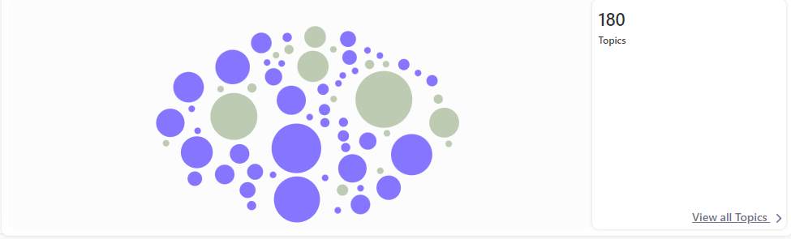
Tasks On-Going / Planned
Collision-Free Bubble Chart According to the API

Slide 14
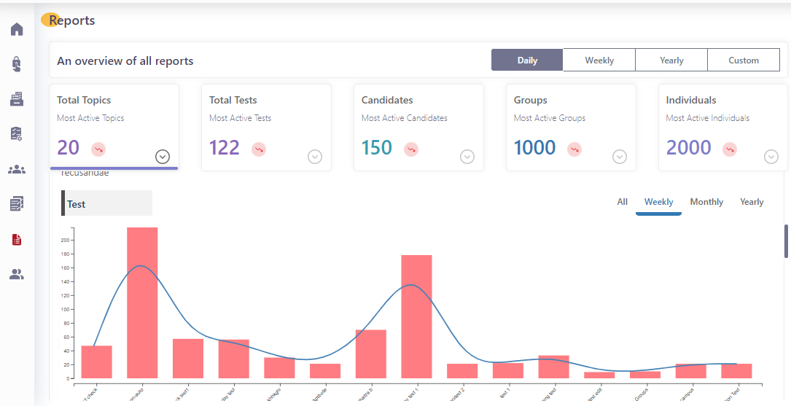
Tasks On-Going
Bar Chart with Fake JSON API

Slide 15
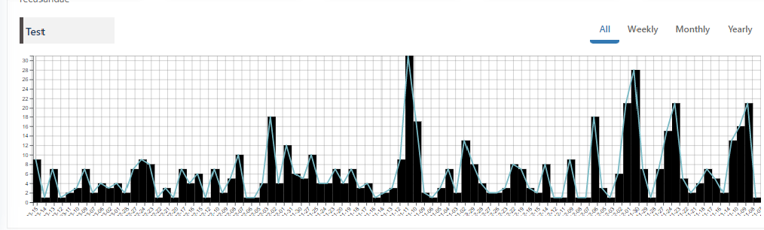
Tasks On-Going
Bar Graph from Backend API

Slide 16
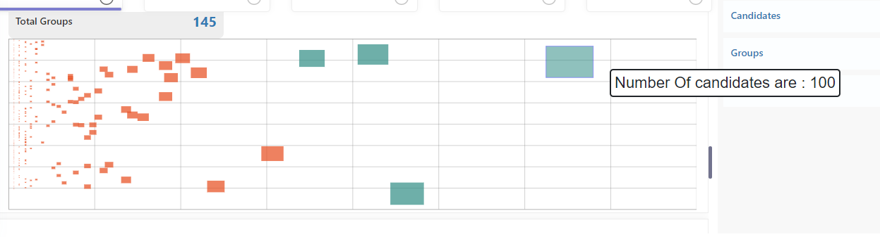
Tasks On-Going
Scatter Graph with tooltip

Slide 17
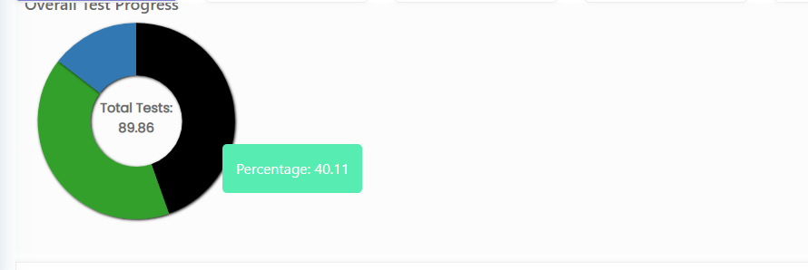
Tasks On-Going
Pie Chart to Show Overall Test Progress

Slide 18
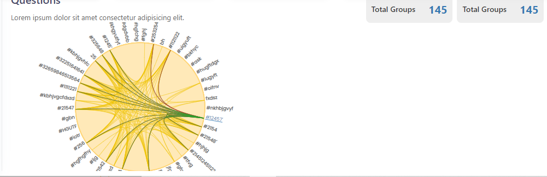
Tasks On-Going
Dendogram with Tree Graph along TAGS

Slide 19
Conclusion
Learnt And understood standard and efficient coding.
Learnt about the libraries in JS.
Learnt about API calling and CRUD operation with modifying JSON data.
There is less information present about D3 JS, but it is a very efficient and useful library for making graphs, maps, and data visualization.

Slide 20
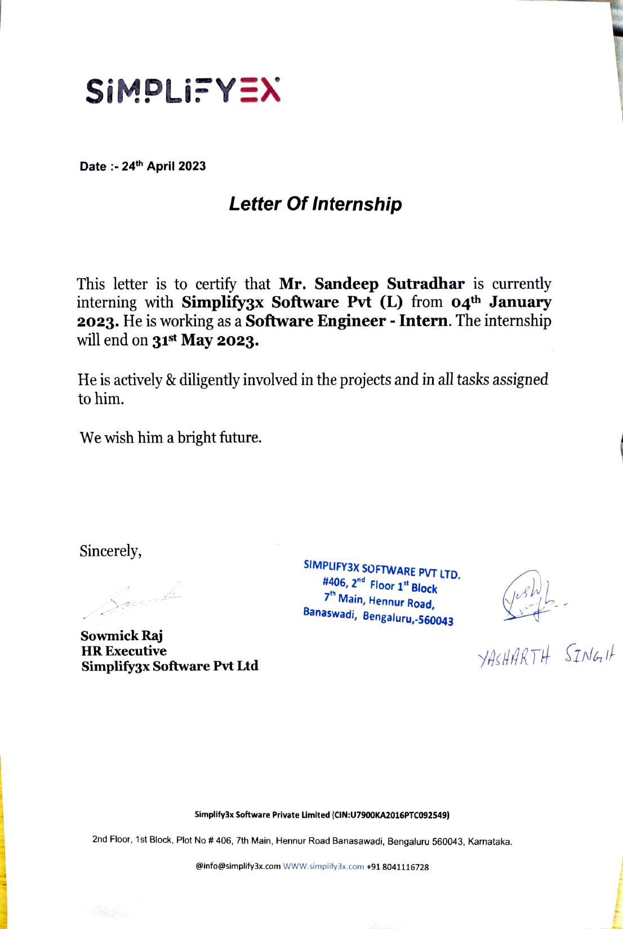

Slide 21
THANK YOU!!!

