Slide 1
Sustainable Health Monitoring Patch: Advancing Non-Invasive Care
By Team Horizon:
Sandeep S
Ravichandran R S
Sabareesh SL

Slide 2
Sustainable Health Monitoring Patch: Advancing Non-Invasive Care"
Problem statement: The current landscape of Insulin pump for Type-2 Diabetics lacks a cost-effective, non-invasive, and multipurpose solution for glucose detection. Traditional diagnostic methods are often invasive and costly, making continuous monitoring challenging. The problem at hand is to develop a single, versatile patch exclusively for non-invasive glucose detection, addressing the need for an affordable, accurate, and user-friendly glucose monitoring device to be added to the pump.
Objective:
Patch Development: We have developed a versatile single patch capable of detecting glucose, uric acid, and monitoring cardiovascular diseases, type 2 diabetes, kidney functioning, and cystic fibrosis.
NIR sensor Development: A Non-Invasive Near Infrared Sensor will also additionally monitor along with the patch for enhanced Accuracy.
Materials and Method: The patch is fabricated using a combination of CNT, graphene, zinc alloy, and gold nanosponges (AuNS) for surface-enhanced Raman spectroscopy (SERS). Simple pour and mix chemistry is employed for preparation.
Enhancement and Potential: We investigate how the morphology of AuNS enhances SERS signals and discuss the potential of this technology for molecular and biomolecular detection.
Machine Learning Algorithm: To optimize efficiency in pumping and monitoring, our sensor incorporates a machine learning-enhanced algorithm, ensuring precise and timely responses.
Application: A application with Realtime control and Update mechanism for organ function report

Slide 3
Main Patch-Based Sensor:
Multipurpose Functionality: The main patch-based sensor is a versatile device capable of non-invasive monitoring of various health parameters, including glucose levels, cardiovascular health, kidney functioning, and cystic fibrosis, all within a single wearable patch.
Advanced Materials: It incorporates cutting-edge materials such as carbon nanotubes (CNT), graphene, zinc alloy, and gold nanosponges (AuNS). These materials contribute to its sensitivity and effectiveness in detecting different molecules and biomarkers.
User Comfort: The patch is designed for user comfort, with a flexible and lightweight structure that ensures a comfortable fit during extended wear. Its non-invasive nature minimizes discomfort for users.
Data Accuracy: Rigorous quality control measures and testing ensure high data accuracy. The patch provides precise and reliable health data, making it valuable for both monitoring and diagnosis.
Cost-Effective Solution: The patch is engineered to be cost-effective, making it accessible to a broader population. Its scalability and efficiency in production contribute to its afforablity.
NIR Sensor (947nm):
Wavelength Selection: The NIR sensor operates at a specific wavelength of 947nm. This wavelength is carefully chosen for its suitability in detecting target molecules like glucose with high accuracy and reduced interference from other substances.
Beer-Lambert Law: The sensor employs the Beer-Lambert law, a fundamental principle in spectroscopy, to quantify the concentration of molecules. This law relates the absorption of light to the concentration of the target molecule in the patch.
Enhanced Sensitivity: The NIR sensor's design and wavelength selection enhance its sensitivity to specific molecules, allowing for precise and reliable measurements. This feature is crucial for accurate glucose monitoring.
Non-Invasive Operation: The NIR sensor operates non-invasively, eliminating the need for pricking or invasive procedures. This makes it user-friendly and minimizes discomfort for individuals using the health monitoring patch.
Contributing to Accuracy: When integrated into the main patch-based sensor, the NIR sensor significantly contributes to the overall accuracy and reliability of health data, ensuring that users receive high-quality monitoring and diagnostic information.

Slide 4
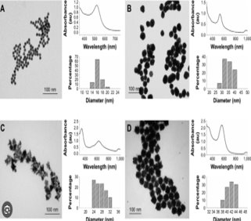
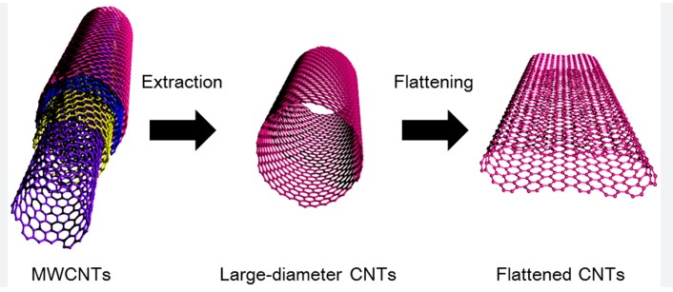
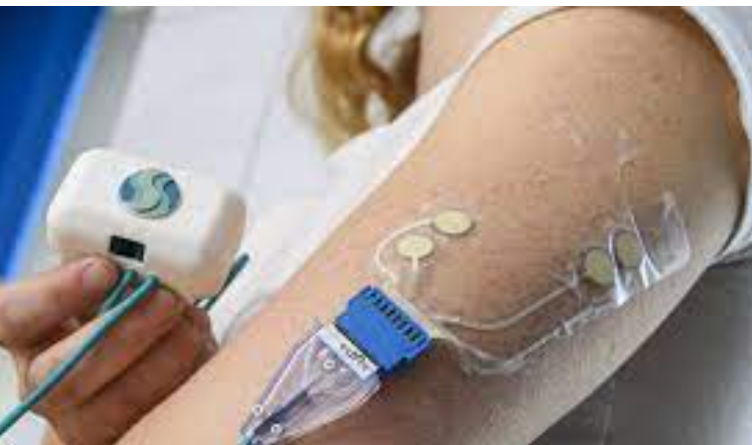
AuNS(Gold NonoSponge)
CNT flattened for the Sensor

Slide 5
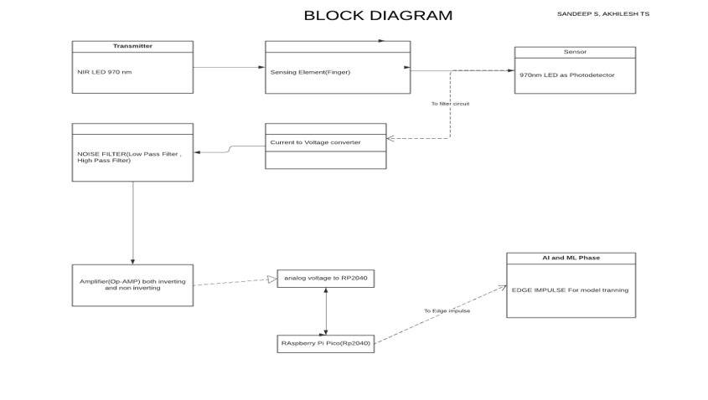
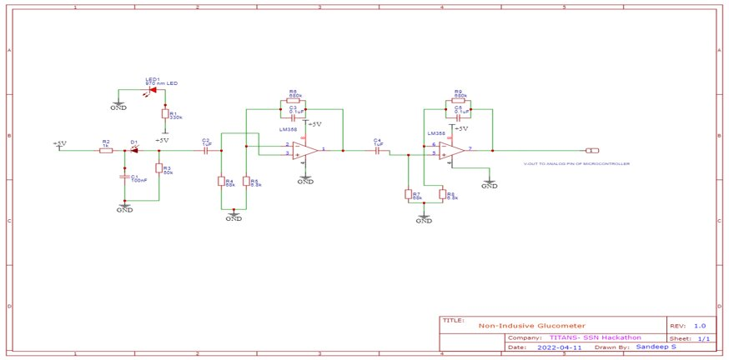
Block Diagram for NIR Sensor
Circuit for the Glucometer

Slide 6
Sustainability
Biodegradable Patch Materials:
Eco-Friendly Design: The health monitoring patch is designed with biodegradable materials to minimize its environmental footprint. Components like the patch substrate and adhesive are carefully selected for their biodegradability.
Natural Polymer Usage: Biodegradable materials may include natural polymers like cellulose or starch-based adhesives. These materials break down naturally over time, reducing waste and pollution.
Reduced Landfill Impact: Biodegradable patches reduce the accumulation of non-recyclable waste in landfills, promoting a more responsible approach to disposable healthcare products.
User Health and Environment: The use of biodegradable materials not only benefits the environment but also ensures that users are not exposed to harmful substances when disposing of used patches.
Complete Decomposition: Biodegradable patch materials are selected to decompose into non-harmful byproducts, leaving minimal environmental impact as they break down.
Recycling Nanomaterials:
Sustainability Focus: To align with sustainability goals, the sensor design incorporates recyclable nanomaterials, such as carbon nanotubes (CNT) and graphene. These materials can be efficiently recycled, reducing environmental impact.
Reclamation Process: A structured reclamation process is established to extract and reuse nanomaterials from the worn-out or discarded patches. This minimizes waste and conserves valuable resources.
Resource Efficiency: Recycling nanomaterials not only reduces waste but also promotes resource efficiency, as it lowers the need for new raw materials in the manufacturing process of future patches.
Environmental Responsibility: The inclusion of recyclable nanomaterials demonstrates a commitment to environmental responsibility, contributing to a more sustainable approach to healthcare technology.

