Slide 1

Data Science Foundations | Project
Telco Customer Churn
Team Members-
Krishan Chawla - 041090023
Sandeep Sudesh - 041093172
Shyam Kishore Pandian - 041098636
Vivek Anandham - 041092466
Notes:
Good Morning everyone
Team members intro
Today we are gone see the topic Telco customer churn analysis using machine learning models.
In Industry People are dealing with lot of variety of Data,
One interesting Problem that business is facing now days is Churn Analysis.
Let’s dive deeper into Churn Analysis.
(Or)
Good Morning everyone, Our topic is Telco customer churn analysis using machine learning models.
As data professionals, we often encounter diverse data sets in our industry, and one prominent issue businesses face is churn analysis. Let's explore this topic in more detail.

Slide 2

1 | Business Understanding
Telecom churn analysis is an important business practice that involves identifying and reducing customer churn in the telecom industry.
Churn refers to the rate at which customers leave a company for its competitors or discontinue using its services altogether.
The goal of telecom churn analysis is to understand why customers are leaving and to develop strategies to retain them.
This involves analyzing customer data, such as usage patterns and demographics, and identifying key factors that influence churn.
We’re going to look at how to increase customer retention in the telecoms industry by analyzing the sample dataset provided by IBM.
Notes:
What is Churn?
When an existing customers who is using the services of a company and stop using the service of the company.
Moves to other company to have better benefits
So these factors impact revenue of a company. Deteriorates the brand value.
In telecommunication industry, churn plays an very important role. So analyzing and predicting churn is important.
Scope of this project is to retain its customers in a long period of time.

Slide 3
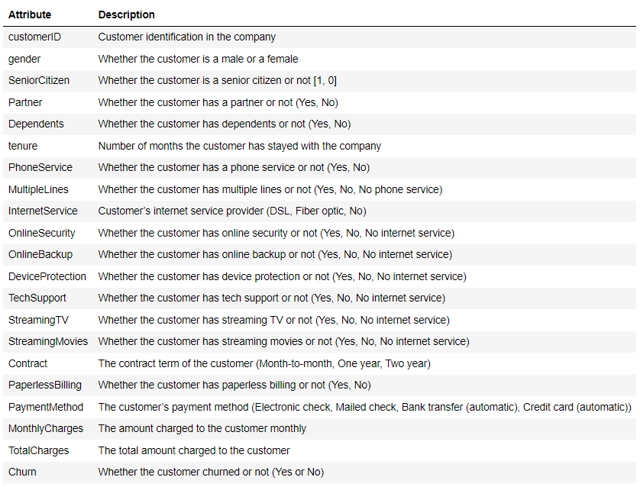
2 | Dataset Understanding
Dataset-Link: https://www.kaggle.com/datasets/blastchar/telco-customer-churn
Develop a machine learning model, which will predict if a customer will stay or leave the telecom company.
The dataset contains 7043 records, and each record has 21 features.
In the telecom industry, churn refers to the rate at which customers leave or switch to another service provider.
the "Target variable" is customer churn, used to identify reasons for high churn rates and develop predictive models to retain customers.
Notes:
The dataset used in this project is Telco churn dataset provided by IBM.
The dataset contains 7043 records and each record has 21 features.
The Churn Column is our Target Variable, where the class No means that the customers are loyal to the company and the class Yes means that the customers who are not loyal and left the company.
Tenure is very important feature, which refers to the period of time the customer stayed in the company. And some other important features are gender, senior citizen, phone service , payment methods and internet service.
Making visuals of the Data to understand it and know the Skewness and the distribution of the data.

Slide 4
3 | Data Preparation
Total Charges column was converted to float type.
"TotalCharges" feature now has missing values as the "errors=coerce" parameter in "to_numeric" function has converted string " " to NaN.
A single space character is also considered as a string.
Here we are Imputing the Nan values with the median of the Total Charges.
Notes:
In the Data Preparation part, we tend to change the data type for doing modeling. Here in our dataset the Total charges is converted from object to float as it contains numeric features.
After changing it into numeric we have some empty values in it due to empty spaces given in the data collection. We are replacing the empty space with the Nan.
Handling Missing values places an important role, but this may result in loss of valuable data. Alternatively, imputation methods can be used to estimate missing values.
Now we are going to impute the missing data by median. Here total charges Nan values is imputed by its median.
We also Performed EDA to Analyze the hidden Trends within the data.

Slide 5
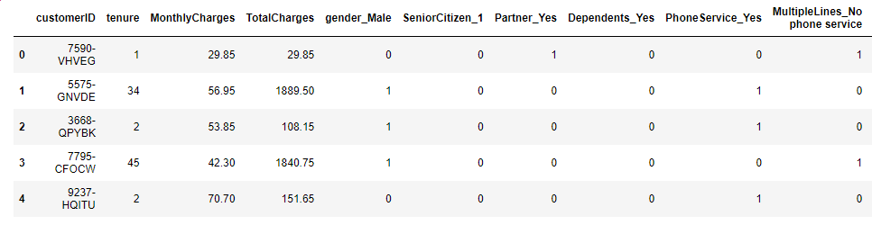
3 | Data Preparation – One Hot Encoding
Category features are being Encoded, using the One Hot Encoding method.
Data after Encoding
Notes:
One Hot Encoding is a technique used to convert categorical data into numerical data for machine learning algorithms to better interpret.
It works by creating a binary representation of each category in a feature column, where a 1 indicates the presence of a category and a 0 indicates its absence.
One hot encoding can convert features into a format that can be used for training predictive models accurately and its reliable for this dataset which has very less categories.

Slide 6
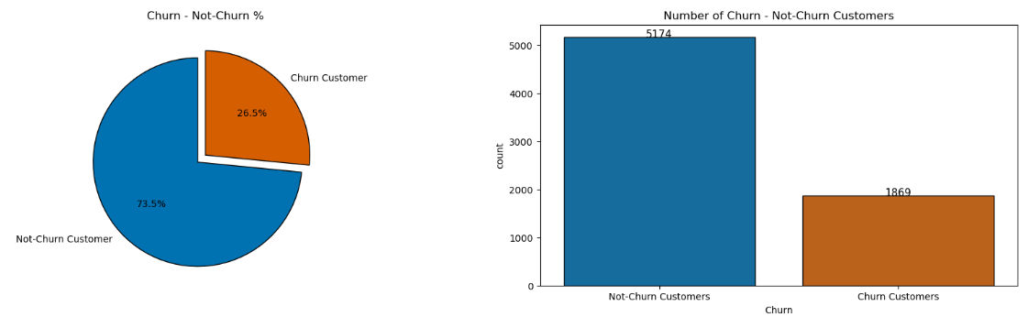
3 | Data Preparation – Handling Imbalanced Data
Target Label is Imbalanced, where the Not-Churn Customers contribute 73.5% and Churn customers only contribute 26.5%.
The Imbalanced data will be handled by the help of SMOTE and stratified methods for the various machine learning models.
Notes:
In our project the target variable churn is imbalanced, where non churn customers contribute 73.5% and churn customers contribute only 26.5%.
Handling imbalanced data in the target variable churn is a critical step in ensuring the success of our machine learning model, planning to use smote method and Stratified sampling.

Slide 7
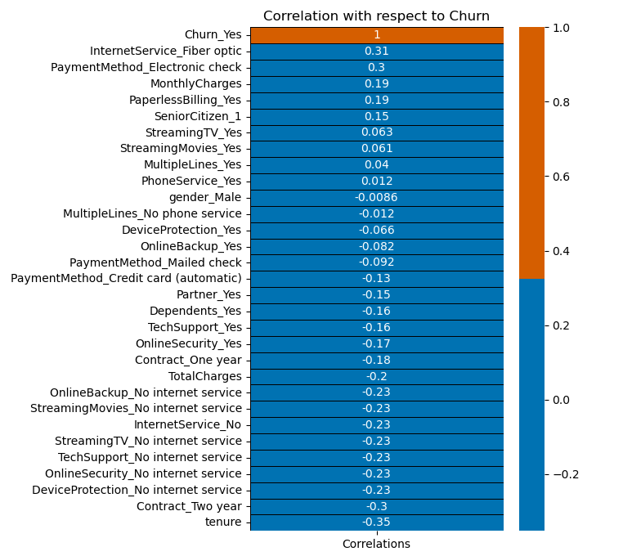
3 | Data Preparation – Feature Selection
Correlation is plotted with respect to the Target Label “ Churn “.
The Correlation matrix helps us to select the features which are highly co-related to the target variable.
Here -1 indicating a perfect negative correlation, 0 indicating no correlation, and 1 indicating a perfect positive correlation.
According to this examination, most of the features have significance to the prediction of churn.
Notes:
Correlation matrix helps in identifying the correlation between the different variables in the churn dataset.
Here Correlation is plotted with the target variable churn.
The Correlation matrix helps us to select the features which are highly co-related to the target variable.
Here -1 indicating a perfect negative correlation, 0 indicating no correlation, and 1 indicating a perfect positive correlation.

Slide 8
4 | Modeling and Pipeline Creation
We will be using Supervised Machine Learning Models to our Project.
We will compare various Supervised Machine Learning Models like Logistic Regression, Decision Tree Classifier, Random Forest Classifier, and Support Vector Machine and analyse the best model by hyperparameter tuning (using SMOTE).
Train and Test splits using SMOTE (for handling imbalanced data)
SMOTE (Synthetic Minority Oversampling Technique) It is the strategic technique to increase the number of cases in an imbalanced dataset to make it balanced.
Stratified Sampling is used to ensure that the training and testing data sets represent the same proportion of churned and non-churned customers as the actual population.
Notes:
It's important to evaluate multiple models and select the one that performs the best.
Hyperparameter tuning can be performed to optimize the performance of the model.
SMOTE
Stratified Sampling

Slide 9
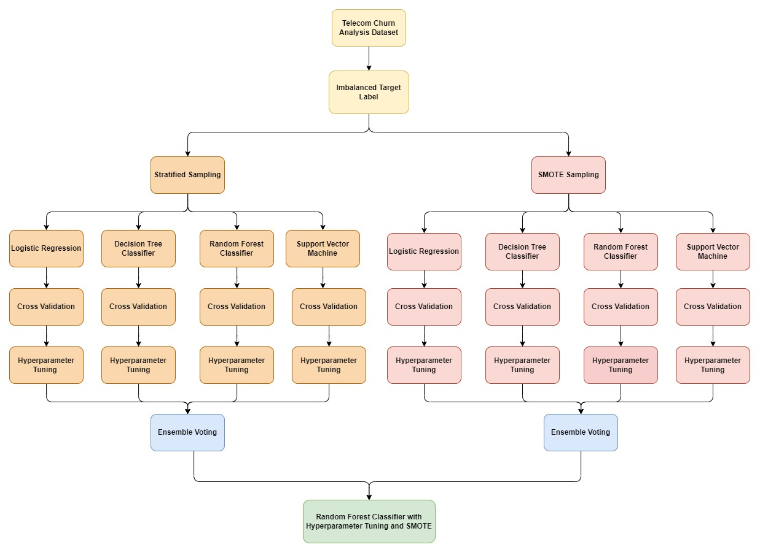
4 | Pipeline Creation
Notes:
Pipelines Created in our Project - - -
Explain the various pipelines and the Highest performing models. Show the Flow.
Explain more about SMOTE and Stratified.
Highlight cross validation and Hyperparameter Tuning.
Ensemble learning methods used in our project.

Slide 10
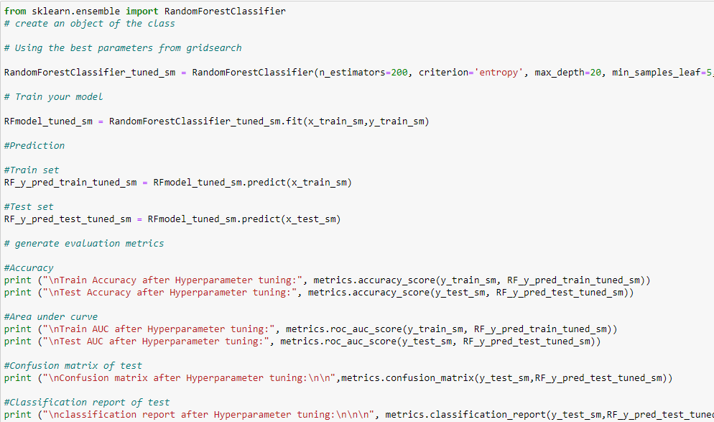
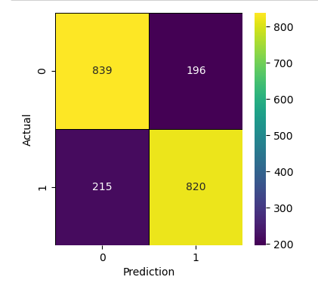
5 | Model Evaluation and Selection
Selected Model : Random Forest Classification
Confusion Matrix :
Notes:
The combination of Random Forest Classifier with SMOTE and hyperparameter tuning helped to improve the model's performance on the imbalanced churn dataset, by reducing false negatives and increasing recall.
Some of the hyperparameters that were tuned include the number of trees in the forest, the maximum depth of the trees, and the minimum number of samples required to split an internal node.
This model can be used to make predictions on new, unseen data, and can also be deployed in a production environment for real-time churn prediction.

Slide 11
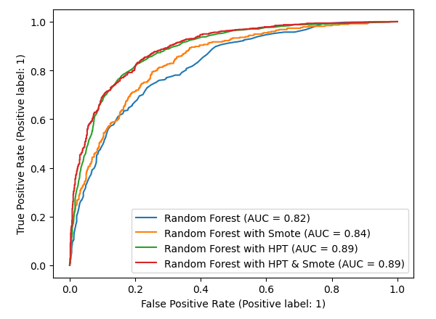
5 | Model Evaluation and Selection
The most efficient machine learning method for the churn dataset is Random Forest Classification.
SMOTE was a good booster for the model as it converted the data to a more balanced state.
Hyperparameter tuning really enhanced the model with best parameters to predict the churn rate.
We can infer from the Comparison graph that Random Forest with hyperparameter and Smote tweaking gives us the best results.
Notes:
After comparing the ROC curves and AUC scores, we can select the model that has the highest AUC score as the best-performing model.
The AUC score of the Random Forest classifier with SMOTE and hyperparameter tuning is the highest among all the models, it can be considered as the best-performing model. This model has balanced classes, which can address the issue of imbalanced data. Additionally, by tuning the hyperparameters, we can find the optimal set of parameters that improve the model's performance. Overall, this model can effectively predict customer churn with a high degree of accuracy.

Slide 12
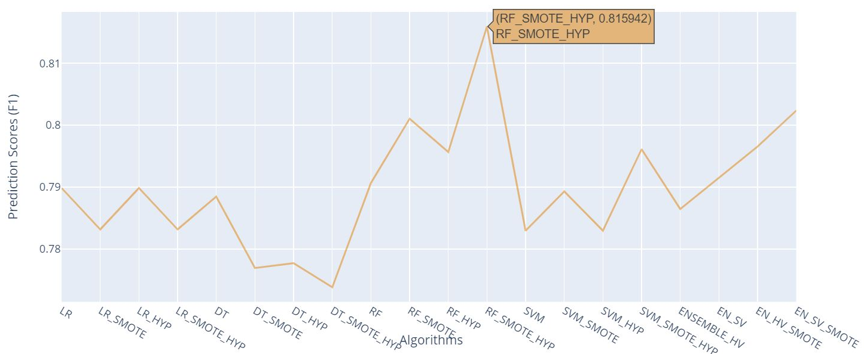
6 | Conclusion – Result Analysis
Among all the models, the Random Forest Classification with Hyperparameter and SMOTE sampling has the highest F1 score of 0.8159, indicating that this model is the most accurate in predicting the target variable.
Notes:
Among all the models, the Random Forest Classification with Hyperparameter and SMOTE sampling has the highest F1 score of 0.8159, indicating that this model is the most accurate in predicting the target variable.
Random Forest Classification with SMOTE sampling also performed well with an F1 score of 0.8010, indicating that oversampling the minority class using SMOTE has improved the performance of the model.
The Ensemble models (both Hard and Soft Voting) with SMOTE sampling have higher F1 scores than the corresponding models without ensemble voting.
Logistic Regression and Decision Tree Classification models perform similarly and have lower F1 scores than other models.
SVM Classification models have moderate F1 scores and have performed better with the addition of SMOTE sampling.
Overall, the Random Forest model with Hyperparameter tuning and SMOTE sampling is the best-performing model, followed closely by the Ensemble Soft Voting with SMOTE sampling model.

Slide 13
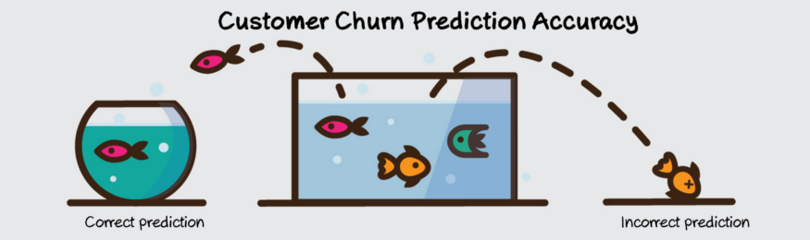
6 | Conclusion - Recommendations
The predictive models developed in this project showed good performance in identifying customers who are likely to churn. The accuracy of the models could be improved further by collecting more data and optimizing the model parameters.
The cost of acquiring new customers is often higher than retaining existing ones. By using machine learning models to identify and target customers who are likely to churn, telecom companies can now improve their customer retention rates and reduce the cost of customer acquisition.

Slide 14
6 | Conclusion – Web Interface for Model Prediction
Telecom Churn Predictor: A Web-Based Machine Learning Model
The web-based machine learning model allows users to predict the probability of a customer churning based on a set of input parameters.
The user interface is intuitive and user-friendly, making it accessible to non-technical users.
The model is based on a robust machine learning algorithm that has been trained on a large dataset, ensuring high accuracy and reliability.
Let us now proceed to the demonstration of our project.

Slide 15
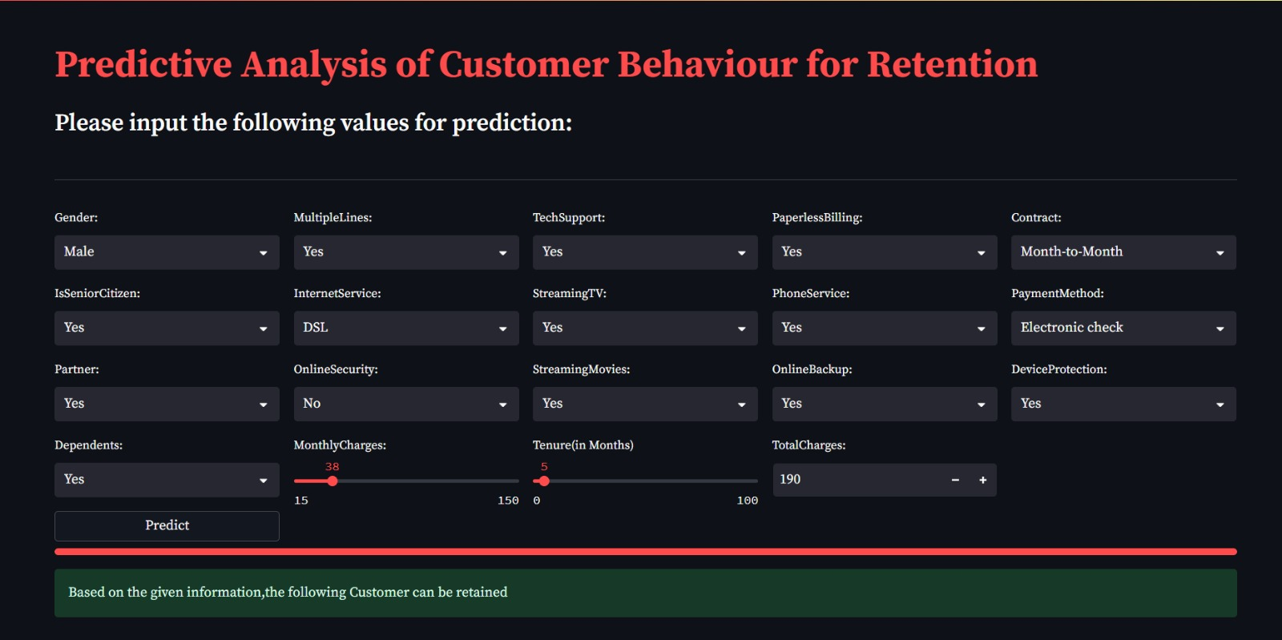
6 | Conclusion – Demo

Slide 16

Thank you!

