Slide 1

SiL, HiL testing plan for Year 2

Slide 2
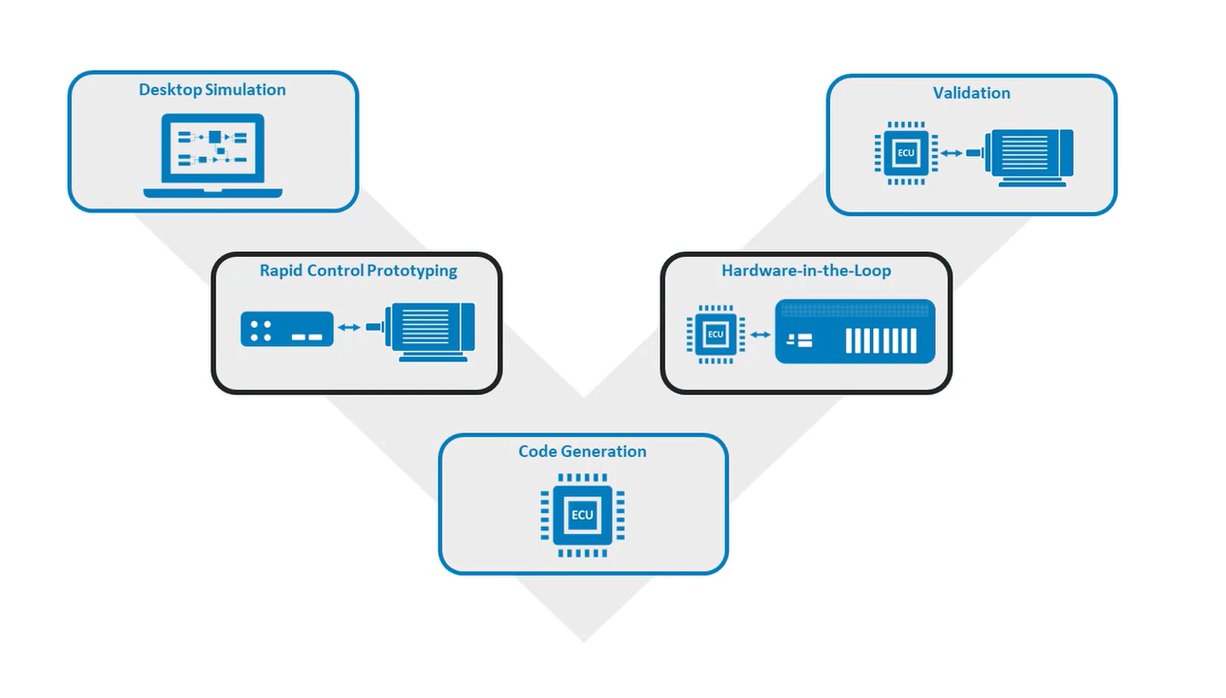
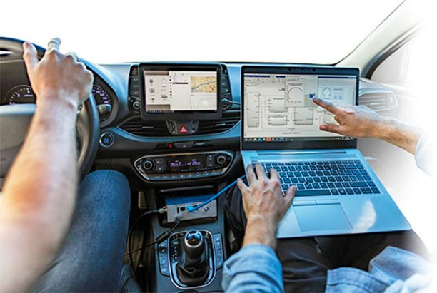
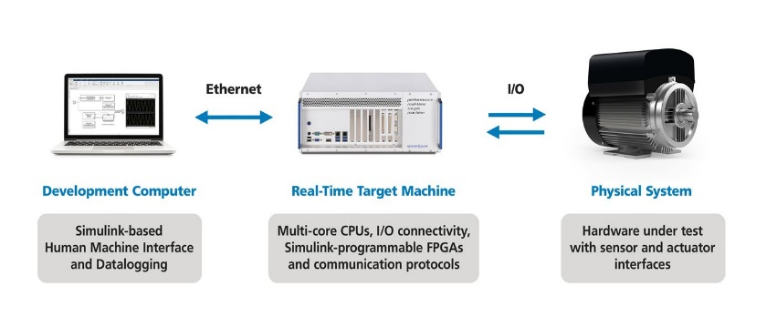
Verification and Validation process
Functional Requirements
MiL & SiL
HiL
Processor in Loop (PiL)

Slide 3
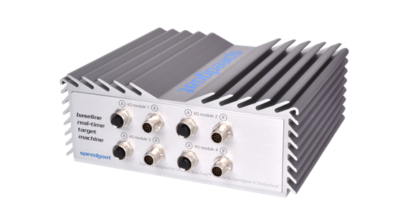

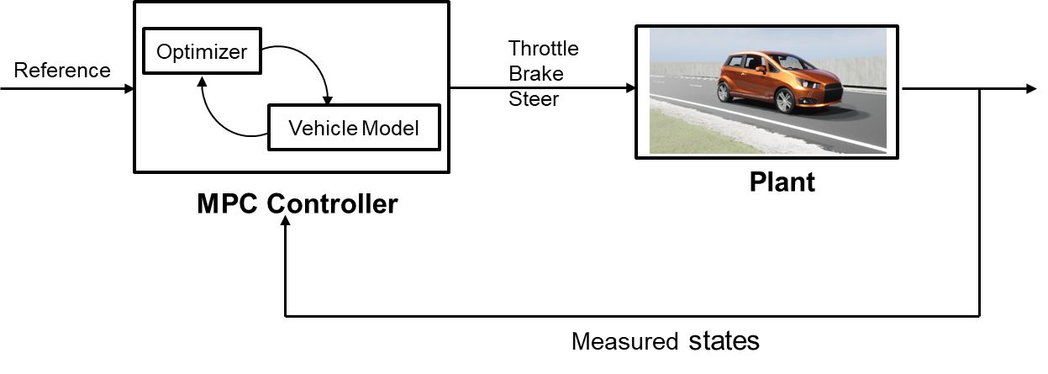

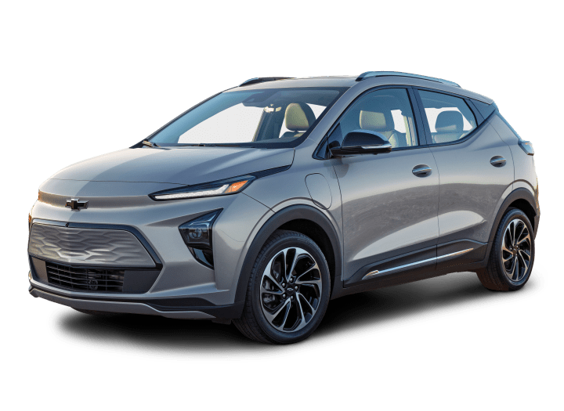

Hardware in the loop setup 1
CAN Interface
dSPACE Vehicle Dynamics Models
Digital Twin
Raw Control actions
Planning and Control
Vehicle Dynamics Model

Slide 4
Highway Challenge for AutoDrive 2 requirements.
Vehicle needs to avoid the static obstacle ( road barricades) and change the lane.
Current plan:
Working on lane change algorithm for dynamic actors/ static actors.
Various lane change trajectories

Slide 5
Three main categories in which path tracking algorithms can be classified: (1) Geometric path tracking methods; (2) Kinematic model-based path tracking methods; (3) Dynamic model-based path tracking methods
1) Geometric path tracking methods;
Based on the geometry of the vehicle and reference points.
2) Kinematic model-based path tracking methods;
By employing a kinematic model, all phenomena that occur between the wheels and the road, which give rise to the so-called slipping conditions, are neglected
3) Dynamic model-based path-tracking methods

Slide 7
How the vehicle system and environment uncertainties affect the lane change maneuver in presence of dynamic actors in automated driving – Sensitivity analysis
Impact of uncertainties on the yaw plane dynamics of the vehicle, path tracking control behavior, and passenger comfort during a complex maneuver like lane change.
Uncertainties:
Tire-road friction coefficient:
This value may change depending on the properties and condition of the road, e.g. if there is the presence of water, ice, and snow.
Vehicle mass and location of the center of gravity:
Different mass distributions leading to different horizontal and vertical positions of the center of gravity and may influence the vehicle’s steering tendency, and vertical forces on tires.
Tire’s cornering stiffnesses front Cf and rear Cr:
Constant cornering stiffnesses hold for operations in the linear region of the tire. The non-linear region of the tire typically starts at higher lateral accelerations from 3 to 4 m/s2. (typically for lane change maneuvers)
Aerodynamic wind gusts- drag forces

Slide 8
Models to start with:
Two-track dynamics with dug-off tire model
Powertrain: FWD single motor open differential (Including the entire drive shaft dynamics) (for chevy bolt)
TTC-based decision logic and quintic polynomial trajectory for a lane change in presence of dynamic actors
The influence of these parameters on the resulting autonomous vehicle control system and vehicle motion is important.
How well the chosen vehicle configuration ( with these uncertainties) performs the lane change in the presence of dynamic actors? (lane change feasibility). Also analyze the comfort for occupants in terms of parameters – ax, ay, and yaw acceleration.
Perform sensitivity analysis.
Recommend possible changes in the decision logic, and vehicle configuration(torque split, lateral dynamics) which can satisfy the uncertainties for a safe lane change.

Slide 9
Using the information on the tire-road friction coefficient, vehicle and traffic data and vehicle configuration, it is determined whether a safe lane change is possible.
Xiangkun He, Yulong Liu, Chen Lv, Xuewu Ji & Yahui Liu (2019) Emergency steering control of autonomous vehicle for collision avoidance and stabilisation, Vehicle System Dynamics, 57:8, 1163-1187, DOI: 10.1080/00423114.2018.1537494
-Use dynamic threat assessment model to evaluate risk associated with collision with surrounding actors based on road friction and the chosen vehicle configuration.
When a lane change is desired either to the right or left lane and possible in a safe way, the end point and maneuver time of the desired lane change maneuver are calculated
Ego States
Actor States
Modified Decision Making for lane change
Road Condition(friction)
Control Actions
Vehicle model & constraints

Slide 10
Faults: We choose a few ASIL-D faults (like Tire pressure loss/impact of friction (snow conditions) and analyze which fault is crucial.
Ackermann steering fault.
Brake Sluggish response
Unintended acceleration/ loss of acceleration(lateral)
Tire blowout
We describe the redundancy needed for a road vehicle to meet certain safety goals.

Slide 11
Parameters that are critical for lane changes during challenging weather conditions
Vehicle Speed
Vehicle speed adjustment based on the road conditions
Sensor performance
Accurate detection in the presence of adverse weather conditions
Traction control
Reliable traction system requirement
Monitoring wheel slip and adjusting motor’s power output.
Road information
Access to updated road information to adjust its behavior to ensure a safe journey.
Vehicle Dynamics
Vehicle mass distribution
Tire road friction
Torque control for wheels
Steering and braking
Adjusting the steering and braking commands/ pressure to maintain control.

Slide 12
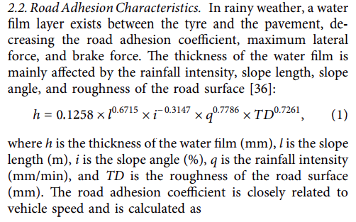
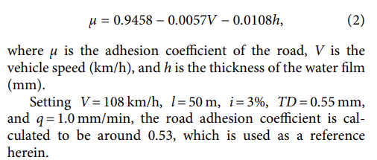
Road adhesion coefficient as a function of vehicle velocity and thickness of water film
Safe longitudinal lane change distance based on conditions - optimization

Slide 13
Horiuchi S, Okada K, Nohtomi S. Model-based validation procedure for the certification of advanced chassis control systems. Vehicle System Dynamics. 2010;48(sup1):393–409. Available from: https://doi.org/10.1080/ 00423111003777780
To verify vehicle dynamics control algorithms, the evaluation of the static properties by constrained bifurcation and continuum analysis and (2) the evaluation of the dynamic properties by the optimization-based worst-case seeking. In the first method, the stability of equilibrium points for varying parameters are analyzed, thus creating limits of operation for the analyzed system. In the second approach, the optimal control theory is applied to maximize deviations from desired response outputs by seeking the worst possible combination of inputs. These both methods rely on the same underlying system description and are useful to understand the boundaries of the controlled vehicle subsystem from inputs to the VMC and actuator layers.
Sahoo, S, Subramanian, SC, & Srivastava, S. "Sensitivity Analysis of Vehicle Parameters for Heading Angle Control of an Unmanned Ground Vehicle." Proceedings of the ASME 2014 International Mechanical Engineering Congress and Exposition. Volume 12: Transportation Systems. Montreal, Quebec, Canada. November 14–20, 2014. V012T15A022. ASME. A realistic mathematical model of the vehicle considering the steering actuator dynamics has been developed by calculating the cornering stiffnesses from the basic tire information and the vertical load on each tire. Sensitivity analysis has been carried out to check the robustness and stability of the controller by varying the cornering stiffness of tires, the most uncertain parameter.
Steinbock, N, Prange, L, & Fabien, BC. "Active Torque Vectoring in High Speed Lane Change Maneuvers." Proceedings of the ASME 2016 International Mechanical Engineering Congress and Exposition. Volume 4B: Dynamics, Vibration, and Control. Phoenix, Arizona, USA. November 11–17, 2016. V04BT05A034. ASME
We would like to increase the yaw and lateral accelerations that the vehicle can perform safely by controlling differing torques out of the two motors. Regulating these accelerations requires a control strategy over the left and right motor torques. Equal-torque control of the electric motors will be used as a baseline
Snider JM, et al. Automatic steering methods for autonomous automobile path tracking. Robotics Institute, Pittsburgh, PA, Tech Rep CMU-RITR-09-08. 2009;
Several lane change tests have been performed at different velocities, for value of lateral acceleration ranging from 1 to 6 m/s2 . The results of these experiments show that, at low velocities, by increasing lateral acceleration, the path tracking accuracy increase. But at higher velocities (e.g. 20 m/s), the controller performances and robustness drastically decrease. This is due to the fact that this control approach does not take into account some vehicle dynamics that can not be neglected at high velocities.
Zhonghua Zhang, Caijin Yang, Weihua Zhang, Yanhai Xu, Yiqiang Peng, Maoru Chi, "Motion Control of a 4WS4WD Path-Following Vehicle: Dynamics-Based Steering and Driving Models", Shock and Vibration, vol. 2021, Article ID 8861159, 13 pages, 2021. https://doi.org/10.1155/2021/8861159

Slide 14
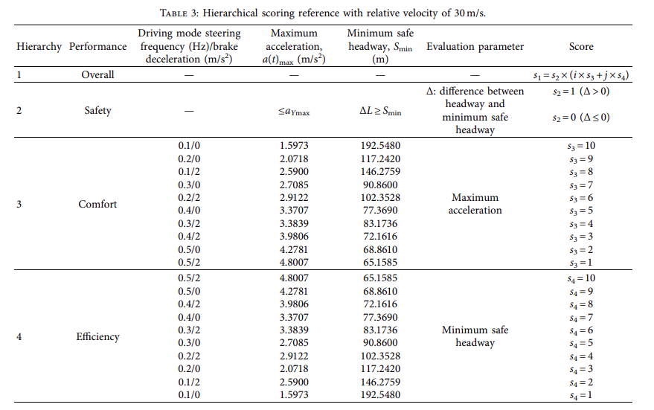
Lane-Change Model and Tracking Control for Autonomous Vehicles on Curved Highway Sections in Rainy Weather
Tao Peng,^{1,2}Li-li Su,³Zhi-wei Guan,⁴Hai-jing Hou,¹Jun-kai Li,⁵Xing-liang Liu,³and Yi-ke Tong⁶
Developed an adaptive lane change system that consists of an intelligent trajectory planning and tracking controller.
Based on the scoring references under specific circumstances, a four-level lane-change mode for collision avoidance is proposed
Single track vehicle dynamics model
A scoring reference-based lane-change decision mechanism for collision avoidance on a curved road with low adhesion.

Slide 15
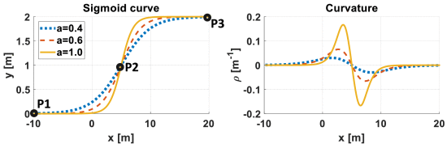
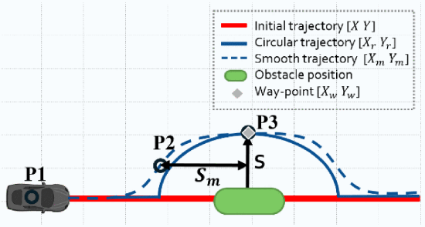
Use of a sigmoid function to avoid the obstacle and the use of a rolling horizon to plan for a decomposed area of the path

