Slide 1

SiL, HiL testing plan for Year 2

Slide 2
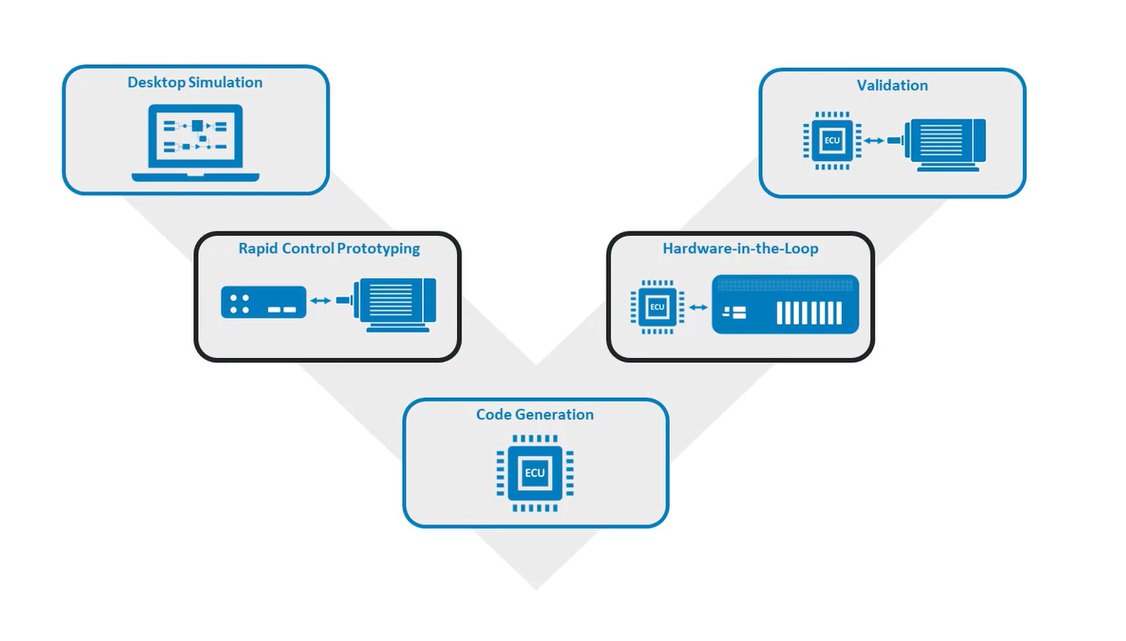
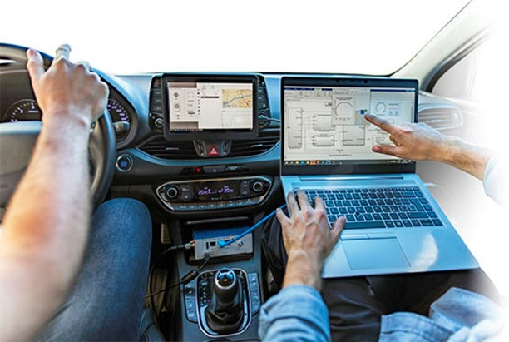
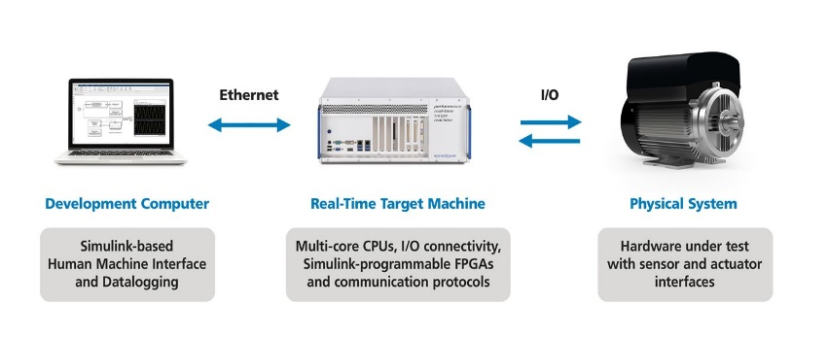
Verification and Validation process
Functional Requirements
MiL & SiL
HiL
Processor in Loop (PiL)

Slide 3
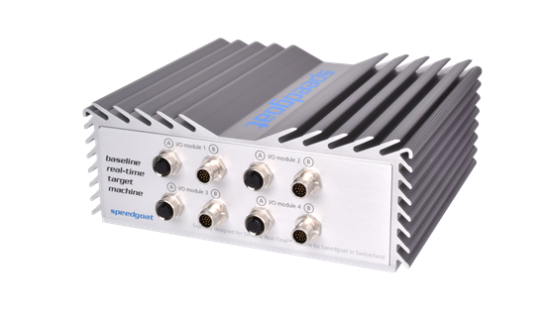
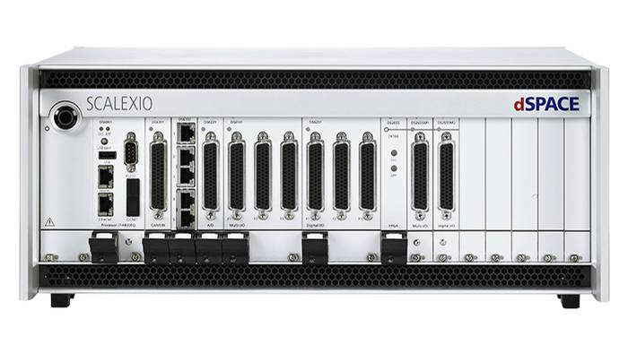
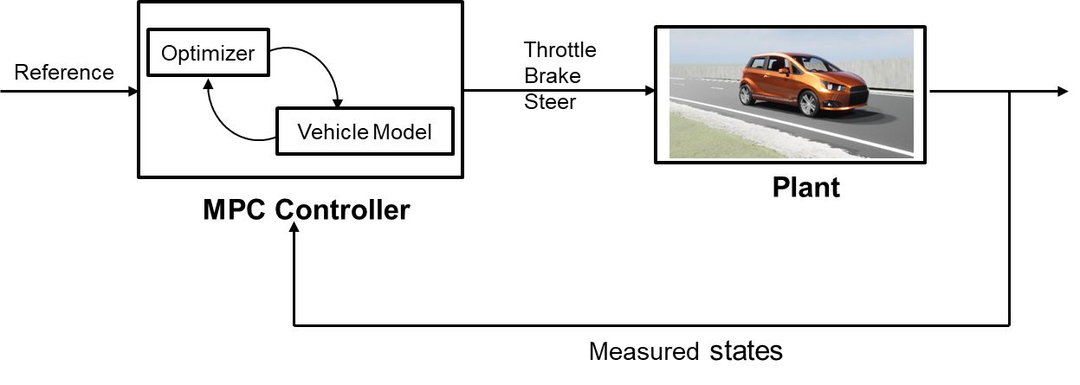

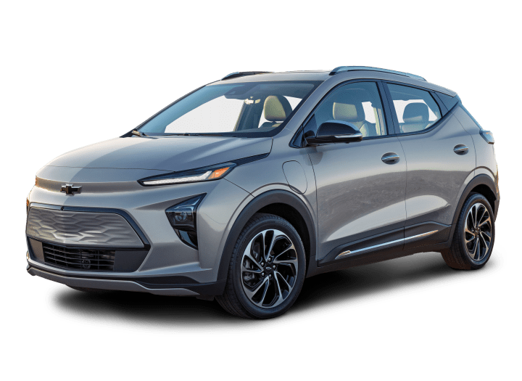

Hardware in the loop setup 1
CAN Interface
dSPACE Vehicle Dynamics Models
Digital Twin
Raw Control actions
Planning and Control
Vehicle Dynamics Model

Slide 4
Using the information on the tire-road friction coefficient, vehicle and traffic data and vehicle configuration, it is determined whether a safe lane change is possible.
Xiangkun He, Yulong Liu, Chen Lv, Xuewu Ji & Yahui Liu (2019) Emergency steering control of autonomous vehicle for collision avoidance and stabilisation, Vehicle System Dynamics, 57:8, 1163-1187, DOI: 10.1080/00423114.2018.1537494
-Use dynamic threat assessment model to evaluate risk associated with collision with surrounding actors based on road friction and the chosen vehicle configuration.
When a lane change is desired either to the right or left lane and possible in a safe way, the end point and maneuver time of the desired lane change maneuver are calculated
Ego States
Actor States
Modified Decision Making for lane change
Road Condition(friction)
Control Actions
Vehicle model & constraints

Slide 5
Faults: We choose a few ASIL-D faults (like Tire pressure loss/impact of friction (snow conditions) and analyze which fault is crucial.
Ackermann steering fault.
Brake Sluggish response
Unintended acceleration/ loss of acceleration(lateral)
Tire blowout
We describe the redundancy needed for a road vehicle to meet certain safety goals.

Slide 6
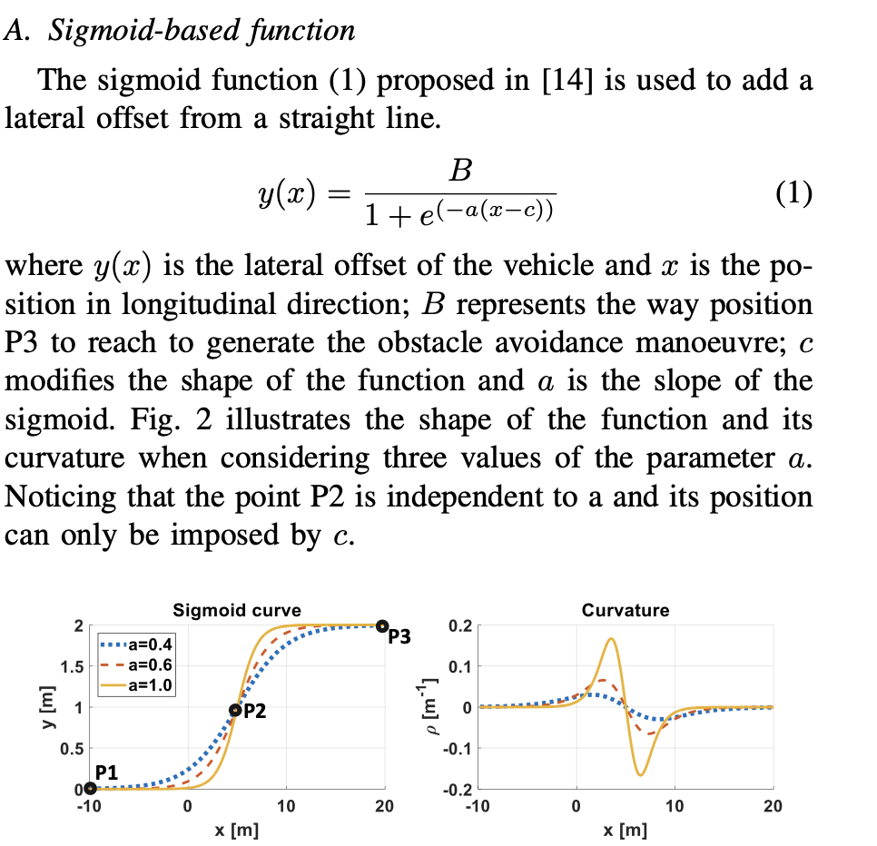
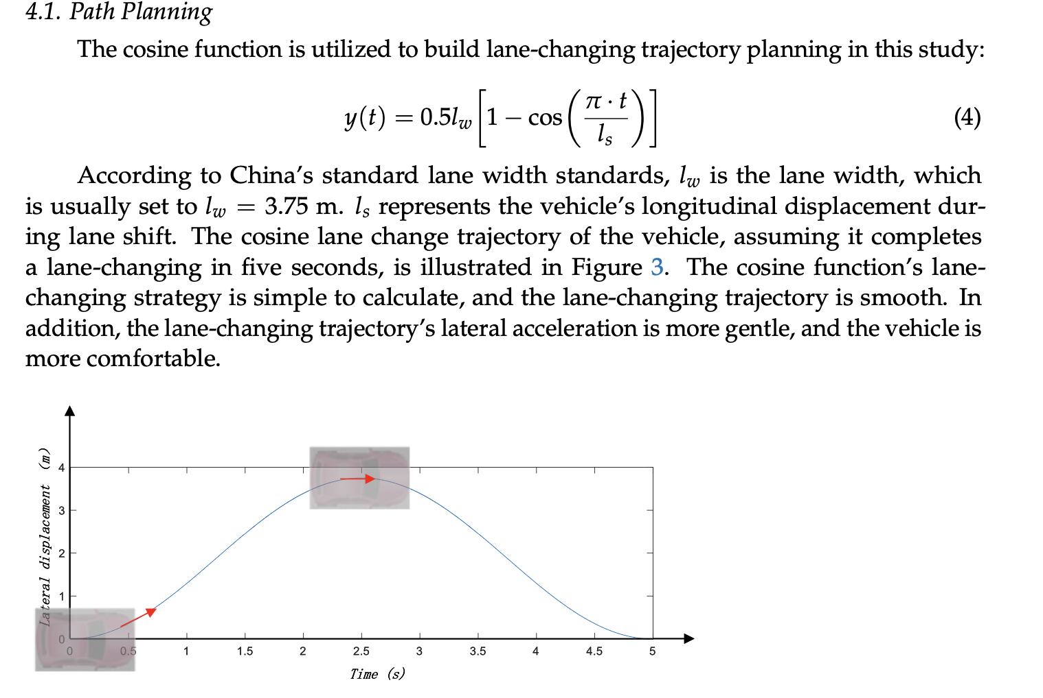
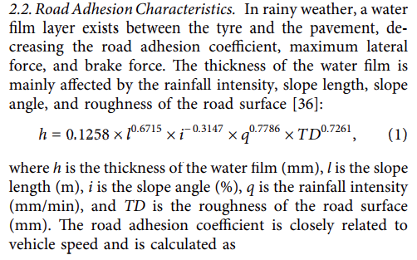
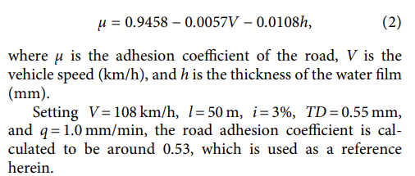
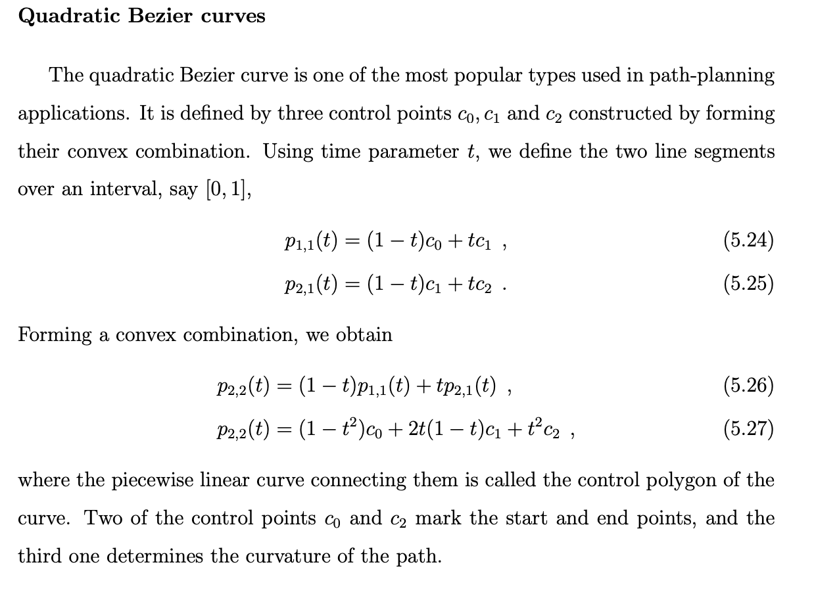
Ideas
Road adhesion coefficient as a function of vehicle velocity and thickness of water film
Safe longitudinal lane change distance based on conditions - optimization

Slide 7
Models to start with:
Two-track dynamics with dug-off tire model
Powertrain: FWD single motor open differential (Including the entire drive shaft dynamics) (for chevy bolt)
TTC-based decision logic and quintic polynomial trajectory for a lane change in presence of dynamic actors
The influence of these parameters on the resulting autonomous vehicle control system and vehicle motion is important.
How well the chosen vehicle configuration ( with these uncertainties) performs the lane change in the presence of dynamic actors? (lane change feasibility). Also analyze the comfort for occupants in terms of parameters – ax, ay, and yaw acceleration.
Perform sensitivity analysis.
Recommend possible changes in the decision logic, and vehicle configuration(torque split, lateral dynamics) which can satisfy the uncertainties for a safe lane change.

Slide 8
Parameters that are critical for lane changes during challenging weather conditions
Vehicle Speed
Vehicle speed adjustment based on the road conditions
Sensor performance
Accurate detection in the presence of adverse weather conditions
Traction control
Reliable traction system requirement
Monitoring wheel slip and adjusting motor’s power output.
Road information
Access to updated road information to adjust its behavior to ensure a safe journey.
Vehicle Dynamics
Vehicle mass distribution
Tire road friction
Torque control for wheels
Steering and braking
Adjusting the steering and braking commands/ pressure to maintain control.

Slide 9
Highway Challenge for AutoDrive 2 requirements.
Vehicle needs to avoid the static obstacle ( road barricades) and change the lane.
Current plan:
Working on lane change algorithm for dynamic actors/ static actors.
Various lane change trajectories

Slide 10
Three main categories in which path tracking algorithms can be classified: (1) Geometric path tracking methods; (2) Kinematic model-based path tracking methods; (3) Dynamic model-based path tracking methods
1) Geometric path tracking methods;
Based on the geometry of the vehicle and reference points.
2) Kinematic model-based path tracking methods;
By employing a kinematic model, all phenomena that occur between the wheels and the road, which give rise to the so-called slipping conditions, are neglected
3) Dynamic model-based path-tracking methods

Slide 11
Highway Lane Change development framework
Highway lane change for AutoDrive requires lane changing in the presence of a road barricade
(static obstacle and no moving vehicles)
Currently I am working on the model which can work for dynamic actors as well.
Lane change development process
Scenario and Sensor architecture design in MATLAB.
Sensor Fusion in Simulation
Reformat the sensor fusion data in a usable format.
Develop lane change algorithm

Slide 12
Developing lane change algorithm in the presence of dynamic actors.
Interaction with other cars. (positions , velocities)
Take into consideration the uncertainty and unpredictability.
Safety parameters need to be considered
Lane change decision
Develop the lane change Algorithm
Generate a trajectory that starts from the previous reference path and integrates into another lane
After changing the lane, another reference path has to be generated.
This process needs to be repeated whenever the vehicle performs the lane change and merges into another lane.
Reference points need to calculated in real time which is a challenge.
Trajectory planning

Slide 13
Current Work:
Trajectory generation and merging with previous path.
Keep on calculating the real time reference points for the vehicle to follow according to
Follow lane
lane change left
lane change right
The existing controller models cannot handle the lane change maneuvers.
These maneuvers are high speed and have high lateral components of velocities and accelerations.
Develop a trajectory tracking controller which can handle the lane changes.

Slide 14
Current software architecture
Scenario and sensor fusion models
Lane Change decision making model
Reference path generation in real time
Trajectory Generation
Dynamic model Stanley Controller
Single track 3 DOF bicycle model for vehicle Dynamics

Slide 15
Effect of environment and vehicle uncertainties on lane change maneuver
What if there are uncertainties in the environment ( like adverse weather changes) and vehicle system
Environment effects
Vehicle system uncertainties
Impact of Rain/ snow on the road characteristics.
Adhesion Coefficient as a function of vehicle velocity and film thickness
Vehicle mass distribution because of passengers.
Tire’s Cornering stiffnesses
Tire’s longitudinal stiffnesses
Will the existing model still be able to perform effective lane change? Or will the vehicle start slipping? or any other effects?

Slide 16

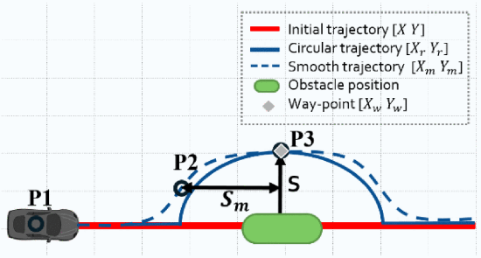
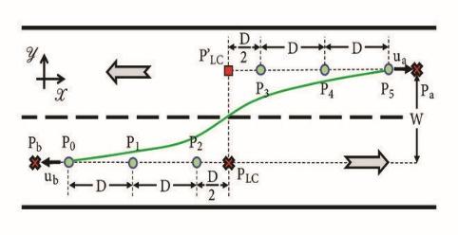
Parameter combinations for sensitivity analysis study on various trajectories
Vehicle and Environment uncertainties
Realistic Road adhesion Coefficient
Vehicle mass distribution
Tire parameters
Parameter Combinations for sensitivity analysis
Cubic polynomial
Sigmoid based
Bezier curve based ( cubic, quintic)
Cosine function
Tangent hyperbolic
Evaluate performance metrics for each of these trajectories
Determine the maximum lateral and longitudinal
accelerations and Jerks for each of these trajectories

Slide 17
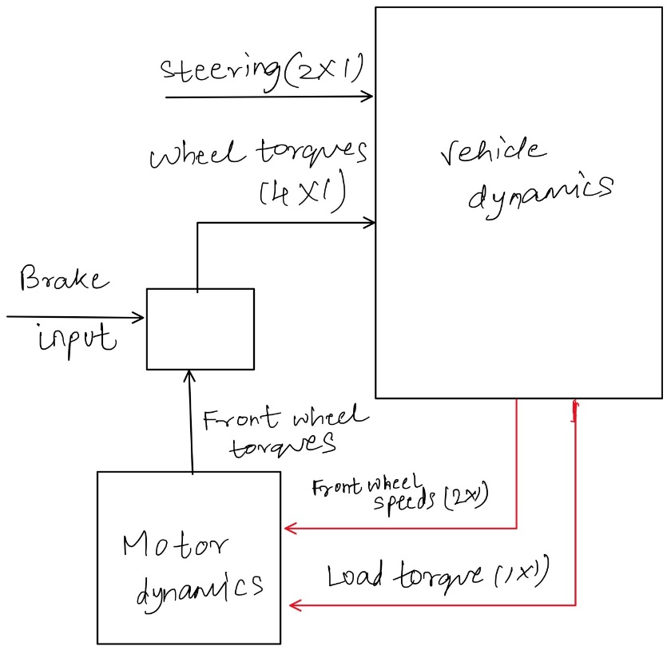
Vehicle Model and Dynamics
Ackermann steering
Two-track dynamics with dug-off tire model
Powertrain: FWD single motor open differential

Slide 18
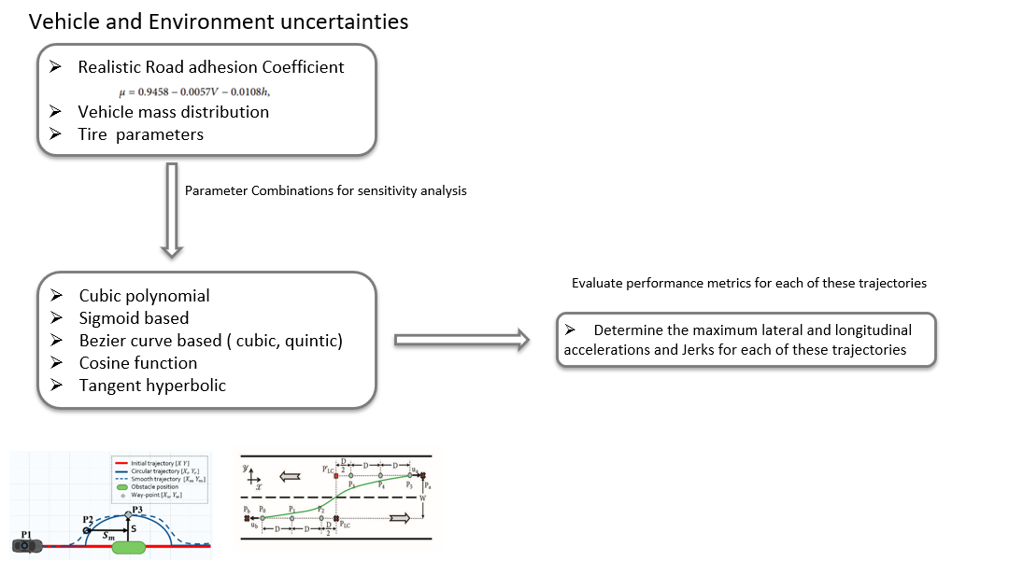
Develop an adaptive lane change system which consists of intelligent tracking
and control
Part 1
Introduce these environment and vehicle uncertainties in the current model and analyze the performance on the output.
Understand which uncertainties affect the performance metrics for the lane change the most.
Perform the sensitivity analysis using cross array design of experiments approach.
Part 2
Design a multilevel adaptive lane change model that can take the uncertainties into picture.
(Minimum safe lane change distance based on road adhesion )

Slide 19
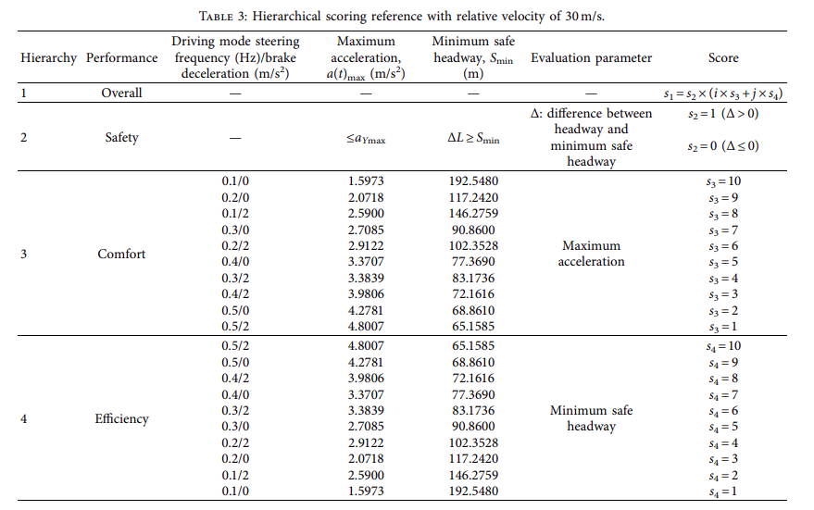
Lane-Change Model and Tracking Control for Autonomous Vehicles on Curved Highway Sections in Rainy Weather
Tao Peng,^{1,2}Li-li Su,³Zhi-wei Guan,⁴Hai-jing Hou,¹Jun-kai Li,⁵Xing-liang Liu,³and Yi-ke Tong⁶
Based on the scoring references under specific circumstances, a four-level lane-change mode for collision avoidance is proposed
Single track vehicle dynamics model
A scoring reference-based lane-change decision mechanism for collision avoidance on a curved road with low adhesion.

Slide 20
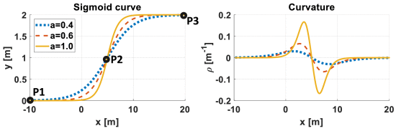
W. Ben-Messaoud, M. Basset, J. -P. Lauffenburger and R. Orjuela, "Smooth Obstacle Avoidance Path Planning for Autonomous Vehicles," 2018 IEEE International Conference on Vehicular Electronics and Safety (ICVES), Madrid, Spain, 2018, pp. 1-6, doi: 10.1109/ICVES.2018.8519525.
Use of a configurable sigmoid function to generate a path to avoid the obstacle and the use of a rolling horizon to plan for a decomposed area of the path.
Each horizon is calculated and updated at each step
Pros: Reactivity to the obstacle motion and the generation of a smooth trajectory in a low execution time

Slide 21
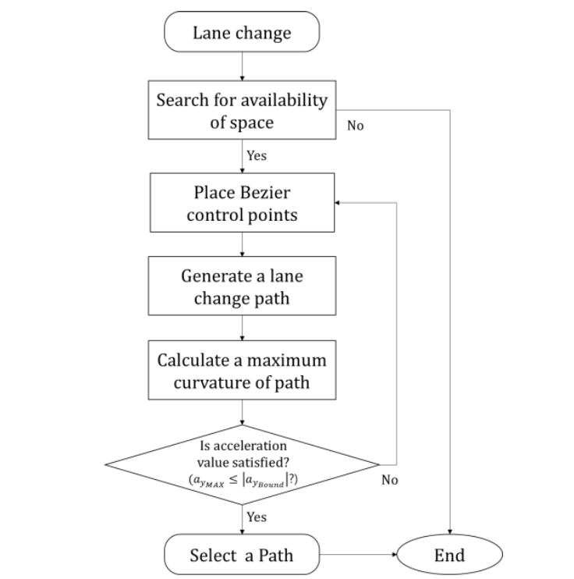
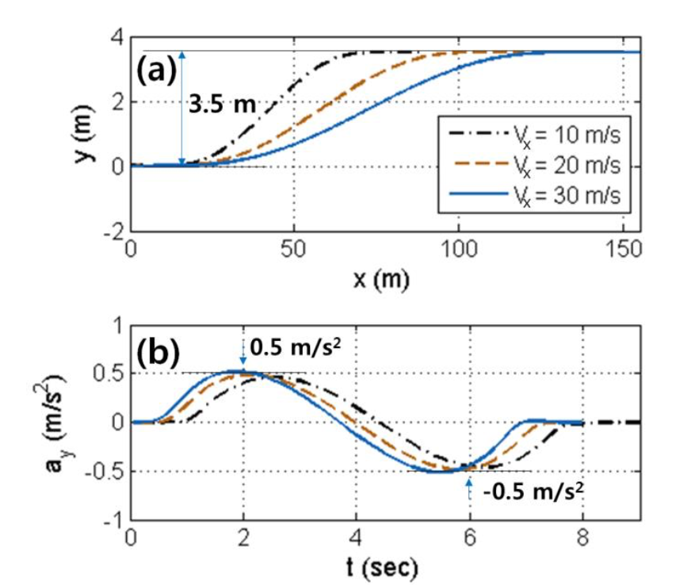

Lane Change Maneuver based on Bezier Curve providing Comfort Experience for Autonomous Vehicle Users
Il Bae1, Jin Hyo Kim2, Jaeyoung Moon1 and Shiho Kim1, Member, IEEE
Proposed an LCM algorithm based on evaluating the expected maximum lateral acceleration using the curvature of a Bezier curve and following the generated trajectory.
Used a desired lateral acceleration limit and compared it with bezer curvature limit
Used a linear bicycle model
No motor dynamics
No steer dynamics (Ackermann steering)
No variation in adhesion coefficients

Slide 22
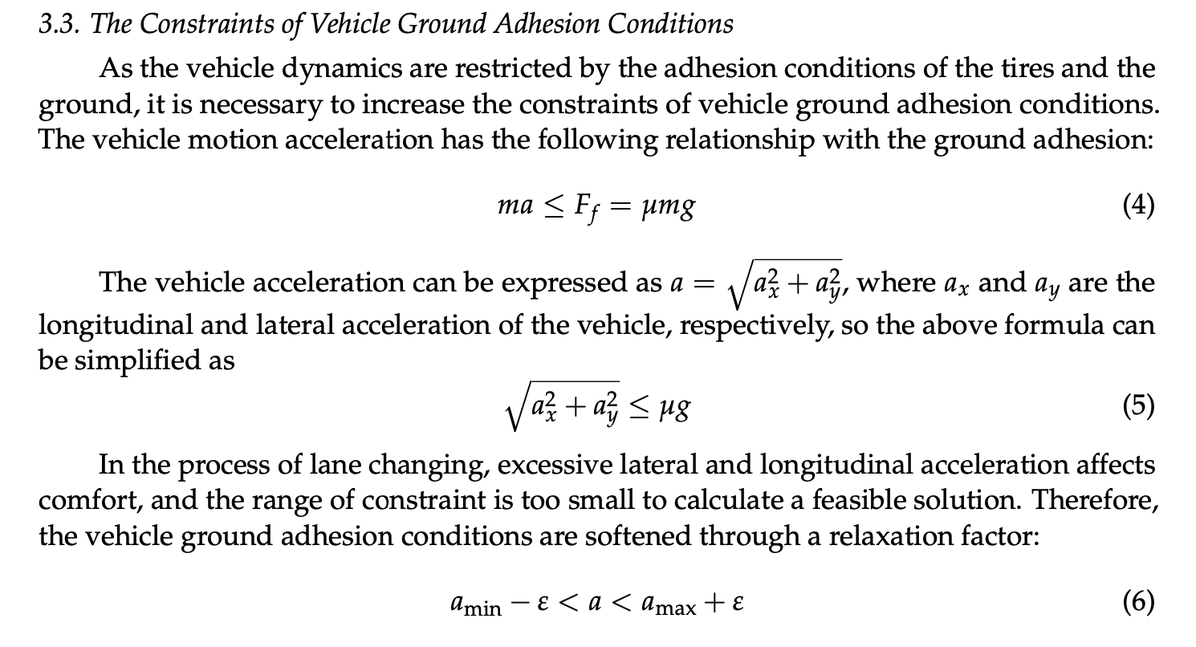
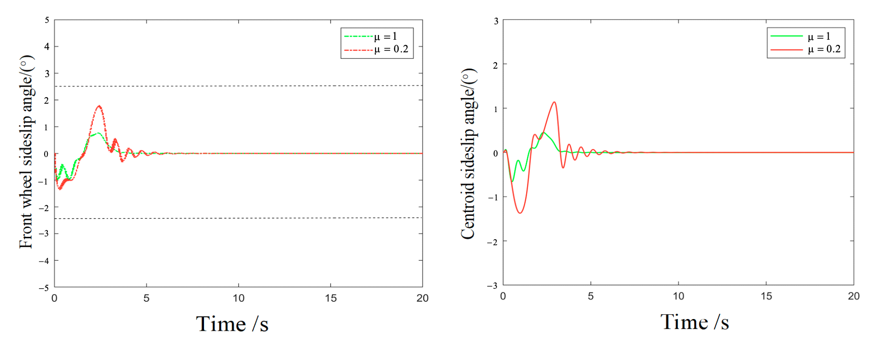
Lane-Changing Trajectory Tracking and Simulation of Autonomous Vehicles Based on Model Predictive Control
Hui Song , Dayi Qu *, Haibing Guo, Kekun Zhang and Tao Wang
MPC controller to track Quintic Bezier curve and validation for different road adhesions and vehicle speeds
Considered the ground adhesion (friction limits) for the
Acceleration constraints.
For different velocities, the MPC is able to handle the
Lane change with different friction coeff.
Focus on designing MPC controller with two track vehicle dynamics
With road friction friction constraints.

Slide 23
"Sensitivity Analysis of Vehicle Parameters for Heading Angle Control of an Unmanned Ground Vehicle."
Sahoo, S, Subramanian, SC, & Srivastava, S. - Proceedings of the ASME 2014 International Mechanical Engineering Congress and Exposition.
A realistic mathematical model of the vehicle considering the steering actuator dynamics has been developed by calculating the cornering stiffnesses from the basic tire information and the vertical load on each tire.
Sensitivity analysis has been carried out to check the robustness and stability of the controller by varying the cornering stiffness of tires, the most uncertain parameter.
Varied the longitudinal speed and analyzed the heading angle change
At lower speeds, the controller is more sensitive to the steering actuator dynamics and at higher speeds, the controller is more sensitive to the cornering stiffness of tires

Slide 24
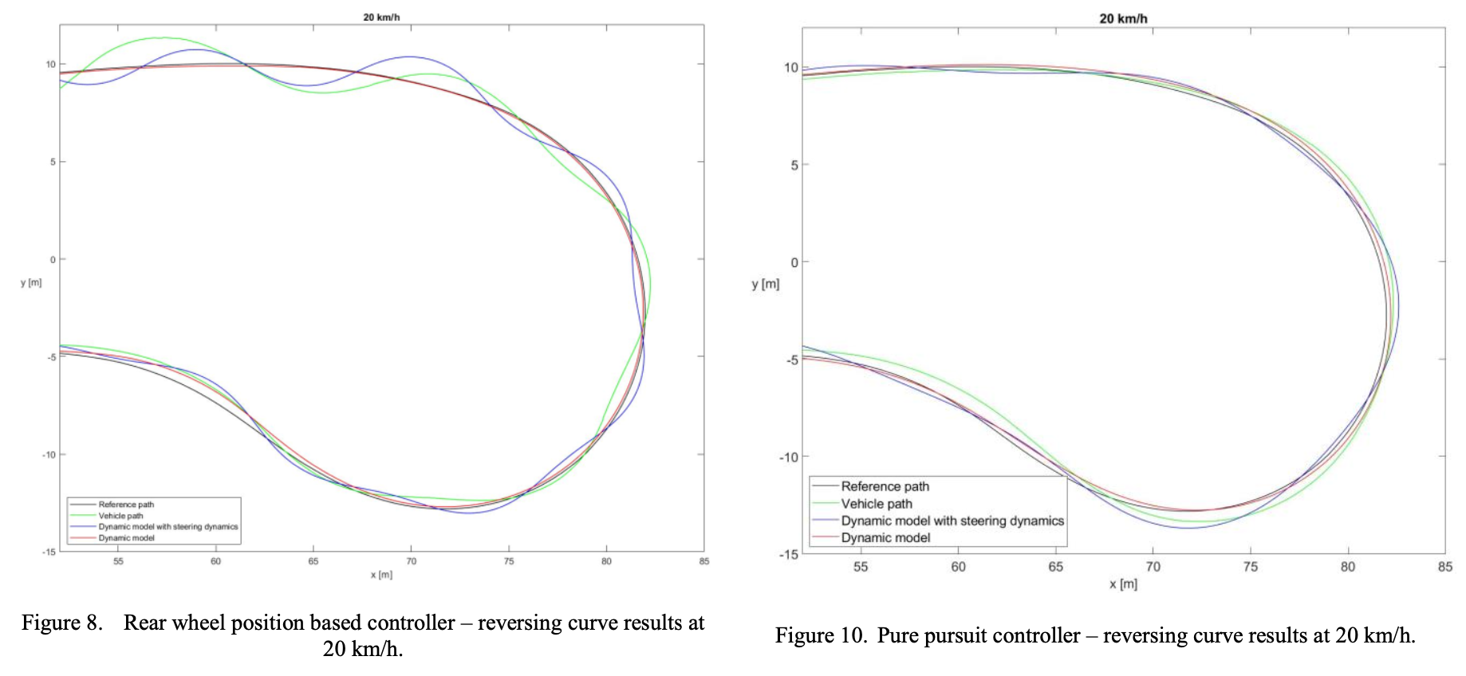
Modelling the dynamic behavior of the steering system for low speed autonomous path tracking
Ádám Domina, Viktor Tihanyi
Considered the dynamic behavior of the steering system, including the effect of the tires.
The path following simulation with the improved model was calculated, which was compared to the real vehicle measurement and the results showed good correlation.
Comparision with three different tracking controllers

Slide 25
Active Torque Vectoring in High Speed Lane Change Maneuvers." Steinbock, N, Prange, L, & Fabien, BC.
Proceedings of the ASME 2016 International Mechanical Engineering Congress and Exposition. Volume 4B: Dynamics,Vibration, and Control. Phoenix, Arizona, USA. November 11–17, 2016. V04BT05A034. ASME
We would like to increase the yaw and lateral accelerations that the vehicle can perform safely by controlling differing torques out of the two motors. Regulating these accelerations requires a control strategy over the left and right motor torques. Equal-torque control of the electric motors will be used as a baseline

Slide 26
Path Planning and Predictive Control of Autonomous Vehicles for Obstacle Avoidance
2022 18th IEEE/ASME International Conference on Mechatronic and Embedded Systems and Applications (MESA)

