Slide 1

SiL, HiL testing plan for Year 2

Slide 2
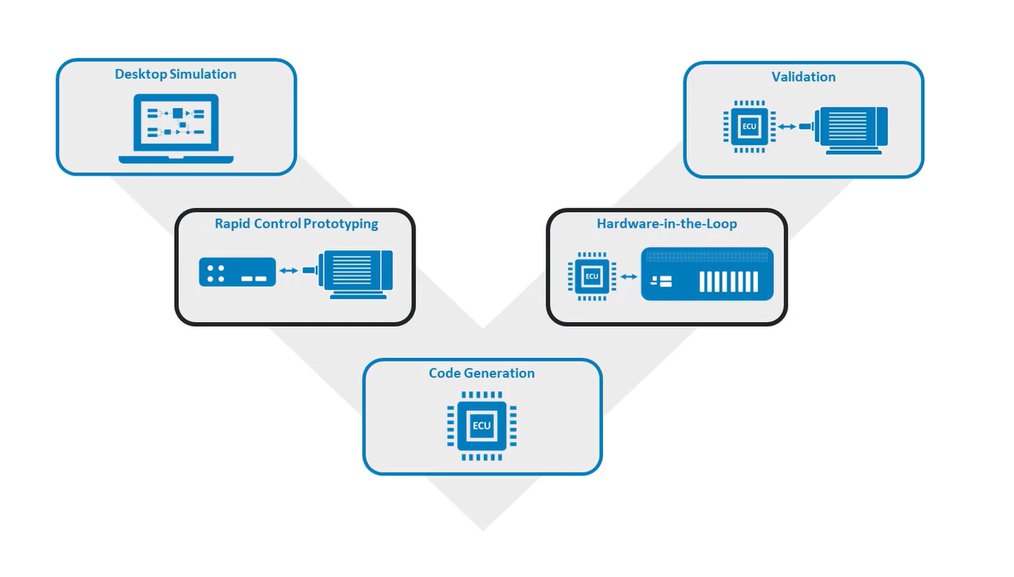
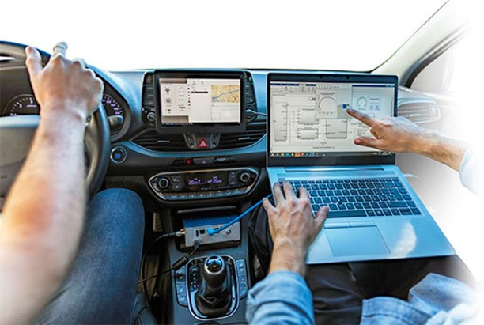
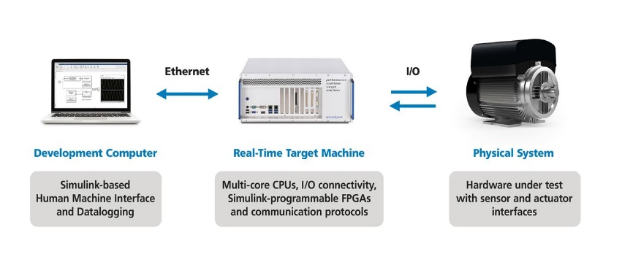
Verification and Validation process
Functional Requirements
MiL & SiL
HiL
Processor in Loop (PiL)

Slide 3
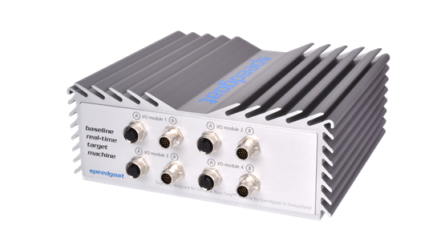

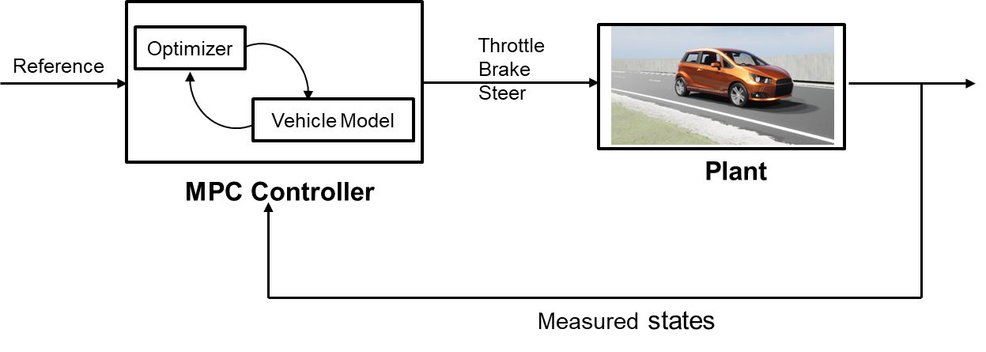

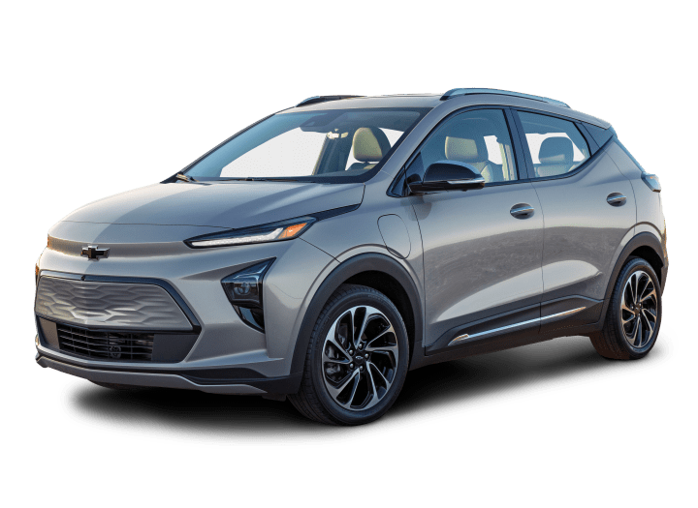

Hardware in the loop setup 1
CAN Interface
dSPACE Vehicle Dynamics Models
Digital Twin
Raw Control actions
Planning and Control
Vehicle Dynamics Model

Slide 4
Highway Challenge for AutoDrive 2 requirements.
Vehicle needs to avoid the static obstacle ( road barricades) and change the lane.
Current plan:
Working on lane change algorithm for dynamic actors/ static actors.
Various lane change trajectories

Slide 5
Three main categories in which path tracking algorithms can be classified: (1) Geometric path tracking methods; (2) Kinematic model-based path tracking methods; (3) Dynamic model-based path tracking methods
1) Geometric path tracking methods;
Based on the geometry of the vehicle and reference points.
2) Kinematic model-based path tracking methods;
By employing a kinematic model, all phenomena that occur between the wheels and the road, which give rise to the so-called slipping conditions, are neglected
3) Dynamic model-based path-tracking methods

Slide 7
How the vehicle system and environment uncertainties affect the lane change maneuver in presence of dynamic actors in automated driving – Sensitivity analysis
Impact of uncertainties on the yaw plane dynamics of the vehicle, path tracking control behavior, and passenger comfort during a complex maneuver like lane change.
Uncertainties:
Tire-road friction coefficient:
This value may change depending on the properties and condition of the road, e.g. if there is the presence of water, ice, and snow.
Vehicle mass and location of the center of gravity:
Different mass distributions leading to different horizontal and vertical positions of the center of gravity and may influence the vehicle’s steering tendency, and vertical forces on tires.
Tire’s cornering stiffnesses front Cf and rear Cr:
Constant cornering stiffnesses hold for operations in the linear region of the tire. The non-linear region of the tire typically starts at higher lateral accelerations from 3 to 4 m/s2. (typically for lane change maneuvers)
Aerodynamic wind gusts- drag forces

Slide 8
Models to start with:
Two-track dynamics with dug-off tire model
Powertrain: FWD single motor open differential (Including the entire drive shaft dynamics) (for chevy bolt)
TTC-based decision logic and quintic polynomial trajectory for a lane change in presence of dynamic actors
The influence of these parameters on the resulting autonomous vehicle control system and vehicle motion is important.
How well the chosen vehicle configuration ( with these uncertainties) performs the lane change in the presence of dynamic actors? (lane change feasibility). Also analyze the comfort for occupants in terms of parameters – ax, ay, and yaw acceleration.
Perform sensitivity analysis.
Recommend possible changes in the decision logic, and vehicle configuration(torque split, lateral dynamics) which can satisfy the uncertainties for a safe lane change.

Slide 9
Using the information on the tire-road friction coefficient, vehicle and traffic data and vehicle configuration, it is determined whether a safe lane change is possible.
Xiangkun He, Yulong Liu, Chen Lv, Xuewu Ji & Yahui Liu (2019) Emergency steering control of autonomous vehicle for collision avoidance and stabilisation, Vehicle System Dynamics, 57:8, 1163-1187, DOI: 10.1080/00423114.2018.1537494
-Use dynamic threat assessment model to evaluate risk associated with collision with surrounding actors based on road friction and the chosen vehicle configuration.
When a lane change is desired either to the right or left lane and possible in a safe way, the end point and maneuver time of the desired lane change maneuver are calculated
Ego States
Actor States
Modified Decision Making for lane change
Road Condition(friction)
Control Actions
Vehicle model & constraints

Slide 10
Faults: We choose a few ASIL-D faults (like Tire pressure loss/impact of friction (snow conditions) and analyze which fault is crucial.
Ackermann steering fault.
Brake Sluggish response
Unintended acceleration/ loss of acceleration(lateral)
Tire blowout
We describe the redundancy needed for a road vehicle to meet certain safety goals.

Slide 11
Parameters that are critical for lane changes during challenging weather conditions
Vehicle Speed
Vehicle speed adjustment based on the road conditions
Sensor performance
Accurate detection in the presence of adverse weather conditions
Traction control
Reliable traction system requirement
Monitoring wheel slip and adjusting motor’s power output.
Road information
Access to updated road information to adjust its behavior to ensure a safe journey.
Vehicle Dynamics
Vehicle mass distribution
Tire road friction
Torque control for wheels
Steering and braking
Adjusting the steering and braking commands/ pressure to maintain control.

Slide 12
Based on the road adhesion coefficient for slippery/Icy conditions, vehicle mass distribution, tire cornering, and longitudinal stiffness coefficients - > determine the maximum lateral and longitudinal accelerations for different trajectories during a lane change maneuver.
Cubic polynomial
Sigmoid based
Bezier curve based ( cubic, quintic)
Cosine function

Slide 13
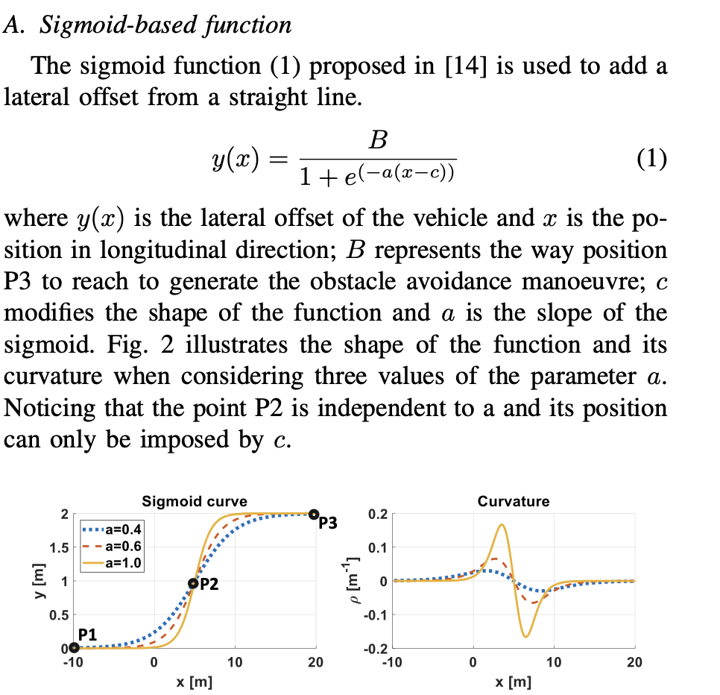
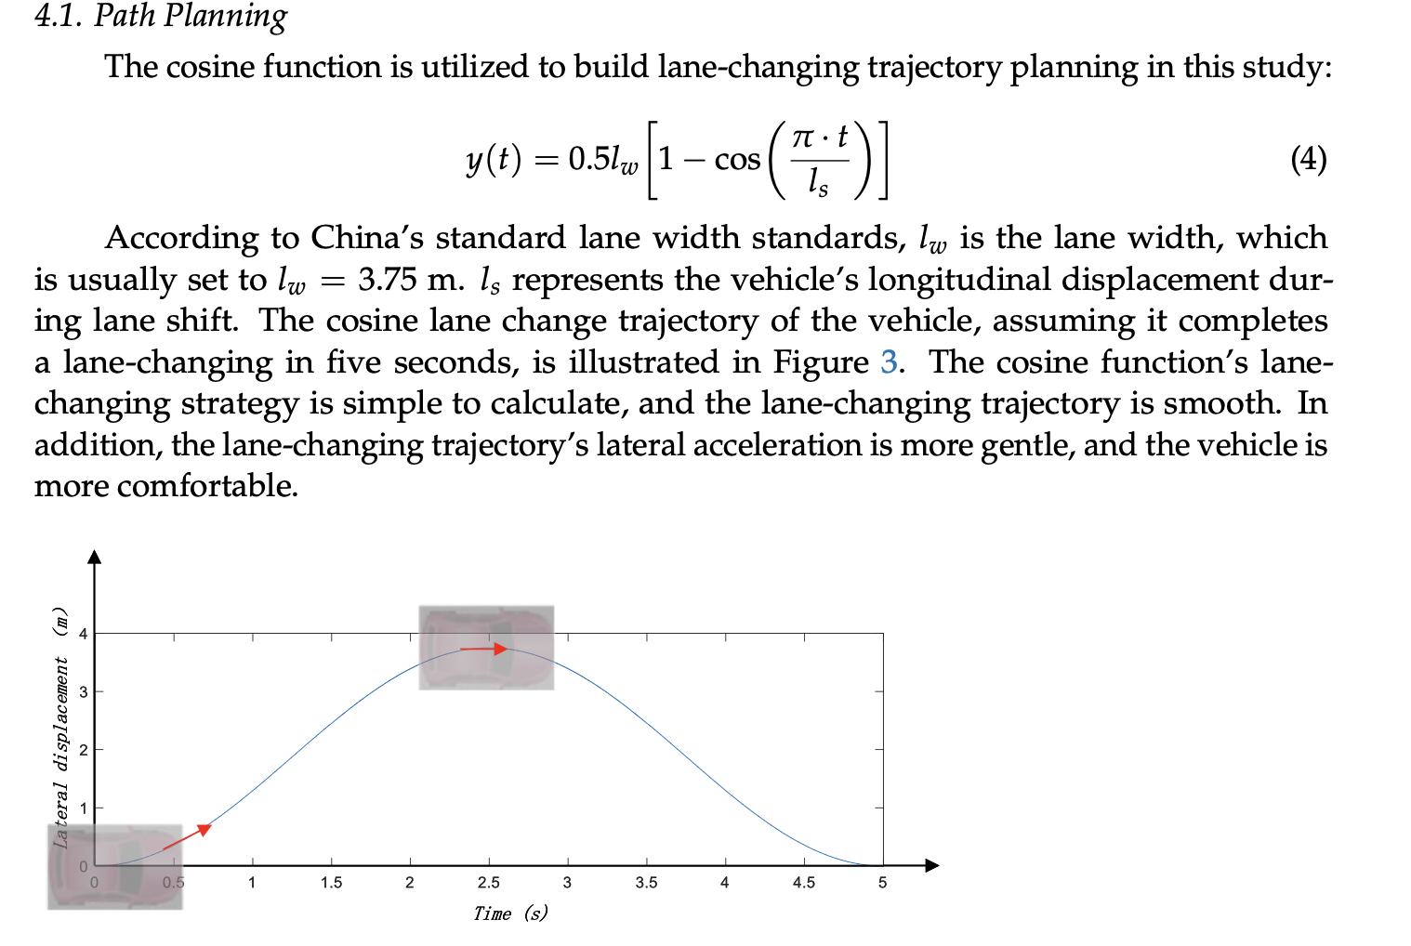
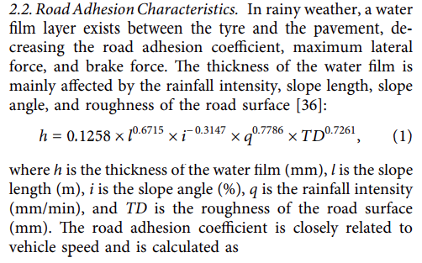
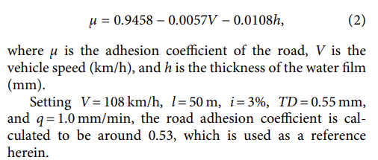
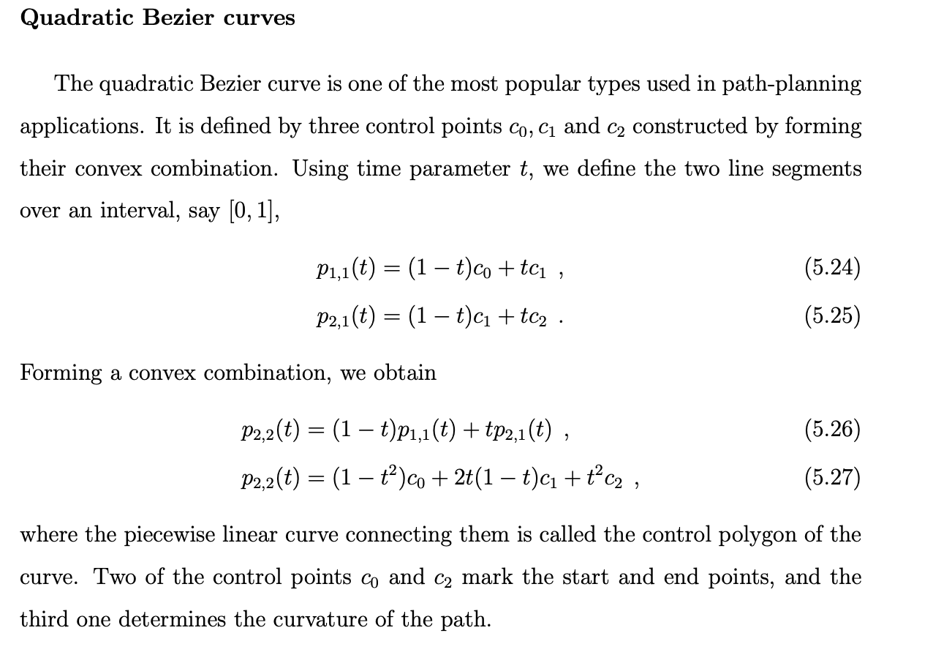
Ideas
Road adhesion coefficient as a function of vehicle velocity and thickness of water film
Safe longitudinal lane change distance based on conditions - optimization

Slide 14
Zhonghua Zhang, Caijin Yang, Weihua Zhang, Yanhai Xu, Yiqiang Peng, Maoru Chi, "Motion Control of a 4WS4WD Path-Following Vehicle: Dynamics-Based Steering and Driving Models", Shock and Vibration, vol. 2021, Article ID 8861159, 13 pages, 2021. https://doi.org/10.1155/2021/8861159

Slide 15
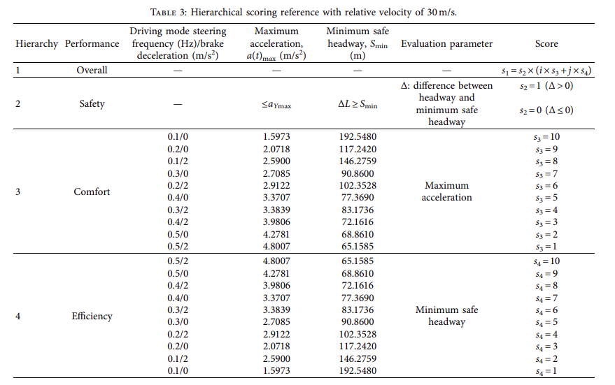
Lane-Change Model and Tracking Control for Autonomous Vehicles on Curved Highway Sections in Rainy Weather
Tao Peng,^{1,2}Li-li Su,³Zhi-wei Guan,⁴Hai-jing Hou,¹Jun-kai Li,⁵Xing-liang Liu,³and Yi-ke Tong⁶
Developed an adaptive lane change system that consists of an intelligent trajectory planning and tracking controller.
Based on the scoring references under specific circumstances, a four-level lane-change mode for collision avoidance is proposed
Single track vehicle dynamics model
A scoring reference-based lane-change decision mechanism for collision avoidance on a curved road with low adhesion.

Slide 16
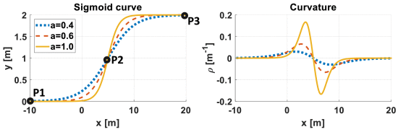
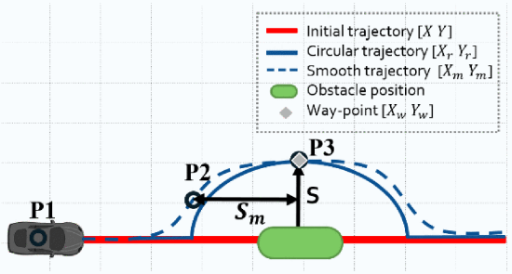
W. Ben-Messaoud, M. Basset, J. -P. Lauffenburger and R. Orjuela, "Smooth Obstacle Avoidance Path Planning for Autonomous Vehicles," 2018 IEEE International Conference on Vehicular Electronics and Safety (ICVES), Madrid, Spain, 2018, pp. 1-6, doi: 10.1109/ICVES.2018.8519525.
Use of a configurable sigmoid function to generate a path to avoid the obstacle and the use of a rolling horizon to plan for a decomposed area of the path.
Each horizon is calculated and updated at each step
Pros: Reactivity to the obstacle motion and the generation of a smooth trajectory in a low execution time

Slide 17
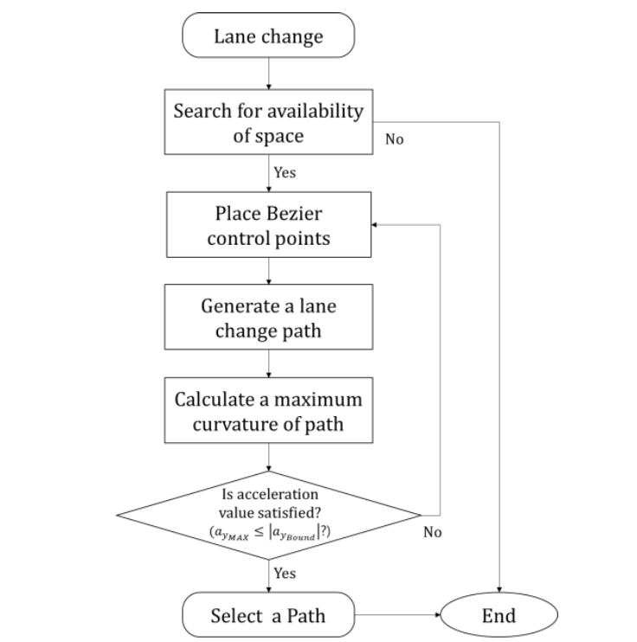
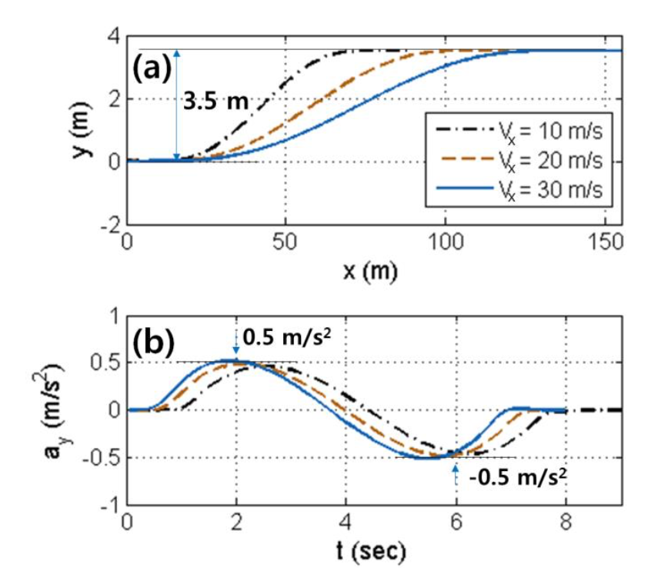

Lane Change Maneuver based on Bezier Curve providing Comfort Experience for Autonomous Vehicle Users
Il Bae1, Jin Hyo Kim2, Jaeyoung Moon1 and Shiho Kim1, Member, IEEE
Proposed an LCM algorithm based on evaluating the expected maximum lateral acceleration using the curvature of a Bezier curve and following the generated trajectory.
Used a linear bicycle model
No motor dynamics
No steer dynamics (Ackermann steering)
No variation in adhesion coefficients

Slide 18
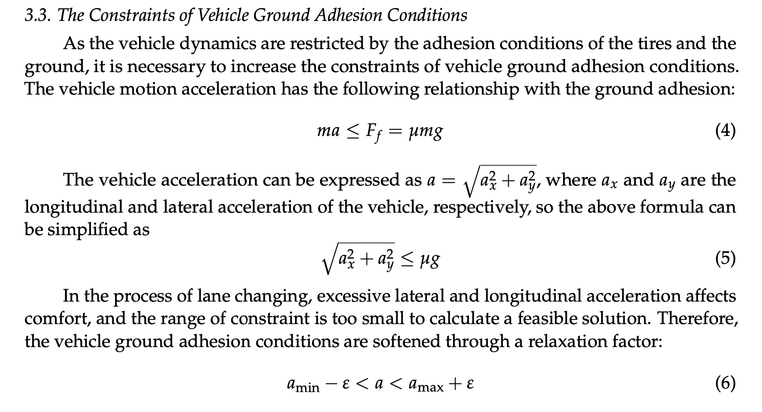
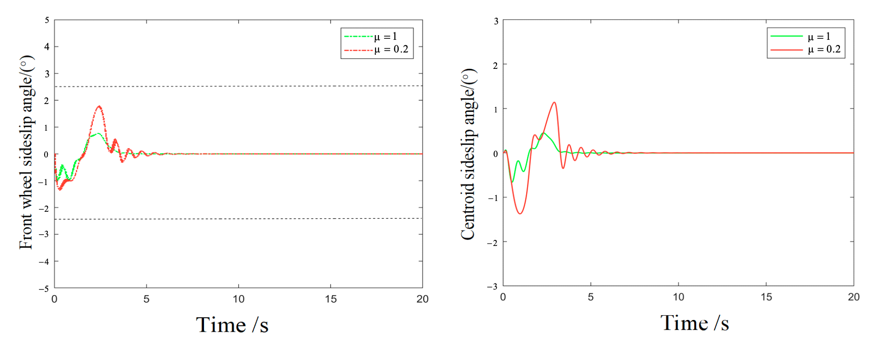
Lane-Changing Trajectory Tracking and Simulation of Autonomous Vehicles Based on Model Predictive Control
Hui Song , Dayi Qu *, Haibing Guo, Kekun Zhang and Tao Wang
MPC controller to track Quintic Bezier curve and validation for different road adhesions and vehicle speeds
Considered the ground adhesion (friction limits) for the
Acceleration constraints.
For different velocities, the MPC is able to handle the
Lane change with different friction coeff.
Focus on designing MPC controller with two track vehicle dynamics
With road friction friction constraints.

Slide 19
"Sensitivity Analysis of Vehicle Parameters for Heading Angle Control of an Unmanned Ground Vehicle."
Sahoo, S, Subramanian, SC, & Srivastava, S. - Proceedings of the ASME 2014 International Mechanical Engineering Congress and Exposition.
A realistic mathematical model of the vehicle considering the steering actuator dynamics has been developed by calculating the cornering stiffnesses from the basic tire information and the vertical load on each tire.
Sensitivity analysis has been carried out to check the robustness and stability of the controller by varying the cornering stiffness of tires, the most uncertain parameter.
Varied the longitudinal speed and analyzed the heading angle change
At lower speeds, the controller is more sensitive to the steering actuator dynamics and at higher speeds, the controller is more sensitive to the cornering stiffness of tires

Slide 20
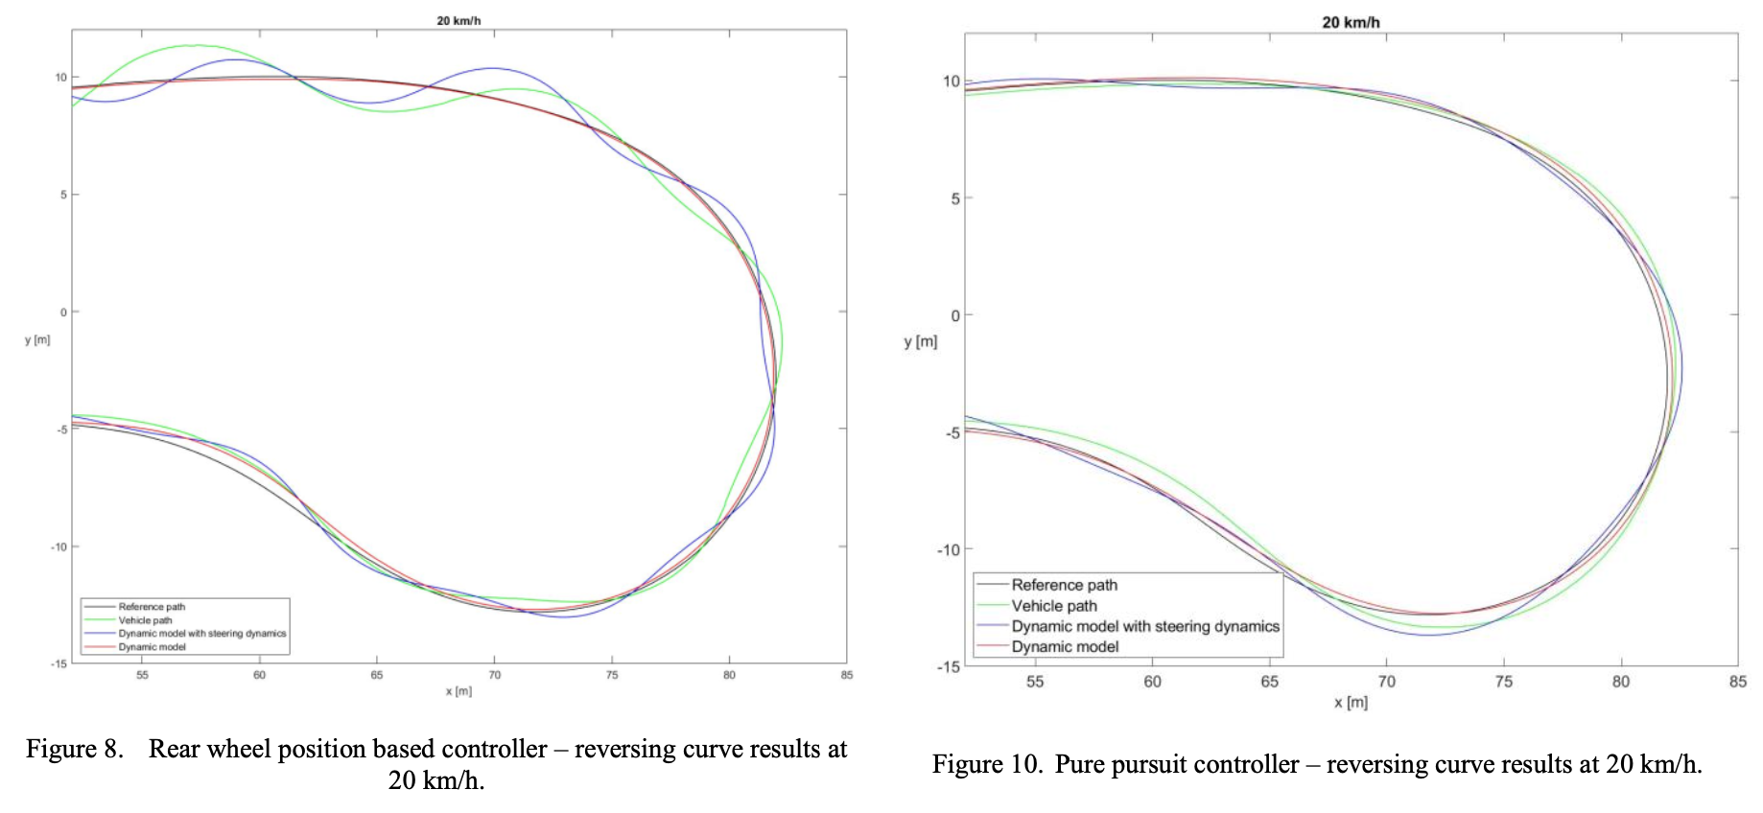
Modelling the dynamic behavior of the steering system for low speed autonomous path tracking
Ádám Domina, Viktor Tihanyi
Considered the dynamic behavior of the steering system, including the effect of the tires.
The path following simulation with the improved model was calculated, which was compared to the real vehicle measurement and the results showed good correlation.
Comparision with three different tracking controllers

Slide 21
Active Torque Vectoring in High Speed Lane Change Maneuvers." Steinbock, N, Prange, L, & Fabien, BC.
Proceedings of the ASME 2016 International Mechanical Engineering Congress and Exposition. Volume 4B: Dynamics, Vibration, and Control. Phoenix, Arizona, USA. November 11–17, 2016. V04BT05A034. ASME
We would like to increase the yaw and lateral accelerations that the vehicle can perform safely by controlling differing torques out of the two motors. Regulating these accelerations requires a control strategy over the left and right motor torques. Equal-torque control of the electric motors will be used as a baseline

Slide 22
Path Planning and Predictive Control of Autonomous Vehicles for Obstacle Avoidance
2022 18th IEEE/ASME International Conference on Mechatronic and Embedded Systems and Applications (MESA)

