Slide 1
NextGen Architecture

Slide 2
Executive Summary
Background
Highlights
Digital business models forcing financial services to balance between stable, secure and high performance services to meet global and regional regulations while able to deliver agile, innovative, value added services quickly to drive new business outcomes
Must meet these demands in a sustainable way without compromising value and performance to prepare cti for future
Digitization changes IT demands by requiring increasingly sophisticated technologies, greater delivery performance across the board and much greater business engagement
Why
Agility with focus on “continuous delivery”
Scalability, reliability & cost optimization with focus on “cloud enablement”
Remarkable User Experience with focus on “mobile-first”
What
NextGen Architecture targets to deliver modern, responsive, modular, scalable applications implemented on cloud and API-oriented architecture
How
2 speed architecture enabling faster time to market
Micro services architecture resulting in smaller units of deployable artifacts enabling frequent releases with reduced testing/operational overhead
Stateless and cloud ready architecture promoting elasticity and resiliency
Web Oriented Architecture with responsive web UI and omni channel APIs support reducing channel application foot print
Rich user experience using java script / native UX libraries
Executive Decision
Information session only – Decision not required
Agenda
Overview
High Level Architecture
Tech Stack
Roadmap
APIs
Distributed Cache
Next Gen vs. Legacy

Slide 3
What is NextGen?
Perception in the organization
API and External App Integration
is NextGen
Infra in VM’s or Cloud is NextGen
ESB will be sunset with NextGen
Moving to Open Source Container
is NextGen (like Tomcat)
Upgrading to New Framework is NextGen
Apps in Cloud are Micro Services
Mainframe apps can never be NextGen
BigData is NextGen

Slide 4
Next Gen in perspective
Application
Framework Services
Web Scale App Design
API Ecosystem
Database design
Cloud Standards
Bi-modal IT
Distributed Cache
Agile development
Dev Ops
CI/CD
Capacity Management
Monitoring
Automation
QoS
App Services
App Runtime
App Provisioning Management
Foundation
Security and Compliance
Roadmap
CATE certifications
Anything as a Service (XaaS)
TIBCO
PCF – Cloud Services
PCT – Container workloads
PaaS
IaaS
People
Communications
Training
Certification
Vendor Management
SW Vendor relationships
Demand Pipeline
Cloud Workload Analysis
R&D
AWS Hybrid Cloud
Next Gen
Application
Dev Ops
Foundation
People
Demand Pipeline

Slide 5
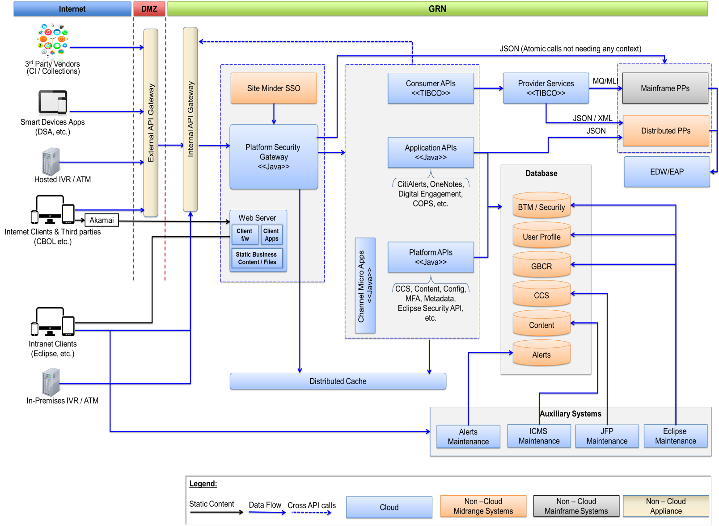
High Level Architecture – End State
Client Apps
Responsive, Cross-Channel framework incorporating the best-of-breed client side technology stack. This is used to build the presentation layer for the next gen apps.
API Gateway
IBM API Manager leveraging DataPower acts as the funnel for all API requests. Enforces OAuth and high level runtime security. Also hosts developer portal used for integration and discovery
Platform Security Gateway (PSG)
PSG provides security filters, dynamic routing, E2E encryption, message encoding etc. for all APIs and Micro Apps. Built as a Spring Boot app with embedded application runtime/container
Platform APIs (Java)
Provides framework based APIs including content (static and dynamic business content), customer credential store, MFA, Risk scoring, Session management, logging etc. Built as a Spring Boot app with embedded application runtime/container
Application APIs (Java)
APIs providing access to Java based applications or RDBMS based system of records. Built as a Spring Boot app with embedded application runtime/container
Consumer APIs (TIBCO BW)
APIs that communicate with HOST systems such as IBS, ECS+ etc. Responsible for fetching data and applying non-view specific business logic
Channel Micro Apps (Java)
Additionally Channel Micro Apps may be leveraged in scenarios where data must be manipulated / personalized before returning to the client where this view logic is too sensitive to be exposed to the client. Built as a Spring Boot app with embedded application runtime/container
PaaS Cloud Integration
Pivotal Cloud Foundry PaaS environment allowing for elasticity (on demand scaling), quick/continuous deployment (agility) and consistent deployment (resiliency)
Distributed Cache
Memory grid based caching solution allowing next gen components to achieve stateless, componentized applications (for agility) and elastic deployment (for scalability)
Note:
TIBCO BW and Pivotal GemFire (Distributed Cache) are planned to available in PCF by Q1 2016
HOST APIs are currently being de-risked by a separate POC activity
Next Gen PPs will be de-risked as part of future POC activities
Road-map for Auxiliary systems is still WIP
Road-map to move DBs to cloud enabled stores (MySQL in cloud, MongoDB in cloud) are still WIP
End state for Event processing and workflow engines are still WIP and not covered

Slide 6
Tech Stack
Client
HTML5 - (jQuery, Backbone, Handlebars, Underscore, Bootstrap, Modernizer, Marionette, Require, PhoneGap, etc.), Native – iOS, Android
External API Gateway
(Data Power, APIm)
Akamai
(WAF, CDN)
Internal API Gateway
(Data Power, APIm)
Cloud Platform - PCF
Web Server
Nginx
PSG
(Spring Boot, Tomcat, Spring Config, Spring Session,
Spring Data GemFire, Eureka Client)
Service Discovery
(Eureka Server)
Config Server
(Spring Boot, Tomcat, Spring Config)
Distributed Cache
(GemFire)
Java APIs
(Spring Boot, Tomcat,
Spring Config,
Eureka Client,
Tibco APIs
(Tibco BW 5.11/6.x
Tibco EMS 8.x, Rabbit MQ)
Mainframe Hosts
EDW/EAP

Slide 7
API Classifications
Open APIs - Open APIs are those which can be consumed by both internal and external application developers. They are considered omni-channel and expose cti’s core banking capabilities with the necessary security controls already incorporated.
Private APIs - Private APIs are those which can be consumed only by cti’s application developers. These APIs are still considered omni-channel but typically contain sensitive information (unmasked account numbers, PII, etc.) which should not be shared with external developers or they expose functionality specific to internal processes. Additional security controls are often enforced on the application including server-side components which execute the request behind cti firewalls.
Partner APIs - Partner APIs are hybrid of Open and Private APIs exposed for integrations with organizations cti has partnered with. Such integrations are often more tightly coupled to the partner and built for a specific purpose. Partner APIs, therefore, are not likely to support multiple partners.
Micro Apps –These are literally small app components which are more tightly coupled to a given channel. They contain presentation and view logic that doesn’t belong on the client. Given their tight coupling to an application, Micro Apps are not considered “Open or Private APIs” as described above. However, they are intended only for internal cti applications and will leverage the API Gateway and PSG layers. They will also follow a governance process similar to that of the other aforementioned APIs to ensure conformity to API standards and prevent duplicative Micro App services.

Slide 8
Key API Characteristics
All API classifications will be fronted by the API Gateway and leverage the Platform Security Gateway. Key differences arise in terms of governance, multi-channel support and API Development Scrum support.
Protocol
Entry
Point
Security
Controls
Payload
Governance
Channel
Support
Scope
Open
REST + JSON
API Gateway + PSG
OAuth 2.0 Security + Transport Layer (TLS) + Payload Encryption (on case-by-case basis)
Governed by Global Consumer Information Model (GCIM)
Omni-channel support
API Scrum Team via NextGen Refactoring
Private
REST + JSON
API Gateway + PSG
OAuth 2.0 Security + Transport Layer (TLS) +
Payload Encryption (on case-by-case basis)
Governed by Global Consumer Information Model (GCIM)
Omni-channel support
API Scrum Team via NextGen Refactoring
Partner
REST + JSON
API Gateway + PSG
OAuth 2.0 Security + Transport Layer (TLS) + Payload Encryption (on case-by-case basis)
Modified GCIM as needed by the partner
Targeted omni-channel support but likely not extended beyond a single partner
API Scrum Team as dictated through product backlog management
MicroApp
REST + JSON
API Gateway + PSG
OAuth 2.0 Security + Transport Layer (TLS) + Payload Encryption (on case-by-case basis)
Modified GCIM as dictated by the client channel
Tightly coupled to one or two consuming channels
Application (Consuming Client Channel) Teams or API Scrum Teams with adequate requirements and alignment with backlog
Omni-Channel APIs
Specialized APIs

Slide 9
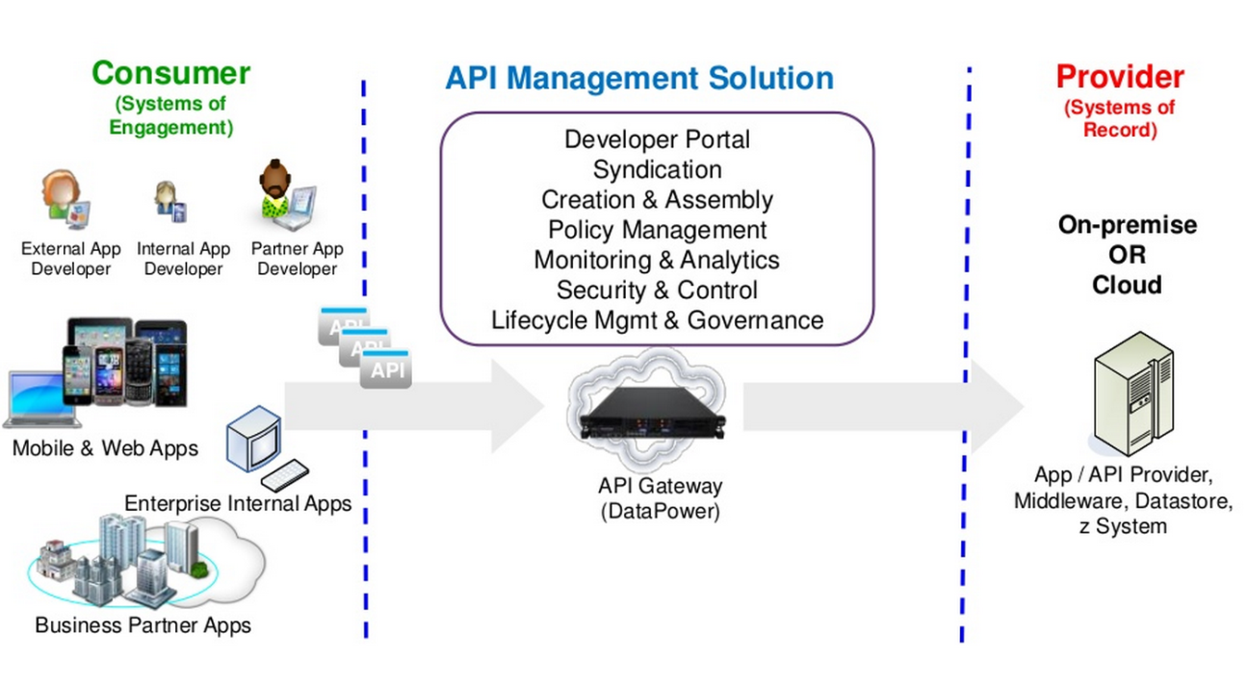
API Gateway
External API Gateway
Deployed in DMZ
Acts as gateway for all API requests from external clients (cti and third party)
Protection against Denial of Service attacks and generates a request UUID for all downstream layers to use
Transport level security (SSL/TLS) terminates at this layer
Internal API Gateway
Deployed in GRN
Manages lifecycle of Authorization tokens (Issue, re-issue, translate, etc.)
Advanced security controls such as XSS, SQL Injection, Payload validation, token resource metering, etc.
Routes API requests to Platform Security Gateway
Acts as gateway for API requests from internal clients.

Slide 10
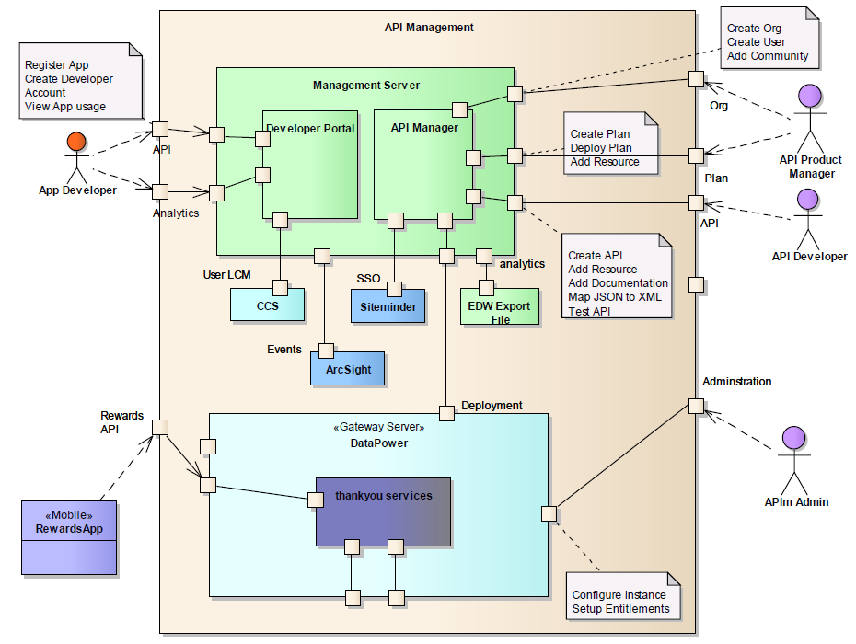
API Management Portal

Slide 11
API Security
Client-side
E2E encryption of sensitive data elements
Client credentials (client-id and client-secret ) used to validate and generate Authorization tokens
Akamai
Protection against Distributed Denial of Service
API Gateway
Generate and validate Authorization tokens based on client id and client secret for 2-legged OAuth and additionally with Login API for 3-legged OAuth
Security controls such as rate limiting, XSS, etc.
Platform Security Gateway
OWASP security controls
Session Management, Sequence protection
Role based access control, MFA Interdiction
External API Gateway to act as proxy for all incoming requests from external clients and protect against denial of service attacks
From | To | Authentication/Authorization Implementation
Client | API Gateway | Client credentials validation (ClientID as request header)
API Gateway | PSG | Server-server authentication via 2-way SSL
PSG | API | Server-server authentication via 2-way SSL
API | API via API Gateway | Client credentials validation (ClientID as request header) Requests routed via API Gateway passing different client credentials
API, PSG | GemFire Cache | Server-server authentication via 2-way SSL UserID/password based authentication with role based authorization

Slide 12
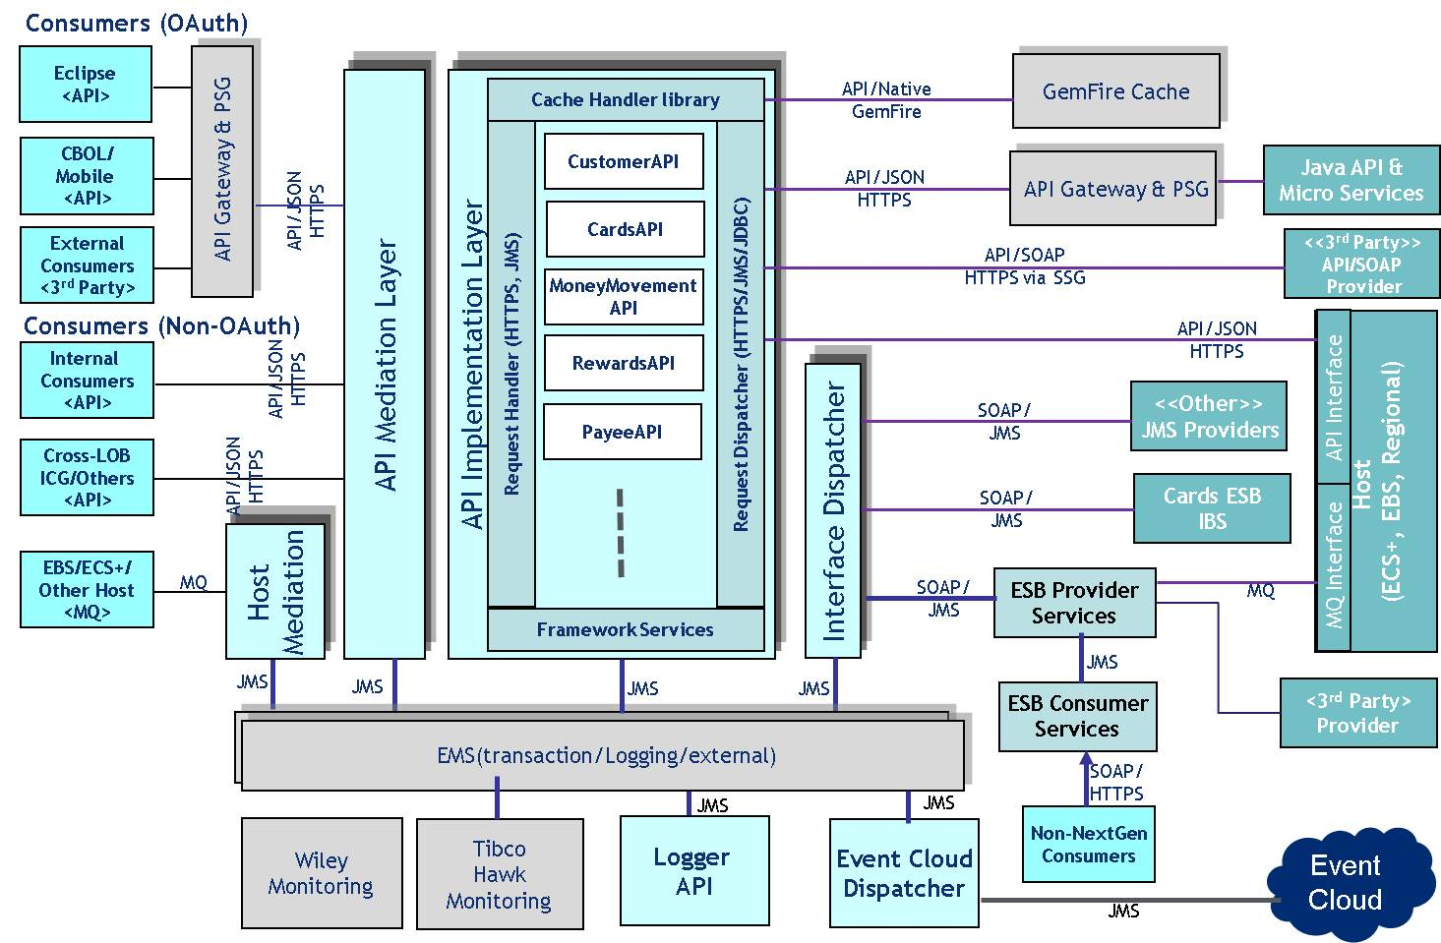
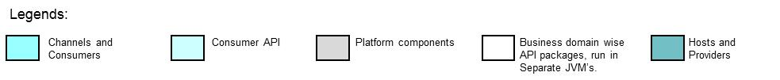
Consumer API: Non-PaaS (BW 5.11) – 1.0
API Mediation
Provides consolidated API Endpoint across APIs.
Consumer API Framework
Reusable resources and utility processes required to implement Consumer APIs
Consumer API Implementation
Consumer API is implemented in this layer.
Interface Dispatcher
Manages JMS Connections and decouple API Implementations getting impacted by deployment time changes.
Logger API
Exposes JMS logging Capabilities.
Event Cloud Dispatcher
Converts Messages into Raw Events and publishes to Event Cloud infrastructure.
ESB Provider Services
Exposes Provider operations to API
ESB Consumer Services
Used for existing Non-NextGen Clients and for co-existence
Host Mediation
Converts MQ calls to API calls

Slide 13
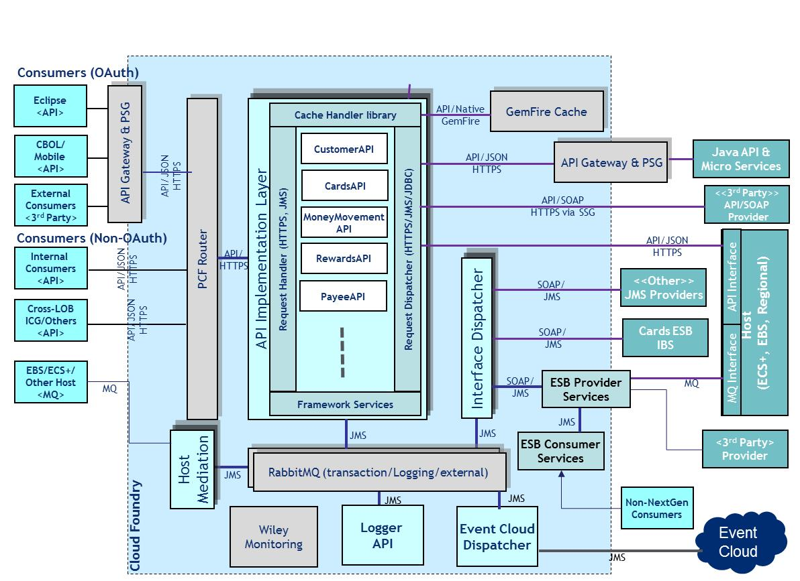
Consumer API: PaaS (BW CE for PCF) – 2.0
PCF Router
Provides consolidated API Endpoint across APIs and routes calls to specific API Endpoints.
Consumer API Framework
Reusable resources and utility processes required to implement APIs using Tibco BW Container Edition.
Consumer API Implementation
API is implemented in this layer.
Interface Dispatcher
Manages JMS Connections.
Logger API
Exposes JMS logging Capabilities
Event Cloud Dispatcher
Converts Messages into Raw Events and publishes to Event Cloud infrastructure
ESB Provider Services
Exposes Provider operations to API. Some of the interfaces over TCP/IP may remain non-cloud.
ESB Consumer Services
Used for existing Non-NextGen Clients and for co-existence.
Host Mediation
Converts MQ calls to API calls

Slide 14
Consumer API: End-State - Operation Details
Move to
Consumer API
To be further
Analyzed
Move to
Consumer API
251
Potentially Moved
to Host
Potentially Moved
to Host
For Now
Continue in ESB
Provider Layer
Potentially Moved
to Host
*Consumer Atomic to Provider Atomic is 1 to 1
**40 Operations are both Consumer and Provider Composite with a 20+20 split

Slide 15
Distributed Cache – Core Contents
Client-Side App
API Gateway
Distributed Cache
Session Security Cache
(Session Id, Security Context,
Last Accessed Time etc.)
Replicated, Sync
(Java Components)
Content Cache
Replicated, Async
Platform Security Gateway
Session Mgmt API
MicroApp Context Cache
Partitioned, Sync
MicroApp (Java)
MicroApp (Java)
Content API
Content API
GBCR Content
Shared Context API
Shared Context API
Partitioned, Sync
User Profile/Entitlements
Partitioned, Sync
Consumer (Tibco) API Layer
Shared Context TIBCO Library
Shared Context Java API
Consumer API Context Cache
Replicated, Sync
Shared Context Cache
(Session, Customer, Account,
Basic User Info etc.)
Replicated, Sync

Slide 16
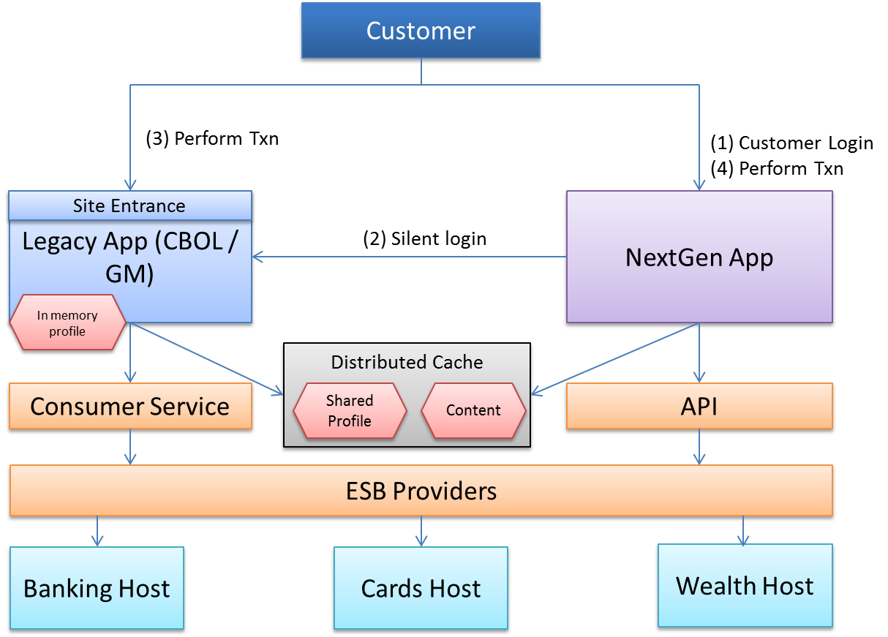
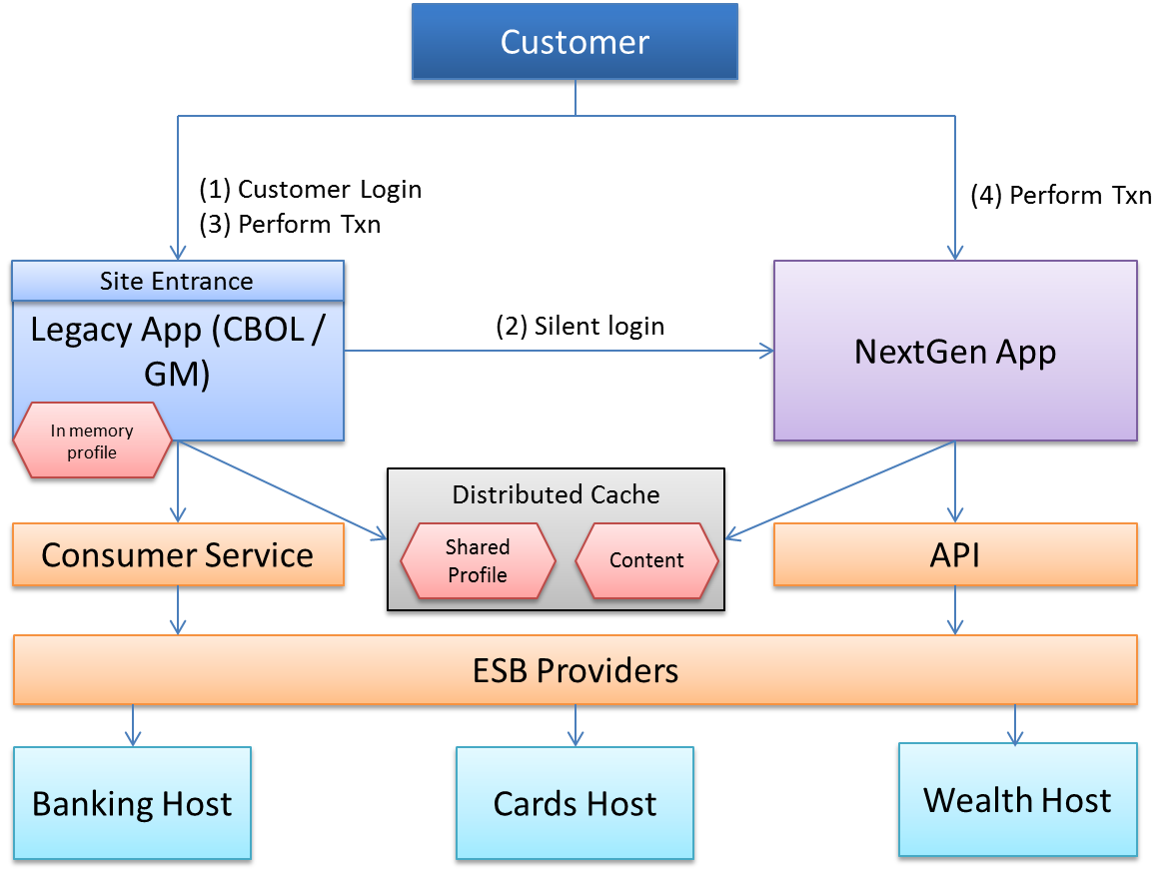
Co-existence approaches – Digital Channels
Business Drivers
Support co-existence of legacy and NextGen apps during transition phase
Minimize throwaway efforts on legacy apps during transition phase (build and regression efforts)
Segregation of Legacy vs NextGen apps with data Isolation may not be possible for every market
Scenario: Login in Legacy and execute transactions in NextGen
Proposed Changes:
Perform silent login on NextGen App
Update profile flags to trigger profile refresh on other app after completing a transaction
Refresh profile data before performing a transaction, if the profile flag is marked stale
Scenario: Login in NextGen and execute transactions in Legacy
Proposed Changes:
Perform silent login on Legacy App
Update profile flags to trigger profile refresh on other app after completing a transaction
Refresh profile data before performing a transaction, if the profile flag is marked stale
Note: The silent login can happen instantly or during a first cross application invocation

Slide 17
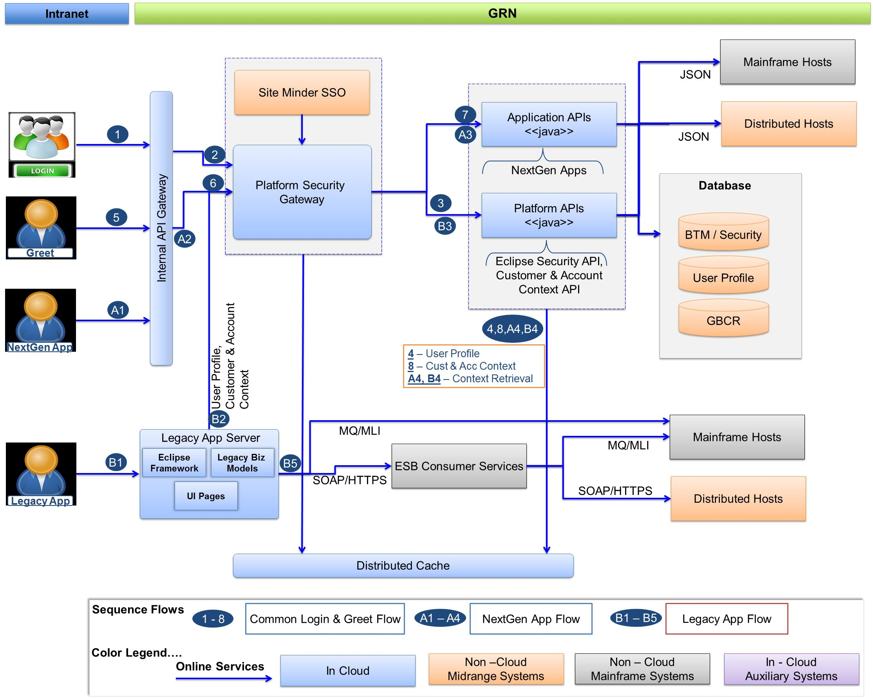
Co-existence approaches – Assisted Channels

Slide 18
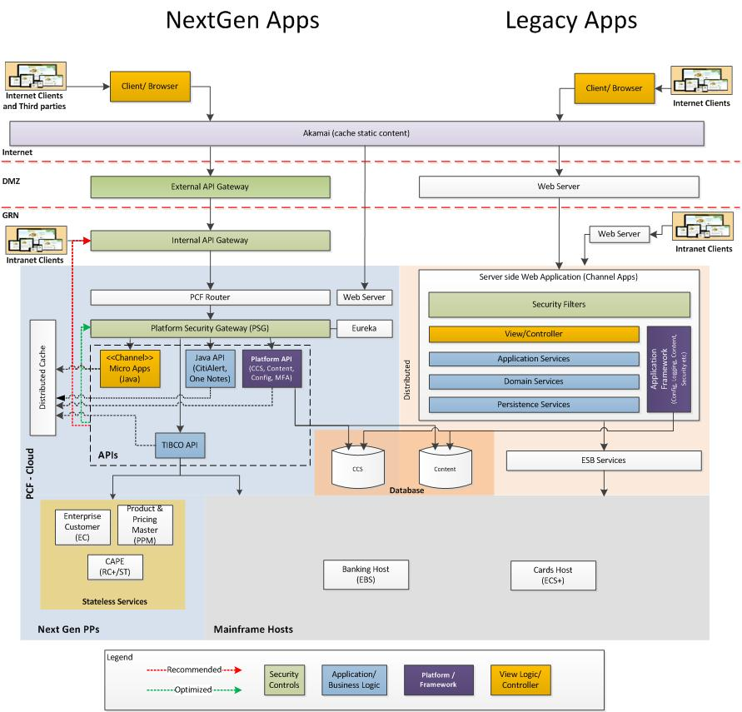
Channel Apps – NextGen vs. Legacy
Simplification Benefits
Developer Productivity:
Channel Apps optimization
Responsive Design: Single application serving multiple form factors, reducing overall efforts
Omni-channel API: Move business logic to API layer and reduce efforts
Data Mapping: Eliminate unnecessary application layers and reduce data mapping efforts
Digital Apps: Mobile thin and tablet apps will be retired
Assisted Apps: ctiplanner and DSA for devices will be reused from desktop. Potential extension to services modules to workbench and ATM express.
API Gateway: About 25% of web security controls moved to API gateway, leveraging out of the box capabilities in API gateway
Modularized Apps: Simplifies developer workspace setup and improves overall productivity
Developer Agility:
2-speed architecture allows client components to be developed and tested independently and improves agility
Faster startup time by up to 30-40x
Other Runtime benefits:
Resiliency: Zero service downtime as the application state is managed in distributed cache
Performance: JSON payload reduces GRN network bandwidth utilization by about 30%, based on efficient caching mechanisms last mile bandwidth utilization can reduce by 30% or more
Scalability: Optimal resource utilization due to component level scaling
Optimization Opportunities
Using embedded SDK where possible results in in-memory calls to platform APIs when consumed within a Java API or a Micro App
Optimize security validations performed in PSG for multiple API invocations within same request context
API Gateway to be explored to be utilized for implementing additional security controls instead of PSG
Converge maintenance functions across digital and assisted apps

Slide 19
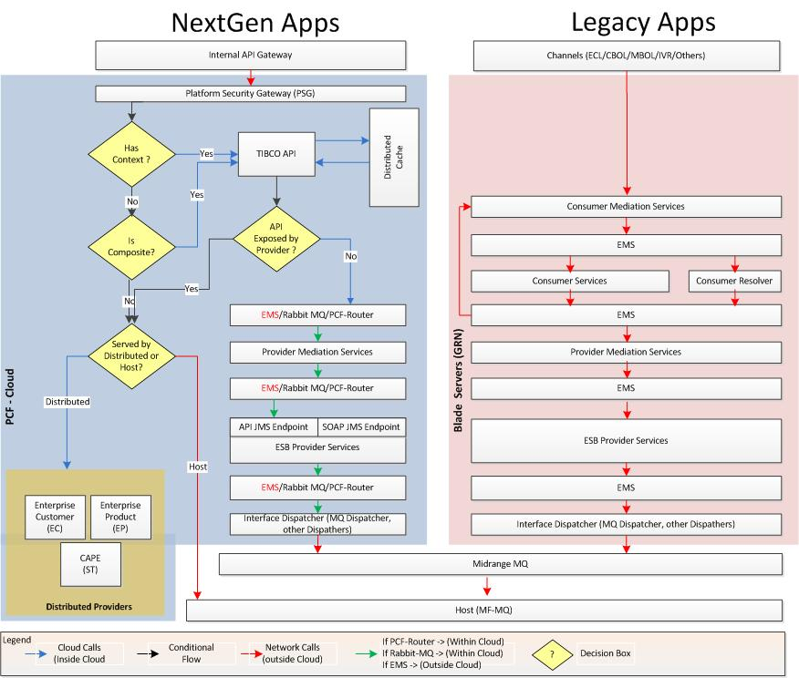
Middleware – NextGen vs. Legacy
Simplification Benefits
# of hops: Reduced from 12 (Legacy ESB) to 8 (NextGen).
# of Minor Versions: Many (WSDL) to 1 (API) with well documented contract.
Simplified Internal XSDs: No cross-impact between APIs (own schemas) vs WSDLs (shared schemas)
Provider Services over JSON: No need to update XSLTs and regression all Services/Operations.
Backward Compatibility: No impact to API if new changes are not consumed.
Independent Packaging & Deployment: APIs are packaged independently and can be deployed independently or combined into a common deployable archive.
GemFire for State Management & Caching: APIs are stateless. State is managed in distributed cache.
Optimization Opportunities
Interface Dispatcher: can be made light by keeping only External JMS and MQ calls.
Provider Mediation Services: can be merged for TIBCO API calls if PCF-Router can support multi-Endpoint routing.
**Benefits are based on Architectural/Design simplification and use of API pattern.
**Developer Agility and Product capability benefits will be identified once Tibco BW 6 lite (for PCF) will be available.

Slide 20
Backend – NextGen vs. Legacy
NextGen Apps
Legacy Apps
Simplification Benefits
Modern of data model: Base on a relational data model using EC from FIS
Data Standard adherence: Deeply embedded approach can be adopted
Multi-Country variation: Variability of data attributes and data quality enforcement rules are better covered
# of hops: Reduced hops for simple API that do not need orchestration and transformation
Overall Integration Simplification: an improved z/OS based integration capability than vanilla FIS GN (with zosConnect via zIIP)
Better Info Security: Data power and its ID propagation, distinguished names can now be registered in SMF
Internal API Gateway
Channels ECL/CBOL/MBOL/IVR/Others
Midrange MQ
Midrange MQ
X86 Linux Cloud - PCF
z/OS Parallel Sysplex
z/OS Parallel Sysplex
CAPE-ST
Mainframe MQ (Queue Sharing Group)
Mainframe MQ (Queue Sharing Group)
Enterprise
Customer
(EC)
Product
Pricing Master
(PPM)
z/OS Connect
Liberty Profile
WOLA
Oracle
EBS, Wealth, Cards
CICSplex
EBS, Wealth, Cards
CICSplex
Optimization Opportunities
Batch job reduction: By migrating workload to a real-time basis, less massive batch jobs runs on the mainframe, reducing MIPS
Loose Coupling: With EC migrating out and interfaces redesigned, overall complexity on mainframe application reduced
DB2
Data Sharing
VSAM
RLS
DB2
Data Sharing
VSAM
RLS
Risk area to address
Re-hosting: By moving the core customer data out, the tight coupling of applications would have to be redesigned otherwise the additional network interface introduced will upset throughput

Slide 21
BI – NextGen vs. Legacy
NextGen Apps
Legacy Apps
Simplification Benefits
Real-time Data Flow: Integration with the host to get real time data feed
Current and Transactional : Deliver current behavior and transactional data
Scalable High Performance: Data repository which can serve the purpose of online real time data needs and the low cost data
Simplified Integration : an integrated data access and processing
Common Tech Stack : for structured and unstructured data
Internal API Gateway
Channels ECL/CBOL/MBOL/IVR/Others
Host – EBS/ECS+/WM
X86 Linux Cloud - PCF
NDM/DB Link/ESB
CAPE-ST
Enterprise
Customer
(EC)
Product
Pricing Master
(PPM)
Ab-Initio/Data Stage
Oracle
Ab-Initio/Cloud
Nextgen EDW
EDW/EAP
(Big Data)
Historic
Real time
Structured/Unstructured Data
Core EDW
Sales Station
ORP
Teradata
DB
Teradata
DB
Teradata
DB
Teradata
DB
Hadoop
Optimization Opportunities
Cycle time reduction: Data delivery will be reduced from days to minutes
Query-Federation Layer
SAS
COGNOS
Qlikview
Risk area to address
Operational Data Model: De-coupling the data model from the core analytical data model, need to ensure the synchronization
Customer
Service
Analytics
Reporting
Contact
Centre
Campaign
Management
Self-Service
Analytics
Reporting

Slide 22
Appendix

Slide 23
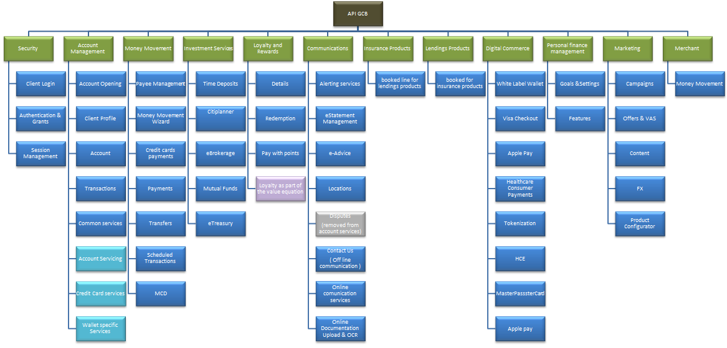
API Taxonomy - Digital

Slide 24
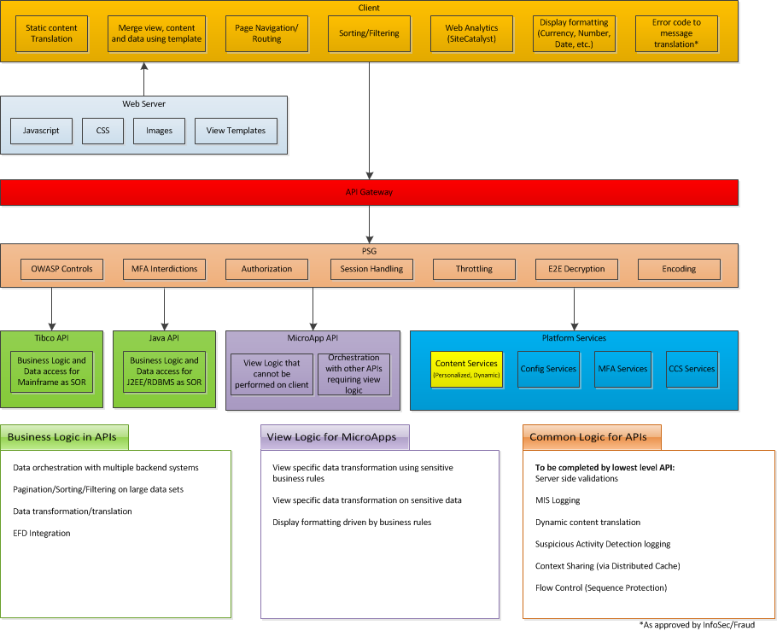
Separation of Concerns

Slide 25
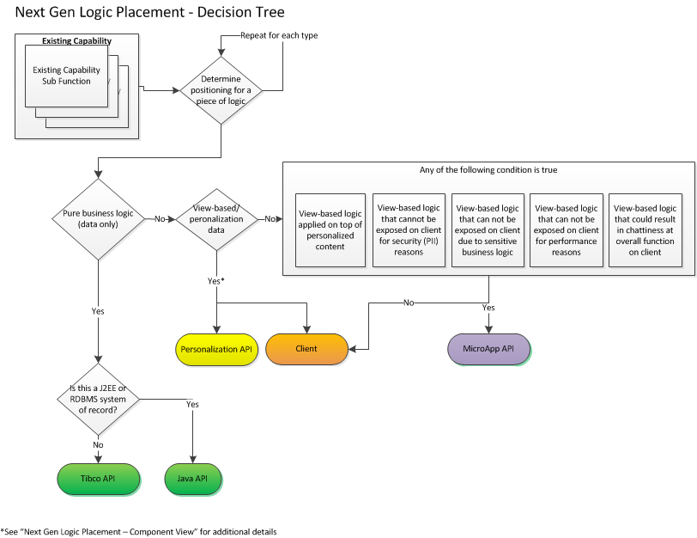
Which Flavor of API Should I Build?

Slide 26
Use Cases Built in MicroApps and Not Part of Open APIs
View-based Logic Applied Upon Personalized Content - Specialized formatting/views or additional data gathered applied after personalizing content
View-based Logic That Cannot be Displayed for Security Reasons - For example, logic pertaining to retry limits when entering username/password
Sensitive Business Logic - The logic in question is considered cti’s IP and provides us a competitive advantage
Application Performance - When the logic performed is too verbose to adequately perform on the client or becomes too bloated that it impacts initial load times of an application
Excessive Chattiness (API Aggregation) - When API calls for data, content, personalization, etc result in several round trips that impact performance

Slide 27
General Partitioning of Business Logic Across APIs
Principle | API Category | Assign To | Developed By | Governed By
Access to mainframe or TIBCO based product processors | Open API, Private API | TIBCO API | API Scrum Teams | CTO API Governance
Access to services currently exposed as Java/API (eg: Java Based Product Processors – CCS, cti Alerts) | Open API, Private API | Java API | API Scrum Teams | CTO API Governance
If orchestration for access to multiple sources of product processor information is required | Open API, Private API | TIBCO API / Java API respectively | API Scrum Teams | CTO API Governance
Transformation for data required to-from product processors | Open API, Private API | TIBCO API | API Scrum Teams | CTO API Governance
Content Formatting | MicroApp API | MicroApps or Client as appropriate | Consuming Application or Product Vertical Scrums | CTO SA/EA
Configuration specific to channels and screen flows | MicroApp API | MicroApps | Consuming Application or Product Vertical Scrums | CTO SA/EA
Data manipulation – sorting, etc for display | MicroApp API | MicroApps or Client as appropriate | Consuming Application or Product Vertical Scrums | CTO SA/EA
Channel specific business logic required to drive a user interaction | MicroApp API | MicroApps or Client as appropriate | Consuming Application or Product Vertical Scrums | CTO SA/EA
Components required to drive digital engagement, customer moments, real-time analytics and decisioning | Open API, Private API | TIBCO API / Java API respectively | API Scrum Teams | CTO API Governance
Business events involving product processors (two way) | Open API, Private API | TIBCO API | API Scrum Teams | CTO API Governance
Localization | MicroApp API, Open API, Private API | MicroApps / TIBCO API / Java API as appropriate | API Scrum Teams or Consuming Application /Product Vertical Scrums | CTO SA/EA + CTO API Governance
Events involving channels, user interactions | MicroApp API | MicroApps or Client as appropriate | Consuming Application or Product Vertical Scrums | CTO SA/EA
Data Validation | MicroApp API, Open API, Private API | MicroApps / TIBCO API / Java API as appropriate | API Scrum Teams or Consuming Application /Product Vertical Scrums | CTO SA/EA + CTO API Governance

Slide 28
Public Access Token issued for Pre-login API Access
Public Access tokens to be issued for accessing non-secure APIs
Implemented as 2-legged OAuth using client-credential grant type
API Gateway to translate ClientID to business code and country code if no OAuth token is passed by client
API Gateway to extract business code, country code, session id and scope when the OAuth token is passed by client
Token has a default expiry time of 30mins. Can be configured with longer expiry time based on market needs or IS requirements

Slide 29
OAuth Token Generation during Login
OAuth token to be issued after a successful sign-on to access secure APIs
Implemented as 2-legged OAuth using resource-owner grant type for cti apps
Implemented as 3-legged OAuth using resource-owner grant type for third party apps
API Gateway to translate ClientID to business code and country code if no OAuth token is passed by client
Generated Token to include business code, country code, session id, scope (customer role) and device id
Device id extracted from OAuth token is validated against the value sent in header for all subsequent requests
API Gateway to extract business code, country code, session id and scope when the OAuth token is passed by client
Can be configured with longer expiry time based on market needs or IS requirements

Slide 30
Using OAuth Token to Access Post-login APIs
OAuth token to be sent in every request from client to access secure (post-login) APIs
Device id extracted from OAuth token is validated against the value sent in header to ensure request is coming from same device that was used to performed login
API Gateway to extract business code, country code, session id and scope when the token is passed by client
If token is invalid, 403 Unauthorized response is returned to client
If session is expired, 403 Unauthorized response is returned to client

Slide 31
OAuth Token Expiry and Reissue
OAuth token to be reissued after token expiry
Reissue token only if session is still active
If session is expired, 403 Unauthorized response is returned to client

Slide 32
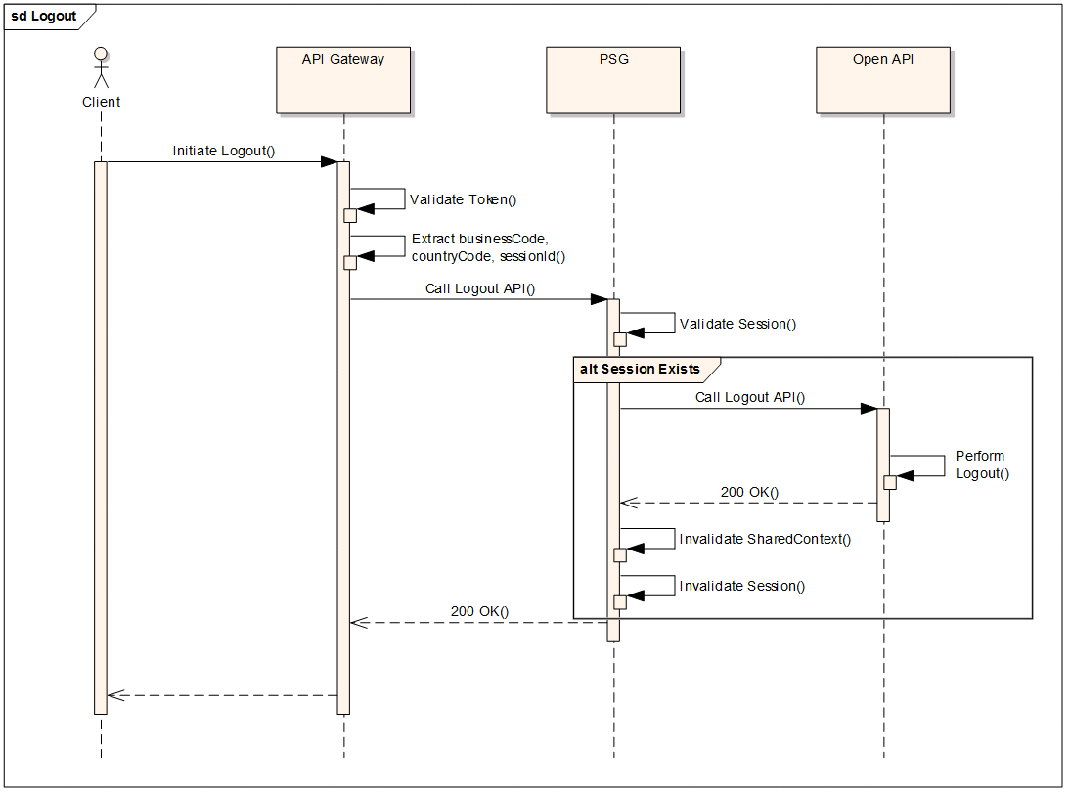
OAuth Token Invalidation during Logout
OAuth token to be invalidated during logout
On session termination, token is invalidated ending empty OAuth token in response header/cookie
If replayed with invalidated token, 403 Unauthorized response is returned to client from PSG

Slide 33
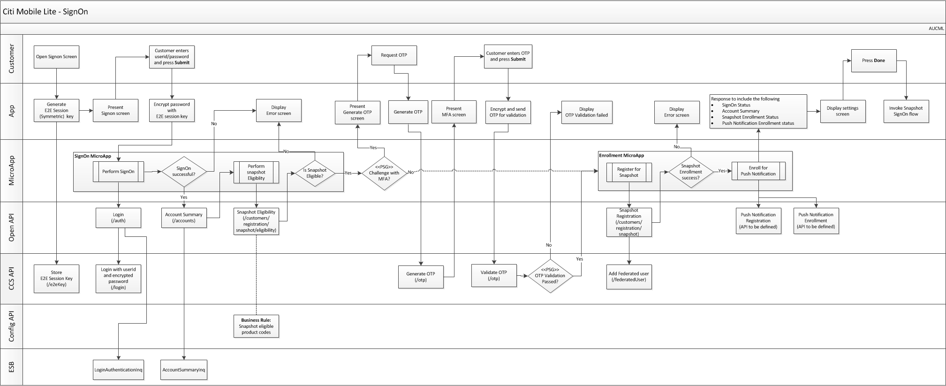
Mobile Lite – Snapshot Registration Flow

Slide 34
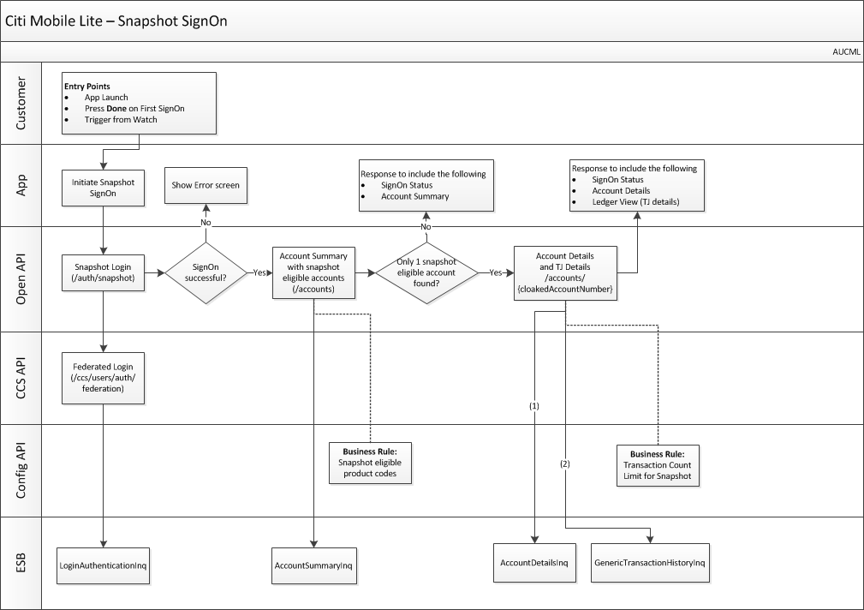
cti Mobile Lite – Snapshot Login Flow
Umesh

Slide 35
Co-Existence Login Approach – Assisted Channels
Deepak

Slide 36
Co-Existence Post Login Approach – Assisted Channels
Deepak

Slide 37
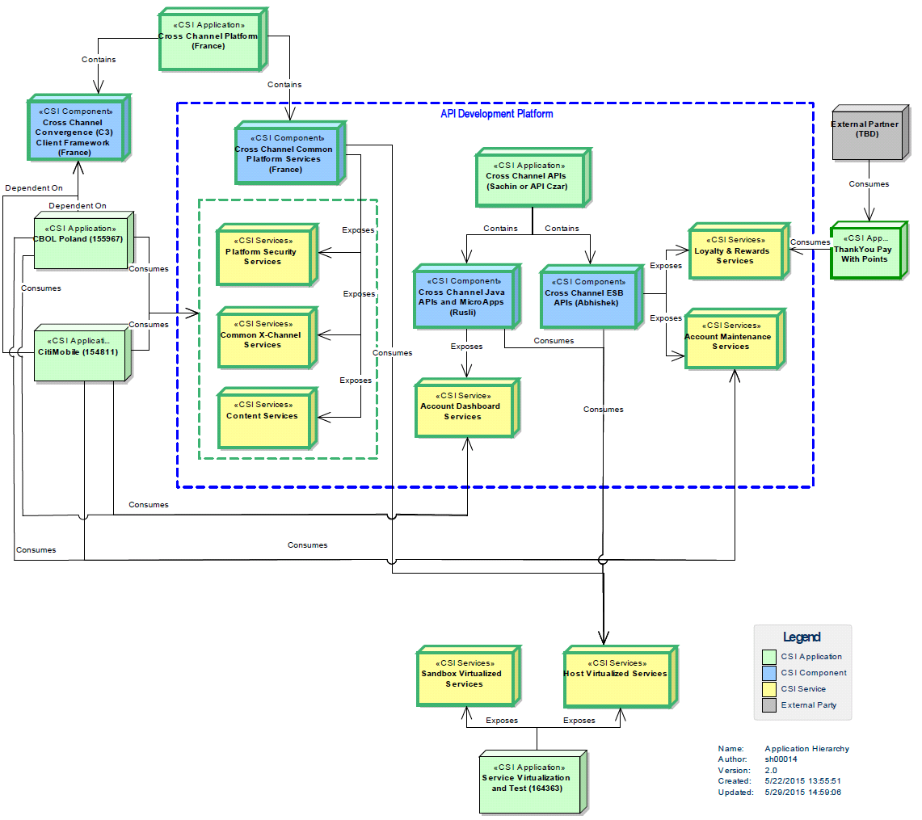
CSI Applications in NextGen
Umesh

Slide 38
Benefits – APIs / Micro Services / Distributed Cache
BENEFITS
OBJECTIVES
PROOF POINTS
APIs
Business logic being removed from channel code and migrated to TIBCO layer reducing channel complexity and creating cross-channel ESB APIs
Improves velocity and faster time to market of new features and capabilities across channels (CBOL/Mobile/Eclipse)
API Gateway provides API discovery, documentation, governance, publication allowing for rapid integration of UI with ESB APIs
Improves velocity and faster time to market for Online / Mobile / Assisted channels and enables 3rd party innovation and functionality leveraging cti capabilities
Micro Services
Micro services are modular and allow for testing and deployment independent of other app modules
Removes interdependencies improving velocity and faster time to market, and enables 2-speed architecture
Supports small vertical agile teams, stateless/ isolated service design with enhanced build/deploy/validate automation
Improves service availability across CBOL and Mobile, resulting in fewer full or partial service outage.
DELIVERABLES
Distributed Cache
Distributed cache enables stateless allowing for session failover across micro services upon failure
Cloud PaaS-enabled stateless services dynamically utilize available infrastructure (ramp-up and scale-down) and Cloud service offerings to meet consumer demand
Lowers operating cost and provide better scalability across all Digital channel applications

Slide 39
Benefits – PaaS
OBJECTIVES
PROOF POINTS
BENEFITS
Developer/
Tester Agility
Higher developer productivity
Sprint velocity
Improve “Value to Market” performance
Better backlog management
Faster regression from automated testing
Defect injection rates
Improved code quality
Operational Agility
Less prone to manual errors
Faster new environment provisioning
Eliminate idle environments
Pilot new apps/versions within existing infra
Minimal efforts for platform version upgrades
Efficient capacity mgmt.
Infrastructure consolidation
Higher capacity utilization; lower costs
DELIVERABLES
Resiliency
Recover quickly from failures without impacting users
Minimize downtime & impact to the business
Report immediately any failure to initiate auto recovery
Elasticity
Quickly scale to handle fluctuating workloads e.g. Black Friday traffic
Free unused capacity

