Slide 1
HOUSE PRICE PREDICTION
USING
MACHINE LEARNING
NAME : VADALA SANDEEP
Dept : mca
UID : 111721039120

Slide 2
TABLE OF CONTENT
ABSTRACT
INTRODUCTION
LANGUAGE USED
TECHNOLOGIES
MACHINE LEARNING
LINEAR REGRESSION
RANDOM FOREST REGRESSON
FLASK
FLOW DIAGRAM
GRAPHS
SCREENSHOTS

Slide 3
ABSTRACT
House price prediction is an important topic of real estate. The literature attempts to derive useful knowledge from historical data of property markets.
Machine learning techniques are applied to analyze historical property transactions in India to discover useful models for house buyers and sellers.
Moreover, experiments demonstrate that the Multiple Linear Regression and Random Forest Regressor that is based on accuracy and mean squared error measurement is a competitive approach.

Slide 4
INTRODUCTION
In this project, we have built a machine learning model to predict the house prices .
This project will very helpful for the real estate market.
Buyers are generally not aware of factors that influence the house prices.
Many problems are faced during buying a house.
The goal of this project is to predict house prices in based on some features such as location, size/area, number of bedrooms, and parking, power backup and etc..
We are using Machine Learning Algorithm to create a predictive model.

Slide 5
TECHNOLOGIES
MACHINE LEARNING :-
Machine learning is a growing technology which enables computers to learn automatically from past data. Machine learning uses various algorithms for building mathematical models and making predictions using historical data or information.
Algorithms used :-
Linear Regression
Random Forest Regressor
FLASK :-
Flask is a web application framework written in Python.

Slide 6
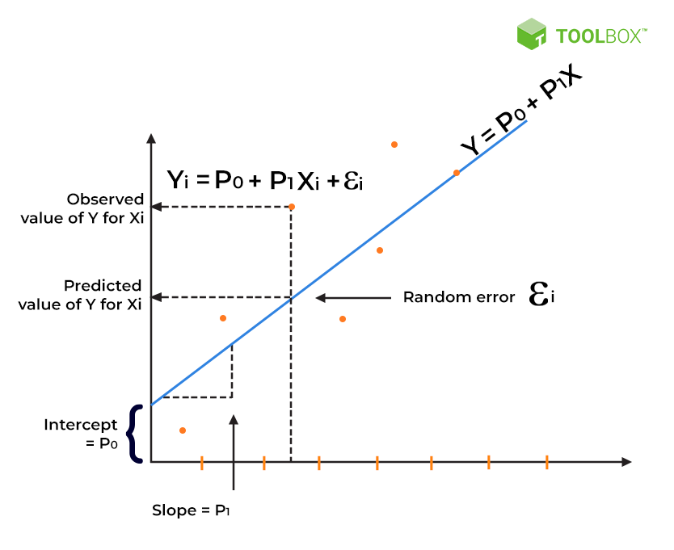
LINEAR REGRESSION
Linear regression algorithm shows a linear relationship between a dependent (y) and one or more independent (y) variables, hence called as linear regression.

Slide 7
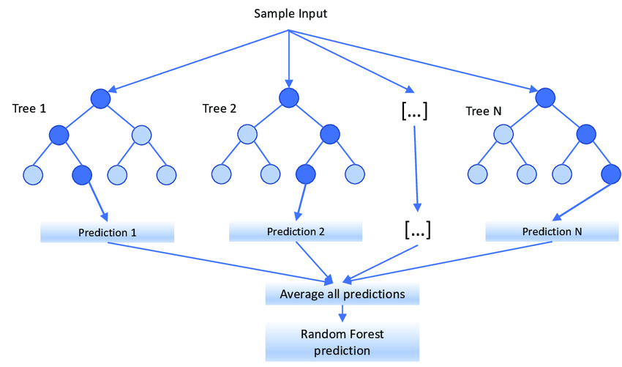
RANDOM FOREST REGRESSOR
"Random Forest Regressor that contains a number of decision trees on various subsets of the given dataset and takes the average to improve the predictive accuracy of that dataset." Instead of relying on one decision tree, the random forest takes the prediction from each tree and based on the majority votes of predictions, and it predicts the final output.

Slide 8
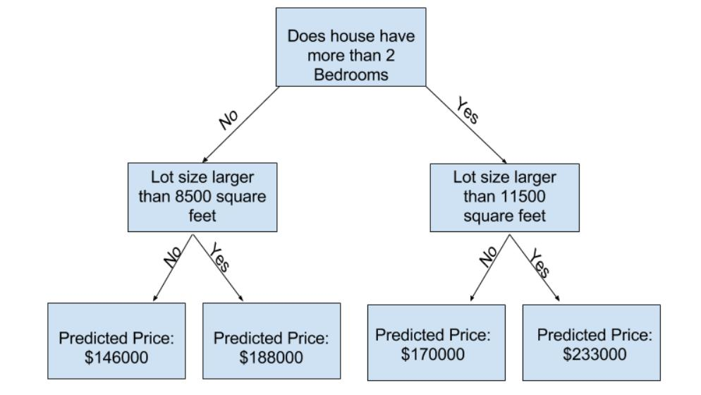
DECISION TREE :-

Slide 9
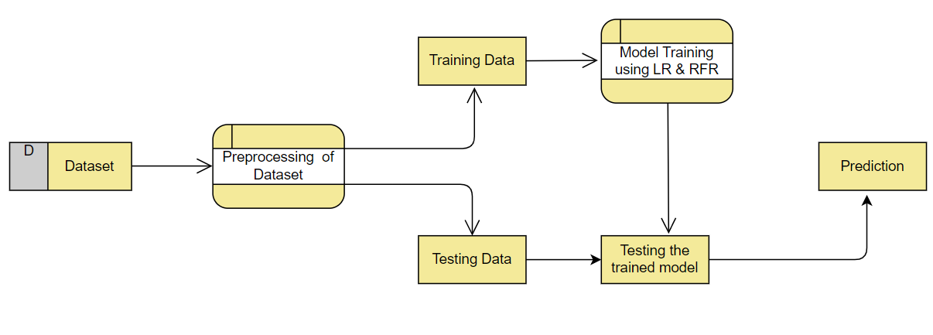
Data Flow diagram

Slide 10
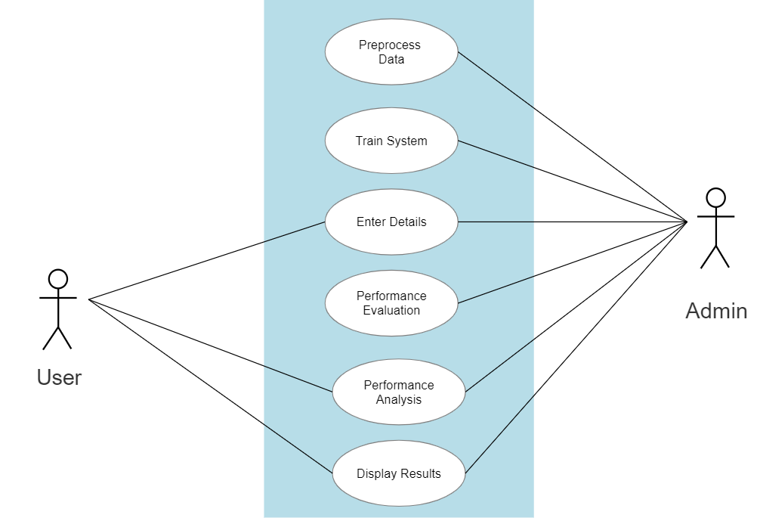
USECASE DIAGRAM

Slide 11
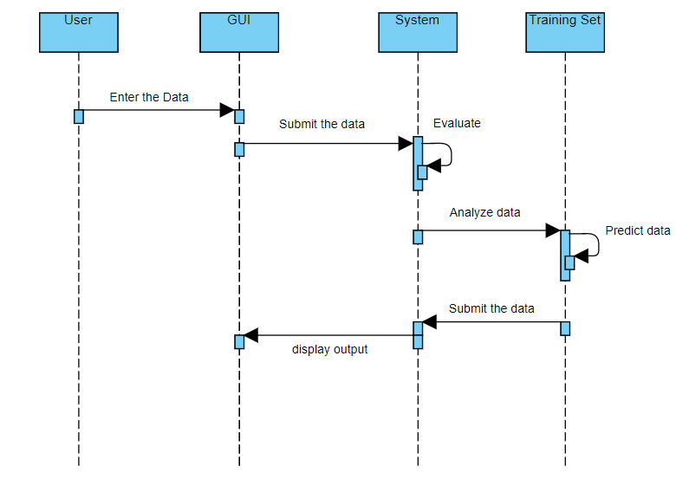
SEQUENCE DIAGRAM

Slide 12
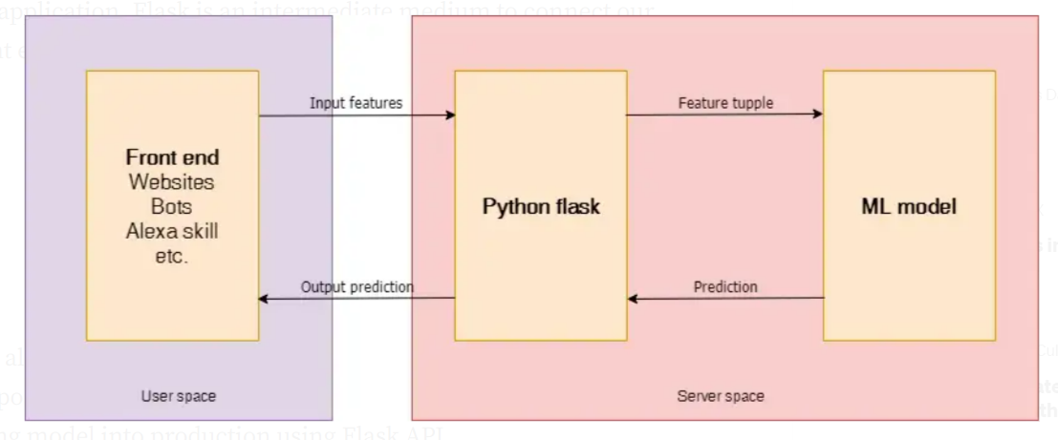
API Data Flow

Slide 13
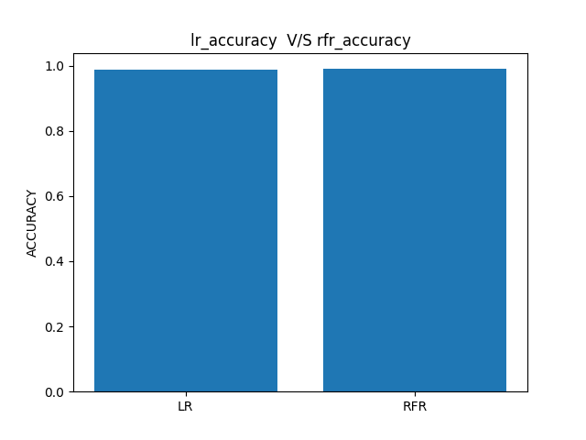
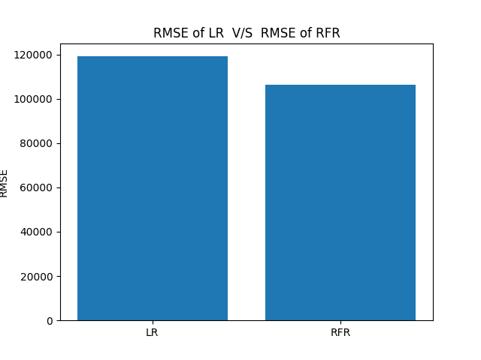
graphs

Slide 14
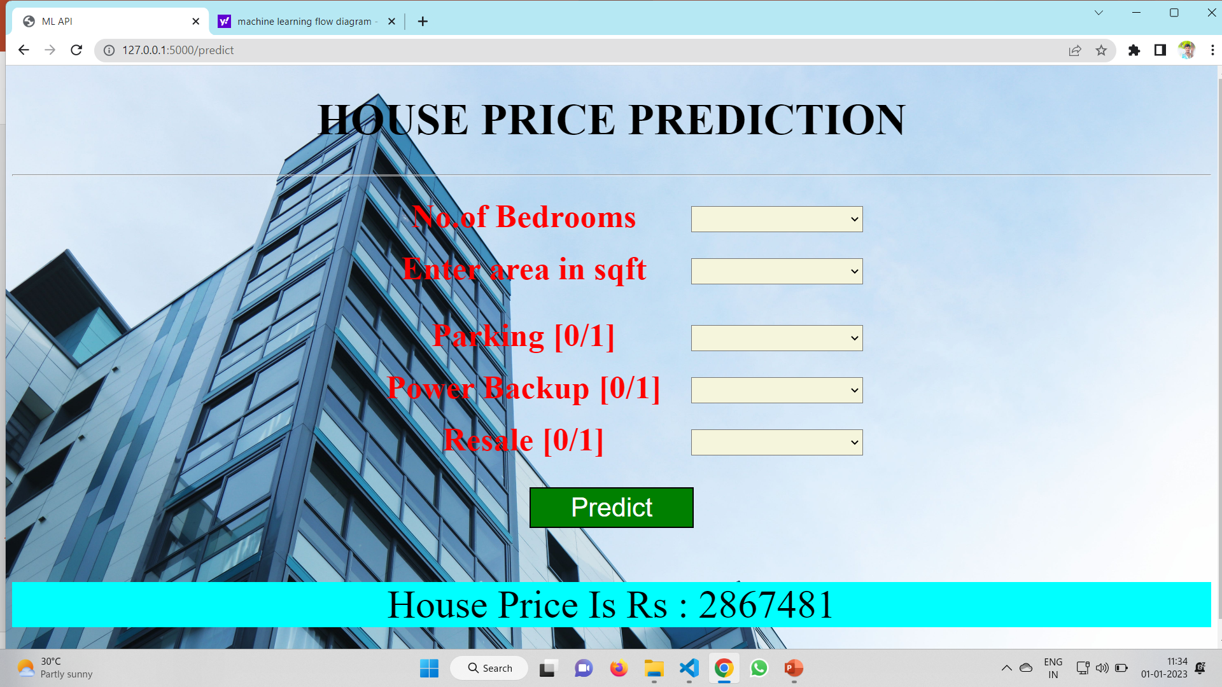
Screen shorts

Slide 15


