Slide 1
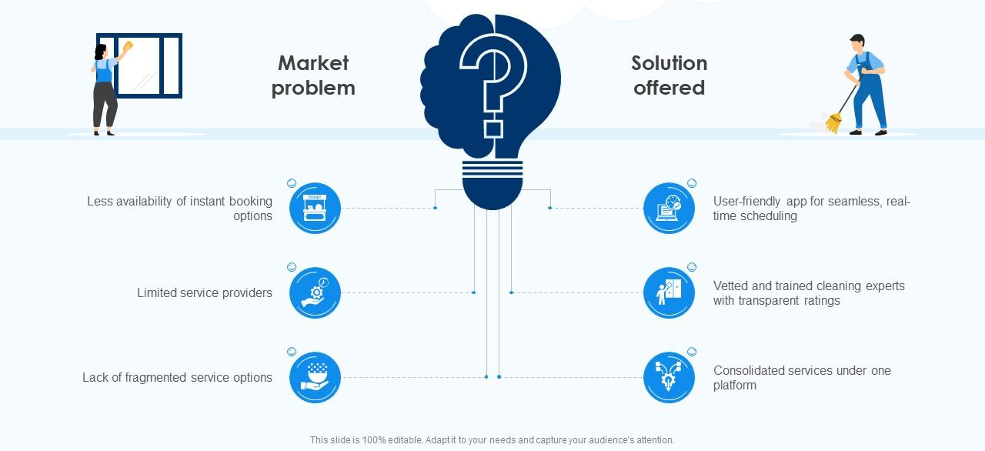
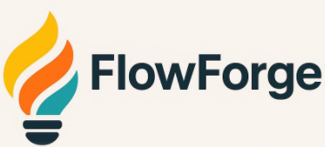



AI Based Auto Schema Detection
No-Code Interface
Production Grade Architecture
Cloud Based Operations
Modern Data Pipelines in YOUR Cloud
Backlog Delays: Analysts wait weeks for each pipeline
Disparate Tools: Multiple ETL tools, inconsistent approaches
Compliance friction: Data residency and audit trail requirements
No self-service: Engineers required for every data request
Key Differentiators:
YOUR
Cloud
Vendor
Neutral

Slide 2



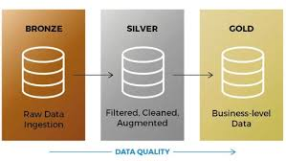

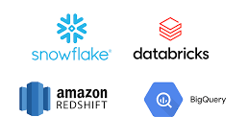


AI Configuration
Monitoring
File Processing
Metadata Catalog
How it works
Orchestration
Vendor Neutral
Key Features
Users
Business Analyst
Data Teams
Data Engineers
Technical Architecture
Platform Components: • Web application (Next.js) • Prefect orchestration server • PostgreSQL metadata database • Object storage (S3/ADLS/GCS) • Prefect workers (containerized)
Data Flow: Files → Landing → Bronze → Silver → Gold → Warehouse
Deployment: Docker containers in your cloud (ECS/AKS/GKE)

Slide 3
Product Comparison
Traditional SaaS | FlowForge Model
✗ Data leaves your environment | ✓ Data stays in YOUR cloud | Security Features | Data Residency: All data in your S3/ADLS/GCS Identity: IAM/Key Vault integration, RBAC Encryption: KMS/CMK, customer-managed keys Network: Private VPC, no public access required Audit: Full logging, immutable Bronze layer Compliance: GDPR, HIPAA, SOX ready
✗ Vendor controls infrastructure | ✓ You control everything
✗ Lock-in risk | ✓ No lock-in
Notes:
Competitive Scripts
vs Fivetran: “Fivetran excels at SaaS connectors. FlowForge excels at custom sources. Plus your data stays in YOUR cloud. Use both.”
vs Matillion: “Matillion locks you into Snowflake with expensive credits. FlowForge is vendor-neutral with flat-rate pricing.”
vs Informatica: “Informatica is comprehensive but expensive and slow. FlowForge is purpose-built for pipelines. Deploy in 1 week vs 6-12 months.”
vs DIY Airflow: “Building takes months and ongoing maintenance. FlowForge gives you production-grade orchestration with self-service UI.”

Slide 4
FlowForge Credentials
Use Case | Before | After | Impact
Financial Close | 50+ Excel files, 3 days manual consolidation | Pattern matching + AI = 30 minutes | 90% Time Savings
Partner Integration | 20+ partners, 2 hours to configure each | AI detects schema in 3 seconds | Instant Onboarding
Marketing Analytics | Wait 1 week for engineer to build pipeline | Analyst builds in 5 minutes | Zero engineering dependency
Compliance | Data must stay in specific region | FlowForge runs in YOUR cloud account | Full data sovereignty, audit-ready
Upcoming New Features
Database Connectors Direct connections to MySQL, PostgreSQL, SQL Server, Oracle
Data Quality Rules Automated validation: “email not null”, “amount > 0”
Incremental Loading Process only changed records (hours → minutes)
Transformation Engine Visual business logic builder (no SQL required)
Data Reconciliation Automated source-to-destination verification

