Slide 1

Ganglia

Slide 2
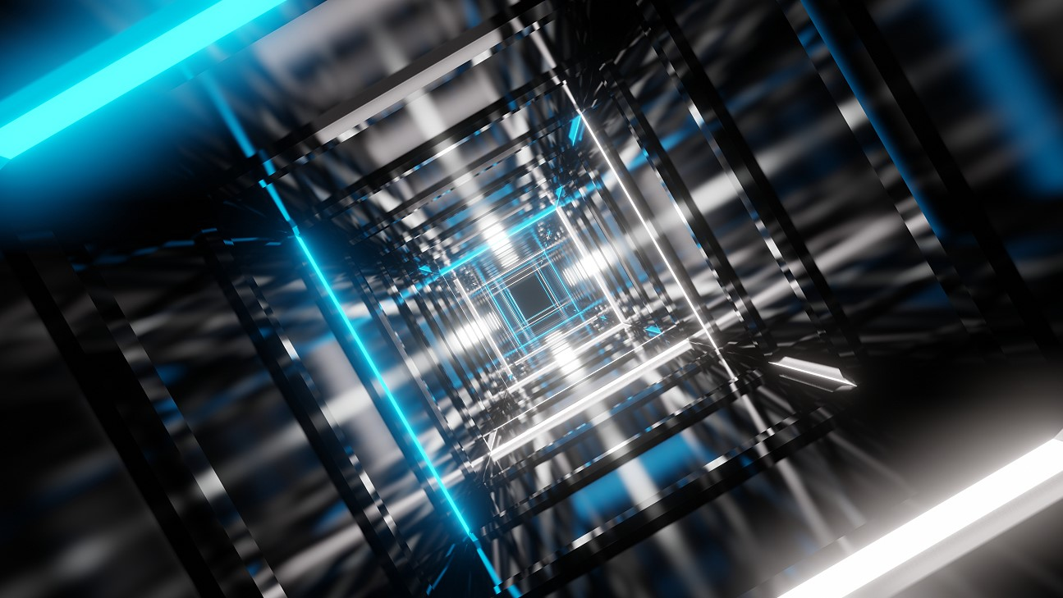
Ganglia
Ganglia is a scalable, distributed monitoring system designed for high-performance computing (HPC) systems, clusters, and grids.
It provides a means to monitor and visualize the performance of systems by collecting various metrics such as CPU usage, memory consumption, disk I/O, network traffic, and more, from different nodes in a cluster.
Ganglia is often used in scientific and research environments where large clusters of computers need to be monitored for performance, efficiency, and troubleshooting.

Slide 3
Ganglia
Ganglia is designed to efficiently collect and display monitoring data in large-scale, distributed environments.
It is particularly well-suited for clusters with hundreds or thousands of nodes, making it widely used in HPC, scientific computing, and enterprise environments.
Ganglia uses a hierarchical design where monitoring data is collected at various levels and aggregated to provide insights into the performance of the entire system.

Slide 4
Ganglia
Scalable
Ganglia is designed to scale from small clusters to large grids with thousands of nodes.
Distributed
It uses a distributed architecture, with a decentralized collection of data from various nodes.

Slide 5
Ganglia
Efficient
Ganglia is built to efficiently handle the collection and aggregation of metrics from a large number of machines with minimal overhead.
Web-based Interface
It provides an easy-to-use web-based interface for visualizing and exploring collected metrics.

Slide 6
Ganglia
Ganglia consists of several core components that work together to gather, aggregate, and display system metrics.
1. gmond (Ganglia Monitoring Daemon)
gmond is a daemon that runs on each node (or machine) in the cluster.
It collects performance data and sends it to other gmond daemons or a central gmetad daemon for aggregation.
Data Collection: gmond collects system statistics such as CPU usage, memory usage, disk usage, network traffic, and other metrics.
Communication: The data is sent via multicast to other gmond daemons or directly to gmetad. This allows the monitoring system to be highly scalable and efficient.

Slide 7
Ganglia
gmetad (Ganglia Meta Daemon)
gmetad is responsible for aggregating and storing data from multiple gmond daemons.
Data Aggregation: gmetad collects performance data from gmond daemons across the cluster or grid and aggregates this information into a centralized database.
Querying: It can query gmond daemons for data and serve that data via a web interface or through an API.
Centralized Storage: It provides a way to store historical performance data from all nodes in the system.

Slide 8
Ganglia
Ganglia Web Frontend
The web interface allows users to visualize and explore the collected data from the gmetad daemon.
Features:
->Graphs showing the performance of various system metrics (CPU usage, memory usage, disk I/O, etc.).
->Real-time monitoring of systems and clusters.
->Historical data visualization to help identify performance trends over time.
->Customizable dashboards for different users or roles.
Implementation: The web frontend is typically written in PHP and can be configured to display information about clusters and nodes through a web browser.

Slide 9
Ganglia
Ganglia PHP Web Interface
The PHP-based web interface provides an easy way to interact with the monitoring data collected by gmetad.
Visualization
It presents a variety of charts, graphs, and tables that show real-time and historical data on CPU, memory, disk, and network performance.

Slide 10
Ganglia
Ganglia Database (Optional)
While not always used, Ganglia can be configured to store metrics in a relational database (e.g., MySQL or SQLite) for long-term storage.
Features:
-> Provides a way to store large volumes of historical data.
-> Useful for generating long-term trend reports or conducting deep analysis.
-> Helps with generating reports and performing troubleshooting analysis over extended periods.

Slide 11
Ganglia
Ganglia Features and Capabilities
1. Scalability
Hierarchical Design
Ganglia can handle large numbers of nodes by using a hierarchical design where data from smaller groups of nodes is aggregated before being sent to a central gmetad. This allows it to scale effectively to clusters with thousands of nodes.
Efficient Data Aggregation
By using multicast and optimized aggregation techniques, Ganglia minimizes overhead and reduces the amount of network traffic needed to gather performance data.

Slide 12
Ganglia
Real-time and Historical Monitoring
Real-time Monitoring
Ganglia provides real-time performance metrics, allowing administrators and users to observe the state of systems and detect issues quickly.
Historical Data
It stores historical performance data, which is crucial for trend analysis, troubleshooting, and performance tuning over time.

Slide 13
Ganglia
Support for Custom Metrics
Custom Metrics
Users can configure Ganglia to collect custom metrics that go beyond the default system parameters (such as CPU, memory, and disk usage).
User-Defined Scripts
Custom scripts or plugins can be used with gmond to collect application-specific data or other specialized metrics.

Slide 14
Ganglia
Extensibility
Plugins and Extensions: Ganglia can be extended to monitor additional hardware or applications by creating custom plugins.
These can be used to track database performance, application-specific metrics, or specialized hardware components.
Multi-cluster Support
Ganglia is capable of monitoring multiple clusters, and it can aggregate data from different clusters or grids, providing a unified view of system performance.

Slide 15
Ganglia
Alerting and Notifications
Alerting
While Ganglia doesn't have a built-in alerting mechanism, it can be integrated with other tools such as Nagios, Zabbix, or custom scripts for alerting based on certain thresholds (e.g., CPU usage exceeding a set limit).
Thresholds
Custom thresholds can be defined, and administrators can configure external monitoring tools to trigger alerts when these thresholds are breached.

Slide 16
Ganglia
Common Use Cases for Ganglia
Ganglia is widely used in various environments, particularly in scenarios that involve large numbers of machines or complex computational tasks. Some common use cases include ----
High-Performance Computing (HPC)
Ganglia is popular in HPC environments where monitoring the performance of hundreds or thousands of compute nodes is essential for ensuring optimal resource usage.
Scientific Computing
Used in research environments to monitor clusters running simulations, experiments, or scientific applications that require large-scale computation.

Slide 17
Ganglia
Common Use Cases for Ganglia
Cloud Computing
In cloud-based infrastructures, Ganglia can be used to monitor virtual machines and the physical hardware that supports cloud services.
Data Centers
It is commonly used in data centers to monitor the health and performance of servers, network equipment, and storage systems.
Grid Computing
For large distributed computing systems that span multiple data centers or geographical locations, Ganglia provides a way to aggregate and monitor performance data across the entire grid.

Slide 18
Ganglia
Ganglia can be integrated with other monitoring, alerting, and logging systems for enhanced functionality.
Nagios or Zabbix - For integrating Ganglia data into comprehensive monitoring and alerting solutions.
Prometheus - You can export Ganglia data to Prometheus for advanced time-series analysis and visualization with tools like Grafana.
•
Elastic Stack (ELK) - For ingesting Ganglia metrics into Elasticsearch for advanced search and analytics, with visualization in Kibana.

Slide 19
THANK YOU

