Slide 1
Data Deduplication

Slide 2
Data Deduplication
Data Deduplication, often called Dedup for short, is a feature that can help reduce the impact of redundant data on storage costs.
When enabled, Data Deduplication optimizes free space on a volume by examining the data on the volume by looking for duplicated portions on the volume.
Duplicated portions of the volume's dataset are stored once and are (optionally) compressed for additional savings.

Slide 3
Data Deduplication
Data Deduplication helps storage administrators reduce costs that are associated with duplicated data.
Large datasets often have a lot of duplication, which increases the costs of storing the data. For example:
User file shares may have many copies of the same or similar files.
Virtualization guests might be almost identical from VM-to-VM.
Backup snapshots might have minor differences from day to day.

Slide 4
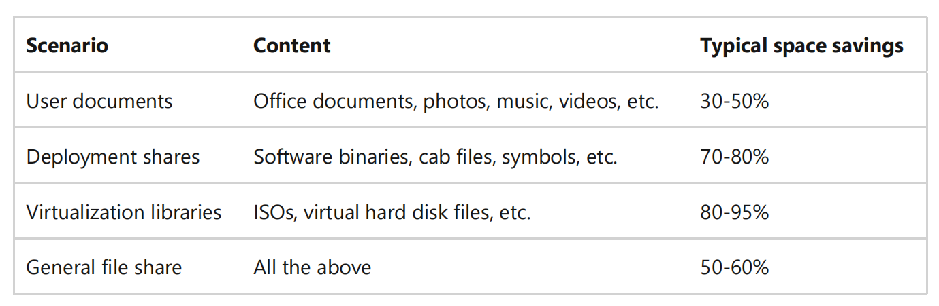
Data Deduplication
The space savings that you can gain from Data Deduplication depend on the dataset or workload on the volume.
Datasets that have high duplication could see optimization rates of up to 95%, or a 20x reduction in storage utilization.

Slide 5
Data Deduplication
Data Deduplication in Windows Server was created with the following two principles:
1. Optimization should not get in the way of writes to the disk
Data Deduplication optimizes data by using a post-processing model. All data is written unoptimized to the disk and then optimized later by Data Deduplication.
2. Optimization should not change access semantics
Users and applications that access data on an optimized volume are completely unaware that the files they are accessing have been deduplicated.

Slide 6
Data Deduplication
Once enabled for a volume, Data Deduplication runs in the background to:
Identify repeated patterns across files on that volume.
Seamlessly move those portions, or chunks, with special pointers called reparse points that point to a unique copy of that chunk.

Slide 7
Data Deduplication
This occurs in the following steps:
1. Scan the file system for files meeting the optimization policy
2. Break files into variable-size chunks.
3. Identify unique chunks.
4. Place chunks in the chunk store and optionally compress.
5. Replace the original file stream of now optimized files with a reparse point to the chunk store.

Slide 8
Data Deduplication
When optimized files are read, the file system sends the files with a reparse point to the Data Deduplication file system filter (Dedup.sys).
The filter redirects the read operation to the appropriate chunks that constitute the stream for that file in the chunk store.
Modifications to ranges of a deduplicated files get written un optimized to the disk and are optimized by the Optimization job the next time it runs.

Slide 9
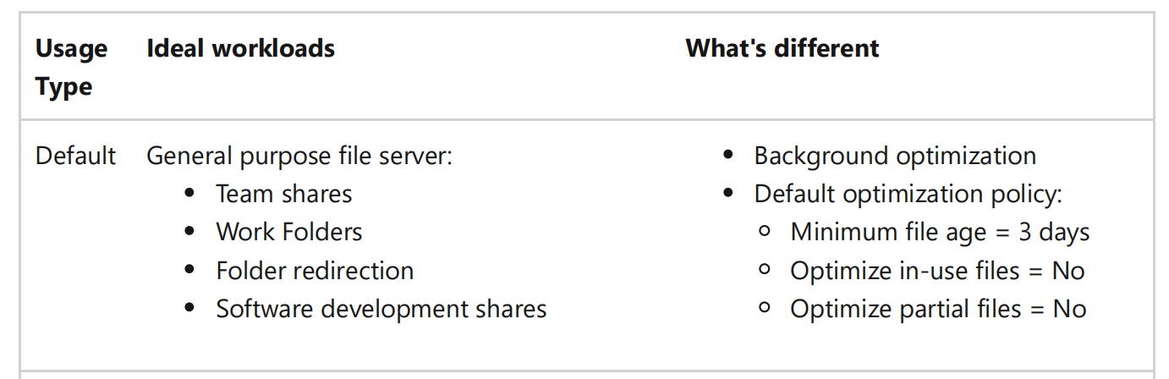
Data Deduplication
The following Usage Types provide reasonable Data Deduplication configuration for common workloads:

Slide 10
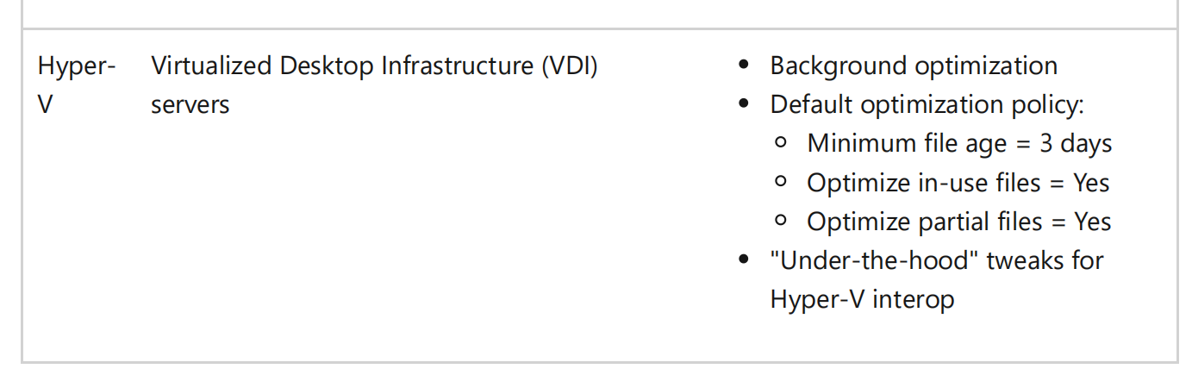
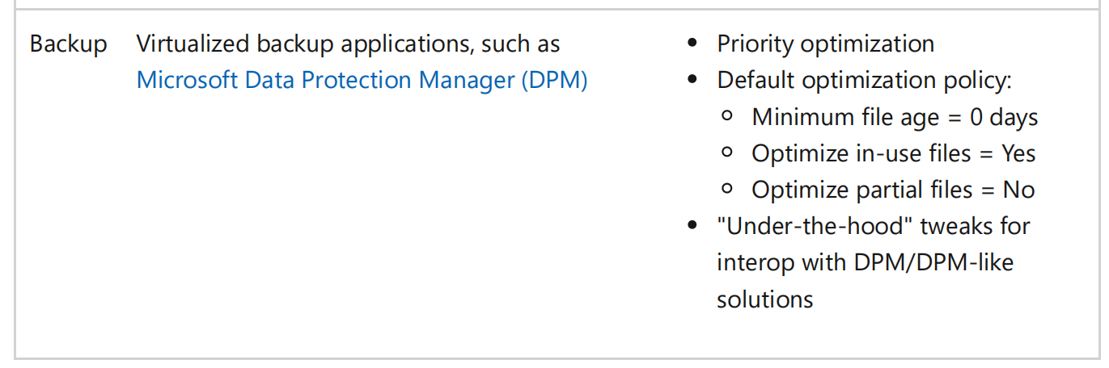
Data Deduplication

Slide 11
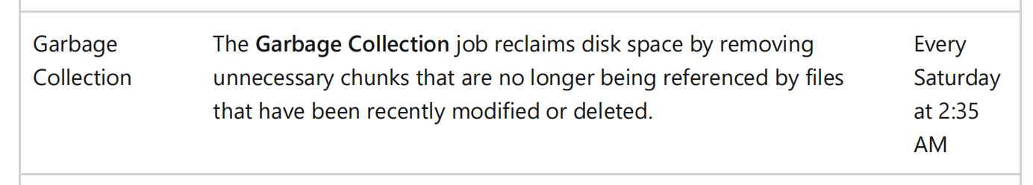
Data Deduplication
Data Deduplication uses a post-processing strategy to optimize and maintain a volume's space efficiency.

Slide 12
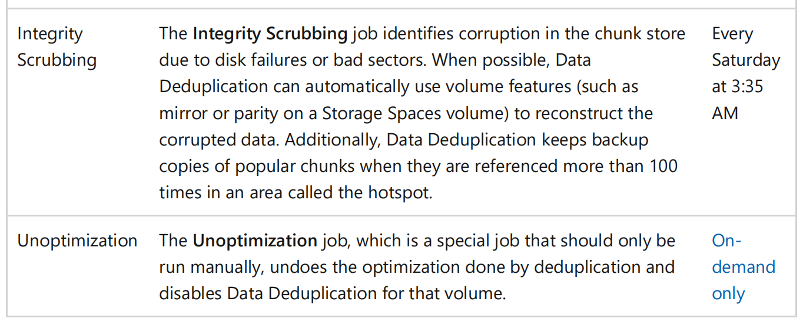
Data Deduplication

Slide 13
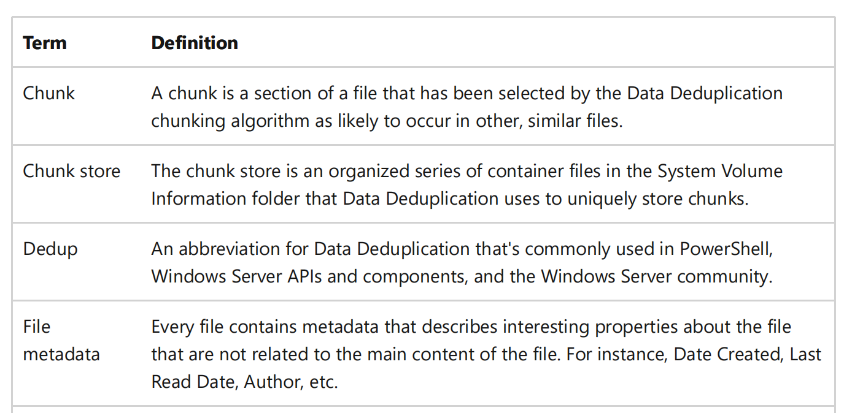
Data Deduplication
Data Deduplication terminology

Slide 14
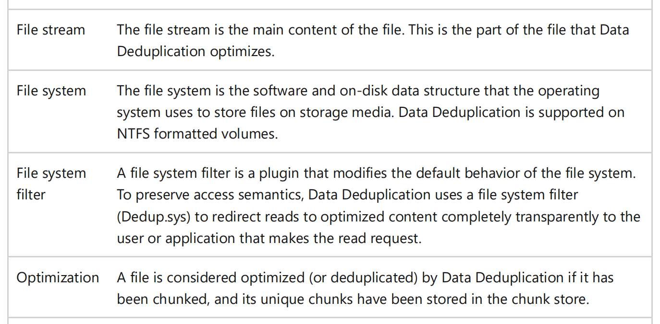
Data Deduplication

Slide 15
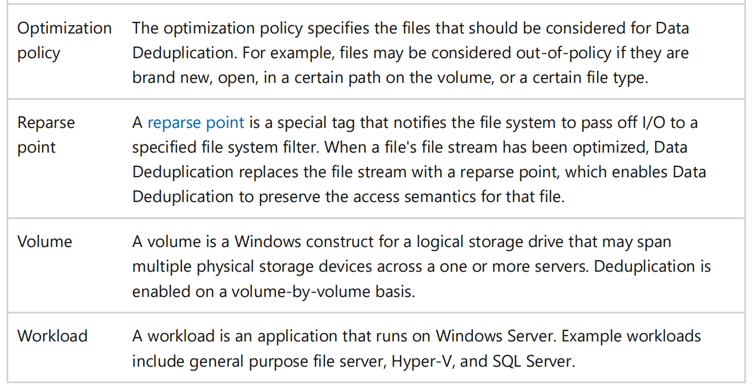
Data Deduplication

Slide 16
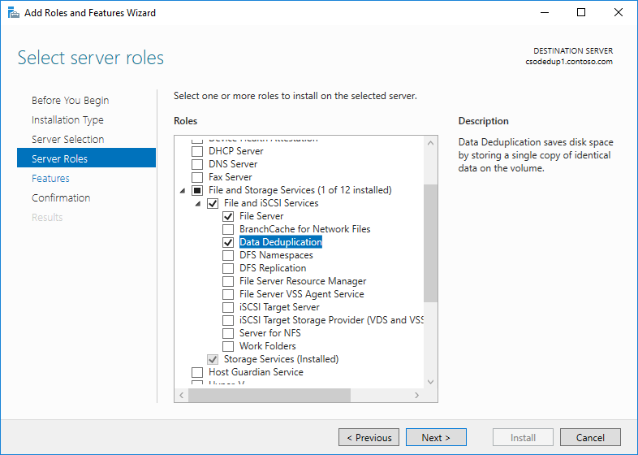
Data Deduplication
Install and enable Data Deduplication
Install Data Deduplication by using Server Manager
1. In the Add Roles and Feature wizard, select Server Roles, and then select Data Deduplication.

Slide 17
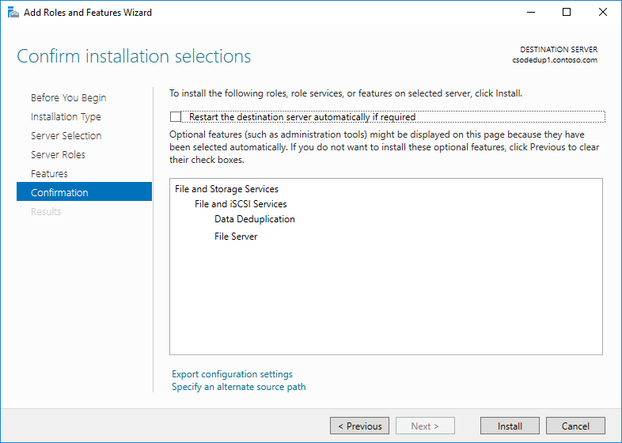
Data Deduplication
Click Next until the Install button is active, and then click Install.

Slide 18
Data Deduplication
Install Data Deduplication by using PowerShell
To install Data Deduplication, run the following PowerShell command as an administrator:
Install-WindowsFeature -Name FS-Data-Deduplication

Slide 19
Data Deduplication
Before enabling Data Deduplication for a workload, investigate how much duplication your workload's dataset has by using the Data Deduplication Savings Evaluation tool, or DDPEval.
After installing Data Deduplication, you can find this tool at C:\Windows\System32\DDPEval.exe .
DDPEval can evaluate the potential for optimization against directly connected volumes (including local drives or Cluster Shared Volumes) and mapped or unmapped network shares.

Slide 20
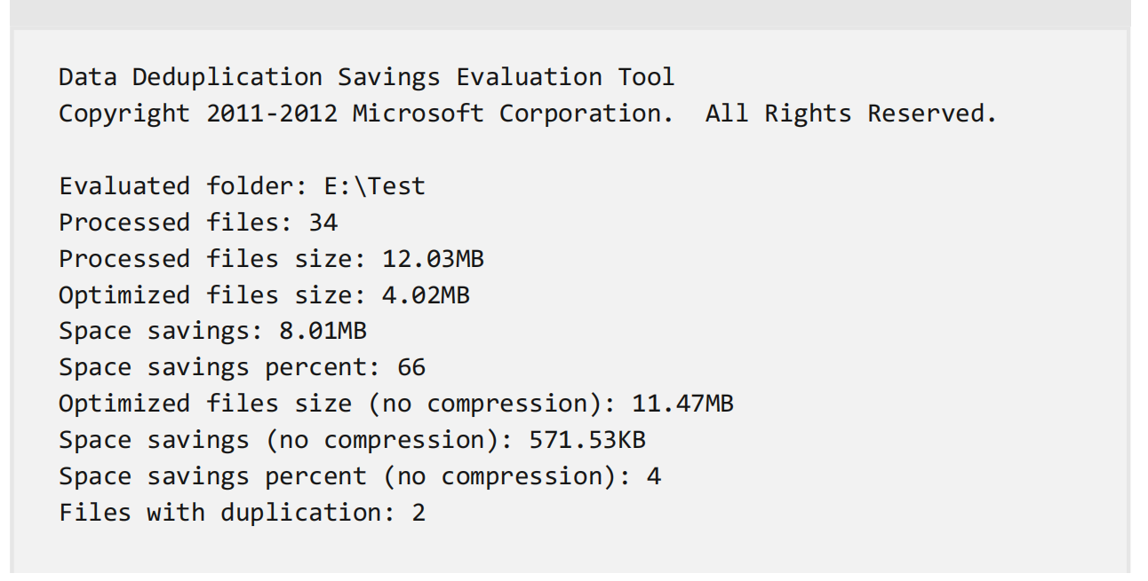
Data Deduplication
Running DDPEval.exe will return an output similar to the following:

Slide 21
Data Deduplication
Enable Data Deduplication
Before enabling Data Deduplication, you must choose the Usage Type that most closely resembles your workload.
There are three Usage Types included with Data Deduplication.
Default - tuned specifically for general purpose file servers
Hyper-V - tuned specifically for VDI servers
Backup - tuned specifically for virtualized backup applications, such as Microsoft DPM

Slide 22
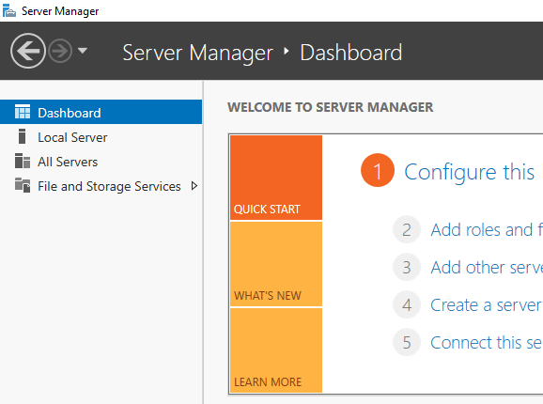
Data Deduplication
Enable Data Deduplication by using Server Manager

Slide 23
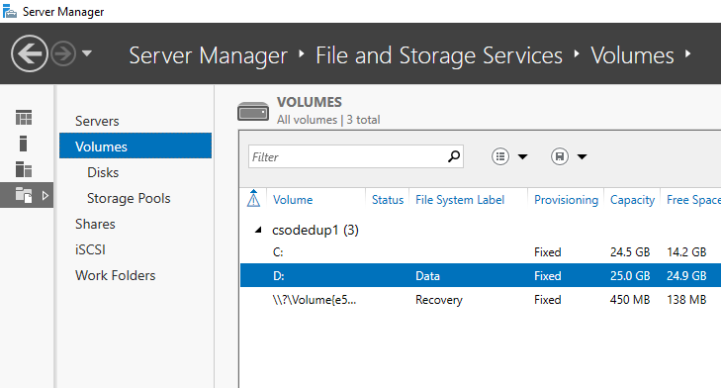
Data Deduplication
Select Volumes from File and Storage Services.

Slide 24
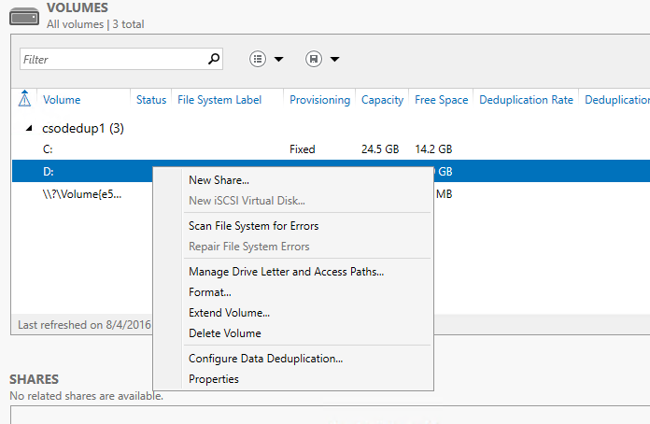
Data Deduplication
Right-click the desired volume and select Configure Data Deduplication.

Slide 25
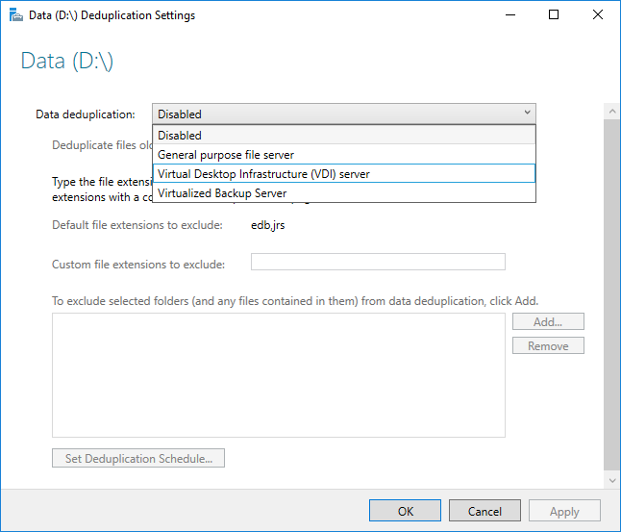
Data Deduplication
Select the desired Usage Type from the drop-down box and select OK

Slide 26
Data Deduplication
Enable Data Deduplication by using PowerShell
1. With an administrator context, run the following PowerShell command:
Enable-DedupVolume -Volume <Volume-Path> -UsageType <Selected-UsageType>

Slide 27
Questions???

Slide 28
Thank You !!!

