Slide 1

Network Load Balancing

Slide 2

Network Load Balancing
You can use NLB to manage two or more servers as a
single virtual cluster.
NLB enhances the availability and scalability of Internet server
applications such as those used on web, FTP, firewall, proxy, virtual private network (VPN), and other mission-critical servers.
The Network Load Balancing (NLB) feature distributes traffic across several servers by using the TCP/IP networking protocol.
By combining two or more computers that are
running applications into a single virtual cluster, NLB provides reliability and performance for web servers and other mission-critical servers.

Slide 3
Network Load Balancing
The servers in an NLB cluster are called hosts, and each host runs a separate copy of the server applications.
NLB distributes incoming client requests across the hosts in the
cluster.
You can configure the load that is to be handled by each host. You can also add hosts dynamically to the cluster to handle increased load.
NLB can also direct all traffic to a designated single host, which is called the default host.

Slide 4
Network Load Balancing
NLB allows all of the computers in the cluster to be addressed by the same set of IP addresses, and it maintains a set of unique, dedicated IP addresses for each host.
For load-balanced applications, when a host fails or goes offline, the load is automatically redistributed among the computers that are still operating.
When it is ready, the offline computer can transparently rejoin the cluster and regain its share of the workload, which allows the other computers in the cluster to handle less traffic.

Slide 5
Network Load Balancing
NLB is useful for ensuring that stateless applications, such as web servers running Internet Information Services (IIS), are available with minimal downtime, and that they are scalable (by adding additional servers as the load increases).
High availability
A high availability system reliably provides an acceptable level of service with minimal downtime. To provide high availability, NLB includes built-in features that can automatically:
Detect a cluster host that fails or goes offline, and then recover.
Balance the network load when hosts are added or removed.
Recover and redistribute the workload within ten seconds.

Slide 6
Network Load Balancing
Scalability
Scalability is the measure of how well a computer, service, or application can grow to meet increasing performance demands.
For NLB clusters, scalability is the ability to incrementally add one or more systems to an existing cluster when the overall load of the cluster exceeds its capabilities.
To support scalability, you can do the following with NLB:

Slide 7
Network Load Balancing
1. Balance load requests across the NLB cluster for individual TCP/IP services.
2. Support up to 32 computers in a single cluster.
3. Balance multiple server load requests (from the same client or from several clients) across multiple hosts in the cluster.
4. Add hosts to the NLB cluster as the load increases, without causing the cluster to fail.
5. Remove hosts from the cluster when the load decreases.
6. Enable high performance and low overhead through a fully pipelined
implementation. Pipelining allows requests to be sent to the NLB cluster without waiting for a response to a previous request.

Slide 8
Network Load Balancing
Manageability
To support manageability, you can do the following with NLB:
1. Manage and configure multiple NLB clusters and the cluster hosts from a single computer by using NLB Manager or the Network Load Balancing (NLB) Cmdlets in Windows PowerShell.
2. Specify the load balancing behavior for a single IP port or group of ports by using port management rules.
3. Define different port rules for each website. If you use the same set of load balanced servers for multiple applications or websites, port rules are based on the destination virtual IP address (using virtual clusters).

Slide 9
Network Load Balancing
4. Direct all client requests to a single host by using optional, single-host rules. NLBroutes client requests to a particular host that is running specific applications.
5. Block undesired network access to certain IP ports.
6. Enable Internet Group Management Protocol (IGMP) support on the cluster hosts to control switch port flooding (where incoming network packets are sent to all ports on the switch) when operating in multicast mode.
7. Start, stop, and control NLB actions remotely by using Windows PowerShell commands or scripts.
8. View the Windows Event Log to check NLB events. NLB logs all actions and cluster changes in the event log.

Slide 10
Network Load Balancing
Important functionality
NLB is installed as a standard Windows Server networking driver component.
Its operations are transparent to the TCP/IP networking stack.
The following figure shows the relationship between NLB and other software components in a typical configuration.

Slide 11
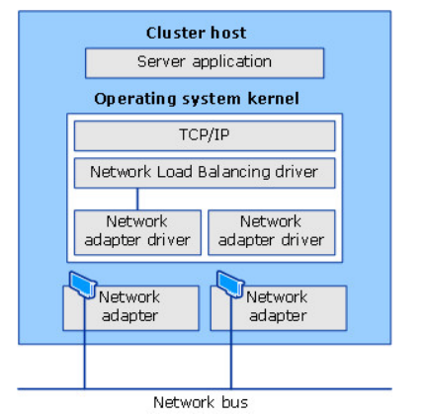
Network Load Balancing
Following are the primary features of NLB.-
->Requires no hardware changes to run.
->Provides Network Load Balancing Tools to configure and manage multiple clusters and all of the hosts from a single remote or local computer.
->Enables clients to access the cluster by using a single, logical Internet name and virtual IP address, which is known as the cluster IP address.

Slide 12
Network Load Balancing
Enables NLB to be bound to multiple network adapters, which enables you to configure multiple independent clusters on each host. Support for multiple network adapters differs from virtual clusters in that virtual clusters allow you to configure multiple clusters on a single network adapter.
Requires no modifications to server applications so that they can run in an NLB cluster.
Can be configured to automatically add a host to the cluster if that cluster host fails and is subsequently brought back online. The added host can start handling new server requests from clients.

Slide 13
Network Load Balancing
Enables you to take computers offline for preventive maintenance without disturbing the cluster operations on the other hosts.
Hardware requirements
Following are the hardware requirements to run an NLB cluster.
>All hosts in the cluster must reside on the same subnet.
>There is no restriction on the number of network adapters on each host, and different hosts can have a different number of adapters.
>Within each cluster, all network adapters must be either multicast or unicast.
> NLBdoes not support a mixed environment of multicast and unicast within a single cluster.
>If you use the unicast mode, the network adapter that is used to handle client-to cluster traffic must support changing its media access control (MAC) address

Slide 14
Network Load Balancing
Software requirements
Following are the software requirements to run an NLB cluster.
Only TCP/IP can be used on the adapter for which NLB is enabled on each host.
Do not add any other protocols (for example, IPX) to this adapter.
The IP addresses of the servers in the cluster must be static.
NLB does not support Dynamic Host Configuration Protocol (DHCP). NLB disables DHCP on each interface that it configures.

Slide 15
Network Load Balancing
Installation
You can install NLB by using either Server Manager or the Windows PowerShell commands for NLB.
Optionally you can install the Network Load Balancing Tools to manage a local or remote NLB cluster.
The tools include Network Load Balancing Manager and the NLB
Windows PowerShell commands.
Make sure to install the appliation like IIS for which NLB will be used, before the installation of NLB on all nodes.

Slide 16
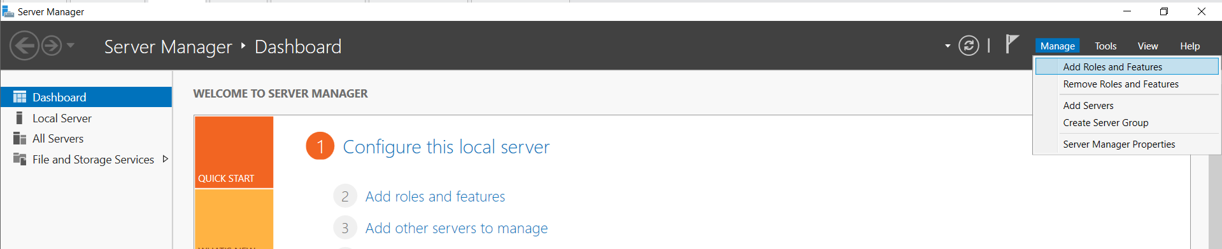
Network Load Balancing
Installation with Server Manager
In the Server Manager window click Manage and select Add Roles and Features.

Slide 17
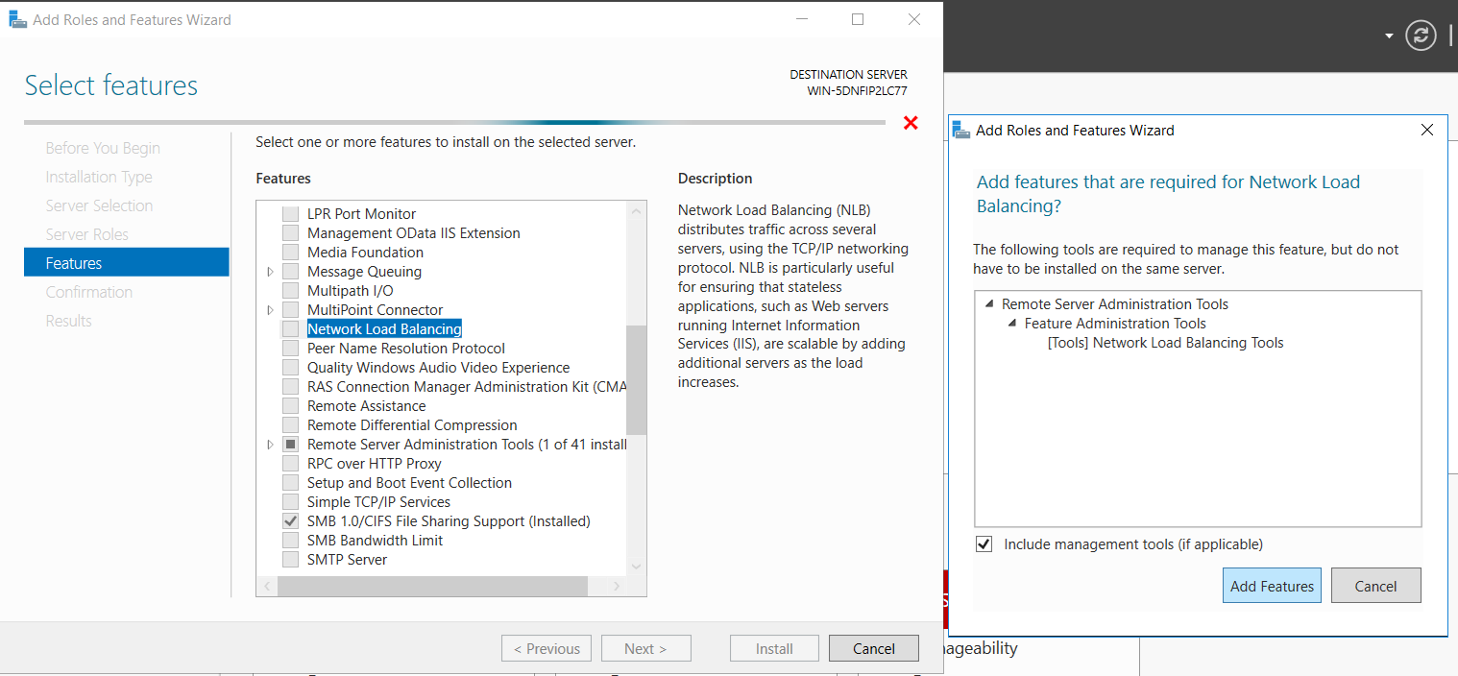
Network Load Balancing
In the wizard that starts click Next till you reach the Add Features window. In that search for Network Load Balancing and select the check box. A separate window opens as shown below.

Slide 18
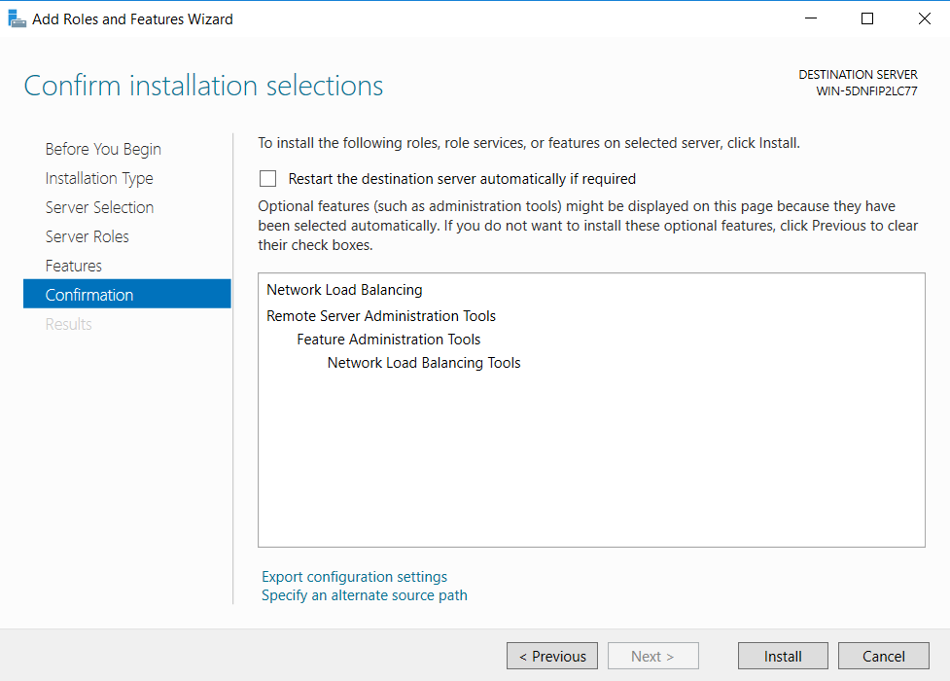
Network Load Balancing
Click Add features button. The window will close. In the main window click Next. The following window will open. Click Install button to install the Network Load Balancing feature.

Slide 19
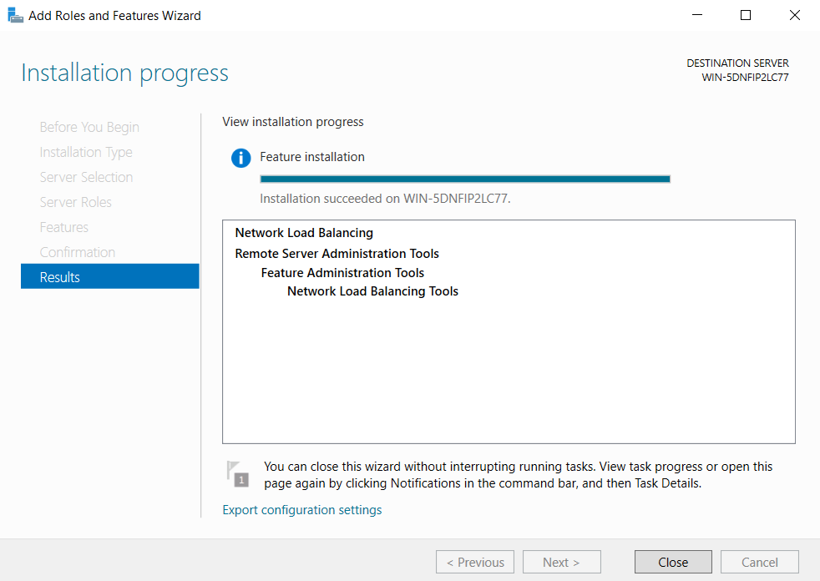
Network Load Balancing
Once the installation is complete, click close.

Slide 20
Network Load Balancing
Installation with Windows PowerShell
To install NLB by using Windows PowerShell, run the following command at an elevated Windows PowerShell prompt on the computer where you want to install NLB.
PowerShell command
Install-WindowsFeature NLB -IncludeManagementTools
After installation is complete, no restart of the computer is required.
Install NLB feature on all nodes of the cluster using one of the method.

Slide 21
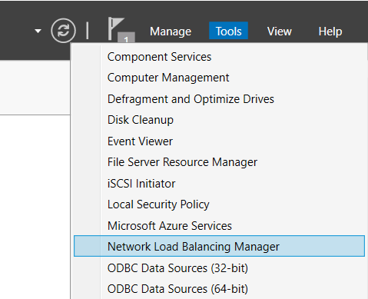
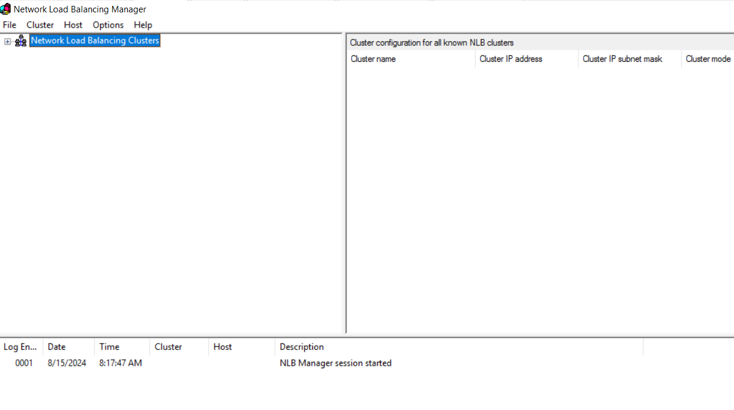
Network Load Balancing
The NLB can be managed using the Network Load Balancing Manager. The utility is available in Server Manager below Tools as shown below.

Slide 22
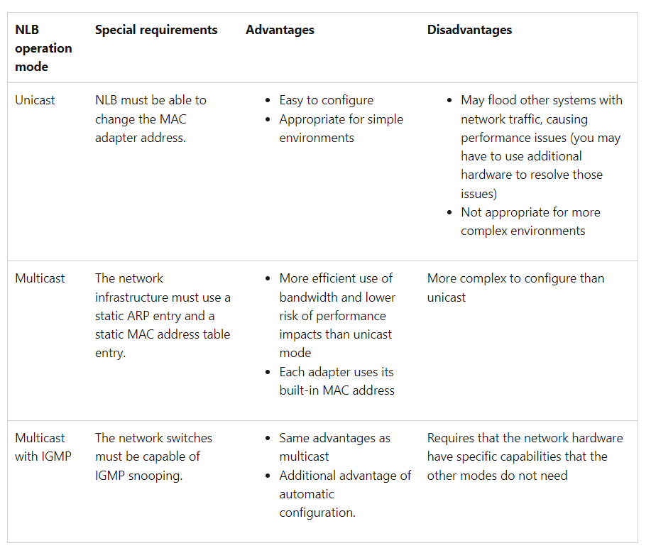
Network Load Balancing
NLB Operation Modes

Slide 23
Network Load Balancing
You can configure an NLB cluster in one of three operation modes: Unicast, multicast, or IMGP multicast.
All three modes work very well if your infrastructure is correctly configured.
Unicast
Unicast is the simplest operation mode to configure. In theory, you don't have to do anything else in your network infrastructure.
In unicast mode, NLB uses the NLB MAC address to replace the original hardware MAC address of each adapter in each node of the cluster.

Slide 24
Network Load Balancing
Because multiple adapters now have the same address, any physical switches in the network can no longer correctly maintain their MAC address tables.
Because they cannot determine which traffic goes to which switch port, the switches start sending all traffic to all ports to make sure that the traffic reaches its destination.
This is known as a unicast flood scenario.
A unicast flood can seriously affect the network performance. In addition to the regular network traffic, every NLB node sends out a heartbeat packets (each heartbeat packet contains about 1500 bytes of data).

Slide 25
Network Load Balancing
By default, a node sends a heartbeat packet each second and waits for five of those packets to be received until it considers the node as converged.
In a unicast flood situation, any switches rebroadcast this heartbeat traffic to all switch ports just like the regular network traffic.
For example, if your network has a 24-port or 48-port switch, and only two of those ports connect to NLB nodes, the switch may end up broadcasting significant network traffic to 22 (or 46) servers that don't need it.

Slide 26
Network Load Balancing
Multicast
Multicast mode differs from unicast mode.
Instead of changing the MAC addresses on the network adapters, NLB converts the NLB virtual IP (VIP) address to an NLB multicast MAC address.
This MAC has the format of 03-BF-XX-XX-XX-XX. NLB also makes sure that the cluster's primary IP address resolves to this multicast address as part of the Address Resolution Protocol (ARP).
Although the individual network adapters retain their original MAC addresses, the NLB traffic is addressed to the NLB multicast MAC address.

Slide 27
Network Load Balancing
IGMP multicast
To use IGMP multicast, the network switches must be capable of IGMP snooping.
This mode is basically the same as multicast mode, except that the switches can automatically build their MAC address tables in this mode.
When you enable IGMP multicast, the NLB nodes send IGMP Join messages to the 239.255.x.y multicast address (in this address, x.y represents the last two octets of the NLB VIP).
For example, if the NLB VIP is 10.0.0.1, the multicast address for IGMP Join messages is 239.244.0.1. These messages indicate the group membership of the NLB nodes. The switches use this information to configure the MAC address table.

Slide 28
THANK YOU

