Slide 1
Buffer Overflow

Slide 2
Buffer Overflow
A buffer is a temporary storage location in RAM that is used to hold data so that the CPU can manipulate it before writing it back to the disc.
Buffers have a size limit.
This type of attack loads the buffer with more data that it can hold.
This causes the buffer to overflow and corrupt the data it holds.

Slide 3
Buffer Overflow
A buffer has a specified data storage capacity, and if the data copied into the buffer exceeds this capacity, the buffer overflows.
Buffers are developed to maintain a finite amount of data, so extra information may overflow into neighboring buffers, destroying or overwriting legal data.
The execution stack of a Web application is damaged when a buffer overflows.

Slide 4
Buffer Overflow
An attacker can then send specially crafted input to the Web application, causing the Web application to execute the arbitrary code and allowing the attacker to successfully take over the machine.
Buffer overflows are not easy to discover, and even upon discovery they are difficult to exploit.

Slide 5
Buffer Overflow
However, a successful buffer overflow attack can grant access to a staggering array of products and components.
The format string attack is a similar attack.
Both Web applications and server products have the potential for buffer overflow errors.
Any buffer overflow vulnerabilities found in the server products are usually commonly known.

Slide 6
Buffer Overflow
When Web applications use those libraries, they become vulnerable to possible buffer overflow attacks.
Custom Web application code, through which a Web application is passed, may also contain buffer overflow potential.
Buffer overflow errors in a custom Web application are not easily detected.

Slide 7
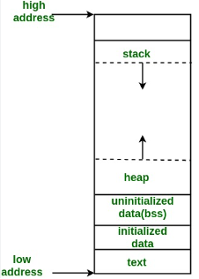
Buffer Overflow
A typical layout of a C program

Slide 8
Buffer Overflow
When dealing with buffer overflows, there are basically three things that can happen.
The first is denial of service. It is really easy to get a segmentation fault when dealing with process memory.
However, it’s possible that is the best thing that can happen to a software developer in this situation, because a crashed program will draw attention.

Slide 9
Buffer Overflow
The other alternatives are silent and much worse.
The second thing that can happen when a buffer overflow occurs is that the eip can be controlled to execute malicious code at the user level of access.
This happens when the vulnerable program is running at the user level of privilege.

Slide 10
Buffer Overflow
The third and absolutely worst thing that can happen when a buffer overflow occurs is that the eip can be controlled to execute malicious code at the system or root level.

Slide 11
Buffer Overflow
The basic concept of buffer overflow exploits is to overflow a vulnerable buffer and change eip for malicious purposes. Remember, eip points to the next instruction to be executed.
A copy of eip is saved on the stack as part of calling a function in order to be able to continue with the command after the call when the function completes.

Slide 12
Buffer Overflow
If you can influence the saved eip value, when the function returns, the corrupted value of eip will be popped off the stack into the register (eip) and be executed.
Components of the Exploit
To build an effective exploit in a buffer overflow situation, you need to create a larger buffer than the program is expecting, using the following components.

Slide 13
Buffer Overflow
NOP Sled
In assembly code, the NOP command (pronounced “No-op”) simply means to do nothing but move to the next command (NO OPeration).
This is used in assembly code by optimizing compilers by padding code blocks to align with word boundaries.
Hackers have learned to use NOPs as well for padding.

Slide 14
Buffer Overflow
When placed at the front of an exploit buffer, it is called a NOP sled.
If eip is pointed to a NOP sled, the processor will ride the sled right into the next component.
On x86 systems, the 0x90 opcode represents NOP.
There are actually many more, but 0x90 is the most commonly used.

Slide 15
Buffer Overflow
Shellcode
Shellcode is the term reserved for machine code that will do the hacker’s bidding.
Orig inally, the term was coined because the purpose of the malicious code was to provide a simple shell to the attacker.
Since then, the term has evolved to encompass code that is used to do much more than provide a shell, such as to elevate privileges or to execute a single command on the remote system.

Slide 16
Buffer Overflow
Shellcode
The important thing to realize here is that shell code is actually binary, often represented in hexadecimal form.
You can get shellcodes from shell-storm or from exploit-db.

Slide 17
Buffer Overflow
Countermeasures
Validate input length in forms using server-side code.
In programs, perform bounds checking and be extra carerful when using for and while loops to copy data.
Avoid functions that do not perform bounds checking and substitute them with functions that do.

Slide 18
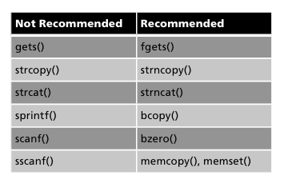
Buffer Overflow

Slide 19
Thank you!

