Slide 1
Compare two cities using data from four square API

Slide 2
Introduction
When moving across cities, many people face challenge in terms of how the new city will be and what to expect after they move.
If the move is to a different state and they have not been to the city before and hence won’t know what to expect after the move.
This analysis will bring the data from different sources, Wikipedia, Foursquare, Weather.com etc to compare 2 cities side-by-side and provide insights to the person, so that they can envision what to expect after the move and decide whether the move is worth or not.

Slide 3
Data Acquisition
Data Source | Data to be extracted | Originally Planned | Included in Final Project
Wikipedia/other resources | Population (Ethnicity, if available) | Yes | Yes
Four Square | Venues in the city and comparison. Cluster of venues and their comparison | Yes | Yes
Weather.com | Weather data for comparison | Yes | No
Wikipedia/Google Maps | Point of interest around the city | Yes | No
Zillow | Range of rent in the city and average rent. | Yes | No

Slide 4
Data Acquisition challenges
Data Source | Challenge
Demographic Information | Available on Wikipedia, but it is not easy to consume this data.
Weather.com | Time Constraint
Wikipedia/Google Maps | Time Constraint
Zillow | No Free Version Available.

Slide 5
METHODOLOGY
Data Type | Comparison
CITIES CHOOSEN | Based on authors interest, two cities Fremont (California, USA) and Saskatoon (Saskatchewan, Canada) were chosen across US and Canada for the comparison.
POPULATION METRICS | This type of data can be directly compared
VENUE DATA | Comparison can be done in following ways: 1 – Compare the clusters of venues using Cosine Similarity 2 – Compare the total number of venues 3 – Compare the Common venues across the cities

Slide 6
METHODOLOGY
CLUSTERING
WIKIPEDIA DATA
COORDINATES USING GEOCODE
VENUES USING FOURSQUARE API
COSINE SIMILARITY

Slide 7
SIMILARITY INDEX (Method 1)
Based on the venue data extracted from the FourSquare API, a similarity index was derived using the Cosine Similarity method.
These 2 cities appear to be similar from venues perspective.
Since the Cosine Similarity doesn’t take into consideration the frequency of venues – this score only tells similarity between the cities in terms of types of venues i.e. the venues overlap between these cities, but not the frequency.
57%
Similarity Index

Slide 8
SIMILARITY INDEX (Method 2)
Since Method 1 didn’t account for the frequency of the venues, another cosine similarity was applied to frequency data.
This similarity index represents the correct picture and tells that these 2 cities are not very similar to each other in terms of frequency of the venues.
34%
Similarity Index

Slide 9
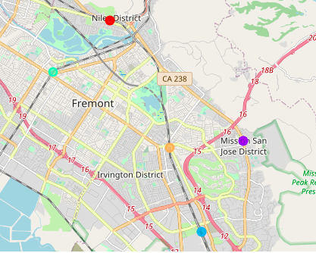
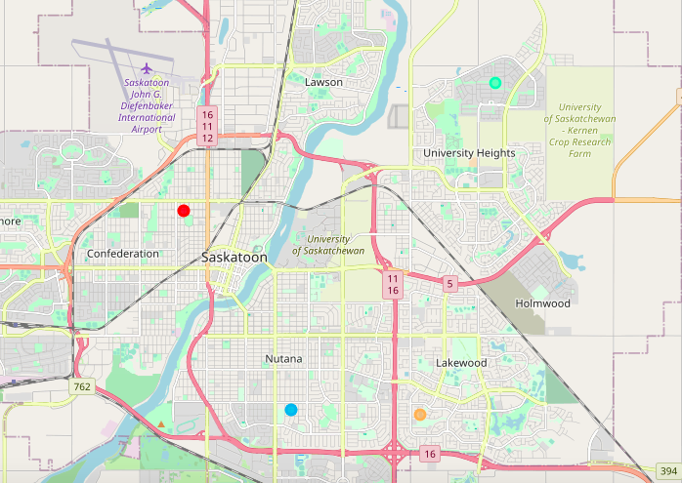
CITY COMPARISON
 | City 1 (Fremont) | City 2 (Saskatoon)
VENUE CLUSTERS
POPULATION | 246,376 | 214,089
POPULATION DENSITY | 2,797/sq mi | 2,400/sq mi
The 2 cities are very similar in terms of total population and population density.
The cities have similar type of venue clusters.

Slide 10
Venue COMPARISON
Neighborhood | Evergreen | Adelaide | Mayfair | Lakeview | Centerville | Niles | Irvington | Warm Springs | Mission San Jose
City | Saskatoon | Saskatoon | Saskatoon | Saskatoon | Fremont | Fremont | Fremont | Fremont | Fremont
Cluster Labels | 3 | 2 | 0 | 4 | 3 | 0 | 4 | 2 | 1
1st Most Common Venue | Coffee Shop | Pub | Hotel | Pub | Coffee Shop | Park | Coffee Shop | Coffee Shop | Coffee Shop
2nd Most Common Venue | Hotel | Coffee Shop | Restaurant | Coffee Shop | Grocery Store | Coffee Shop | Grocery Store | Fast Food Restaurant | Ice Cream Shop
3rd Most Common Venue | Restaurant | Café | Coffee Shop | Café | Sushi Restaurant | Grocery Store | Ice Cream Shop | Gym | Trail
4th Most Common Venue | Bakery | Grocery Store | Pub | Pizza Place | Bakery | Breakfast Spot | Fast Food Restaurant | Grocery Store | Bakery
5th Most Common Venue | Pub | Pizza Place | Café | Mexican Restaurant | Ice Cream Shop | Sushi Restaurant | Gym | Sushi Restaurant | Fast Food Restaurant
6th Most Common Venue | Asian Restaurant | Restaurant | Bakery | Restaurant | Park | Bakery | Pizza Place | Juice Bar | Grocery Store
7th Most Common Venue | Café | Mexican Restaurant | Steakhouse | American Restaurant | Thai Restaurant | Fast Food Restaurant | Trail | Trail | Gym
8th Most Common Venue | Pizza Place | Sandwich Place | Pizza Place | Bakery | Breakfast Spot | Chinese Restaurant | Bakery | Thai Restaurant | Mexican Restaurant
9th Most Common Venue | American Restaurant | Breakfast Spot | Asian Restaurant | Hotel | Trail | Mexican Restaurant | Falafel Restaurant | Bakery | Pizza Place
10th Most Common Venue | Grocery Store | Bookstore | American Restaurant | Breakfast Spot | Mexican Restaurant | Thai Restaurant | Park | Mexican Restaurant | Falafel Restaurant
The different neighbors in these cities can be allocated to each of the cluster identified, except cluster 1.

Slide 11
Top 10 Venues
City | Fremont, California, USA
Coffee Shop | 34
Grocery Store | 24
Park | 19
Ice Cream Shop | 19
Bakery | 18
Fast Food Restaurant | 17
Trail | 15
Sushi Restaurant | 15
Thai Restaurant | 14
Mexican Restaurant | 13
City | Saskatoon, Saskatchewan, Canada
Coffee Shop | 18
Pub | 16
Hotel | 14
Café | 14
Restaurant | 14
Bakery | 12
Pizza Place | 12
American Restaurant | 10
Grocery Store | 9
Asian Restaurant | 9
In terms of venues, both cities have coffee shops as the top venue.
In terms of composition of the top 10 venues, both cities are quite different. For example, Fremont has Park, different types of restaurant and no hotels; Saskatchewan has hotel, Pizza Place and Pubs.

Slide 12
Top Venues NOT in SASKATOON
City | Fremont, California, USA | Saskatoon, Saskatchewan, Canada
Park | 19 | 0
Sushi Restaurant | 15 | 0
Falafel Restaurant | 12 | 0
Pet Store | 10 | 0
Lake | 7 | 0
Spa | 7 | 0
Dessert Shop | 6 | 0
Donut Shop | 6 | 0
Japanese Restaurant | 6 | 0
Juice Bar | 6 | 0
Shanghai Restaurant | 6 | 0
Burmese Restaurant | 5 | 0
Dog Run | 5 | 0
Library | 5 | 0
There are many venues that SASKATOON city lacks compared to Fremont. Most prominently – Parks, Sushi Restaurant, Falafal Restaurant, Pet Stores, Lake and Spa.

Slide 13
Top Venues NOT in FREMONT
City | Fremont, California, USA | Saskatoon, Saskatchewan, Canada
Steakhouse | 0 | 8
Gluten-free Restaurant | 0 | 5
Bar | 0 | 4
Brazilian Restaurant | 0 | 4
Cajun / Creole Restaurant | 0 | 4
Caribbean Restaurant | 0 | 4
Cheese Shop | 0 | 4
Gift Shop | 0 | 4
Indie Movie Theater | 0 | 4
Italian Restaurant | 0 | 4
New American Restaurant | 0 | 4
Zoo | 0 | 4
Gastropub | 0 | 3
Golf Course | 0 | 3
Museum | 0 | 3
There are many venues that FREMONT city lacks compared to Saskatoon. Most prominently – Steakhouse, Gluten-Free Restaurant, Bar, and Brazilian, Cajun, and Caribbean Restaurants.

Slide 14
CONCLUSION AND FUTURE
Using the data and analytics, the overall comparison across the cities was made easier as there was less noise and more meaningful information.
More information can be included such as demographics, weather and point of interests (as originally planned) between the cities. However, the data is not available in easy to consume format and more work is required to make this data available.
Specifically, data across different countries are available on different platforms in different formats – making the data acquisition a time consuming issue.
FUTURE: The original idea behind this project was to convert this into a tool that can be made available to general public. However, in current state of data, which is not easily consumable, it is not possible to make this available in tool format. In future, if this data is made available easily, the comparison using this method can be enhanced and made available in easy to consume format.
Furthermore, capability to compare more than 2 cities can also be added when data is easily available.
Similarity index can be derived separately for other comparison points such as ethnicity, point of interest etc.
A final Similarity Index can be derived based aggregation of similarity indices on each dimension.

