Slide 1
Toronto City Analysis

Slide 2
1. Introduction
2. Analysis
3. Recommendations
Contents of the presentation

Slide 3
The idea is to explore options to setup a new office space in Toronto.
Introduction

Slide 4
Analysis
Toronto City data was explored for
Existing Head Offices of various companies in the areas nearby Toronto
Last years Crime data in the neighborhoods of Toronto.

Slide 5
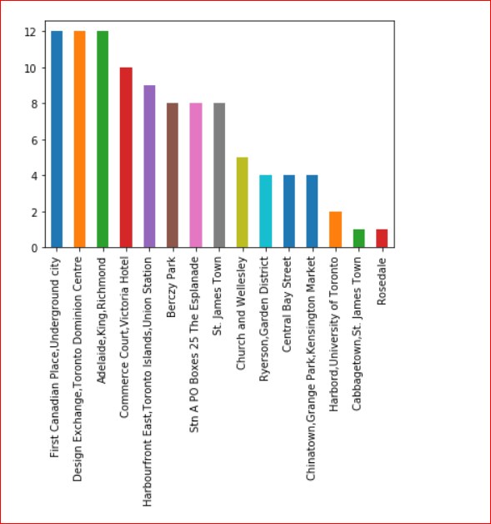
Analysis
The following table shows number of Head Offices of Companies in the Neighborhoods of Toronto.

Slide 6
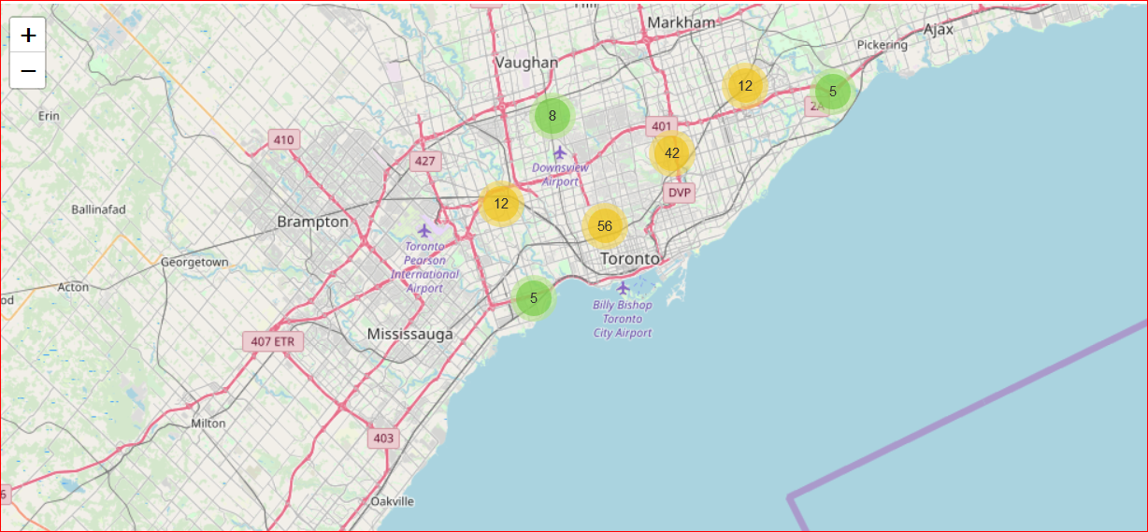
Analysis
The following map shows Crime numbers in various areas during 2017

Slide 7
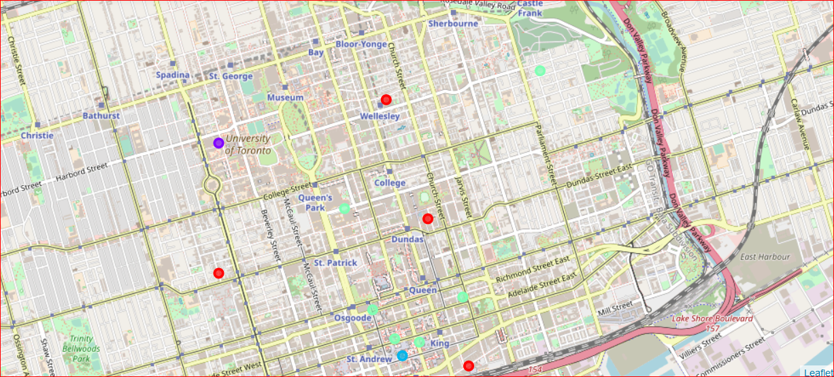
Analysis
The following map shows Clustered data for the Companies

Slide 8
Recommendations
Based on the data analysis , the following is the recommendation
Setup Office space in areas nearby University of Toronto

