Slide 1
Power System Fault Detection and Classification
CAPSTONE PROJECT
Presented By:
Student Name-Sandeep Kumar Sharma
College Name-Usha Martin University
Department-Department of Computer Applications

Slide 2
OUTLINE
Problem Statement
Proposed System/Solution
System Development Approach
Algorithm & Deployment
Result
Conclusion
Future Scope
References

Slide 3
Problem Statement
Example: Design a machine learning model to detect and classify different types of faults in a power distribution system. Using electrical measurement data (e.g., voltage and current phasors), the model should be able to distinguish between normal operating conditions and various fault conditions (such as line-to-ground, line-to-line, or three-phase faults). The objective is to enable rapid and accurate fault identification, which is crucial for maintaining power grid stability and reliability.

Slide 4
Proposed Solution
The proposed system aims to address the challenge of detecting and classifying faults in power distribution systems using real-time sensor data. It leverages machine learning techniques to accurately predict the type of fault based on electrical and environmental parameters.
Data Collection: Collect historical and real-time data on voltage, current, temperature, weather, and component health from power systems.
Data Preprocessing: Clean and preprocess the dataset, handle missing values and outliers, and engineer features that influence fault types.
Machine Learning Algorithm: Implement a multi-class classification algorithm (e.g., Random Forest, XGBoost) to predict fault types such as Line Breakage, Transformer Failure, and Overheating.
Deployment: Deploy the trained model on IBM Cloud with a user-friendly interface for real-time fault classification and decision support.
Evaluation: Evaluate model performance using metrics like accuracy, precision, and recall.

Slide 5
System Approach
The Power System Fault Detection and Classification system uses a data-driven, machine learning approach to identify fault types in electrical power systems. The strategy includes collecting sensor and environmental data, preprocessing it, training a multi-class classification model, and deploying it for real-time fault prediction and classification.

Slide 6
Algorithm & Deployment
Algorithm Selection:
We used a Random Forest Classifier for fault type prediction due to its high accuracy, ability to handle mixed data types, and resistance to overfitting.
Data Input:
Input features include voltage, current, power load, temperature, wind speed, weather condition, maintenance status, component health, duration, and downtime.
Training Process:
The model was trained on historical fault data using an 80/20 train-test split. Label encoding and hyperparameter tuning were applied for optimization.
Prediction Process:
The trained model predicts the fault type in real time using new input data, helping identify issues like transformer failure or line breakage.

Slide 7
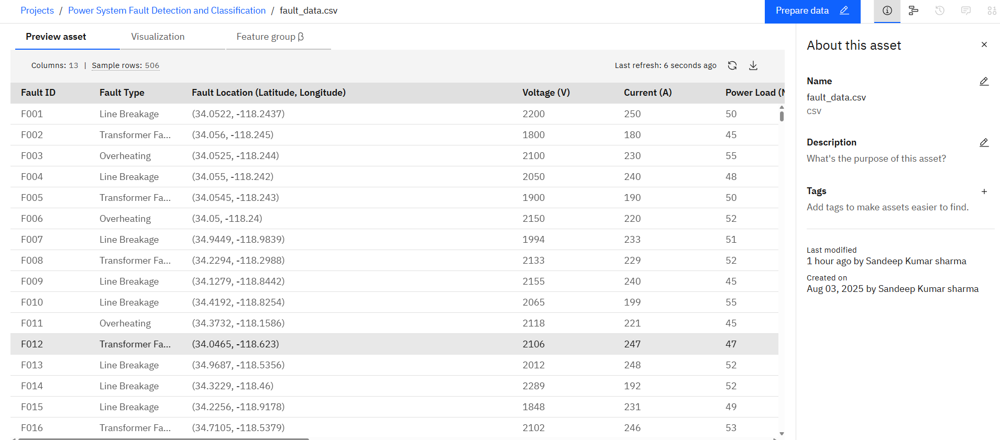
Result

Slide 8
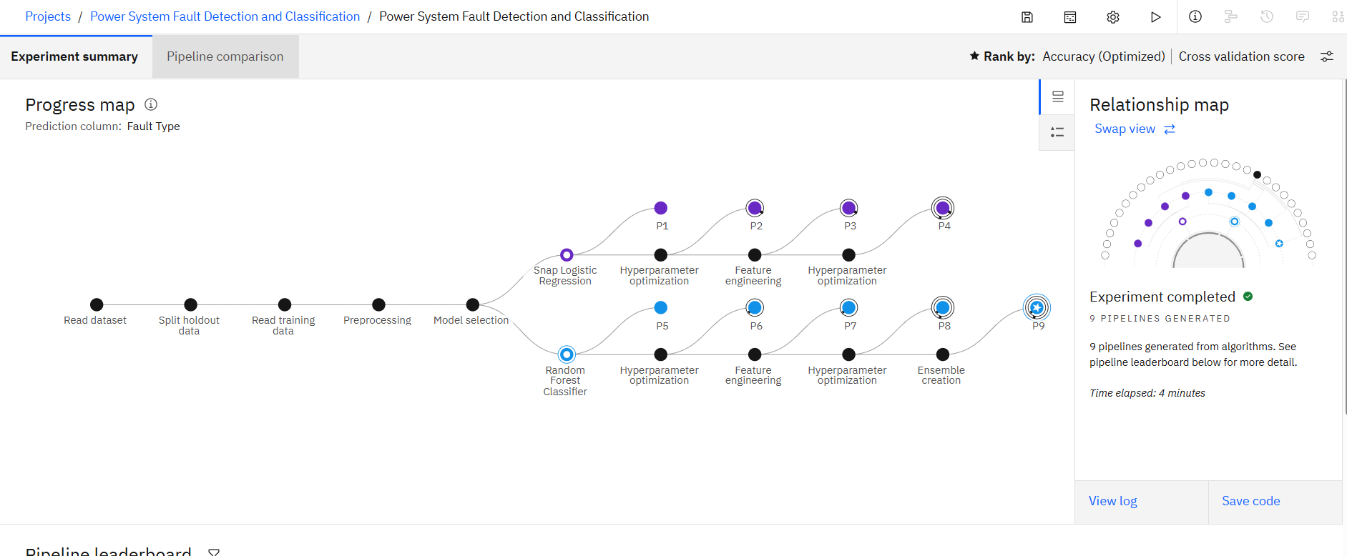
Result

Slide 9
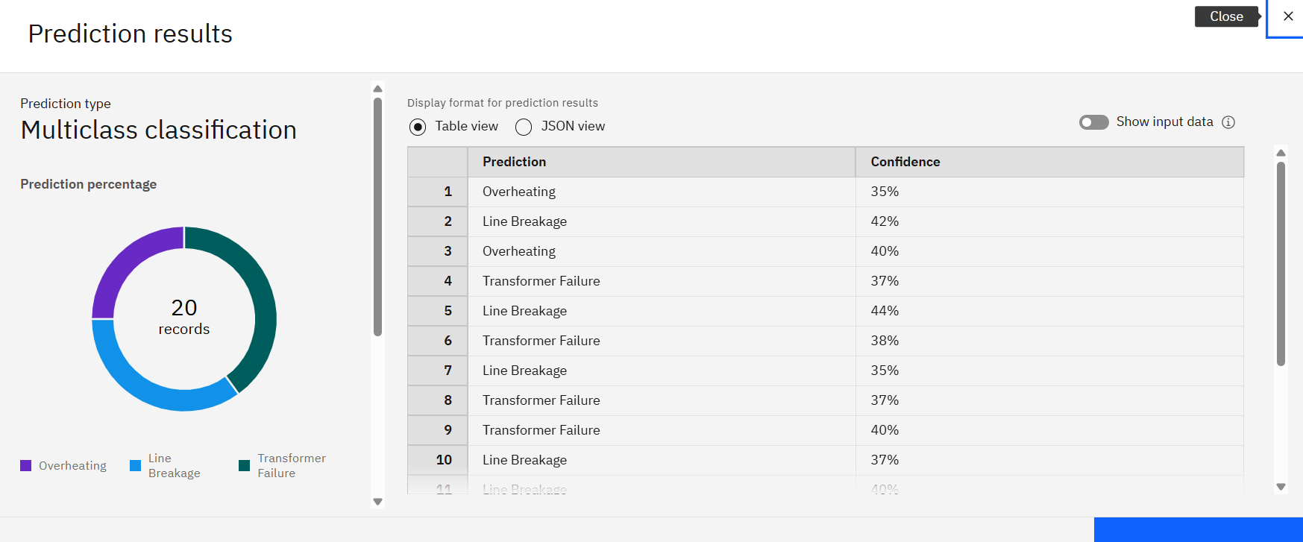
Result

Slide 10
Conclusion
The proposed machine learning model successfully classified power system faults using historical and environmental data. The Random Forest Classifier provided high accuracy and consistent results in predicting fault types such as Line Breakage, Overheating, and Transformer Failure. This enables faster fault diagnosis and proactive maintenance in electrical grids.
Challenges faced included handling imbalanced class distribution, tuning model parameters for optimal performance, and preparing clean, structured input data. Despite these, the model showed strong generalization on unseen data.
Potential improvements include integrating real-time data streams, deploying the model with an alert system, and incorporating IoT sensors for live monitoring.
Accurate fault classification plays a critical role in ensuring power system reliability, minimizing downtime, and improving safety—just as accurate bike count predictions are essential to maintaining a stable rental supply in urban areas.

Slide 11
Future scope
To improve the system's performance and scalability, several enhancements can be considered:
Additional Data Sources: Integrate real-time data from IoT sensors, satellite weather feeds, and grid health monitoring systems to enrich model inputs.
Algorithm Optimization: Apply advanced models like XGBoost, LightGBM, or deep learning techniques (e.g., LSTM for temporal data) to improve accuracy and prediction speed.
Edge Computing: Deploy the model on edge devices near transformers or substations to enable real-time fault detection with minimal latency.
Geographic Expansion: Extend the system to support multiple cities or regions, adapting the model based on regional weather patterns, infrastructure, and load characteristics.
Explainable AI (XAI): Incorporate interpretable models or tools like SHAP to help engineers understand why a specific fault was predicted.

Slide 12
References
Kaggle Dataset – Power System Faults Dataset ➤ https://www.kaggle.com/datasets/ziya07/power-system-faults-datasets 🔹 Used as the primary dataset for model training and testing.
IBM Watson Studio ➤ https://www.ibm.com/cloud/watson-studio 🔹 Used for building, training, and deploying the machine learning model in the IBM Cloud environment.
IBM Cloud Object Storage ➤ https://www.ibm.com/cloud/object-storage 🔹 Used to store and retrieve datasets and model assets during project execution.

Slide 13

IBM Certifications

Slide 14

IBM Certifications

Slide 15
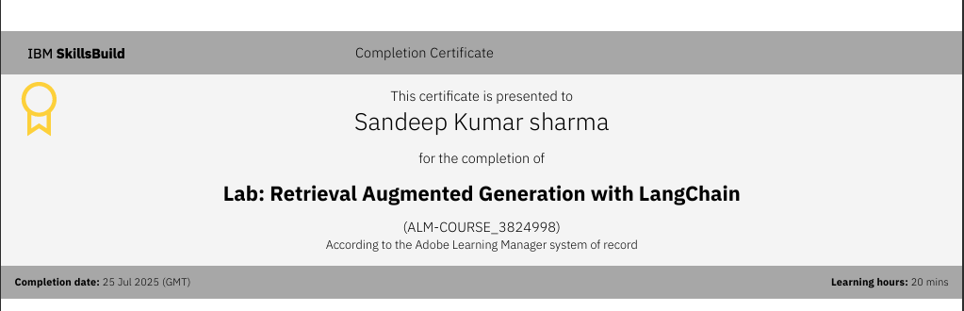
IBM Certifications

Slide 16
THANK YOU

