Slide 1
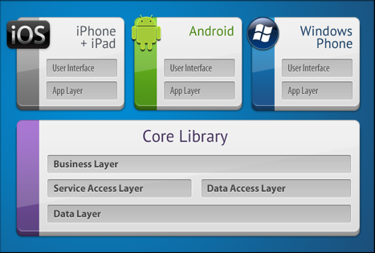
Cross Platform System
Single Layout
Shared Code
Native Execution
https://developer.xamarin.com/guides/cross-platform/application_fundamentals/building_cross_platform_applications/part_1_-_understanding_the_xamarin_mobile_platform/
https://developer.xamarin.com/guides/cross-platform/application_fundamentals/building_cross_platform_applications/part_1_-_understanding_the_xamarin_mobile_platform/
https://developer.xamarin.com/guides/cross-platform/application_fundamentals/building_cross_platform_applications/part_2_-_architecture/

Slide 2
Why Xamarin
Cross Platform Native Execution
C# language
Visual Studio Tooling Support

Slide 3
Xamarin in Visual Studio
VS: https://docs.microsoft.com/en-us/visualstudio/cross-platform/cross-platform-mobile-development-in-visual-studio
MAC: https://docs.microsoft.com/en-us/visualstudio/mac/

Slide 4
Personal Assignments
Familiarization with Xamarin
Understanding core concepts
Apply Concepts to Team Project

Slide 5
Hello World Application
Install Visual Studio
1
Select New Project
2
Choose Cross Platform
3
Compile and Run App on your platform (Win/Mac)
4
Run App on Android
5

Slide 6
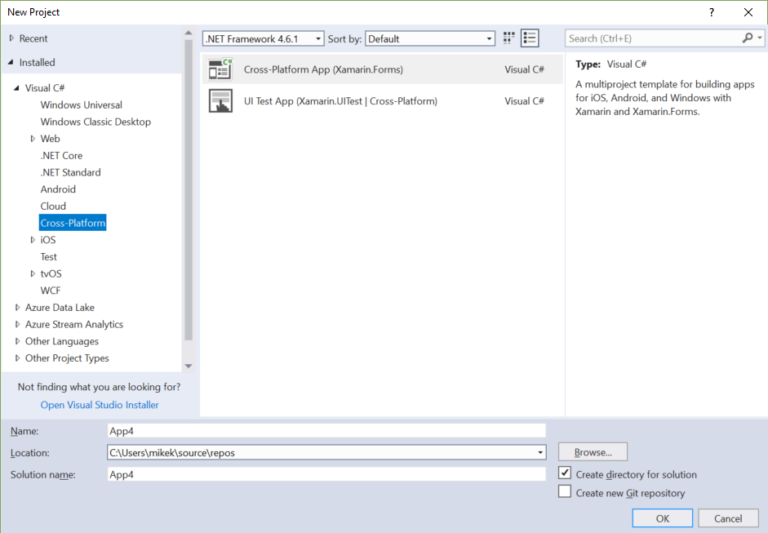
New Project

Slide 7
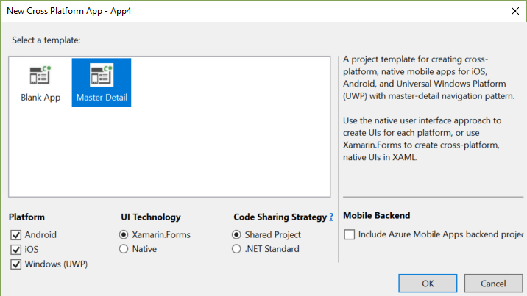
Choose Template

Slide 8
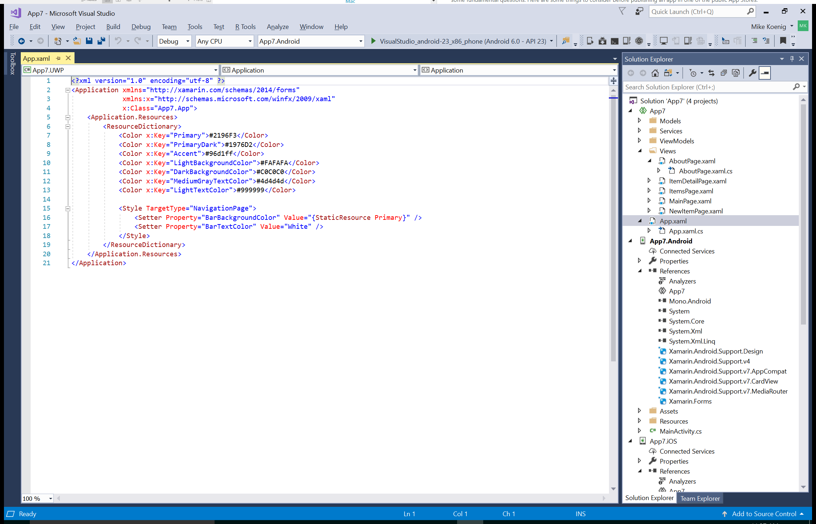
Hello World

Slide 9
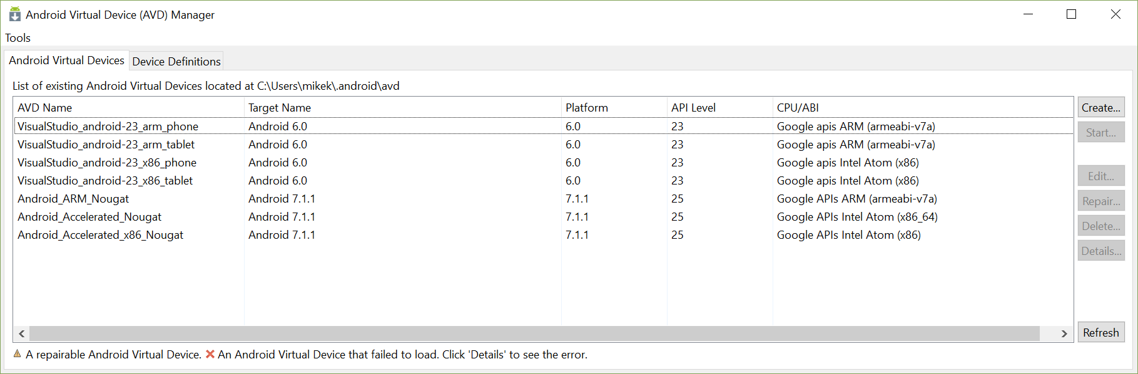
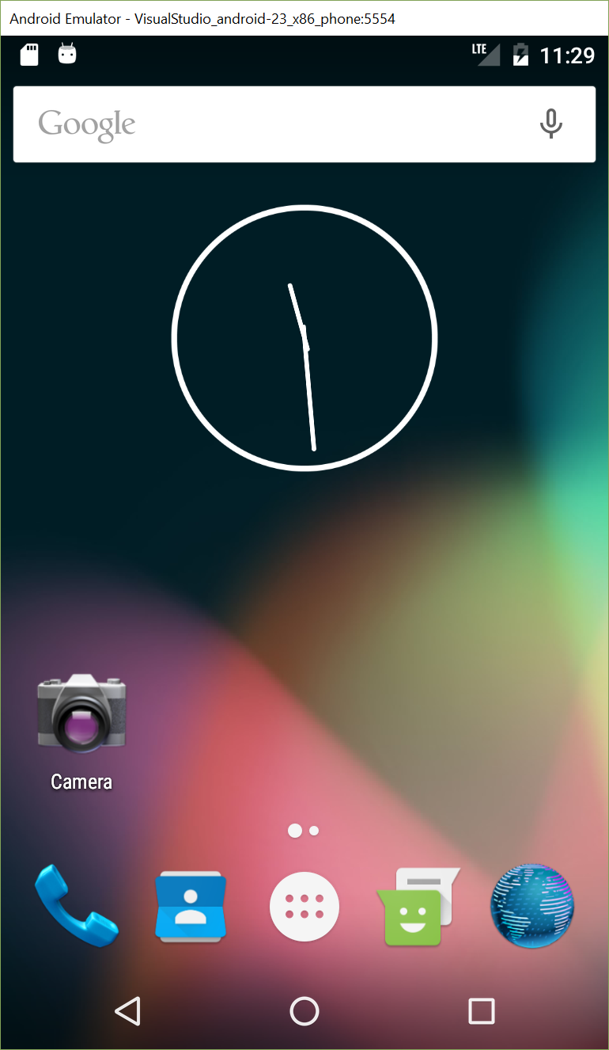
Emulators

Slide 10
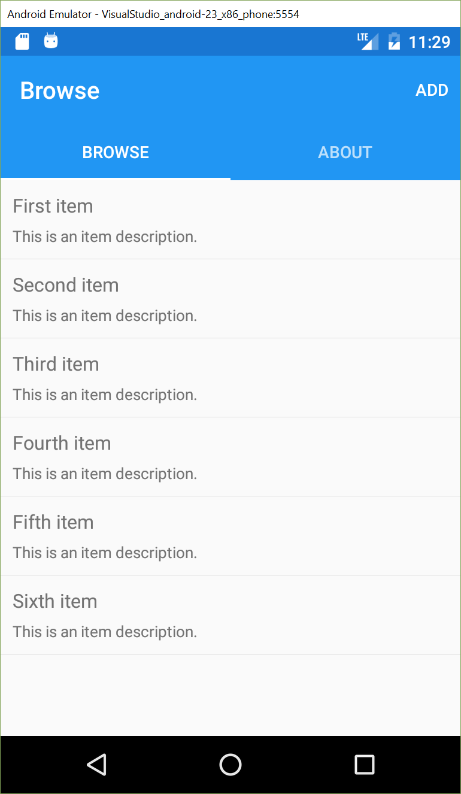
Run

Slide 11
Assignment 1 and 2 Concepts
1 Screen app
Multiple Screens
Buttons (UI elements)
Jumping Between Screens
Layouts
Images

Slide 12
UX Engine
Xamarin.Forms
Benefits
Cons…
https://developer.xamarin.com/guides/xamarin-forms/
https://developer.xamarin.com/guides/xamarin-forms/getting-started/introduction-to-xamarin-forms/

Slide 13
Layouts
Linear
Relative
Table
RecyclerView
ListView
GridView
GridLayout
Tabbed Layouts
https://developer.xamarin.com/guides/android/user_interface/layouts/

Slide 14
Forms
Pages
Layouts
Views
Cells

Slide 15
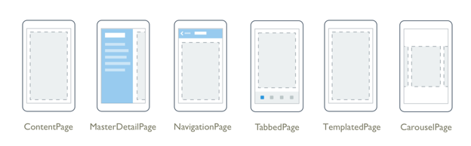
Pages
https://developer.xamarin.com/guides/xamarin-forms/user-interface/controls/pages/

Slide 16
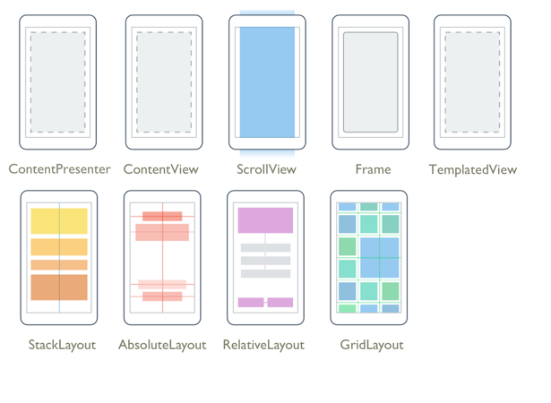
Layouts
https://developer.xamarin.com/guides/xamarin-forms/user-interface/controls/layouts/

Slide 17
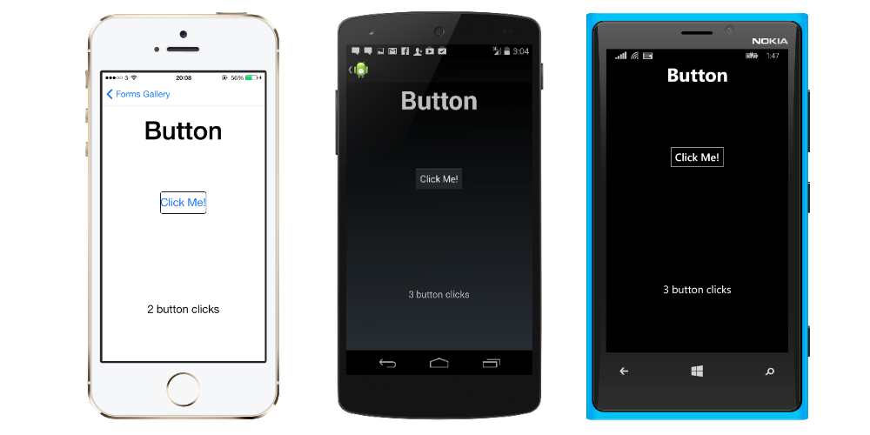
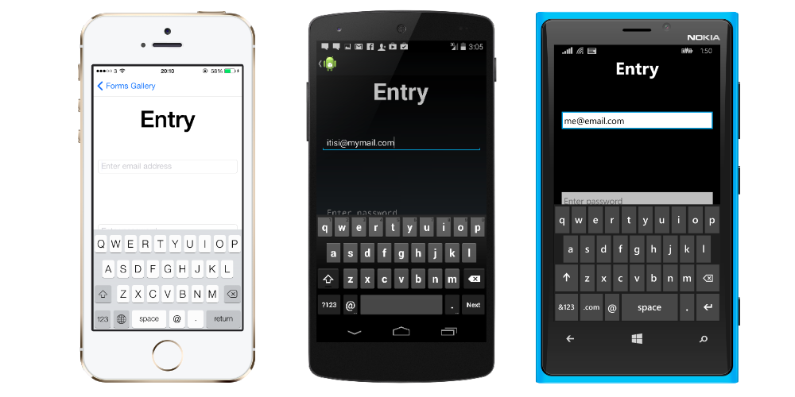
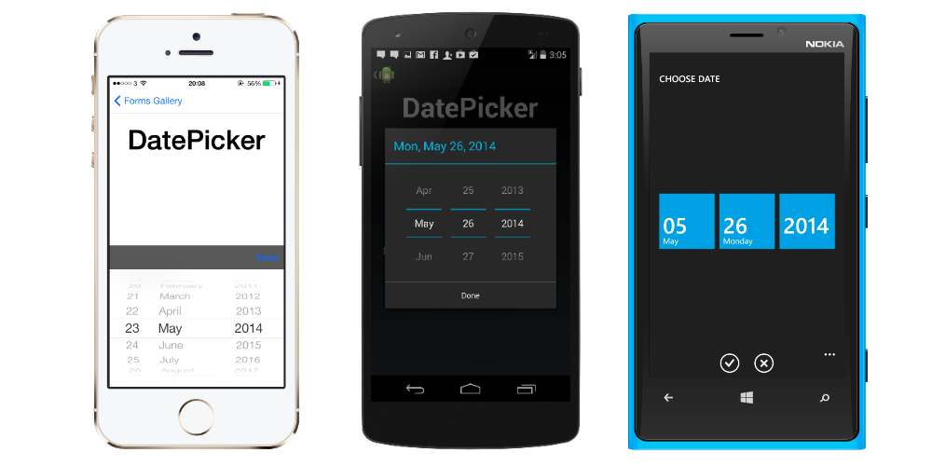
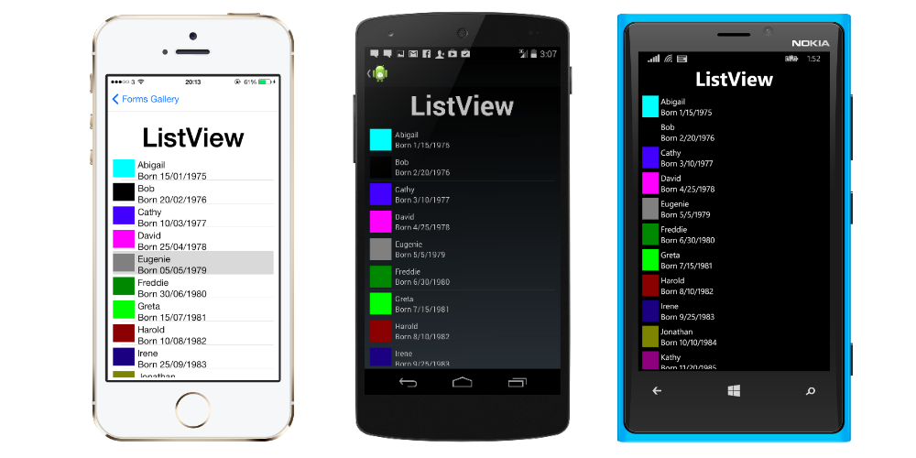
Views
https://developer.xamarin.com/guides/xamarin-forms/user-interface/controls/views/

Slide 18
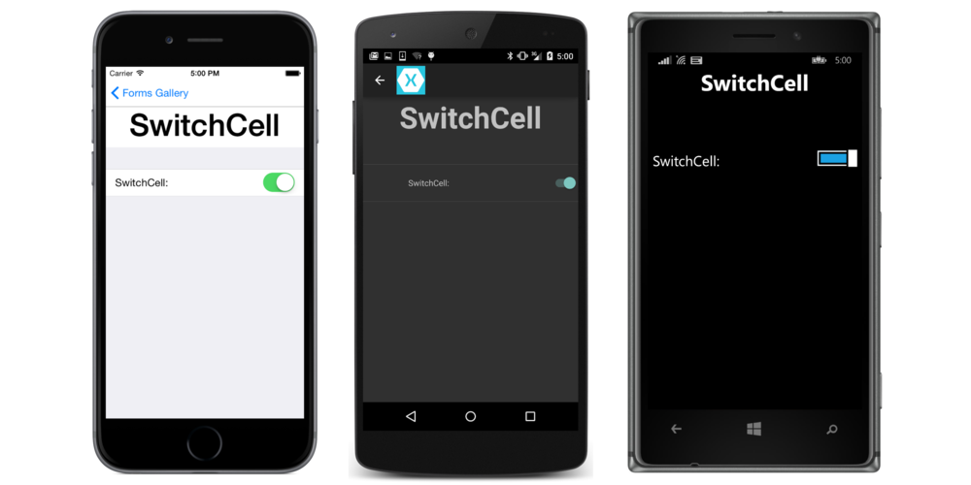
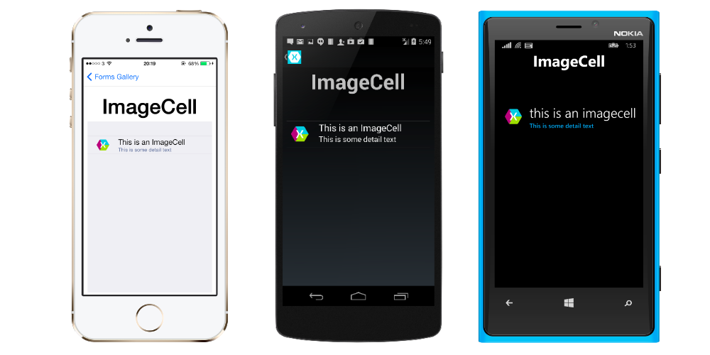
Cells
https://developer.xamarin.com/guides/xamarin-forms/user-interface/controls/cells/

Slide 19
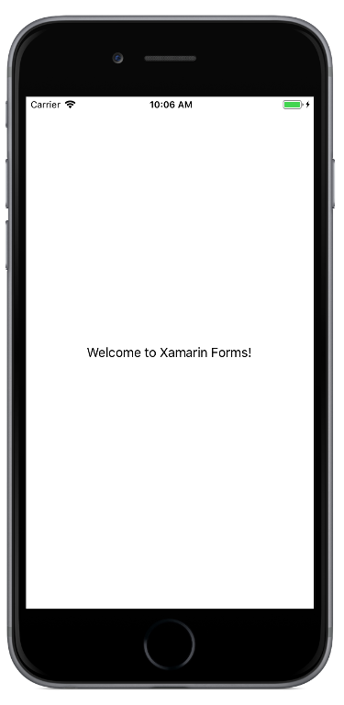
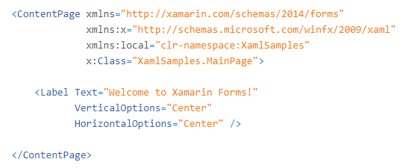
XAML
https://developer.xamarin.com/guides/xamarin-forms/xaml/

Slide 20
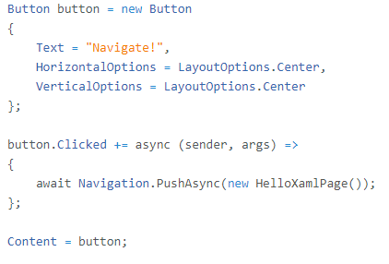
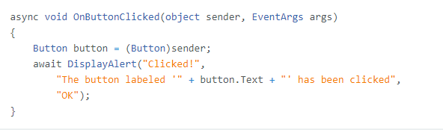
XAML in Code
XAML in Code
Button Handler

Slide 21
Read the following Articles
https://developer.xamarin.com/guides/xamarin-forms/xaml/xaml-basics/getting_started_with_xaml/
https://developer.xamarin.com/guides/xamarin-forms/xaml/xaml-basics/essential_xaml_syntax/
https://developer.xamarin.com/guides/xamarin-forms/xaml/xaml-basics/xaml_markup_extensions/
https://developer.xamarin.com/guides/xamarin-forms/xaml/xaml-basics/data_binding_basics/
https://developer.xamarin.com/guides/xamarin-forms/xaml/xaml-basics/data_bindings_to_mvvm/

Slide 22
Previewer
https://developer.xamarin.com/guides/xamarin-forms/xaml/xaml-previewer/

Slide 23
Images
Images go in different locations based on platform.
https://developer.xamarin.com/guides/xamarin-forms/user-interface/images/
Windows
Android
iOS

Slide 24
Architecture
https://developer.xamarin.com/guides/cross-platform/application_fundamentals/building_cross_platform_applications/part_2_-_architecture/
MVC
MVVM

Slide 25
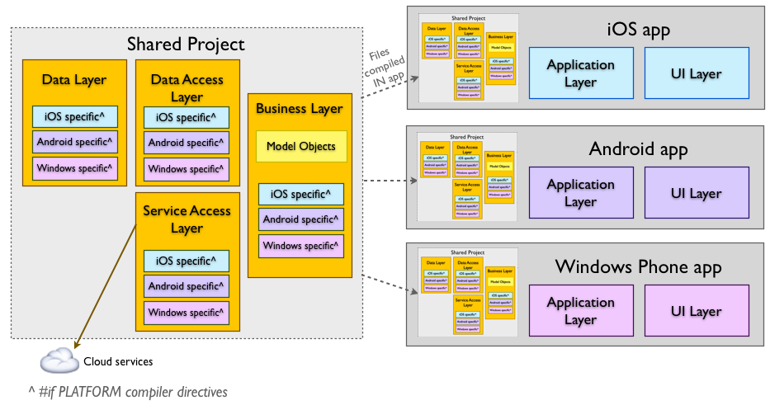
Shared Code and PCL
https://developer.xamarin.com/guides/cross-platform/application_fundamentals/shared_projects/

Slide 26
Nuget Packages
https://developer.xamarin.com/guides/cross-platform/application_fundamentals/nuget-multiplatform-libraries/

Slide 27
Key components
https://developer.xamarin.com/guides/cross-platform/application_fundamentals/building_cross_platform_applications/part_5_-_practical_code_sharing_strategies/
Data Access
File Access
Web Requests

Slide 28
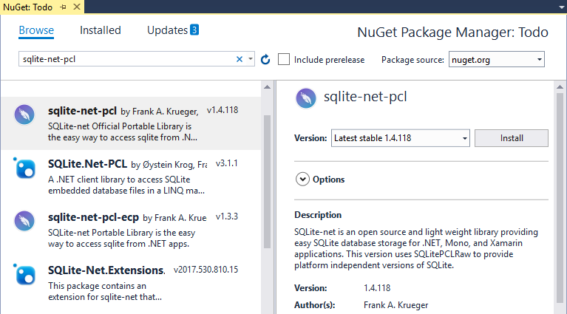
Database
SQL-Lite Configuring
https://developer.xamarin.com/guides/xamarin-forms/application-fundamentals/databases/
SQL-Lite
https://developer.xamarin.com/guides/android/data-and-cloud-services/data-access/using-sqlite-orm/

