Slide 1
Adding Pages

Slide 2
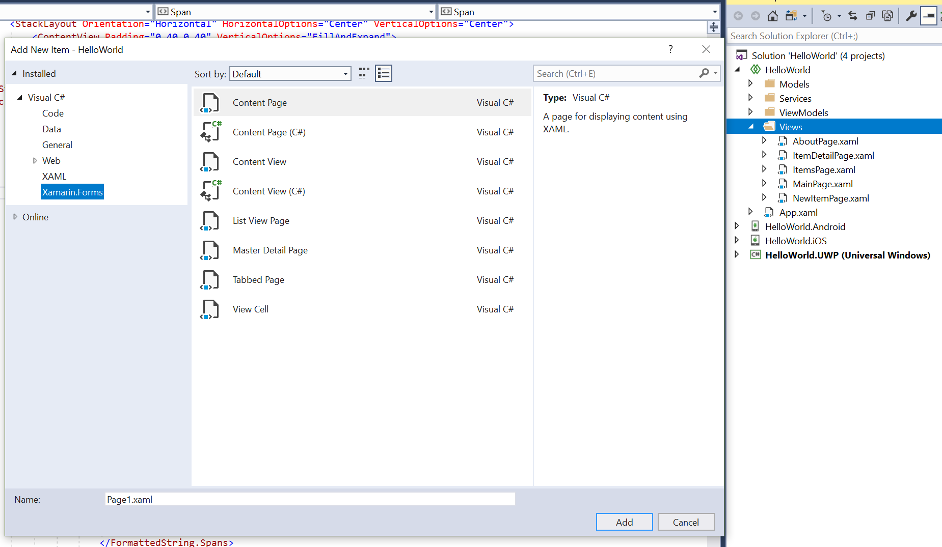
Add the Page
Make the Master Detail Project
Click on Views
Add New Item (Right Click)
Filter down to Xamarin Forms
Choose ContentPage
Give it name (CharacterPage, MonsterPage, ItemPage, GamePage etc.)

Slide 3
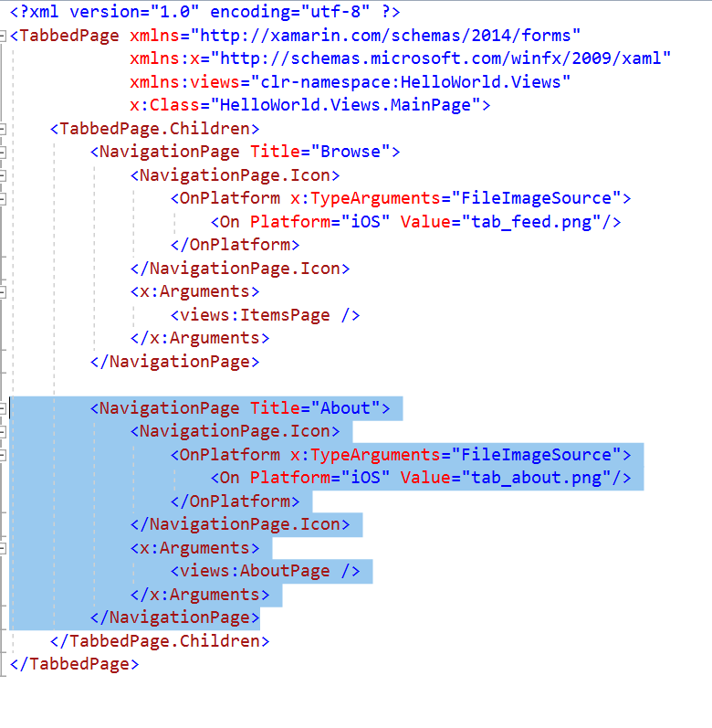
Hook the Page up
Open the xaml file “MainPage.xaml”
Look to see if the new Page is already there if not….
Find the code for AboutPage
This is where more tabs can be added…
Copy and paste the code and change it up to use the new pages. CharacterPage etc…
Make sure to change the <views:AboutPage /> to the new name you have

Slide 4
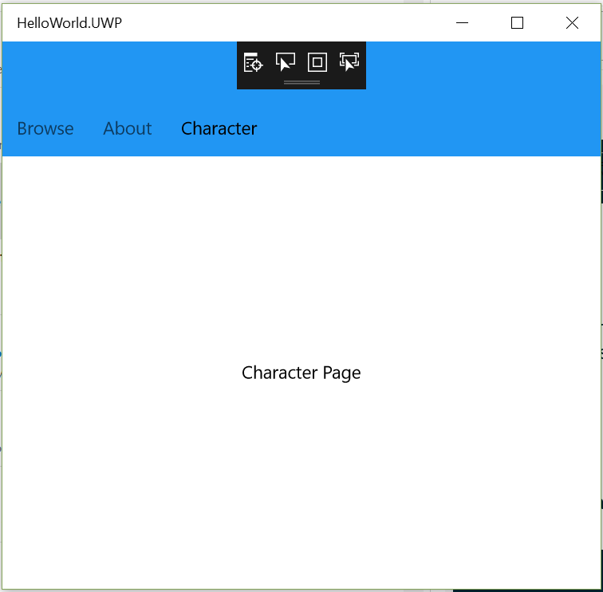
New Tab Page
Should have a new Tab page
“Character”
Add the others…
For GamePage add buttons…

Slide 5
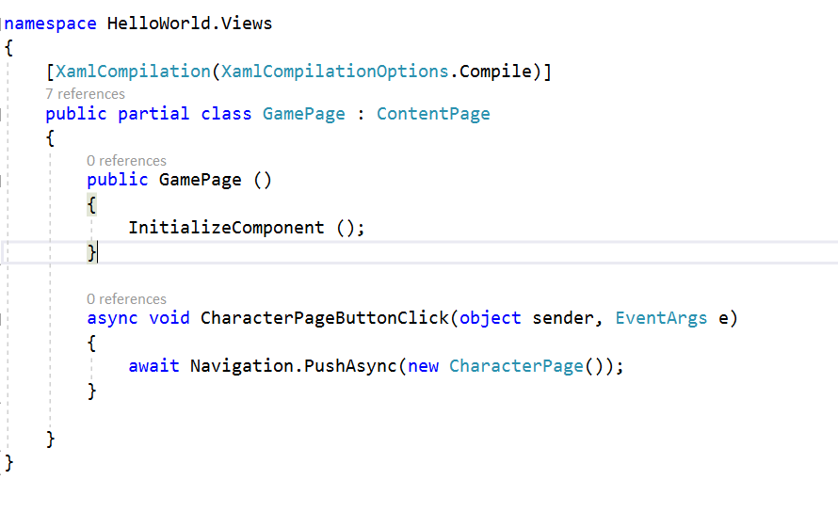
Add Button Code Behind to GamePage
Add a button handler for each button
New up the target page
Repeat for each button.

Slide 6
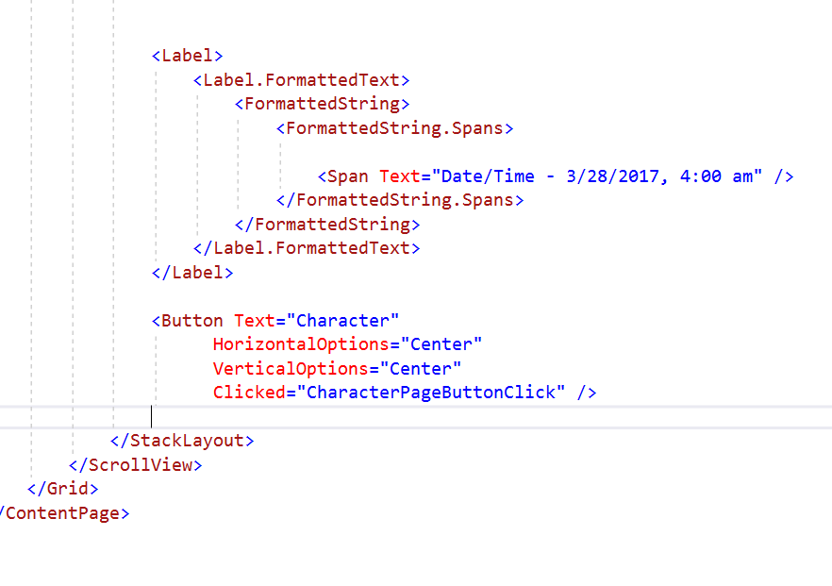
Add XAML
Add button to the XAML
Hook up the Command to call the CharacterPageButonClick
Change the other items on the page (Image, text etc.)

Slide 7
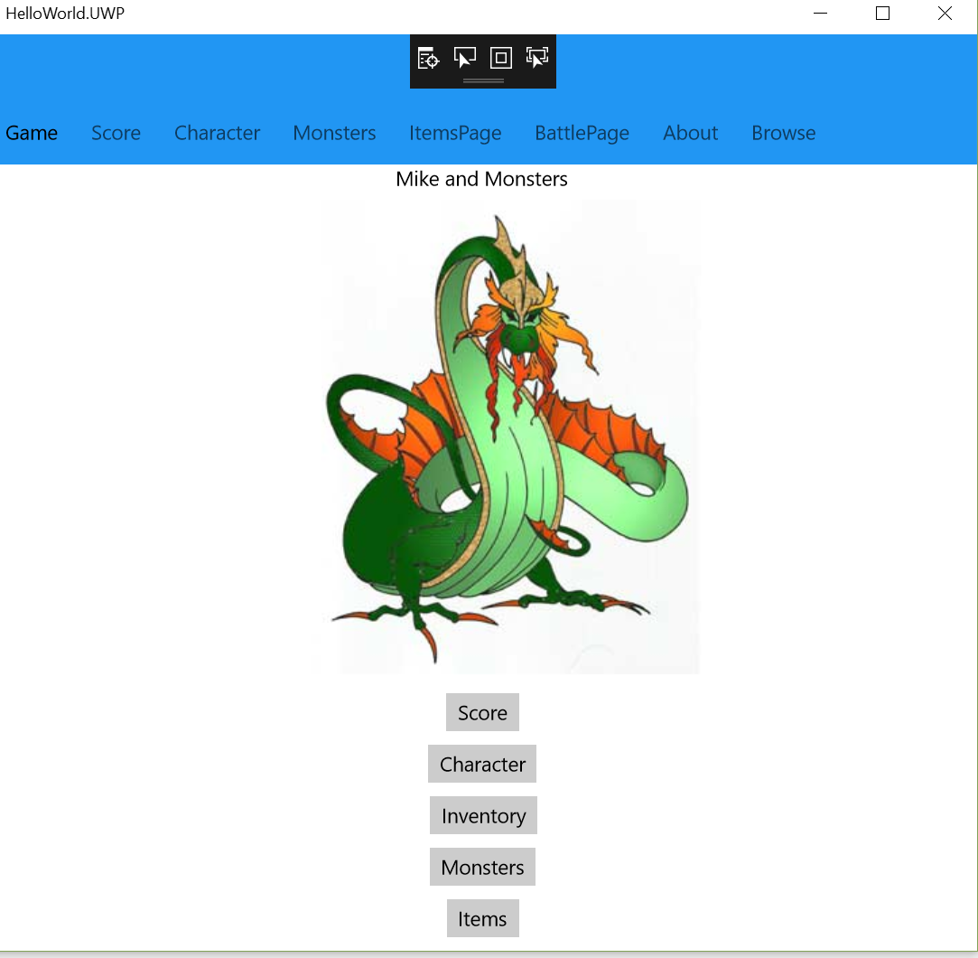
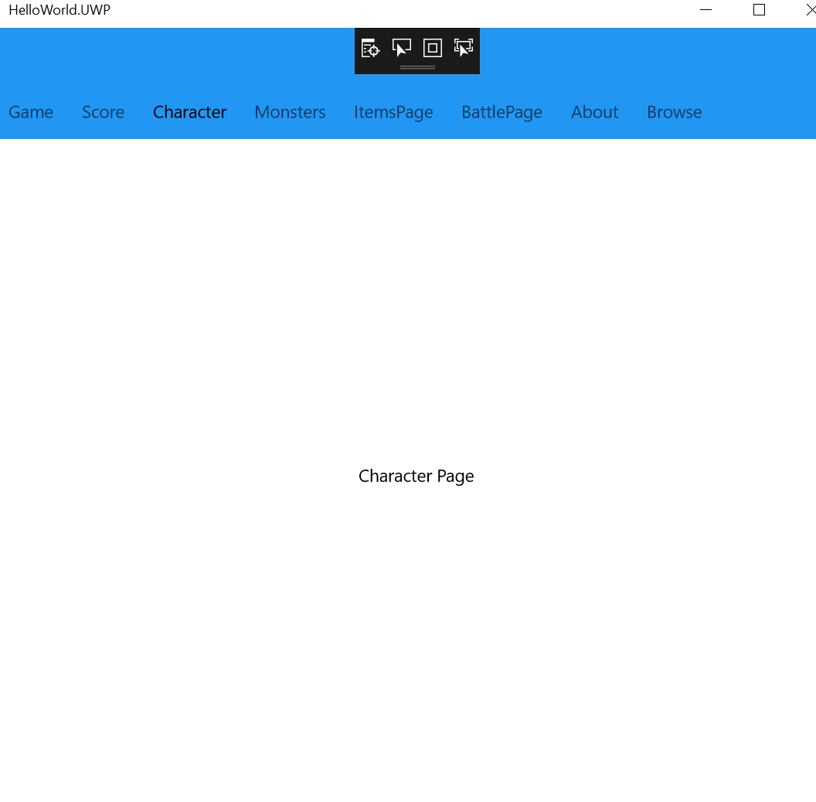
Final App
Add Title, Image, Buttons
Screen shot each of the sub pages….

