Slide 1
Source Control
Setting up
Changing Sources
Merge
Best Practices

Slide 2

What is Source Control?

Slide 3
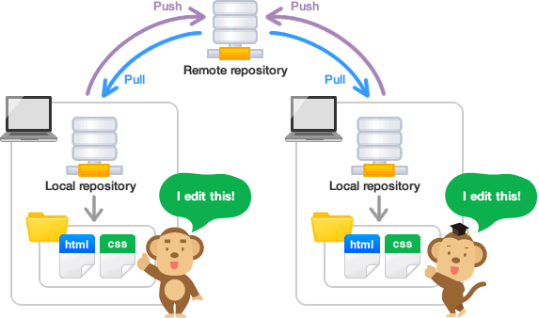
Keeps Multiple places in sync
“Google Drive” or “Drop box” for source *
Multiple People
Multiple Machines (laptop and home computer)
Safe place to keep files
*NOT instantly updates, but instead you must take action to update. Good – because you need to make sure your stuff works before sharing it with others…

Slide 4
Git Hub

Slide 5
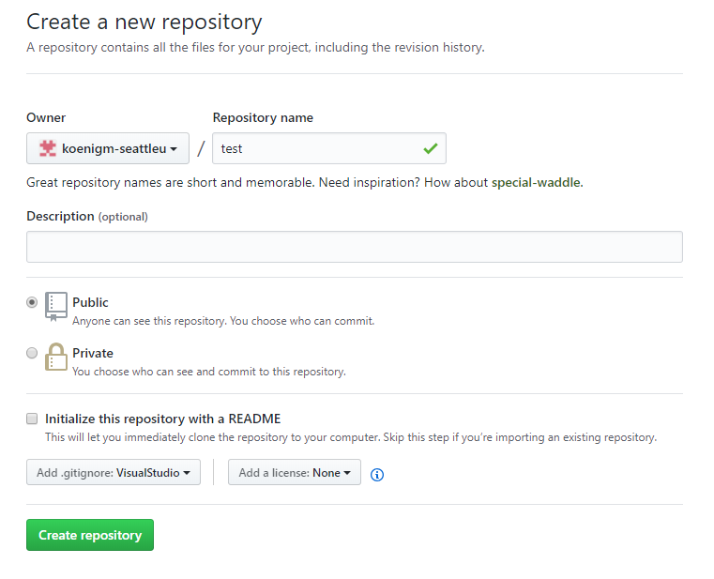
GetHub
New Repository
Add a git hub ignore for Visual Studio
Make sure Each Team member has a github account
Use the SAME account in Visual Studio as in GitHub
Add me to your repository
koenigm-seattleu

Slide 6
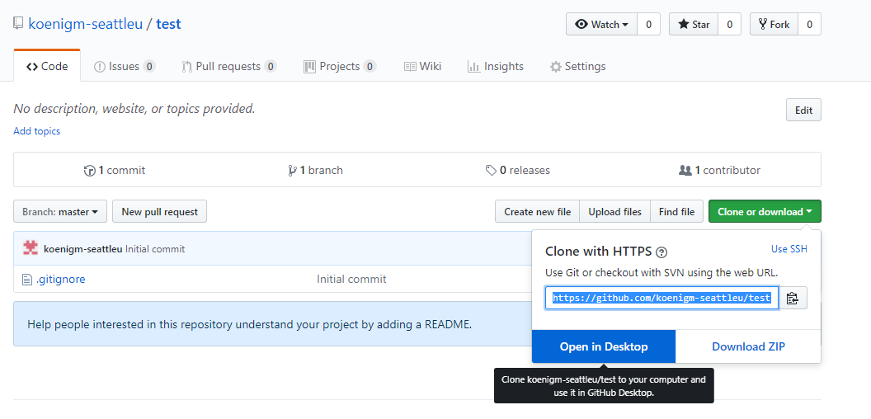
Clone or Download
Setup the clone
Either take the URL or Open in Desktop

Slide 7
Sign In with Account
Make sure Signed in in VS as well.

Slide 8
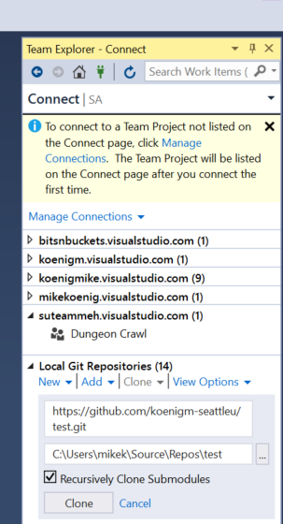
Manage Connections
In Team Explorer
Manage Connections
Connect to a Project
Local Git Repositories
Add URL
Click Clone

Slide 9
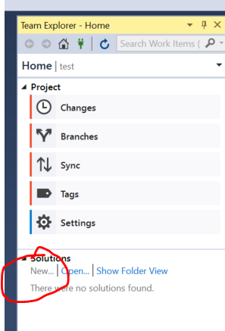
New Solution
If you don’t have a solution, then create one.
Click New on Solution

Slide 10
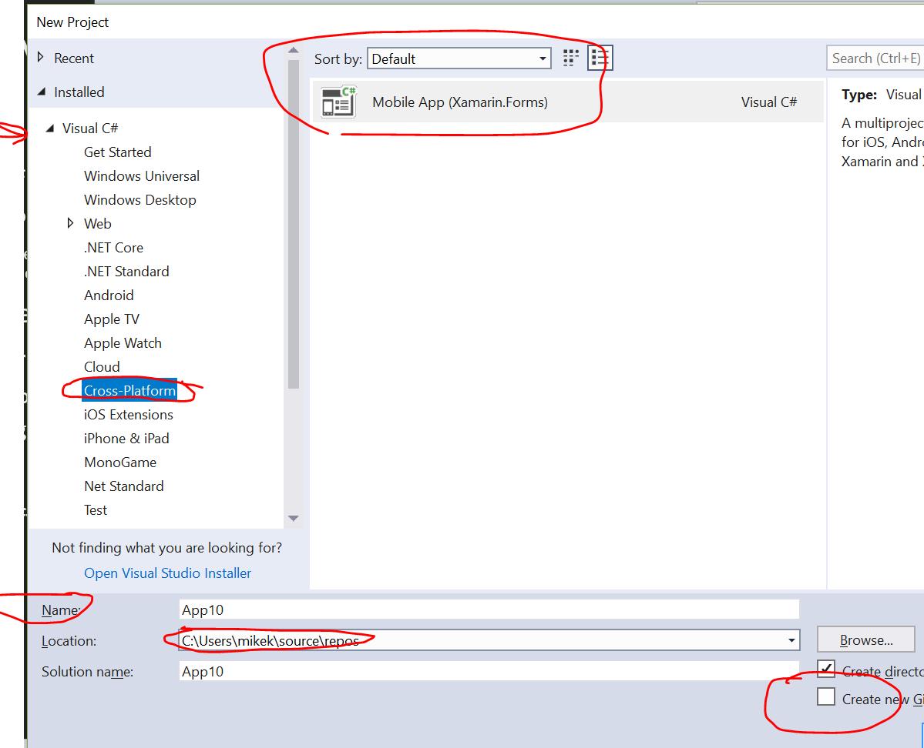
C#, Mobile Application
Pick C#
Cross Platform
(note Android and iOS exist as well, we won’t use these)
Mobile Application
Give Project Name
Shorter is better
Legal for mac/windows
Turn off Create Git repository

Slide 11
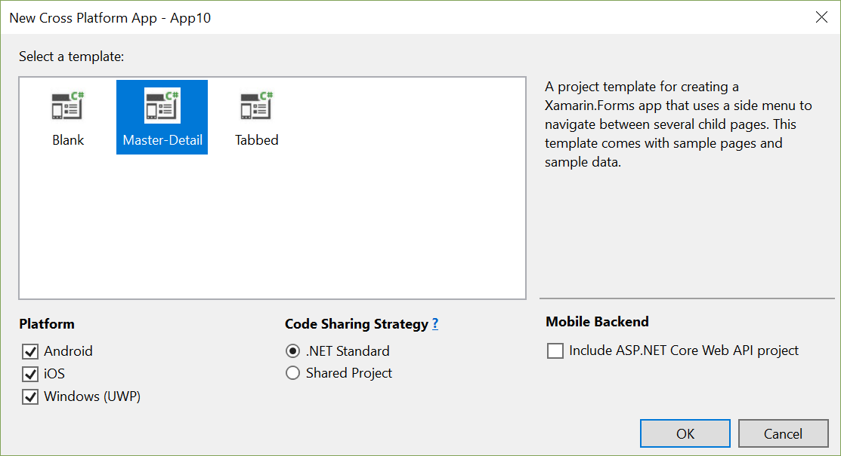
Master Detail
Use Defaults

Slide 12
Two Paths to get the team going
1. Make new repository and add people
2. Make New Project, then repository and then add people.
This ensures the git include file matches the project type
In VS
New Project

Slide 13
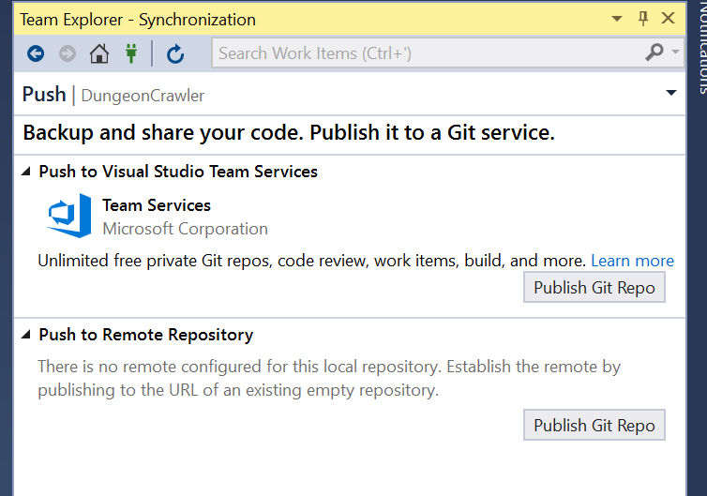
Publish Git Repo
In Team Explorer
Click the <Publish Git Repo> button to make the repo on the server

Slide 14
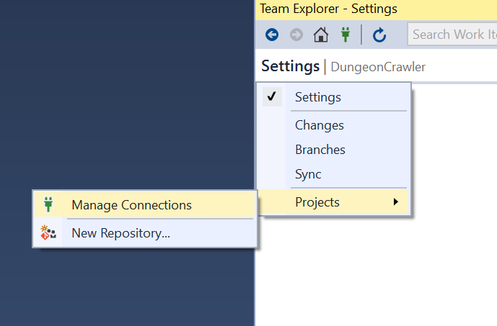
As a User, accessing a Project
Go to VS
Make sure you are logged in with the account you need (seattleu.edu)
Open View.Team Explorer
Select Settings
Select Projects
Select Manage Connections

Slide 15
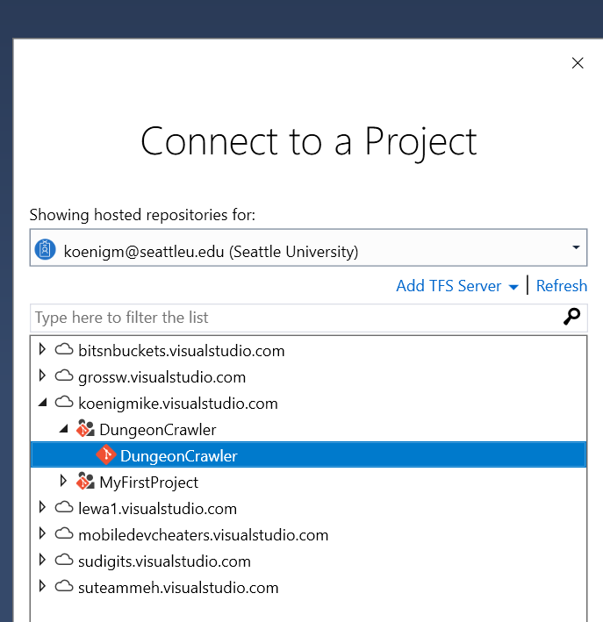
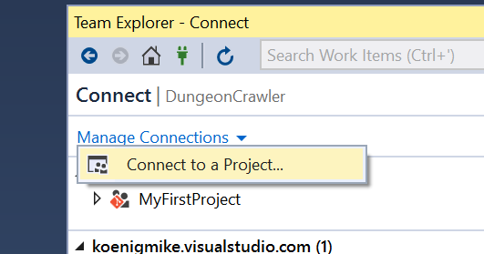
Manage Connections - Connect
Drop down Manage Connections
Select Connect to a Project
Make Clone to store it

Slide 16
In Visual Studio (windows)

Slide 17
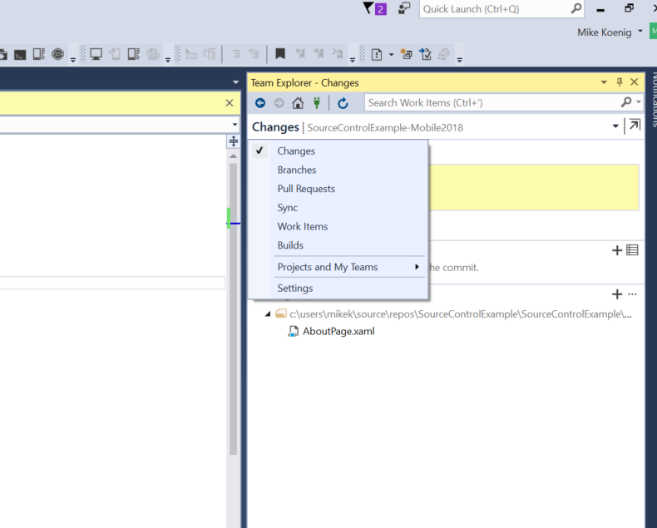
Changes
When you make a change to files in the project, they will show in the Team Explorer Change List.
You must commit your changes and push them to the server and others must Pull them down to get the changes.
Just having changes on your machine is not enough for source control

Slide 18
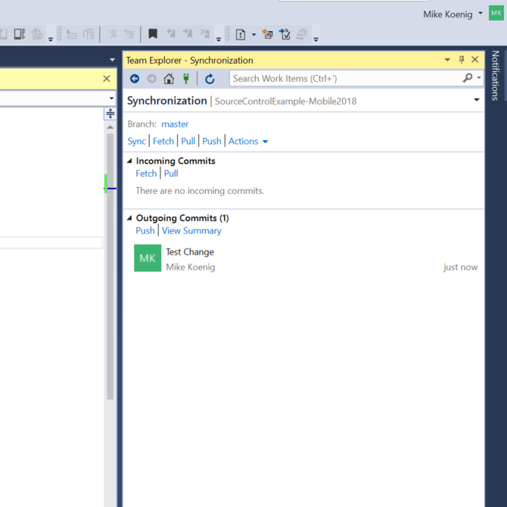
Sync (2 Times… why…)
It is important to always click the Sync button 2 times…
Why?
Because first time, will push up your changes, and fetch.
Second time will give the server time to refetch changes from the server.
It’s OK to click it 3 times as well…

Slide 19
Actions
Undo
Stage

Slide 20
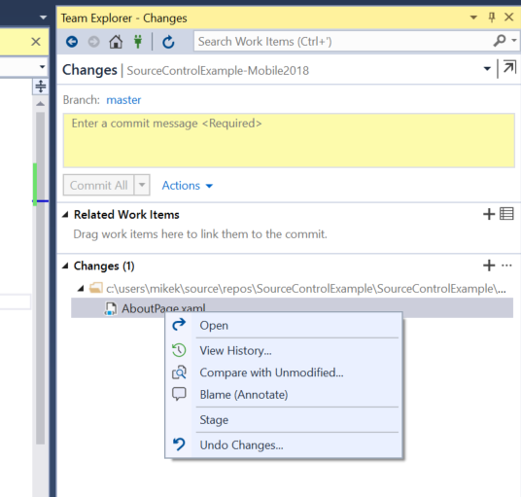
Undo Changes
To undo a change, right click on the change and select undo.
This will return the file to the state in the repository.
Make sure to undo all files changed and ensure project sill builds and runs before submitting any future changes

Slide 21
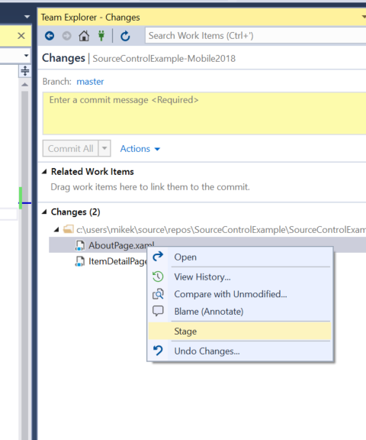
Stage Changes
This is how to get just one file in the depot.
So, you accidently made two changes, and want to check in just one of them…
Select the change you want, and choose Stage.
Now you can commit just that change, and the other will wait for later

Slide 22
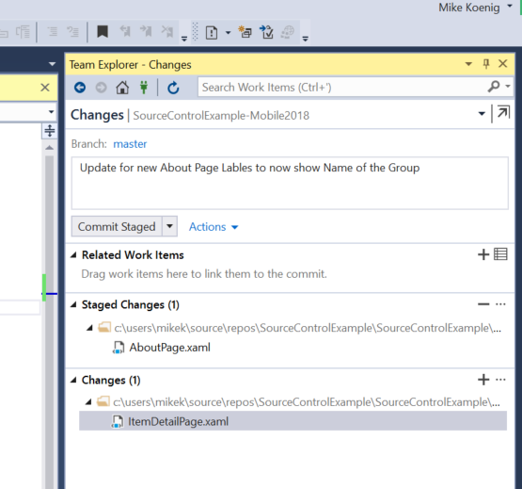
Split Commit
After you Split, you still need to commit the Staged Change.
So enter your comment and click Commit Staged.
As with all commits, this is what people will see in the history, so make it a useful comment.

Slide 23
Adding Comments
For any comment, best practices..
Describe what changed
If the change is not complete (bad practice in general), add that to the comment so it is clear: “Partial checking – had to check because of project change, new User feature not working currently”
If you use Task/Defect tracking, add the “Related Work Items” to show how this change is associated

Slide 24
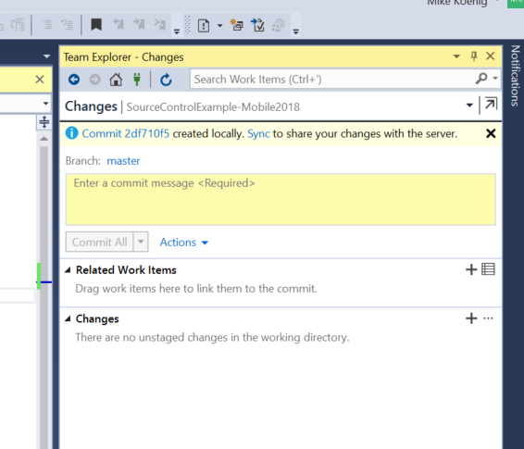
After Submit, Need to Sync….
Did I mention click Sync…
Because committing does not move the change from your machine to the server, or get new files down. It just queues it up…
Need to kit the sync button..
Several times…

Slide 25
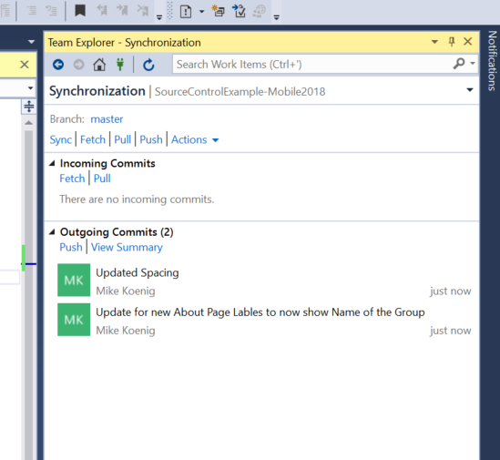
Sync again….
See, those changes are stuck in “Outgoing Commits”, and not up on the server yet.
Need to hit Sync again…

Slide 26
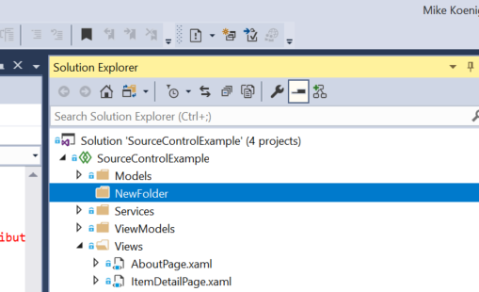
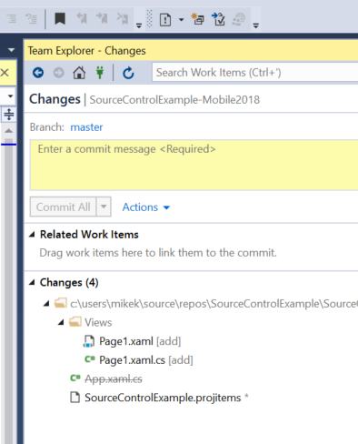
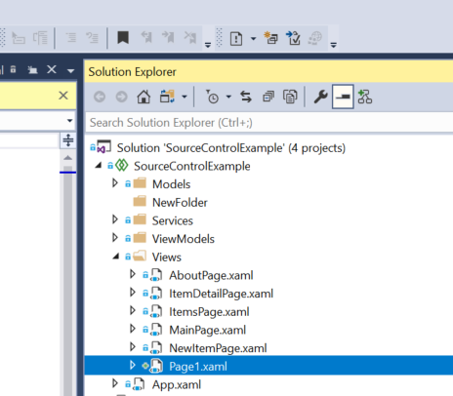
Project Changes
Add Folders
Add Files
Delete Files
All cause changes to the project file
Critical to get project changes to your team ASAP.
If multiple people have project changes, then one person will be blocked from checking in.
They will have to loose their work, revert the change, pull and then do their work again.

Slide 27
Project Changes
Can’t undo additions, so need to Delete them
Can undo Deletes
Can undo project changes as long as all other items are also undo

Slide 28
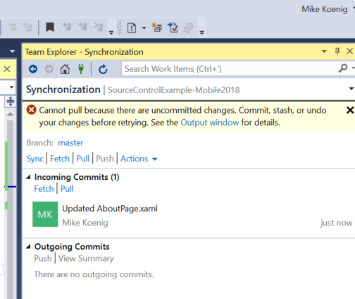
Merge Conflicts
Open Changes that need to be checked in will show an error

Slide 29
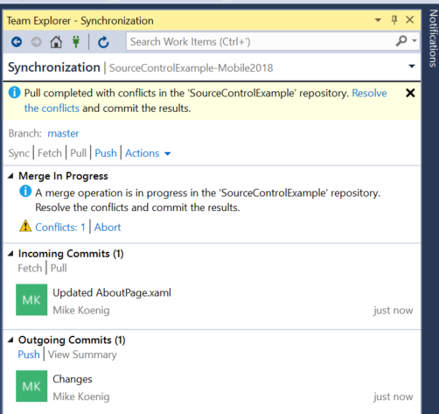
Changes Conflicts
Merge is needed…
Click on “Conflicts”

Slide 30
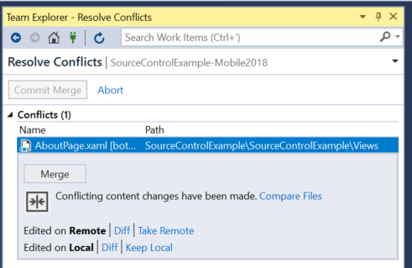
What to take?
Merge – You will let the system try to fix the problem.
Choose someone to break…
Take Remote – Your Team mate wins, and you will redo your work
Take Local – You will destroy your team mate’s work and force your change, breaking them.

Slide 31
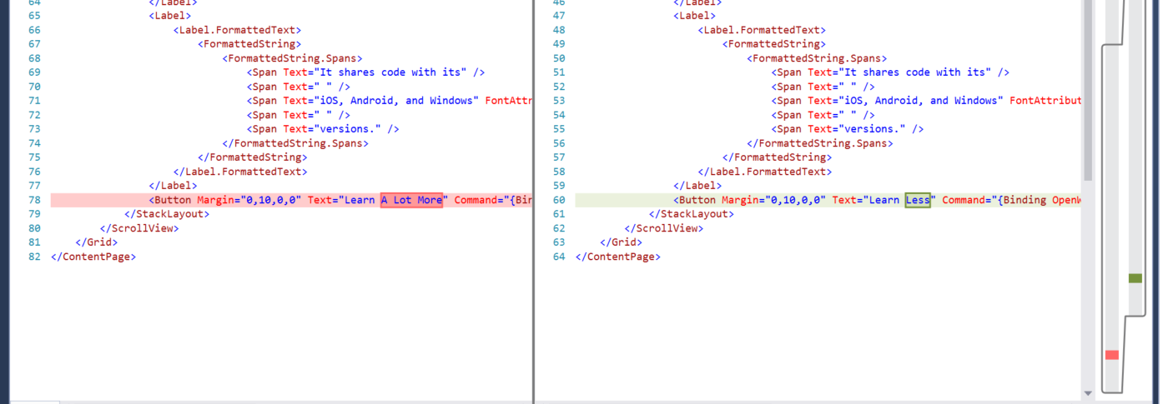
Merge
Example where machine can’t fix this, only human…..
What to do….

Slide 32
Recommendation
Take Remote
That way your team mate does not break, and you can go fix things…

Slide 33
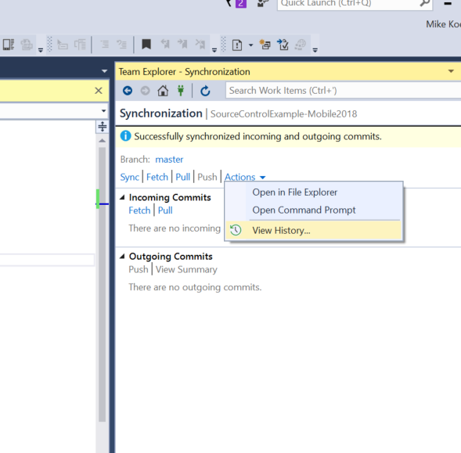
View History
Viewing History lets you see previous changes, and inspect the changes.
Under actions, select View History.
A new window will open up with the history of all changes by each person

Slide 34
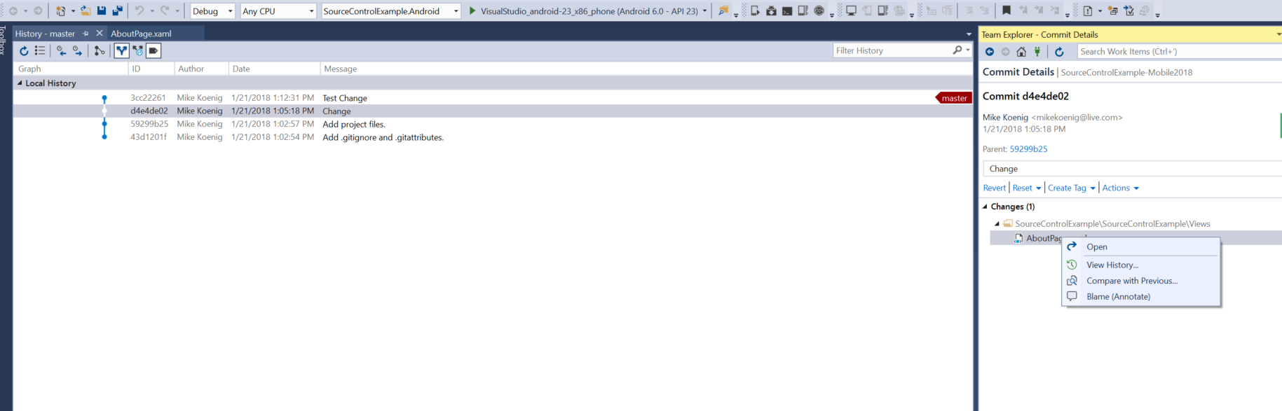
Compare with Previous
Double click on a change in the history list
See the change list in the Team Explore Window
Right click on the change to get choices.
“Compare with previous” very useful …

Slide 35
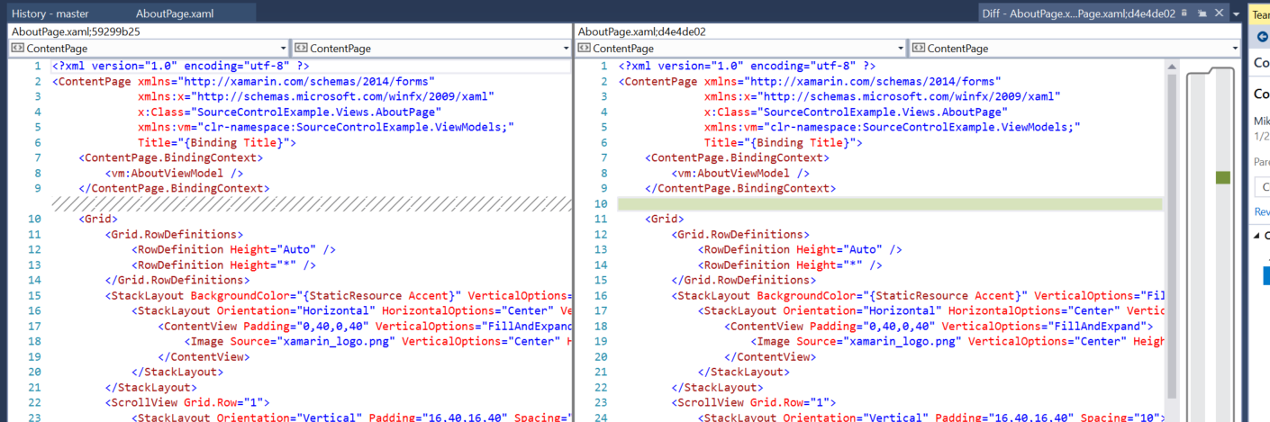
Compare Changes
Red – Removal / Change
Green – Addition
Scroll Bar Icons help find the changes

Slide 36
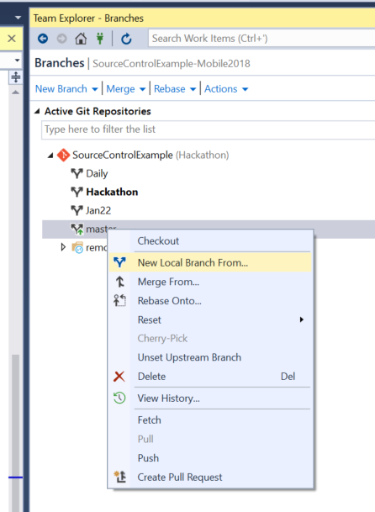
Branches
Personal
Daily
Testing
Published
Recommendation: Use the Master Branch for this class.
Make branches if you know what you are doing and will teach your team…

Slide 37
Best Practices
Changes should be very small. 1 bug, 1 submit
Break features down into smallest working piece possible
Minimize # of files changed to minimum required for smallest piece
Must always work after submitting, don’t break others
Always Sync several times (min 2x) after each commit
Always Sync/Pull before making changes to ensure latest base
If you change the project file – Tell your team so they can pull ASAP, or they will loose work.
Slack is great took for communicating among team !!

Slide 38
Git Information
https://betterexplained.com/articles/a-visual-guide-to-version-control/
https://marklodato.github.io/visual-git-guide/index-en.html
https://medium.freecodecamp.org/git-rebase-and-the-golden-rule-explained-70715eccc372
http://nvie.com/posts/a-successful-git-branching-model/
https://git-scm.com/book/en/v2/Git-Branching-Basic-Branching-and-Merging
https://www.sbf5.com/~cduan/technical/git/
https://www.atlassian.com/git/tutorials/merging-vs-rebasing
https://www.atlassian.com/git/tutorials/resetting-checking-out-and-reverting

