Slide 1
CRUDi

Slide 2
Adding CRUDi to MasterDetail new project
Start with MasterDetail
1
Refactor to make changes easier
2
Add all the CRUDi pages
3
Update the MockDataStore
4

Slide 3
New Project Master Detail
Going to start from the Master Detail Sample Project.
Blank Master Details Project up in the Files folder, to use
New Project Master Detail.

Slide 4
Refactor the Views
Adding a bunch of views will make the code hard to read, so make a folder for each of the views (Items, Characters, Monsters, Reports etc.)
Make a new Folder for Items under Views
Move the Items Views under that folder (Drag and drop the files over)

Slide 5
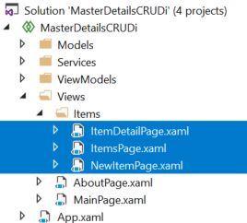
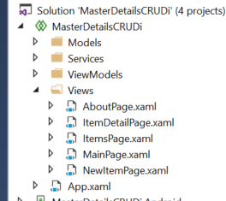
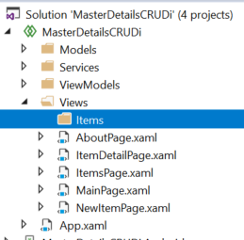
Add Items Folder, and move Files to under it

Slide 6
Change Navigation
I want to use the <- button, so I want a navigation stack.
Need to change the Navigation to support that.
On ItemsPage, change the Push to
await Navigation.PushAsync(new ItemDetailPage(new ItemDetailViewModel(item)));
await Navigation.PushAsync(new NewItemPage());
On NewItemPage, change from PopModel to Pop
await Navigation.PopAsync();

Slide 7
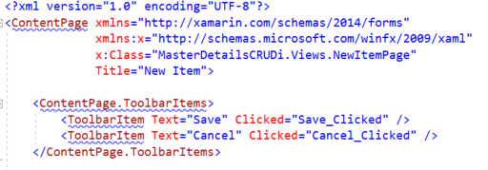
Add Cancel Action
Open the Xaml for NewItemPage
In the ToolbarItems section, duplicate the “Save_Clicked” row
Change the “Save” to “Cancel”
Change the “Save_Clicked” to “Cancel_Clicked”

Slide 8
Add Cancel Code behind
Open the NewItemPage.xaml.cs
Find the “Save_Clicked” method.
Duplicate it and rename it to “Cancel_Clicked”
Remove the line “MessagingCenter.Send(this, "AddItem", Item);”
Run and Verify the Project works
async void Save_Clicked(object sender, EventArgs e)
{
MessagingCenter.Send(this, "AddItem", Item);
await Navigation.PopAsync();
}
async void Cancel_Clicked(object sender, EventArgs e)
{
await Navigation.PopAsync();
}

Slide 9
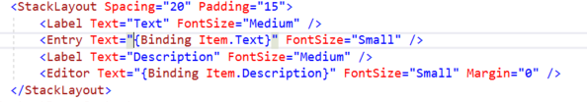
New Item Page Explained
BindingContext is the data that will be passed in to the xaml page. In this case, the binding context is the page itself.
In the XAML, the {Binding… works the same way as in the list page. This will be the input boxes the data will go.
When you add more fields to the model, you also must add the fields here so the model has the data

Slide 10
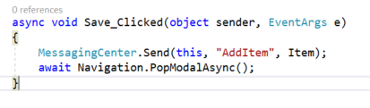
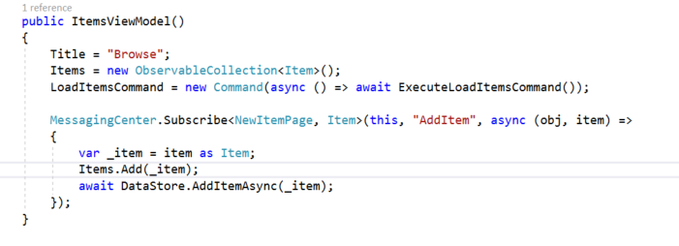
Message Center in Save_Clicked ….
In the “Save_Clicked” notice a call MessagingCenter.Send(this, "AddItem", Item);
This is sending a broadcast message to the full app. The broadcast consist of the sending Page Name (this -> “NewItemPage”), the message title “AddItem”, and the message body the data structure Item.
The ItemsViewModel has a subscription to the message in it’s constructor. This takes the message, and does a lamda expression to execute the code block (update the in memory structure, then make a call to the DataStore to add the item as well.)

Slide 11
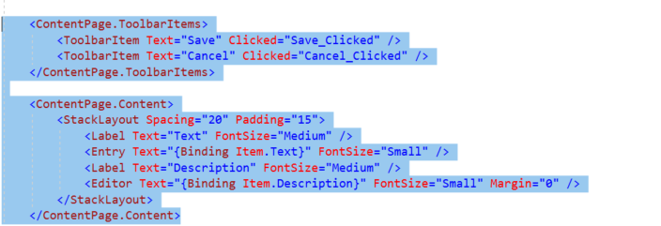
Add EditItemPage
Right Click on Items Folder
Choose Add. New
Choose Xamarin.Forms Content Page
Name it “EditItemPage.xaml”
Click Add
Copy the xaml from the NewItems page into EditItems page for Toolbar, and ContentPage.Content
Give the page a Title=“Edit Item"> (remove the closing > from the line above) after the x:Class line…
Edit and New share the same look in this app…

Slide 12
Code behind for Edit
Copy the Save and Cancel from NewItem and add to EditItem
Change the Save Message title from “AddItem” to “EditItem”
Add Properties
ItemDetailViewModel viewModel;
public Item Item { get; set; }
Add using <project> to the file
using MasterDetailsCRUDi.Models;
using MasterDetailsCRUDi.ViewModels;

Slide 13
EditItem Constructor
Need to pass into the constructor the data structure to edit.
public EditItemPage(ItemDetailViewModel viewModel)
{
// Save off the item
Item = viewModel.Item;
InitializeComponent();
// Set the data binding for the page
BindingContext = this.viewModel = viewModel;
}

Slide 14

Change Item Details page
Add a toolbar to Item Details for “Edit”, and “Cancel”
<ContentPage.ToolbarItems>
<ToolbarItem Text="Edit" Clicked="Edit_Clicked" />
<ToolbarItem Text="Cancel" Clicked="Cancel_Clicked" />
</ContentPage.ToolbarItems>
Add Code to ItemDetails for Edit (jump to new page) and Cancel
Make sure the page jumpted to is EditItemPage
Send the viewModel over to the page as the data to pass
using MasterDetailsCRUDi.Views.Items;
async void Edit_Clicked(object sender, EventArgs e)
{
await Navigation.PushAsync(new EditItemPage(viewModel));
}
async void Cancel_Clicked(object sender, EventArgs e)
{
await Navigation.PopAsync();
}

Slide 15
Add Listener to message in View Model
In the ItemsViewModel.cs
Duplicate the “AddItem” message
Change the message to be from <EditItemPage>
Change the title to “EditItem”
Update the Logic, to do an edit, not an add…
How about using the model to do the copy?

Slide 16
Adding Update on Model
Go to the Item.cs model
Add a Method for Update
public void Update(Item newItem)
{
if (newItem == null)
{
return;
}
// Update all the fields in the Item, except for the Id
this.Text = newItem.Text;
this.Description = newItem.Description;
return;
}

Slide 17
Use the Update method in ItemsViewModel
Go back to ItemsViewModel
Fix the “EditItem” message logic to find the item, can then update
Add
using MasterDetailsCRUDi.Views.Items;
using System.Linq;
MessagingCenter.Subscribe<EditItemPage, Item>(this, "EditItem", async (obj, item) =>
{
var newDataItem = item as Item;
// Find the Item, then update it
var _item = Items.Where((Item arg) => arg.Id == newDataItem.Id).FirstOrDefault();
if (_item == null)
{
return;
}
_item.Update(newDataItem);
await DataStore.UpdateItemAsync(_item);
});

Slide 18
Change the Logic in MockDataStore
Go to Services.MockDataStore.cs
Find the “UpdateItemAsync”
Replace the Remove, Add, to be and update instead
This will address the problem of edits moving the item in the list to the bottom (remove, add) adds to the bottom.

Slide 19
List View Not refreshing…
ItemsPage, has OnAppearing. That will refresh the list if the list is 0, but it does not refresh if the list changes.
Need a way to check to see if the list needs refreshing.
Either remove the if check on count, and always refresh (Simple, but has performance problem)
Or set a method on the view model to hold refresh status (will do for now)
Or add PropertyChange logic to the view model (best, but more code)

Slide 20
Adding flag to ItemsViewModel
1.
// Flag to set if the data in the items changes and refresh is needed to ListView (Title, Description, Image etc…)
private bool _NeedsRefresh;
2.
// Return True if a refresh is needed
// It sets the refresh flag to false if refresh was needed
public bool NeedsRefresh()
{
if (_NeedsRefresh)
{
_NeedsRefresh = false;
return true;
}
return false;
}
3.
Add a line to the “EditItem” message handler to set the flag before ending the method.
_NeedsRefresh = true;

Slide 21
CRUDi
Add, Detail, Edit, Index are done.
Need Delete to finish the set…

Slide 22
Adding Delete…
Under Items, New.Add.ContentPage
Call it DeleteItemPage.cs
Get the xml from the ItemDetail Page, and copy it into the new page, that way it can show all the same information, and can have a toolbar.
Change the toolbar from “Edit” to “Delete” and the code behind method to call

Slide 23
Update the Code behind for delete
In the new DeleteItemPage, code behind.
Copy the methods from the EditItemPage for Save and Cancel.
Paste them in Delete
Change the method name from “Save_Clicked” to “Delete_Clicked”
Change the pop to return to the top of the stack (because the itemdetail is no longer valid).
await Navigation.PopToRootAsync();
Update the message from “EditItem” to “DeleteItem”
Remember to set the Using for Models, and ViewModels
Remember to set the constructor as per the ItemDetails Constructor

Slide 24

Add Delete message in ItemsViewModel
Duplicate the “AddItem” message handeler
Change it to be from the <DeleteItemPage>
Change the message to “DeleteItem”
Change the code to be
var _item = item as Item;
Items.Remove(_item);
await DataStore.DeleteItemAsync(_item);

Slide 25
Add Delete Toolbar and call in ItemDetailPage
Xaml
<ContentPage.ToolbarItems>
<ToolbarItem Text="Edit" Clicked="Edit_Clicked" />
<ToolbarItem Text="Delete" Clicked="Delete_Clicked" />
<ToolbarItem Text="Cancel" Clicked="Cancel_Clicked" />
</ContentPage.ToolbarItems>
Code
async void Delete_Clicked(object sender, EventArgs e)
{
await Navigation.PushAsync(new DeleteItemPage(viewModel));
}

Slide 26
Test full CRUDI on Items
Run app
Cancel
Click on Add Toolbar, click Cancel
Click on Item in list, click Delete Toolbar, click Cancel
Click on Edit Toolbar, click Cancel
Click Cancel
Verify back at the Index
Add
Click Add Toolbar
Enter Name
Enter Description
Click Save
Verify back at the Index, and new item is there
Edit
Click on item (in the middle of the stack)
Click on Edit Toolbar
Edit all fields
Click Save
Verify back at the detail page, and all updated
Click Cancel
Verify item shows in the list correctly, and did not move location
Delete
Click on item (in the middle of the stack)
Click on Delete Toolbar
Click on Delete
Verify back at the index page, and item is deleted
Verify List View

Slide 27
Always Test your code manually !!!
Found some bugs
Edit Return
Delete Return
Android working differently than UWP, iOS?

Slide 28
Bug in Return from Edit
Return from Edit does not refresh the data
Problem is there are now 2 edit details pages on the stack…
This made a second page await Navigation.PushAsync(new ItemDetailPage(new ItemDetailViewModel(Item)));
Need to remove the old ItemDetail page
Then pop this page off

Slide 29
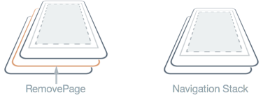
EditItemPage Save Method
Need to find the previous Item page, and remove it.
We know some things about the stack, because we just added a page on it, and were have our current page. Item details is the page before that
Remove Page can take a page reference
Navigation.RemovePage(Navigation.NavigationStack[Navigation.NavigationStack.Count-2]);

Slide 30
Bug <Android>
On Android the listView is not updating after Edit.
Fix that by adding changing OnAppearing
protected override void OnAppearing()
{
base.OnAppearing();
BindingContext = null;
if (ToolbarItems.Count > 0)
{
ToolbarItems.RemoveAt(0);
}
InitializeComponent();
if (viewModel.Items.Count == 0)
{
viewModel.LoadItemsCommand.Execute(null);
}
else if (viewModel.NeedsRefresh())
{
viewModel.LoadItemsCommand.Execute(null);
}
BindingContext = viewModel;
}

Slide 31
Bug <iOS, Android>
Delete, is not jumping to the top list view
On Android the PopToRootAsync is not working.
Help says not supported ☹
Will need to unwind the stack manually…
Navigation.RemovePage(Navigation.NavigationStack[Navigation.NavigationStack.Count-2]);

Slide 32
Refactoring for Character
Make Character Tab
Create all 5 CRUDI features for Character
Create appropriate ViewModels
For the Character model, use the following
public class Character
{
public string Id { get; set; }
public string Name { get; set; }
public int Level { get; set; }
}
Change MockDataSource to Manage Character interactions
Initialize the Data
Deal with methods for CRUDi

Slide 33
Example Project
In the Files folder on canvas.
CRUDi project
Implemented the Item CRUDi
Your task is to add Character CRUDi, and keep Item as well…

