Slide 1
CRUDi
Adding Character

Slide 2
Goal: Add Character
Make Character Tab
Create all 5 CRUDI features for Character
Create appropriate ViewModels
For the Character model, use the following
public class Character
{
public string Id { get; set; }
public string Name { get; set; }
public string Description { get; set; }
public int Level { get; set; }
}
Change MockDataSource to Manage Character interactions
Initialize the Data
Deal with methods for CRUDi

Slide 3
Example Project
In the Files folder on canvas are different projects:
“MasterDetailsCRUDi-NoCharacter” Project. Has CRUDI for Items, Monster and Score
Your task is to add Character CRUDi, and keep the other pages
Item, Monster, and Score you can use for your Game needs later

Slide 4
Part 2, Adding Character
Character will be similar to Item
Before we do, let’s fix the confusion around Item
Refactor model, view models, and datastore
Hooking up Character will involve:
Need to hook up the Character model
Need to setup the overall navigation, so the user can get to Character
Will start by copying all of the Item related features over, and renaming them.
Then need to address the DataStore issues with <item> vs <character>

Slide 5
Steps
1. Make Tab
1
2. Make Character
2
3. Duplicate and Starting Hooking up pages
3
4. Start fixing up the DB…
4

Slide 6
Make a Character Model
For now, copy and duplicate Item.cs
Rename it to Characer.cs
Adjust the class name to Character
Adjust the Update Method to Character

Slide 7
Add Character to MockDataStore
Add the local data variable
private List<Character> _characterDataset = new List<Character>();
Add mockCharacter data init
var mockCharacters = new List<Character>
{
new Character { Id = Guid.NewGuid().ToString(), Name = "First Character", Description="This is an Character description." },
new Character { Id = Guid.NewGuid().ToString(), Name = "Second Character", Description="This is an Character description." },
new Character { Id = Guid.NewGuid().ToString(), Name = "Third Character", Description="This is an Character description." },
new Character { Id = Guid.NewGuid().ToString(), Name = "Fourth Character", Description="This is an Character description." },
new Character { Id = Guid.NewGuid().ToString(), Name = "Fifth Character", Description="This is an Character description." },
new Character { Id = Guid.NewGuid().ToString(), Name = "Sixth Character", Description="This is an Character description." },
};
foreach (var data in mockCharacters)
{
_characterDataset.Add(data);
}

Slide 8
Add Data Methods to MockDataStore
Copy and Duplicate the Item set of Data Methods
Replace _Item with _Character
Replace Item data with Character Data

Slide 9
iDataStore
Copy and Duplicate the Items methods and rename them Character
Fix up Item data be Character data
Make sure to fix the Task<Item> and Task<Ienumerable<Item>>…

Slide 10
Copy and Duplicate ItemDetailViewModel
Fix up the Class Name, and the implementation
Switch data type form Item to Character
Fix the method signature to use Character

Slide 11
Copy and Duplicate ItemsViewModel
Fix the Class name and Constructor
Fix the ObservableCollection<Item> to Character
Fix the subscription page name from abcItemPage to abcCharacterPage
Fix the Subscribe from <Item> to <Character>
Ensure there are no more references to the word Item…

Slide 12
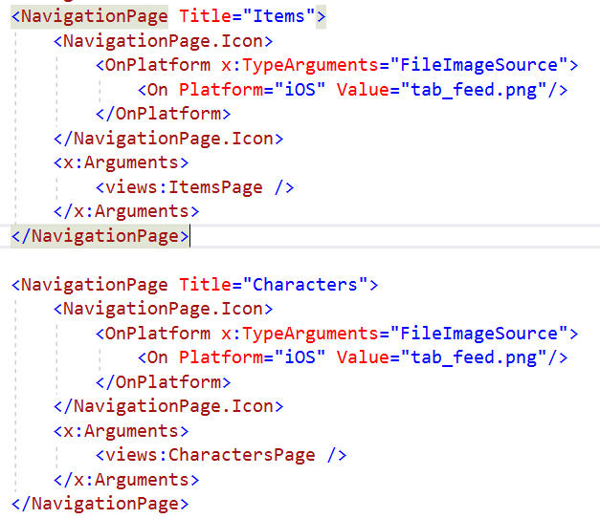
Adding Tab page
Add a Tab page for Character to the overall Navigation
In MainPage.xaml, duplicate the NavigationPage Xaml Block for Item,
Rename it Characters
Set the Views: CharactersPage

Slide 13
Views for Character
Make a Character Folder and each page 1 by 1 copy the file from Item over, and fix it up

Slide 14
Copy and Duplicate the ItemDetailPage
Fixup the Xaml
x:Class="MasterDetailsCRUDi.Views.CharacterDetailPage“
Change the label
from <Label Text="Item Detail Page" FontSize="Small" />
To <Label Text=“Characer Detail Page" FontSize="Small" />
Fix the view model to be CharacterDetailViewModel (3 places)
Fix the variable from Item the Character (1 place)
Fix the page jumps from EditItemPage, DeleteItemPage, to EditCharacterPage and DeleteCharacterPage

Slide 15
Copy and Duplicate the Items Page
Rename the ItemsPage to CharactersPage
Change the class name in the xaml to be
x:Class="MasterDetailsCRUDi.Views.CharactersPage“
Change the label
from <Label Text="Item List Page" FontSize="Small" />
To <Label Text=“Characer List Page" FontSize="Small" />
In the CS file, update the name from ItemsPage to CharactersPage
Rename the Constructor to CharactersPage
Change from ItemsViewModel to CharactersViewModel
Fix OnItemSelected to use Character, and the Jumps to be CharacterDetailPage with CharacterDetailsViewModel

Slide 16
Copy and Duplicate the DeleteItemPage
Rename the file to DeleteCharacterPage
Fix the x:Class in the xaml
Fix the XAML Label from Item to Character
Fix the class and constructor name in the cs
Change the viewmodel from ItemDetailViewModel to CharacterDetailViewModel
Change the data from Item to Character

Slide 17
Copy and Duplicate EditItemPage
Rename the file to EditCharacterPage
Fix the x:Class in the xaml
Fix the XAML Label from Item to Character
Fix the class and constructor name in the cs
Change view model to CharacterDetailViewModel (3 times)
Change variable from Item to Character
Change jump from ItemDetailPage to CharacterDetailPage

Slide 18
Copy and Duplicate NewItemPage
Rename the file to CharacterDetailPage
Fix the x:Class in the xaml
Fix the XAML Label from Item to Character
Fix the class and constructor name in the cs
Change the variable from Item to Character (2 times)

Slide 19
Build and test
Test Items (add, edit, delete, cancel)
1
Test Characters (add, edit, delete, cancel)
2
Make sure all of the character page jumps are correct
3
Make sure all data changes to character are correct
4
Make sure none of the Character edits happen to Item
5

Slide 20
Fixing Up Character Data
Going to add the Level to Character
Leave Name and Description there.
Will need to Change the Model
Change the init in the MockDataStore
Change the XAML Pages for character
Change the CS pages for character

Slide 21
Change Character Model
Add Level to the Model
Public int Level {get;set;}
Add Level to be set in Update
Level = newData.Level;

Slide 22
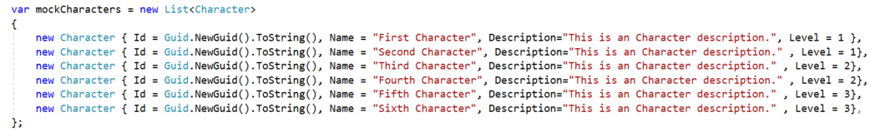
Add Level to MockDataStore
Add a value for Level after each row in the init, choose any int value
, Level = 1

Slide 23
Display Level on Pages
In the Xaml for Delete, Details, Edit, New
Add a binding for Level (Delete and Details) between Name and Description
Ex:
<Label Text="Level:" FontSize="Medium" />
<Label Text="{Binding Data.Level}" FontSize="Small"/>
Note:
Delete and Details will use Label
Edit and New will use Editor

Slide 24
Fix Data Init
In CharacterDetailPage and NewCharacterPage
Fix up the new data to include Level=1

Slide 25
Build and test
Test Items (add, edit, delete, cancel)
1
Test Characters (add, edit, delete, cancel)
2
Make sure all of the character page jumps are correct
3
Make sure all data changes to character are correct
4
Make sure none of the Character edits happen to Item
5

