Slide 1
Information extraction from biomedical texts
Computationele modellen voor taalbegrip
20 maart 2017
Sander Kersten
Universiteit Antwerpen

Slide 2
Structure
Principles of RE and possible applications
Methods for relation extraction
Supervised RE
Semi-supervised RE
Bootstrapping
Relation extraction in practice
Case study

Slide 3
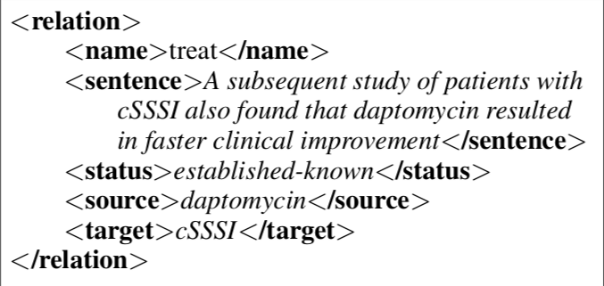
Principles and purposes
Extract structured data from unstructured documents.

Slide 4
Applications?
Question and answering systems
Text summarization

Slide 5
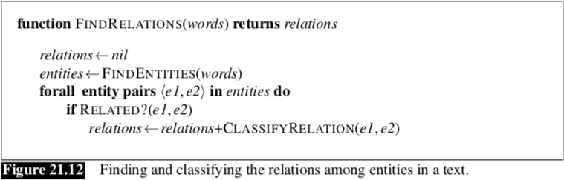
Supervised Relation Extraction

Slide 6
Problem with supervised RE
Requires a lot of annotated data.
Often not available
Expensive and time-consuming to produce

Slide 7
My project at CliPS
ACCUMULATE: Acquiring crucial medical information using language technology
The ACCUMULATE project will automatically recognise crucial information in the free text of clinical reports written in English and Dutch by designing, developing and evaluating advanced language technology (LT) for deep semantic processing of the texts that are often morpho-syntactically not well-formed.
Goal of my project:
Compensate the lack of well-annotated Dutch corpora using semi-supervised RE

Slide 8
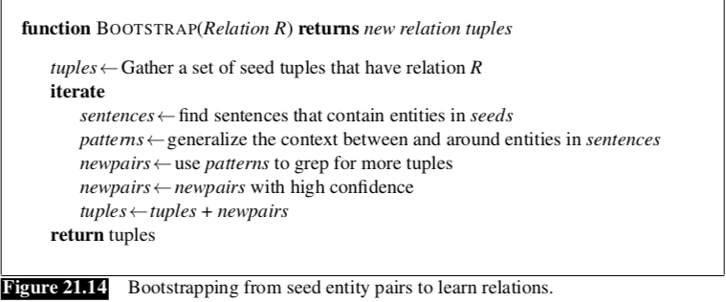
Semi-supervised RE

Slide 9
Data gathering
UMLS (Unified Medical Language System)
Metathesaurus → Provides seed tuples
Semantic Network
SPECIALIST Lexicon and Lexical Tools
Corpus of Dutch wikipedia articles concerning medical topics
Wikidumps
WikiExtractor

Slide 10
Data Processing
Identify medical entities in the subcorpus of Wikipedia articles.
Complicated by lexical and morphological variations.
Check if there are entities that occur in the same sentence and are related according to the Metathesaurus
Use these results as seed tuples and/or seed patterns to generate new pairs and new linguistic patterns.

