Slide 1
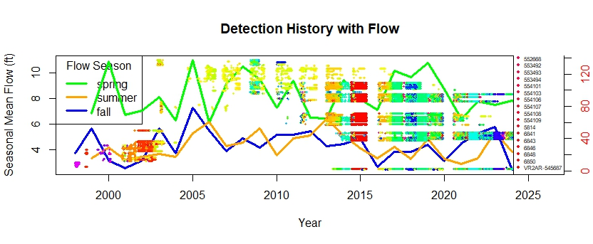
Shows flow in Penobscot River overlaid with detection history plot from multiple rivers
Color corresponds to receiver serial number of which there are over 200
2 legends, serial number can not and should not actually represent all the serial numbers
No legend identifying what that the lines on y axis are individual fish
Flow legend is placed really well
Second y axis pretty much nonsense (fishID on a scale)

