Slide 1
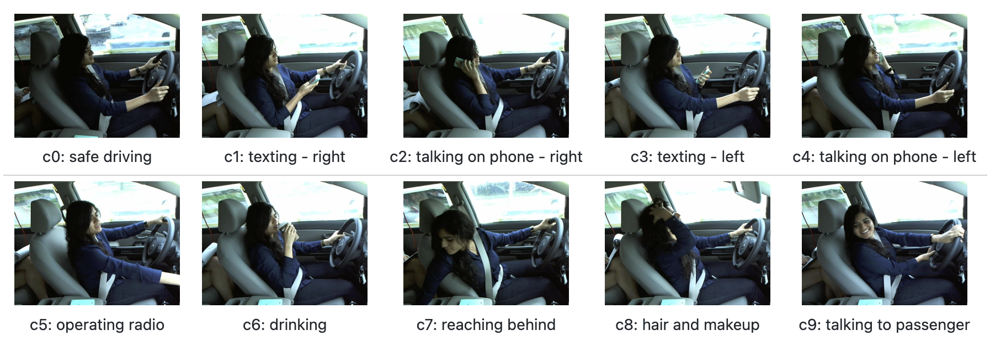
Combatting Driver-Specific Overfitting with Image Augmentation
22,424 images, only 26 individual drivers
Model memorizes environments instead of learning activity signal

Slide 2
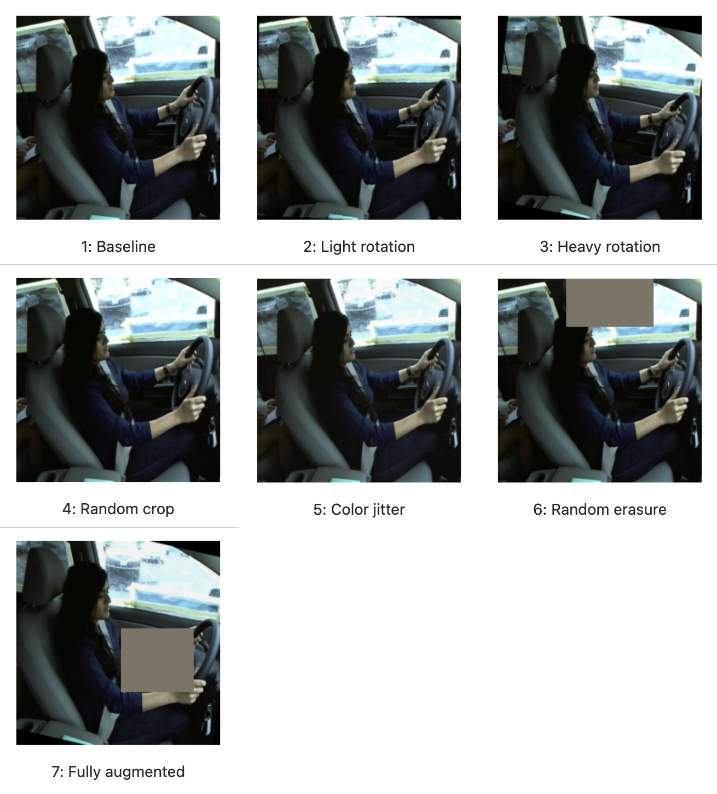
Our Approach
ResNet18 model fine-tuned end-to-end, 5-fold grouped CV
One-at-a-time setup with 7 augmentation configurations

Slide 3
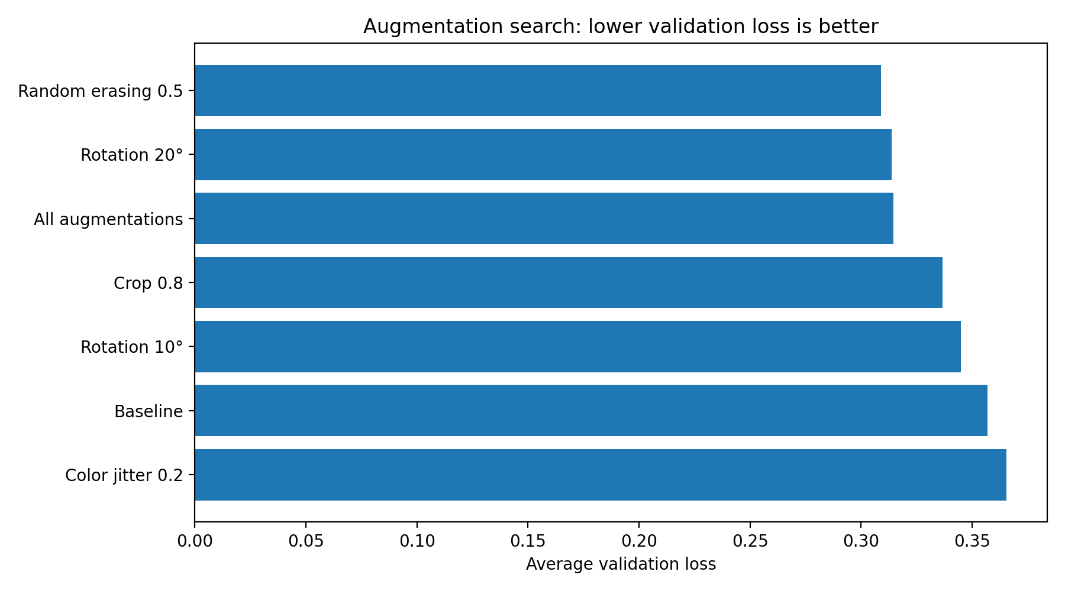
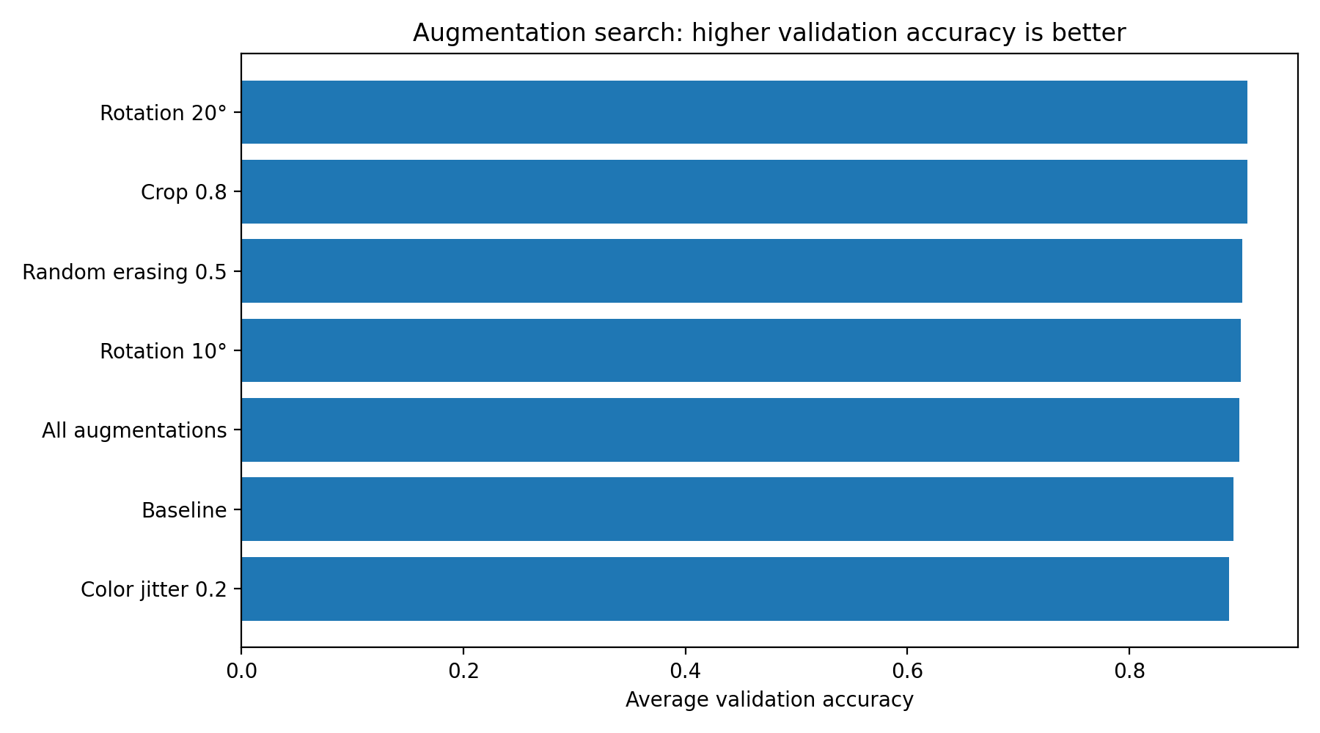
Results
Random erasing and rotation most effective
Color jitter provides no benefit → Task is structural rather then chromatic
Modest but consistent differences

Slide 4
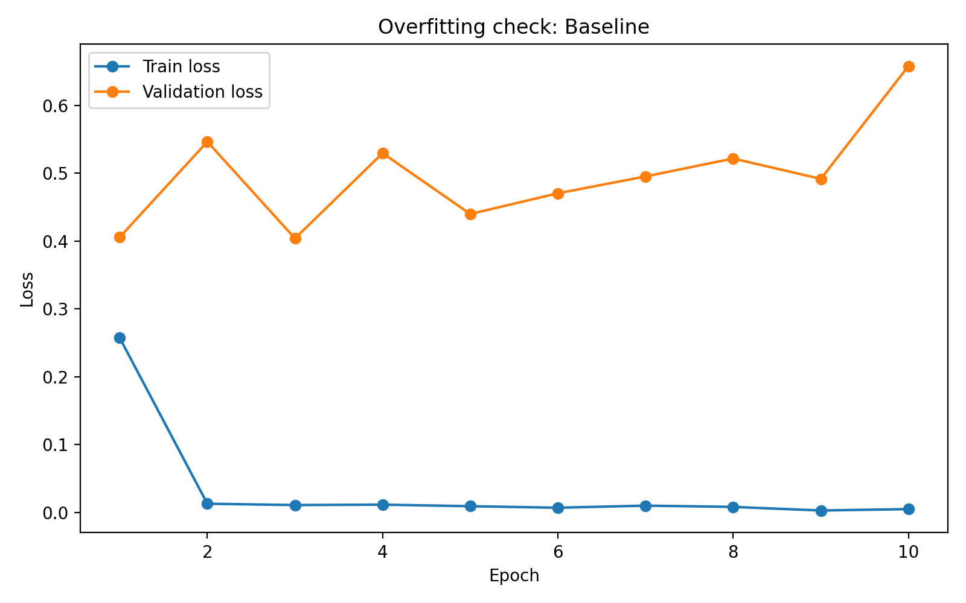
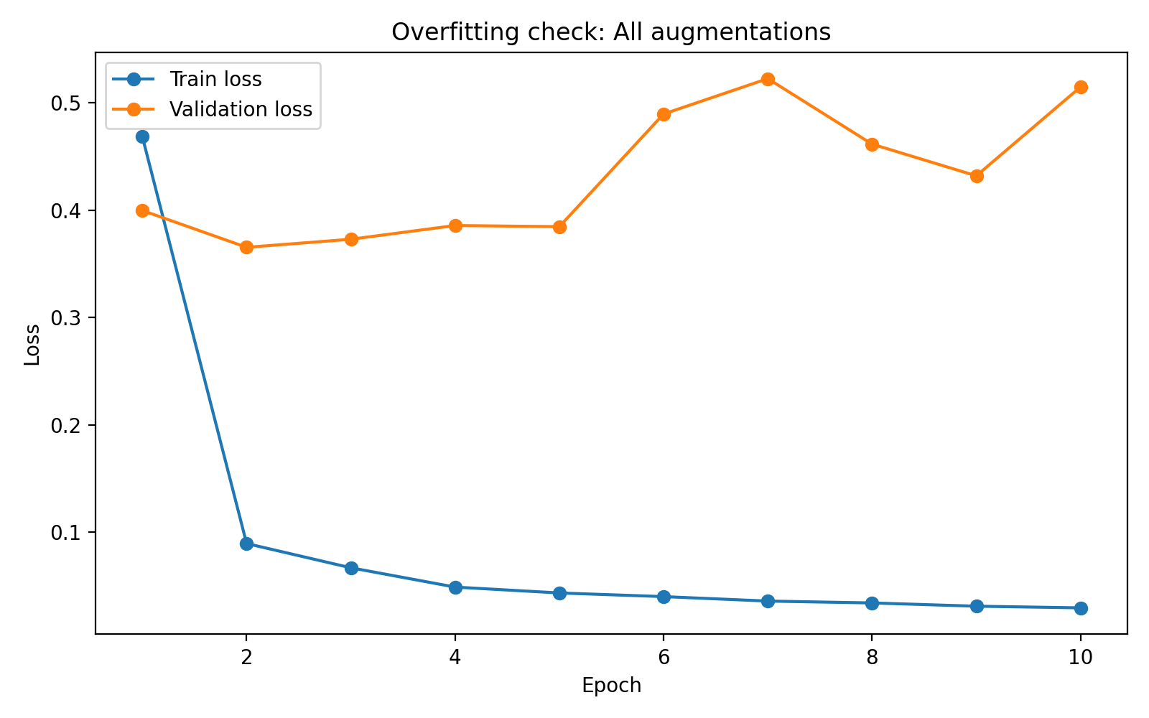
Lessons Learned
Augmentation dampens but does not resolve overfitting → Bottleneck is likely small number of drivers
Potential Next Steps:
Freezing model backbone
Longer training with early stopping
More folds or repeated CV

