Slide 1
Design Review Presentation
TTK4145 – Group 17

Slide 2
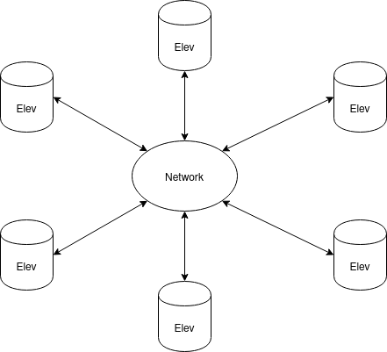
Overall design consideration
- Mesh network topology
- Local queue only
- Orders always* backed up by
another elevator
- Decentralized order decision making
- All elevators run the same code
* Unless elevator is alone on network

Slide 3
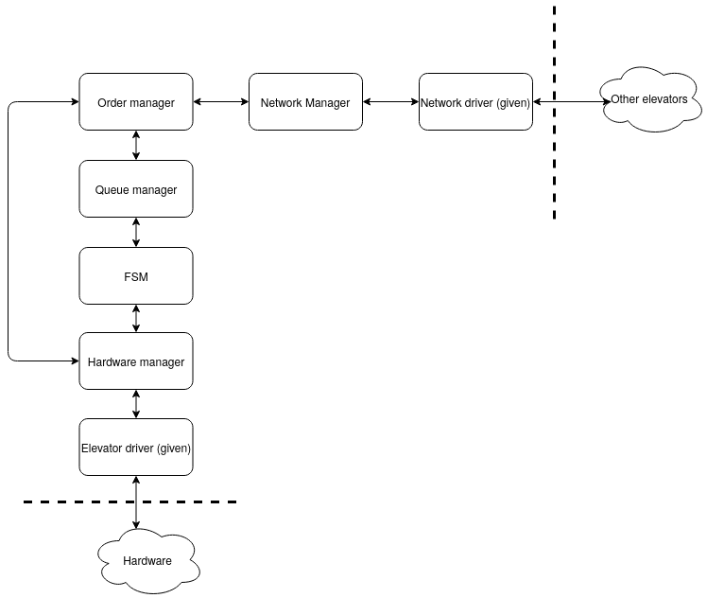
Modules

Slide 4
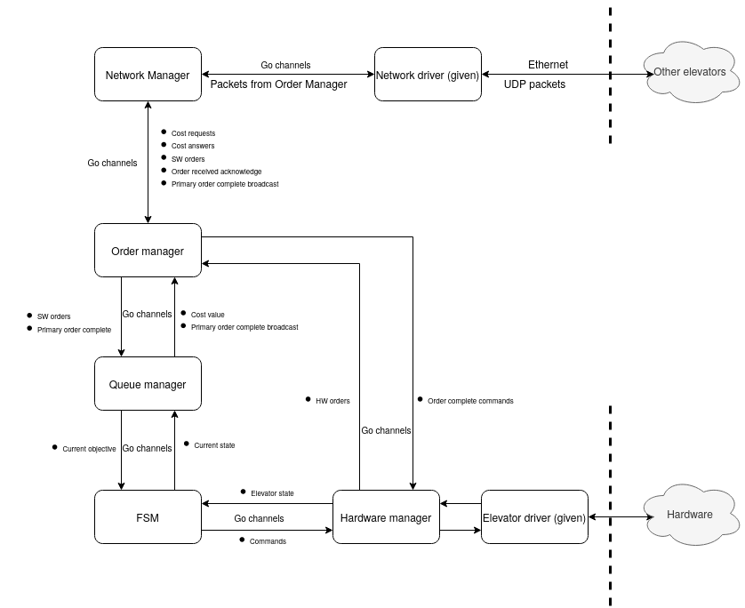
Interfaces

Slide 5
Error handling – General errors
Standalone watchdog for restarting entire program
  Program sends some kind of IamAlive message to watchdog via pipes
All modules may trigger a restart on failure

Slide 6
Error handling - Network
Network connection errors transparent to all modules except Network Manager
  Same behavior for localhost as when connected
Packet loss handled by Network Manager
  Transparent to all other modules
  Transmitting: Send X duplicates
  Receiving: Log recent messages to detect duplicates

Slide 7
Error handling – Orders
All elevators have primary and backup queues
  Primary orders are the order to be executed by the elevator
  Both queues are saved locally
All orders are sent to primary and backup elevator
  Backup becomes primary after timeout

