Slide 1

CST336 Internet programming
Practice 2: PHP arrays

Slide 2
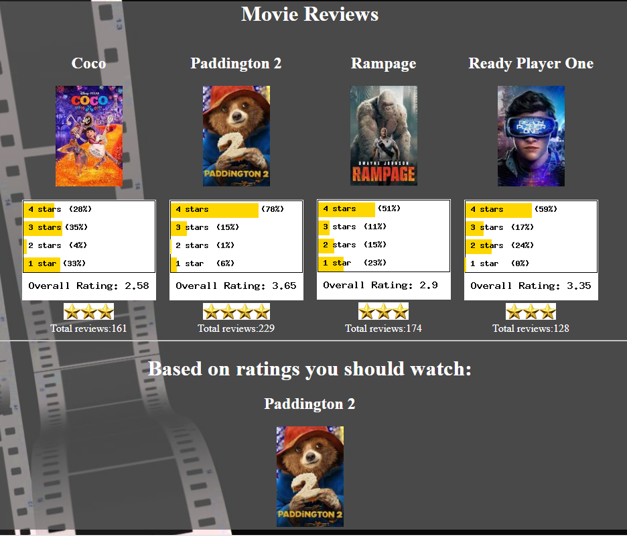
Task: Create a Movie Reviews page

Slide 3
Directions:
Work INDIVIDUALLY for 15 minutes. DO NOT talk to your partner
1) Upload the “p3” folder located in your local computer (from the file you unzipped) to your “practice” folder, in C9.
2) In C9, open and run the “reviews.php” program
3) Within the “main” div container, add a for loop to display 4 reviews
4) Modify the code to display the 4 random reviews in alphabetical order (hint: use the sort() array function)
5) Update the movieReviews() function to assign four random percentages to the $ratings array (the sum of the percentages must be 100)
See Program Sample

Slide 4
Directions:
Work in pairs for 50 minutes. Remember to use ONLY ONE computer and SWITCH typing
Assign a random value to $totalReviews (from 100 to 300)
Display the right number of stars (rounded value of $overallRating)
Display the Movie Title in the right format (Capitalize words, no _ )
Display four random movies ordered by title
Display four random ratings below each movie
Display a background image
For one extra point:
For two extra points:
Below the four reviews, display the movie with the highest overall rating (title and poster)
If the movie is “Ready Player One”, the 4-stars value should be higher than 75

