Slide 1

Intro to MongoDB

Slide 2
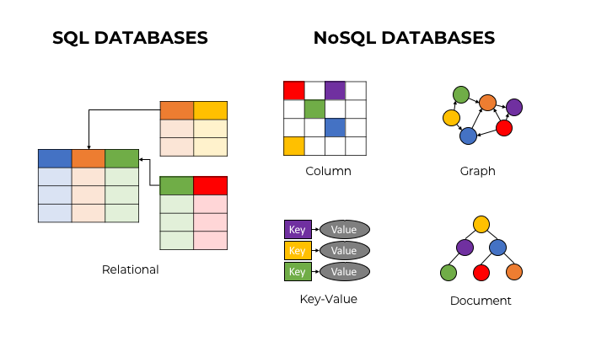

Slide 3


Slide 4
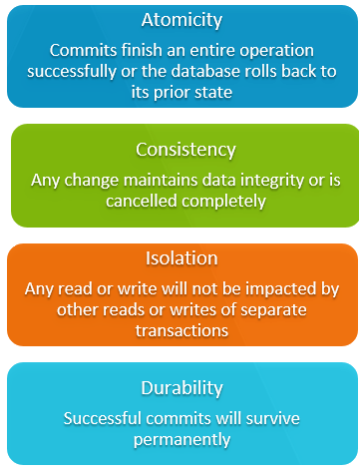

Slide 5

MongoDB Document store

Slide 6
Concepts

Slide 7
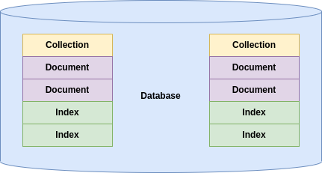

Slide 8
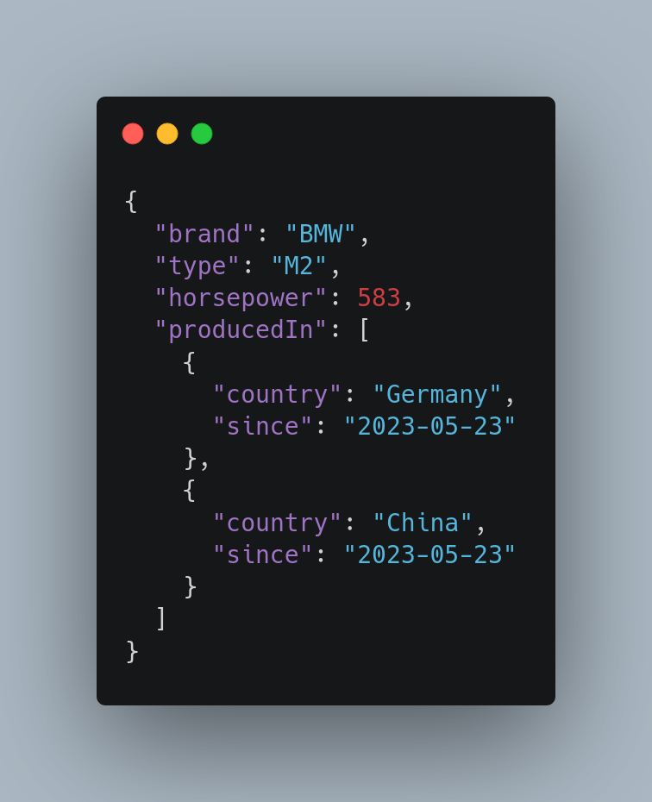

Slide 9
Root
String/Num/Bool
Key/Value
Array
Object

Slide 10
Query operators

Slide 11
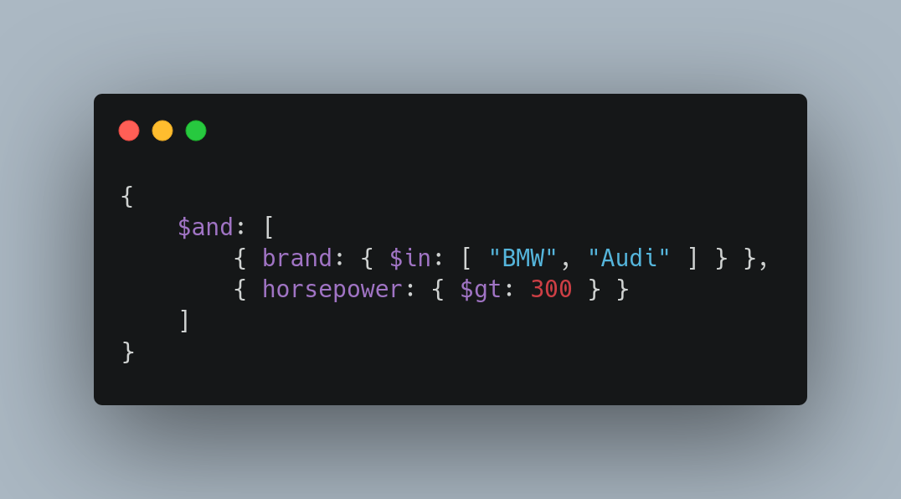
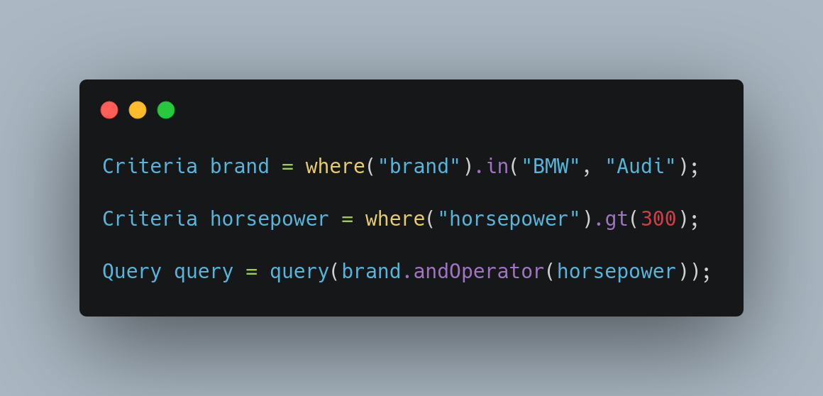
MongoDB Shell
Java (Spring-Data)

Slide 12
Update operators

Slide 13
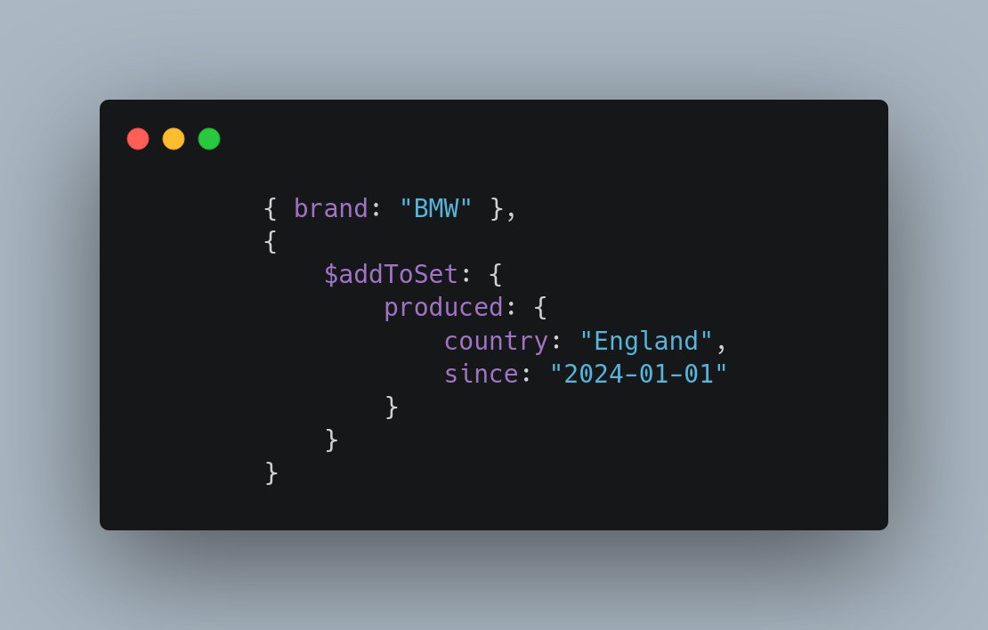
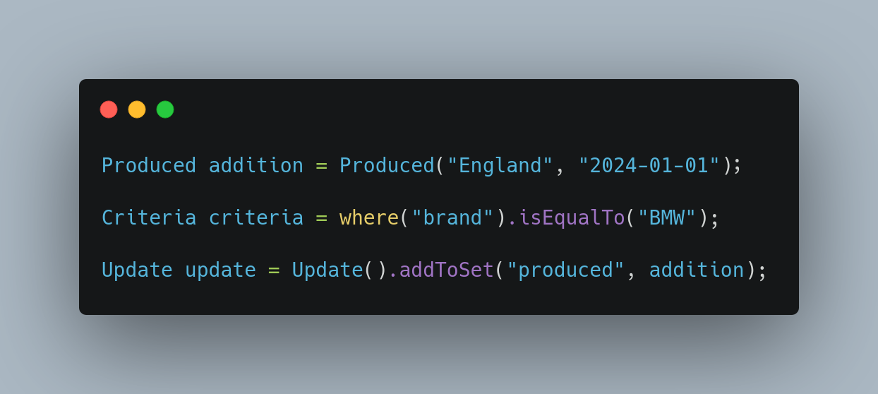
MongoDB Shell
Java (Spring-Data)

Slide 14
Aggregate pipelines
Multi-stage pipelines that transform documents into aggregated results
- Simplify complex queries
- Create new documents
- Sorting, grouping, aggregating etc.

Slide 15
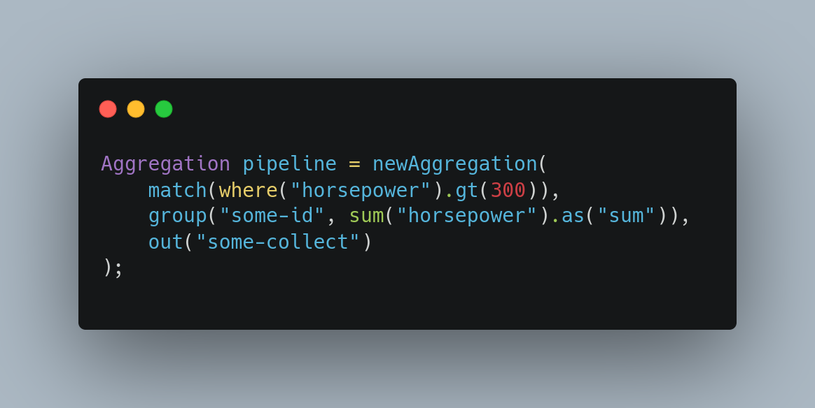

Slide 16
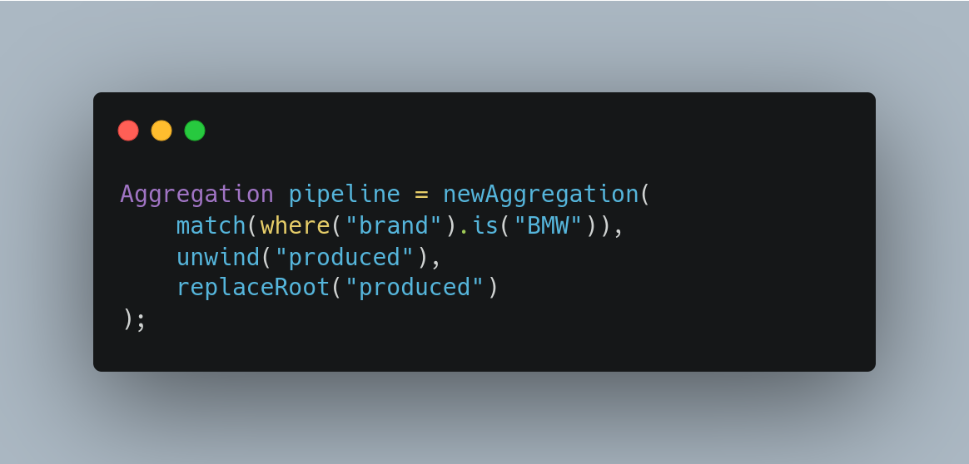

Slide 17
Change streams Access real-time data changes on:
- Collections
- Databases
- Deployments

Slide 18
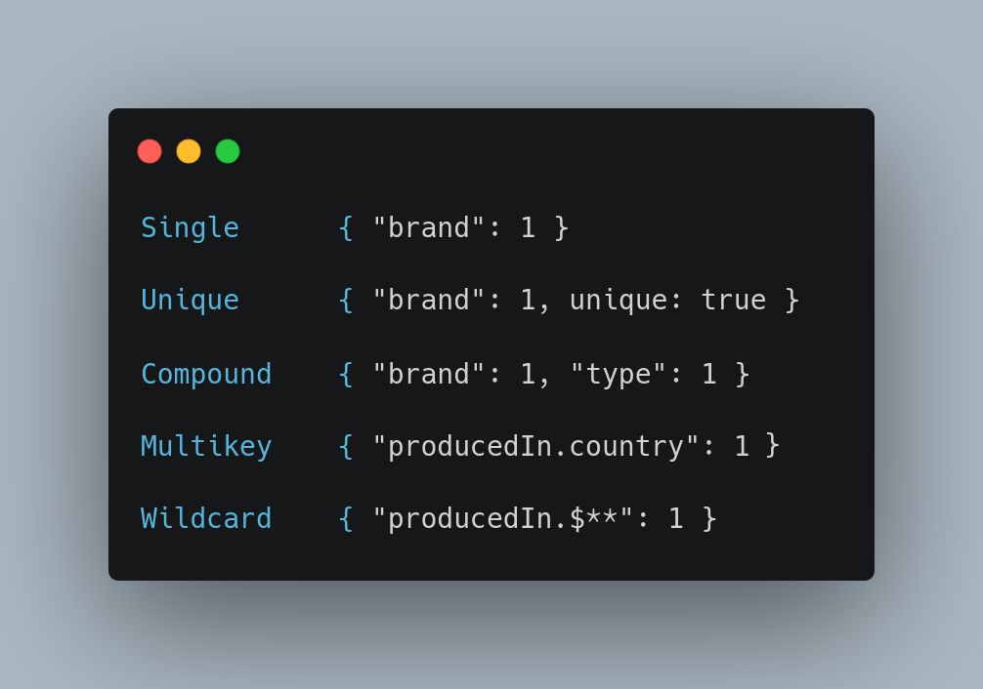
Indices Optimize and put constraints on queries

Slide 19
Transactions
Atomicity across multiple:
- Operations
- Collections
- Databases
- Shards

Slide 20
And more
- Document references
- Time series
- Tree structures
- Etc.

Slide 21


