Slide 1

Intro to MongoDB

Slide 2
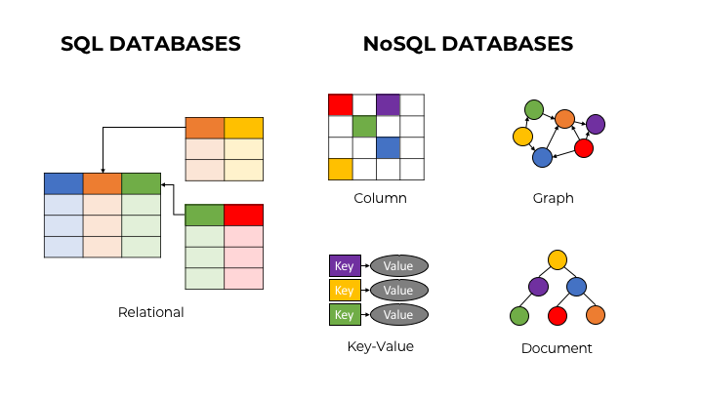

Slide 3


Slide 4
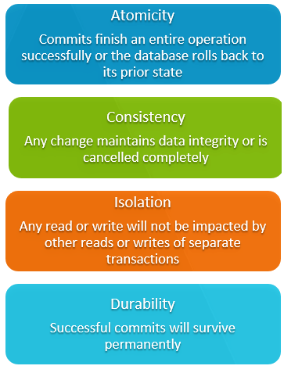

Slide 5

MongoDB Document store

Slide 6
Concepts

Slide 7
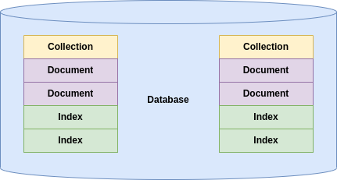

Slide 8
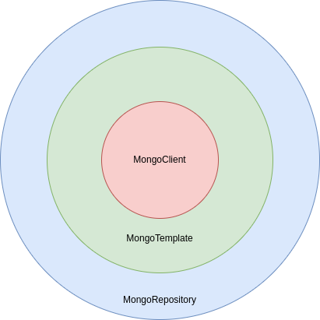

Slide 9
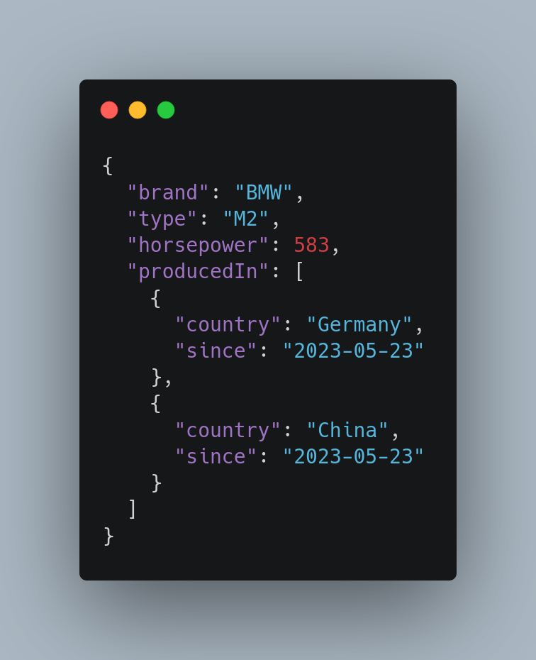

Slide 10
Root
String/Num/Bool
Key/Value
Array
Object

Slide 11
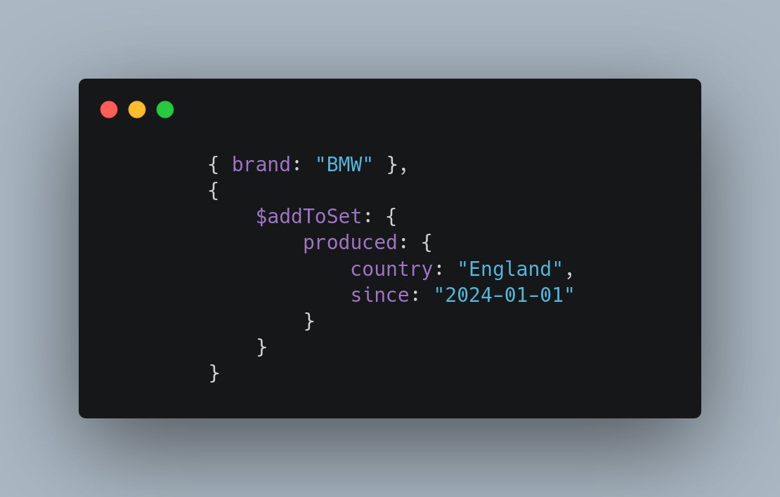
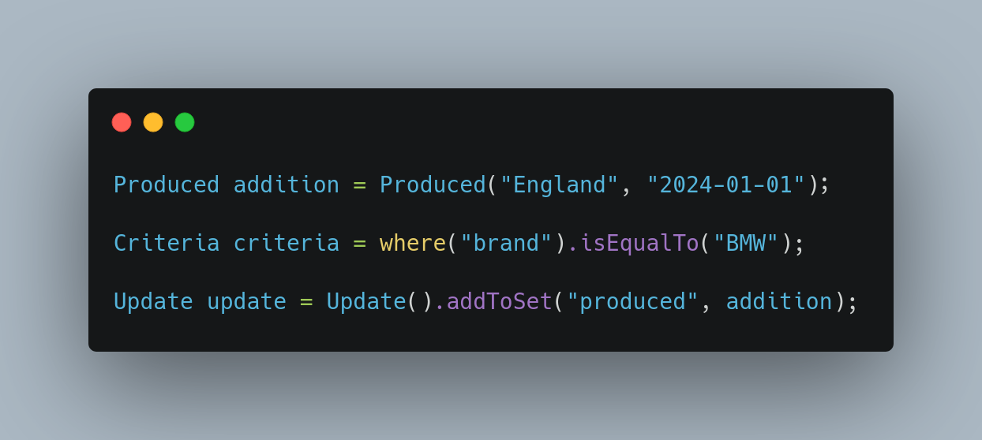
MongoDB Shell
MongoTemplate

Slide 12
Query operators

Slide 13
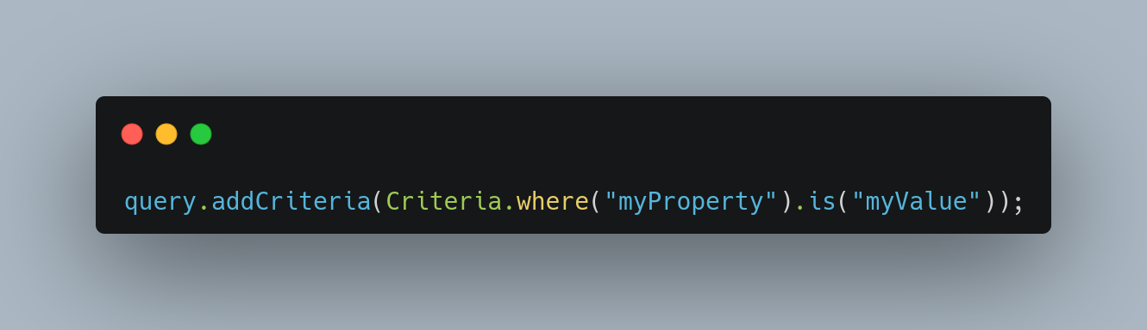
MongoTemplate
MongoDB Shell

Slide 14
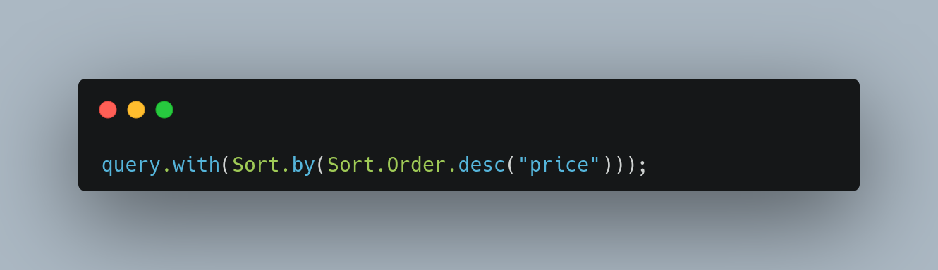

Slide 15
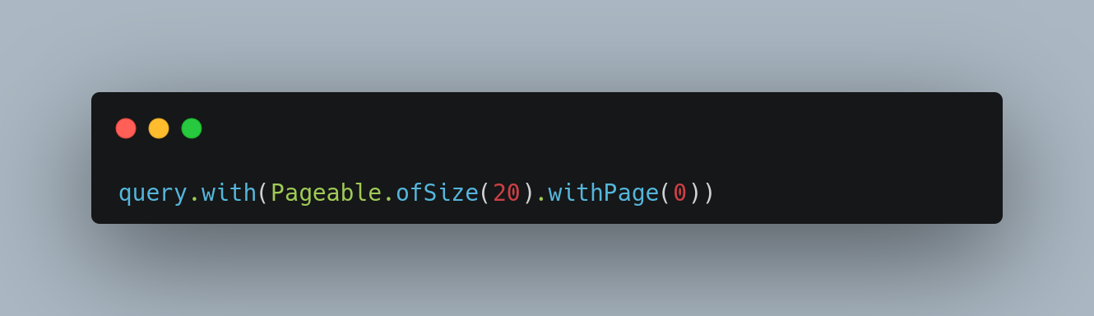

Slide 16
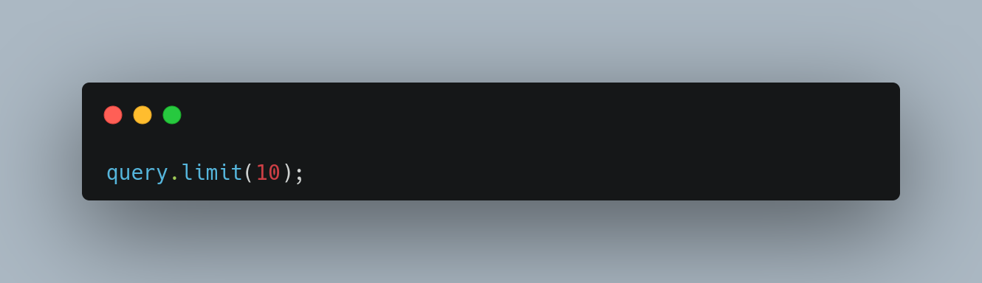

Slide 17
Update operators

Slide 18
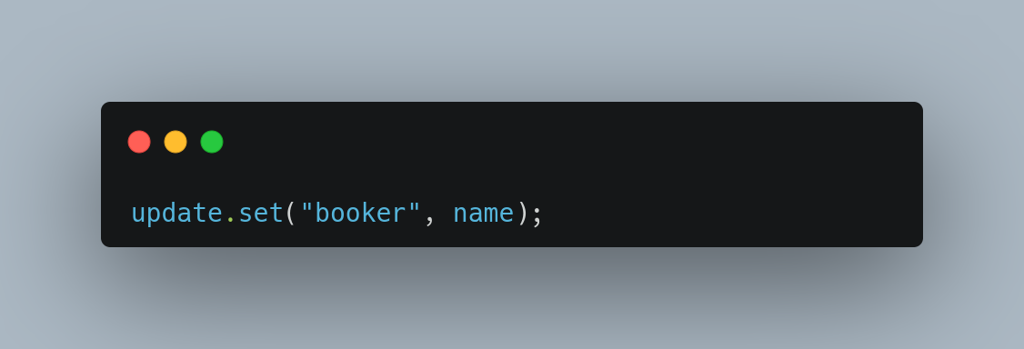

Slide 19
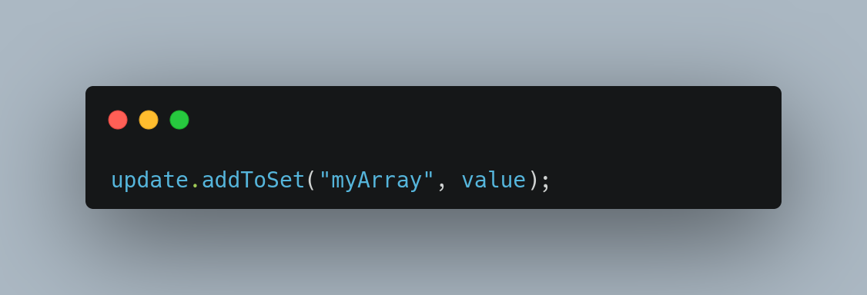

Slide 20
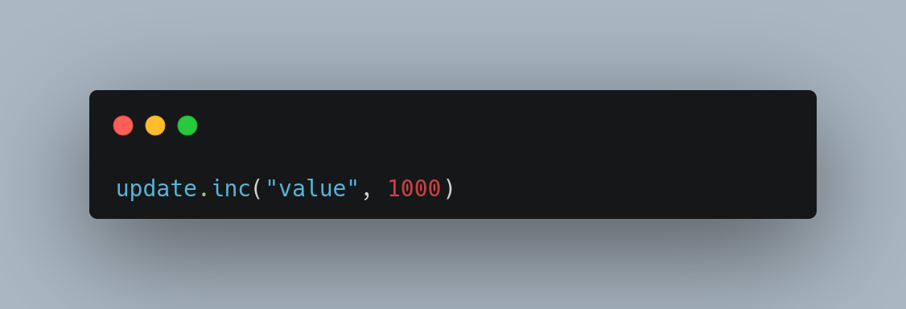

Slide 21
Aggregate pipelines
Multi-stage pipelines that transform documents into aggregated results
- Simplify complex queries
- Create new documents
- Sorting, grouping, aggregating etc.

Slide 22
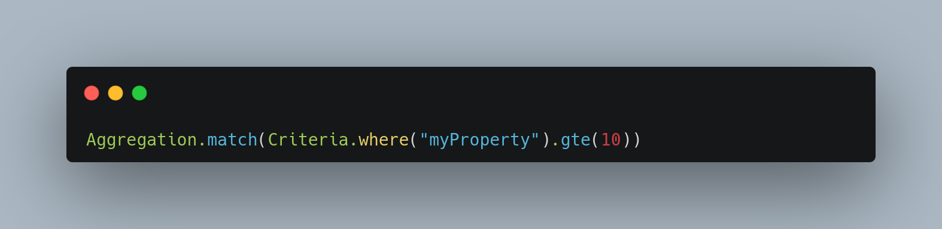

Slide 23
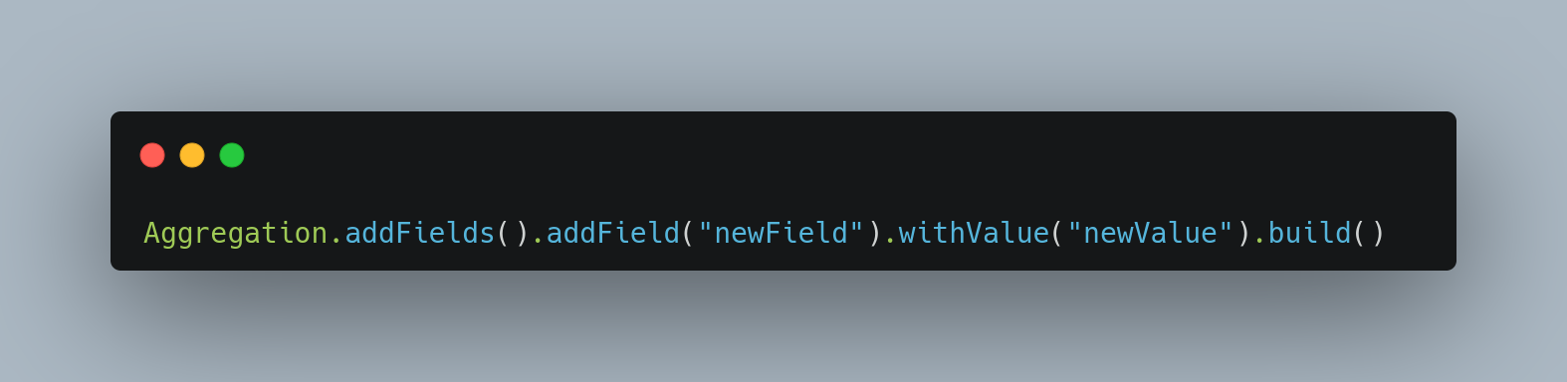

Slide 24
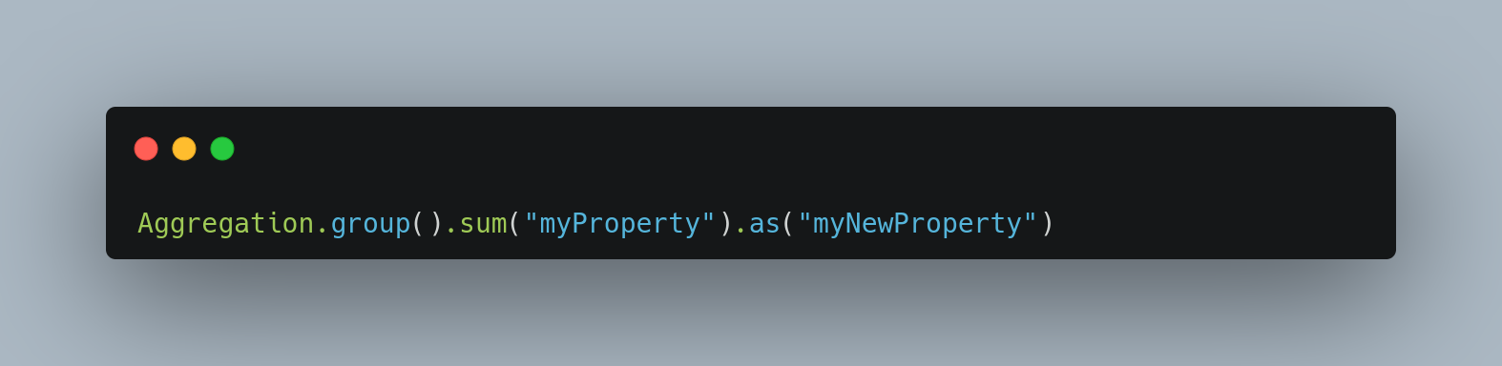

Slide 25
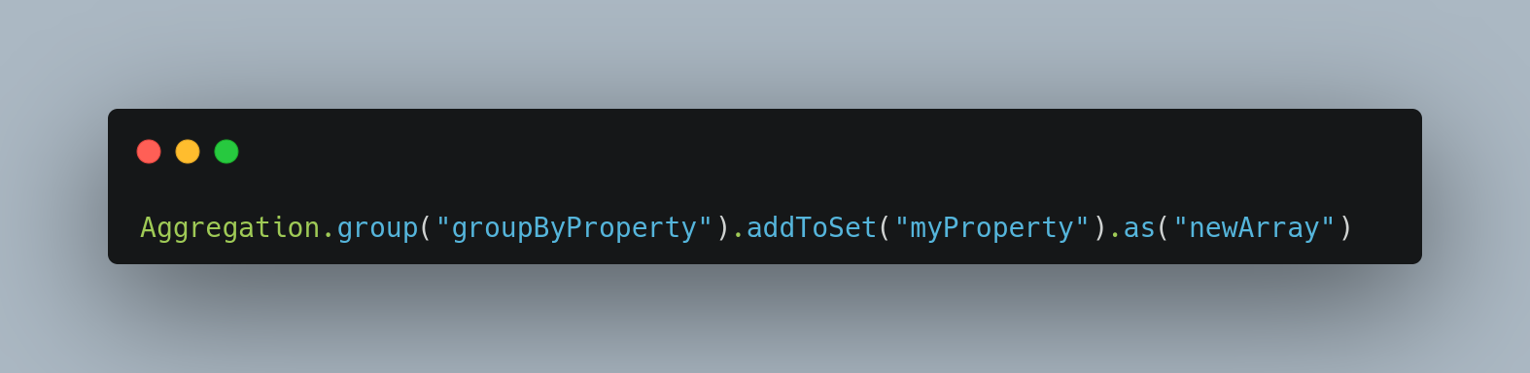

Slide 26
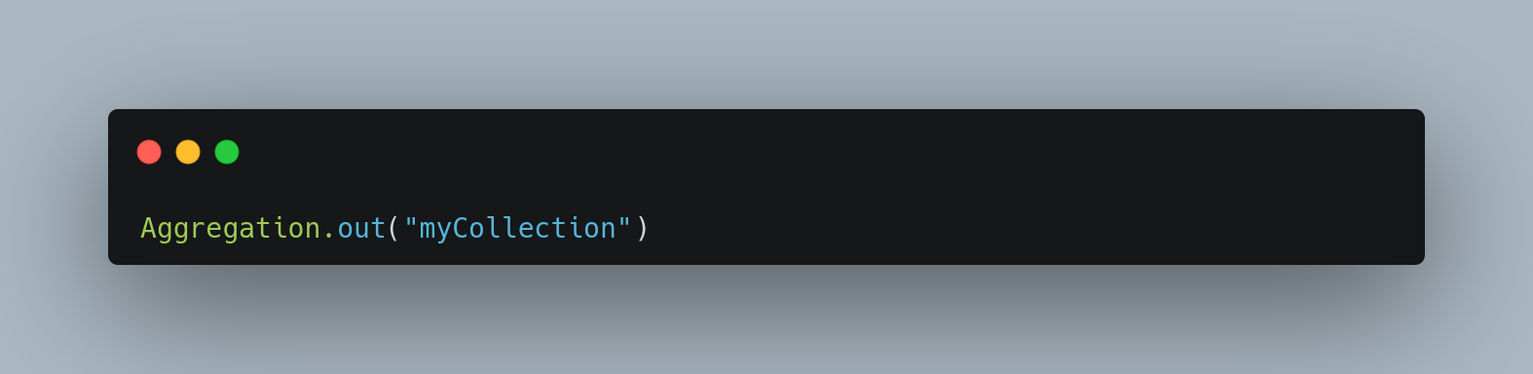

Slide 27
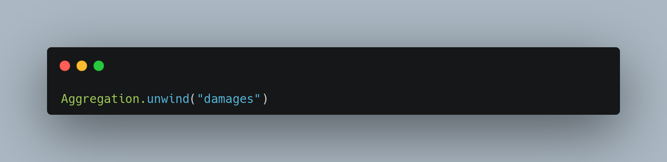

Slide 28
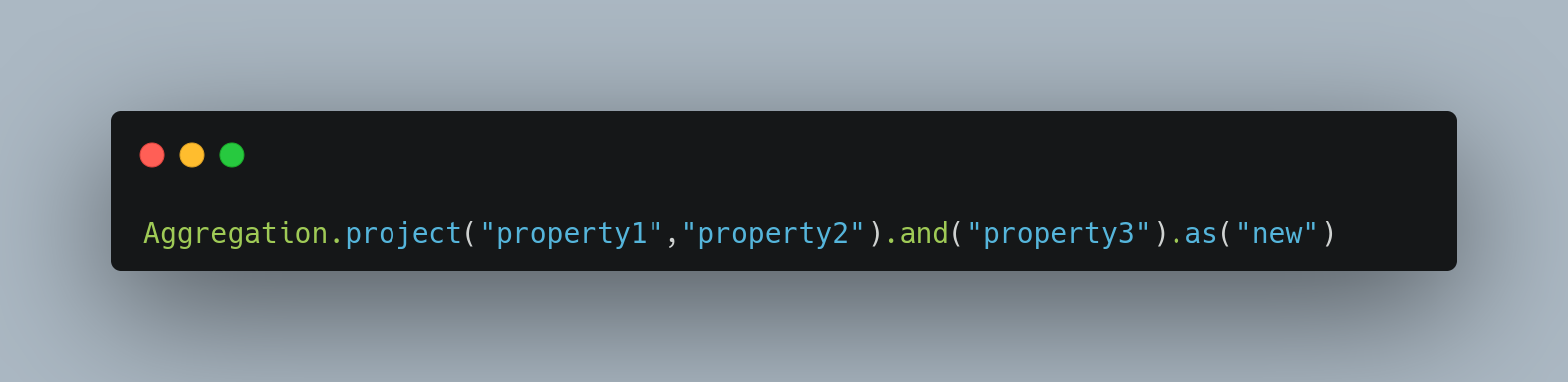

Slide 29
Change streams Access real-time data changes on:
- Collections
- Databases
- Deployments

Slide 30
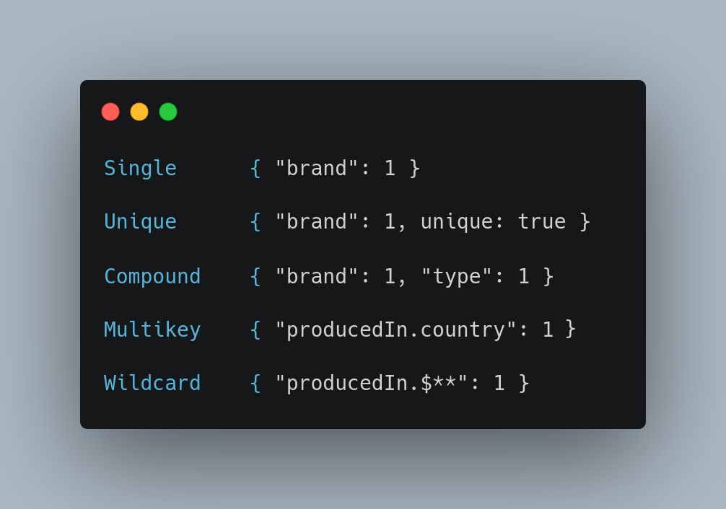
Indices Optimize and put constraints on queries

Slide 31
Transactions
Atomicity across multiple:
- Operations
- Collections
- Databases
- Shards

Slide 32
And more
- Document references
- Time series
- Tree structures
- Etc.

Slide 33


