Slide 1
ϕ

Slide 3
Phlora

Slide 4
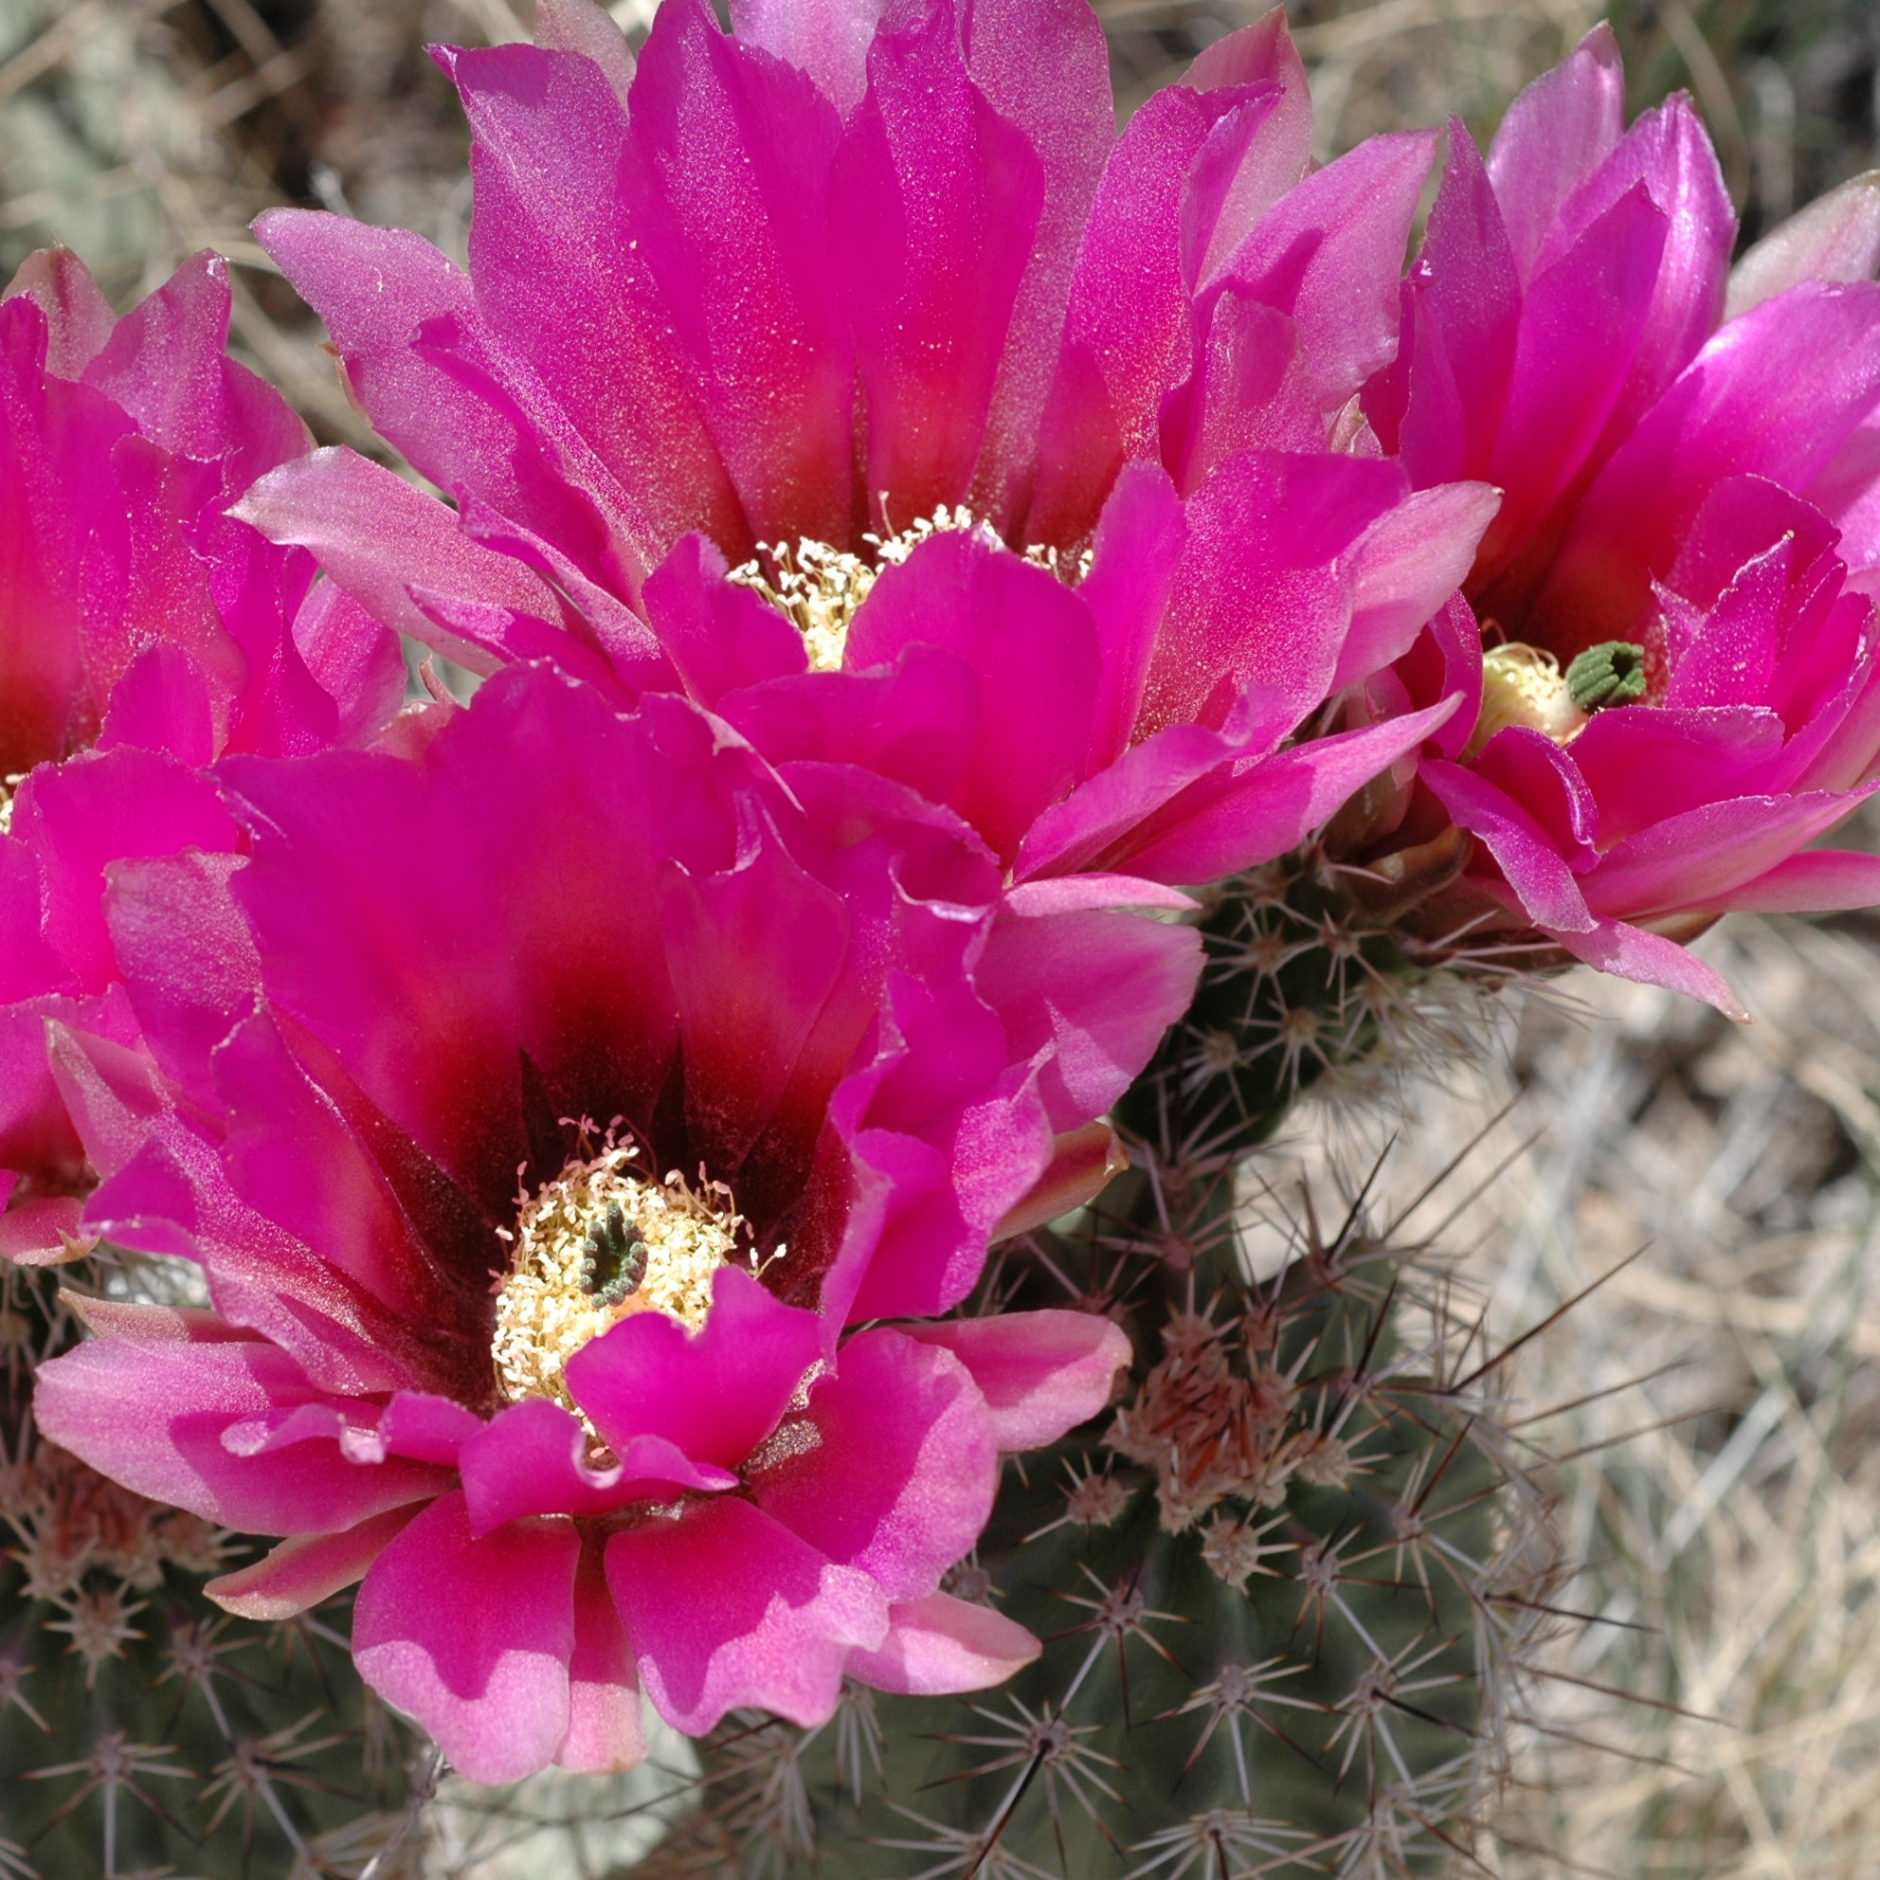
ϕ

