Slide 1
Mocking & unit testing

Slide 2
08:30 Introduction
09:00 Unit testing (theory)
09:10 Unit testing (exercises)
09:50 Mocking (theory)
10:00 Mocking (exercises)
10:50 Break
11:00 Presentation from QA

Slide 3



Sander Philipsen
Balen, Kempen
4 years @Axxes
Functional fullstack team
Rekencentra - Dematic

Slide 4
Types of tests
Functional
Non-functional
Functional
Non-functional
Unit
Integration
Acceptence
Integration
UI
Unit
performance
Accessibility
Load

Slide 5
Unit testing
Isolated ‘units’
Automated
Repeatable
Fast Excecution

Slide 6
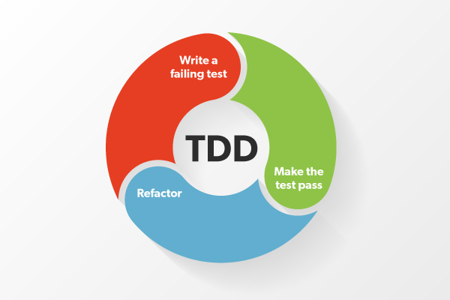
Test driven development

Slide 7
Unit testing, why?
Early bug detection
Validation of the functionality
Refactoring confidence
Documentation
Automation
Cost savings

Slide 8
AAA – Arrange, Act, Assert
Arrange
  You prepare all the ingredients
  You prepare all the input values, mocking objects or dependencies
Act
  You do the actual cooking
  You run the specific unit of code you’re testing
Assert
  You taste the actual dish
  You check if the result of the act matches what you expect

Slide 9

Unit testing frameworks
Software tool
Xunit, Nunit, MSTest

Slide 10
Exercise
Write the test ‘GetValidBelgianLicensePlateNumbers_Returns_Only_The_Valid_LicensePlateNumbers()’
Test should fail
Implement the method ‘GetValidBelgianLicensePlateNumbers(List<string> licensePlateNumbers)’
Test should succeed

Slide 11
Mocking
‘Something made as an imitation’
It can imitate a dependency (service)
We only want to test that one specific ‘unit’

Slide 12

Mocking frameworks
Moq, FakeItEasy

Slide 13
Exercise
A person can register for an upcoming event
The person should exist
The event should exist
You cannot register for an event that is in the passed
If the person ‘CanDrive’ and ‘IsOpenToCarpool’, he should fill in a valid belgian license plate number.
Write the unit tests (minimal 6)
Tests should fail
Implement the method
Tests should succeed
Refactor
Ready? Try to implement Fluentvalidation

Slide 14
Questions?
Feedback form

